Slide 1
Graduated Approach Briefings
October 2023
Notices

Slide 2
Welcome
To locate information about the Graduated Approach Briefings on the Local Offer, go to: https://professionals.lincolnshire.gov.uk/homepage/54/graduated-approach-briefings
Or on the Home Page, click on: Support with Education
Then scroll down to: Graduated Approach Briefings
Welcome and thank you for joining us for this virtual training session.
Please sign in through the Chat to register your attendance.
As usual, to support everyone to maintain connectivity with so many attendees being here:
Please Mute your microphone and turn off your video when not speaking – we have a large number of participants present today and this may mean that we experience feedback or slowing of the network connection if everybody has their microphone and video on. However, we would like to see you if you ask a question, please, so feel free to switch on both your microphone and video in these instances.
Please note that this meeting, or sections of it, will be being recorded for use on the council’s professionals’ website. If you do not wish to be recorded, you should leave the meeting and watch it back later.
If you would like to ask questions, please use the raise your hand facility or use the chat function in Teams
Please keep discussion in the ‘chat’ relevant – the person presenting may not be able to see your comments but we will have someone monitoring it in order to make sure all questions are answered.

Slide 3
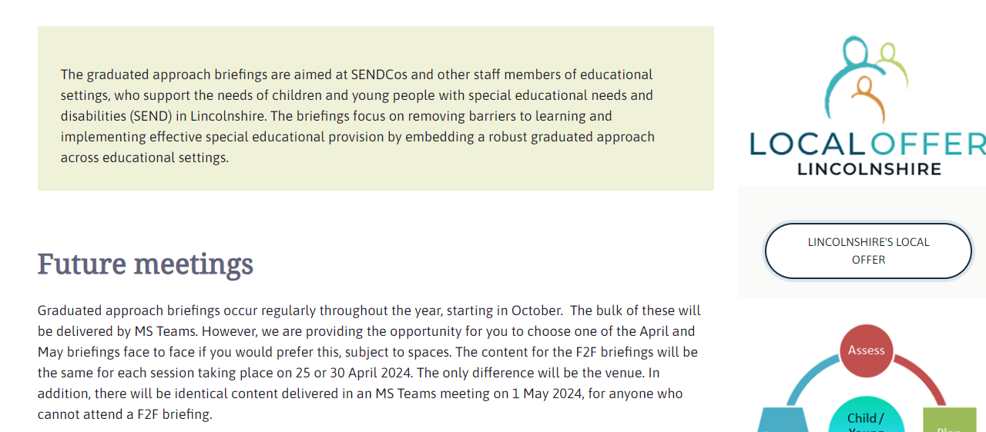
Remember to book your places for each briefing throughout the year on the Local Offer
Graduated approach briefings – Professional resources (lincolnshire.gov.uk)

Slide 4
Agenda
09.25 – 09.30: Arrival in MS Teams 'Meeting Room'.
09.30 – 09.35: Welcome and Notices.
09.35 – 09.50: Emily Walker – Regional Lead Whole School SEND: Whole School SEND updates and Teaching School Hub SEND Offer
09.50 – 10.00: Karen Richardson – Inclusion Team Manager: Ladder of Behavioural Intervention update
10.00 – 10.05: Lincolnshire Parent Carer Forum: Updates
10.05 – 11.05 PRT & EBSA Caseworkers: Introducing the new EBSA Pathway.
(N.B. Please bring your Pastoral Lead or whoever supports EBSA in your setting along to this session if you possibly can.)
11.05 – 11.10 Comfort break
11.10 – 11.40 Josie Pedersen – SEND Team Manager and Nicola Carter – Inclusion Team Manager: SEN Census Guidance document
11.40 – 12.00: ADHD Lincs – Supporting students with ADHD
12.00: Close

Slide 5
Agenda
12.55 – 13.00: Arrival in MS Teams 'Meeting Room'.
13.00 – 13.05: Welcome and Notices.
13.05 – 13.20: Emily Walker – Regional Lead Whole School SEND: SEND Workforce Development Project updates; Whole School SEND updates and Teaching School Hub SEND Offer
13.20 – 13.30: Karen Richardson – Inclusion Team Manager: Ladder of Behavioural Intervention update
13.30 – 14.00: Josie Pedersen – SEND Team Manager and Nicola Carter – Inclusion Team Manager: SEN Census Guidance document
14.00 – 14:05: Lincolnshire Parent Carer Forum: Updates
14.05 – 14.10: Comfort Break
14.10 – 15.10: PRT & EBSA Caseworkers: Introducing the new EBSA Pathway.
(N.B. Please bring your Pastoral Lead or whoever supports EBSA in your setting along to this session if you possibly can.)
15.10 – 15.30: ADHD Lincs – Supporting students with ADHD
15.30: Close

Slide 6
IDL Offer
www.idlsgroup.com

Slide 7
Presentations and Videos will be available from 23rd October
Remember to visit the Graduated Approach Briefings page on the Local Offer so that you can view the presentations and videos for this round of briefings and any from the previous academic year.
Graduated approach briefings – Professional resources (lincolnshire.gov.uk)

