Slide 1
Lincolnshire SEN Census Guidance 2023-2024
Insert doc here
DFE guidance
Complete the school census - Data items 2023 to 2024 - Guidance - GOV.UK (www.gov.uk)

Slide 2
The Census
The submission of a Schools Census return is a statutory requirement under section 537A of the Education Act 1996. This return should be authorised by the head teacher before being sent to Lincolnshire Local Authority (LA).

Slide 3
SEN Register
This can be kept in any format and should contain information regarding a child or young person’s SEN status and their primary need. However, for a school’s own records, secondary and/or additional needs will demonstrate a good understanding of all the children and young people’s needs and will be valuable for planning and evaluating provision. Many schools adapt the SIMS SEN register for this purpose.
N.B. children and young people who have difficulties across any of the four areas of need should be noted on the SEN register - not only those with cognition and learning needs.
This is particularly important for pupils who may display challenging or withdrawn behaviour (such as anxiety), as these behaviours may be linked to unmet needs.
SENCOs should meet regularly with pastoral staff in school to ensure these are not missed and relevant assessments are carried out.
Parents and carers must be formally notified when their child is getting SEN provision and added on to the SEN register and if they have been removed from the SEN register.

Slide 4
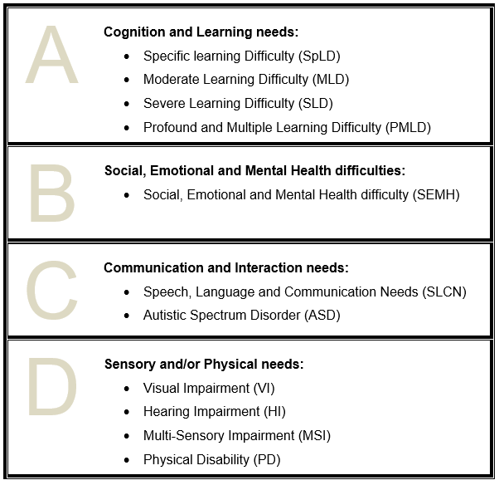
Categories of the Code of Practice and DfE

Slide 5
In a mainstream setting if a child has predominantly Cognition and Learning Needs, you will generally need to select either Specific Learning difficulty (SpLD) or Moderate Learning Difficulty (MLD).
MLD: Pupils with moderate learning difficulties will have attainments significantly below expected levels in all core areas of the curriculum, despite appropriate interventions (for example 3-4 years below in Years 5 upwards).
SpLD: Children and young people identified as having Specific Learning Difficulties (SpLD), will have severe and persistent difficulties in a specific area of learning despite high quality teaching and evidence-based intervention over time.
Notes:
MLD, SLD and PMLD need to have a comprehensive cognitive battery by an Educational Psychologist or a Specialist Teacher, holding an appropriate post-graduate qualification. In addition SLD and PMLD need developmental assessments by an Educational Psychologist.
MLD: Learning difficulties are not specific to one area of the curriculum and we’re not talking about those C/YP who may require booster classes or additional group interventions to support them to maintain progress broadly in line with their peers. These C/YP will be working significantly below their peers and will require a differentiated curriculum to support them in acquiring basic literacy and numeracy skills and in understanding concepts generally. The example given of 3-4 years below in Y5 is straightforward but what about for younger children? They are likely to be working at Pre-key stage levels. In addition, STT assessments may show them as achieving standard scores of below 70 in a number of areas.
SpLD: As a Local Authority, we have made the decision that SpLD does not have to be formally diagnosed for the purpose of the SEN Census Primary Area of Need. There is no requirement for a pupil to have a specialist assessment to be recorded in the main SEN types. However, you would obviously not be able to specify what that Specific Learning Difficulty is without a specialist assessment. This will be helpful for those cases where you have perhaps had a core assessment from STT and the ST has stated in their conclusion that should concerns persist after a period of well-founded intervention, they would be happy to carry out further assessment in order to determine whether there is a specific reason for the C/YP’s difficulties. It may be that the ST has recommended a referral to the Visual Processing Clinic before any further assessment can be carried out and you may be waiting for the child to be seen. It would be expected that you would be putting in place the well-founded recommendations that have been recommended and that progress would be being closely monitored so that if concerns persist, further assessment can be carried out – at which point you may be able to categorise further to say that the C/YP has a formal diagnosis of dyslexia or dyscalculia.

Slide 6
SpLD – Developmental Co-ordination Disorder (DCD) / Dyspraxia
At this current time, the LCHS occupational therapy service is not commissioned to see children who have a diagnosis of developmental co-ordination disorder, also known as dyspraxia, or to assess for this condition. However, there is advice on their website:
https://www.lincolnshirechildrenstherapyservices.nhs.uk/neurodevelopmental-difficulties/developmental-coordination-difficultiesmovement-difficulties
Pre-16:
Consider a STT assessment to gain a learning profile detailing the child’s strengths and areas for development. Although a diagnosis cannot be made, recommendations can be tailored for the child, taking into account possible dyspraxic needs.
Consider a referral to Physiotherapy if there are significant gross motor concerns.
Post-16:
Specialist Teachers can diagnose dyspraxia in Post-16 learners if they have carried out appropriate training. We have suitably qualified assessors in STT.
STT assessments: STTEnquiries@lincolnshire.gov.uk for advice or
via Edulincs: Specialist teaching team – Lincolnshire County Council
Notes:
I’m regularly asked about assessment for dyspraxia. This is not a commissioned service in Lincs. STT are only qualified to assess post-16 learners for dyspraxia. However, what I would normally recommend is that you have a normal STT assessment to establish a learning profile (perhaps a core plus) and, in that, we can give some recommendations for dyspraxia and then I recommend you use the resources and recommendations in the link here. If you have particular concerns about gross motor skills, then a referral to physiotherapy would be recommended.

Slide 7
Who to record
No SEN – N
SEN – K
EHCP - E
Type of SEN
NAS
Other
Notes:
The language is a lot weaker than what it takes to get the top grade in Ofsted’s school inspections and children’s services inspections. Put bluntly, a local area SEND service can get top marks without being expected to deliver anything like an outstanding quality of service.
This outcome was tweaked following consultation. The post-consultation documents show that some local authority reps and professionals argued that the original proposed top outcome “set the bar too high.”
We asked Ofsted what “typical” means when they make these judgements. This is what they said:
“We know that even in the stronger local areas there are often still some areas of weakness and room for improvement. Therefore, even where positive experiences and outcomes are typical, this will not be the case for all children and young people with SEND.
“In this context ‘typical’ means that positive experiences and outcomes are representative of what usually happens to most children and young people with SEND in a local area.”
Av A local area will probably get this outcome if experiences and outcomes for children and young people with SEND aren’t typically strong, or if there are minor areas for improvement that the local area isn’t already taking effective action to sort out.
Pr
What sort of things would trigger this outcome? According to the handbook, inspectors will reach for this outcome when they, “have identified one or more areas for priority action; this will happen when there are significant concerns about the experiences and outcomes of children and young people, because of particular systemic or widespread failings that have a significant negative impact on the experiences and outcomes of children and young people.”
That’s broadly similar to the previous inspection setup: there’s no formal definition of how bad things are to be considered a ‘priority action’, it’s mostly a matter of inspector judgement.
If a local area gets this outcome then, like the previous setup, they have to produce a plan showing how they are going to improve things. Before, this was known as a ‘written statement of action.’ Now, it’s got another, clunkier name: a priority action plan (area SEND).
If an area gets a failing grade, roughly 18 months after the inspection, it will get a monitoring inspection. This will concentrate on the areas for priority action identified in the previous full inspection, similar to the previous revisit system. The handbook says that if any new significant weaknesses get identified during the monitoring inspection, they’ll get reported.

Slide 8
How to decide
EHCPs
Professional reports
MLD/SLD/PMLD
Notes:
The language is a lot weaker than what it takes to get the top grade in Ofsted’s school inspections and children’s services inspections. Put bluntly, a local area SEND service can get top marks without being expected to deliver anything like an outstanding quality of service.
This outcome was tweaked following consultation. The post-consultation documents show that some local authority reps and professionals argued that the original proposed top outcome “set the bar too high.”
We asked Ofsted what “typical” means when they make these judgements. This is what they said:
“We know that even in the stronger local areas there are often still some areas of weakness and room for improvement. Therefore, even where positive experiences and outcomes are typical, this will not be the case for all children and young people with SEND.
“In this context ‘typical’ means that positive experiences and outcomes are representative of what usually happens to most children and young people with SEND in a local area.”
Av A local area will probably get this outcome if experiences and outcomes for children and young people with SEND aren’t typically strong, or if there are minor areas for improvement that the local area isn’t already taking effective action to sort out.
Pr
What sort of things would trigger this outcome? According to the handbook, inspectors will reach for this outcome when they, “have identified one or more areas for priority action; this will happen when there are significant concerns about the experiences and outcomes of children and young people, because of particular systemic or widespread failings that have a significant negative impact on the experiences and outcomes of children and young people.”
That’s broadly similar to the previous inspection setup: there’s no formal definition of how bad things are to be considered a ‘priority action’, it’s mostly a matter of inspector judgement.
If a local area gets this outcome then, like the previous setup, they have to produce a plan showing how they are going to improve things. Before, this was known as a ‘written statement of action.’ Now, it’s got another, clunkier name: a priority action plan (area SEND).
If an area gets a failing grade, roughly 18 months after the inspection, it will get a monitoring inspection. This will concentrate on the areas for priority action identified in the previous full inspection, similar to the previous revisit system. The handbook says that if any new significant weaknesses get identified during the monitoring inspection, they’ll get reported.

Slide 9
Common issues
ADHD
MLD
SPLD
What about other diagnoses

Slide 10
Questions please!

