Slide 1
SEND Advice Line Lincolnshire (SALL)
Current Team Members
Sharon Drewery Linda Baldwin Nicola Amott
Contact
AskSALL@lincolnshire.gov.uk

Slide 2
The SEND Advice Line Lincolnshire
Purpose
To support settings for Children and Young People from 0-25 Years to understand and meet the needs of CYP with SEND, delivering better outcomes and maximising inclusion.
Helping settings to follow the graduated approach to CYP’s needs by providing information, advice and guidance and signposting to services and support.
Support offer
The service will offer settings:
Easy and quick access to an experienced advisor to discuss the individual child/young person, or broader school/setting issue and provide information, advice and guidance (IAG).
Signposting to the Local Offer, SEND inclusion toolkit, the Valuing SEND tool and other services to better understand and meet need.
Where appropriate, a follow up appointment with a relevant Ask SALL team member, or other professional (Educational Psychologist, Early Years Specialist Teacher) can be arranged.
Intended impact
The SALL service is key to efforts to: Ensure children’s needs are understood and met at the earliest point to support better outcomes and inclusion, avoiding the need for specialist provision where possible.

Slide 3
How settings can access this support
Settings (usually SEND manager or SENCo) will be able to get in touch with the team by:
Submitting a short form via the Local Offer
Calling the dedicated number for the team
01522 553199 Mon- Fri 9:30 – 16:30
*

Slide 4
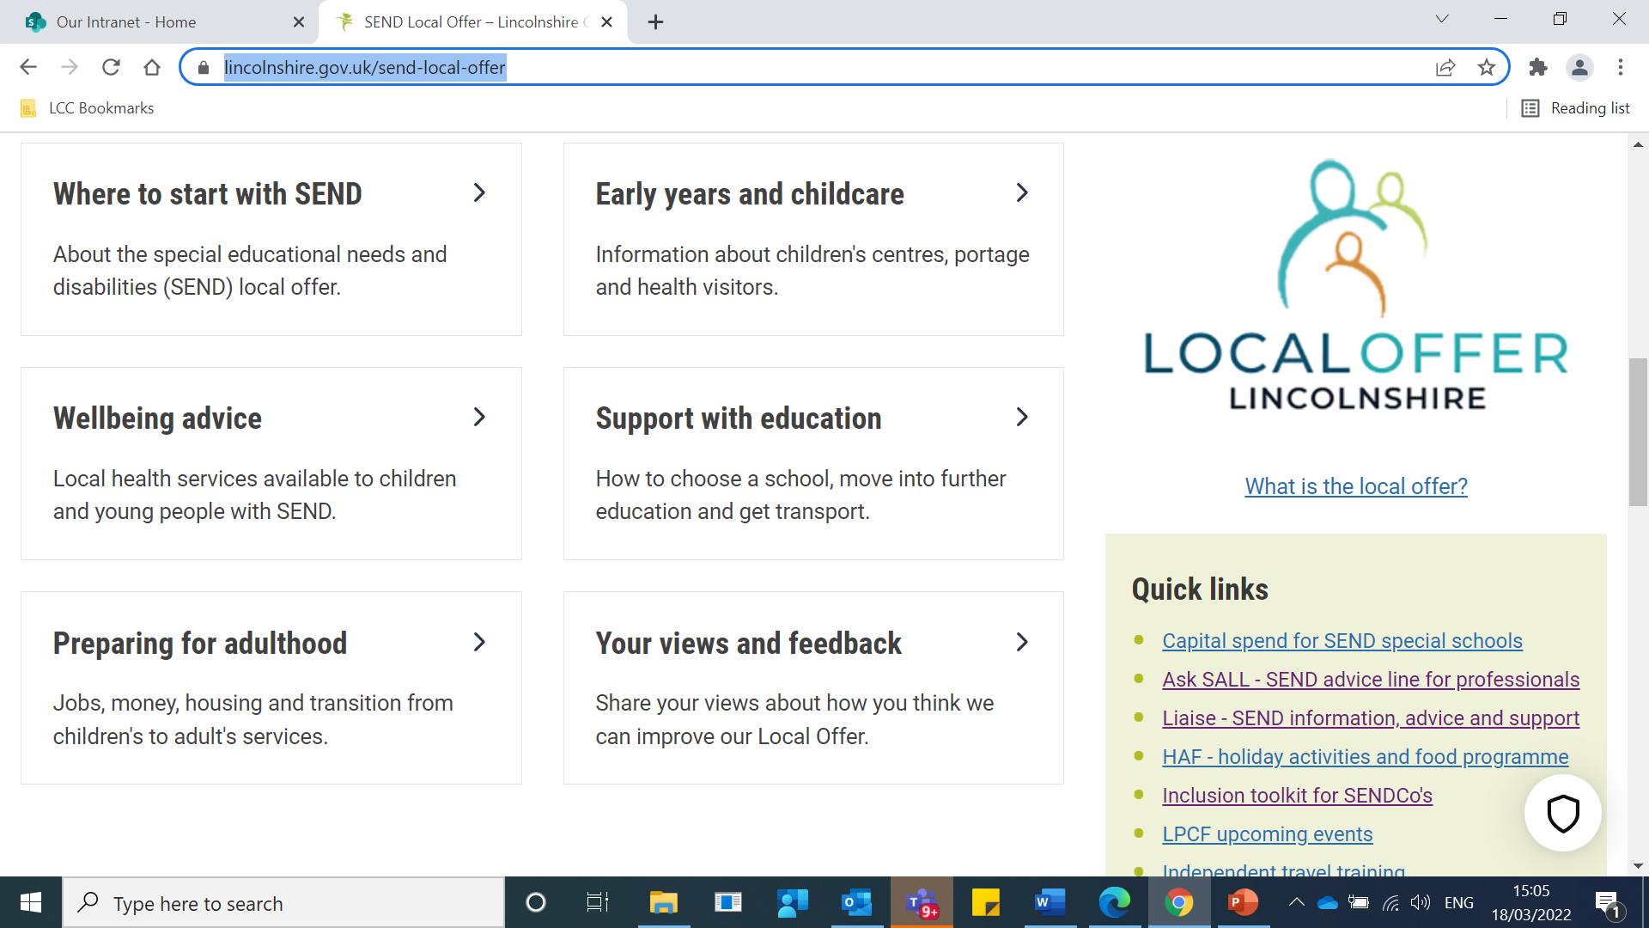
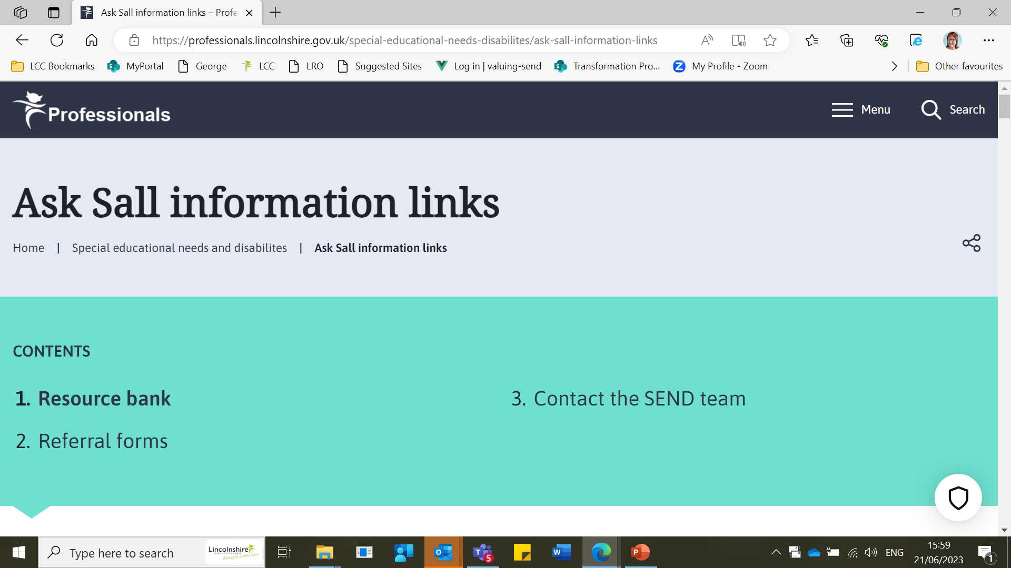
There are now 3 different ways to get advice from SALL
Option 1
SALL Local Offer page: now has 3 pages of information.
PAGE 3 contains :
List of helpful resources from the SALL resource bank
A link to support for parents
Specific referral forms for services
SEND team contact information
AskSALL page can be found via the quick links section on the SEND local offer homepage

Slide 5
Option 2
Quick question/query via SALL line:
Call: 01522 553199
V SEND questions including logging on issues
SEND process questions
Questions regarding EHCP funding
Colleagues from Out of County looking for the most appropriate contact

Slide 6
Find the online form on the SEND Local offer, click complete the online form (page 3)
Option 3
Concerns regarding individual pupils or whole school issues:
Please complete the online form (now on page 3 SALL local offer) with brief details for the child and reason for your consultation request.
SALL will give you and other educators time to discuss concerns at an individual or whole school level. In most cases we will contact you within 48 hours from when your form is received.
A SALL Advisor will:
Signpost you to resources and links to support meeting a child’s needs
direct you to the most appropriate services for a child’s needs
If appropriate arrange for contact back from an experienced professional such as Educational Psychologist or Early Years Specialist Teacher.

