Slide 1
Graduated Approach Briefings
June / July 2023
Notices

Slide 2
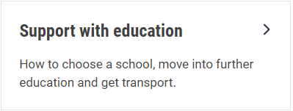
Welcome
To locate information about the Graduated Approach Briefings on the Local Offer, go to: https://professionals.lincolnshire.gov.uk/homepage/54/graduated-approach-briefings
Or on the Home Page, click on: Support with Education
Then scroll down to: Graduated Approach Briefings
Welcome and thank you for joining us for this virtual training session.
Please sign in through the Chat to register your attendance.
As usual, to support everyone to maintain connectivity with so many attendees being here:
Please Mute your microphone and turn off your video when not speaking – we have a large number of participants present today and this may mean that we experience feedback or slowing of the network connection if everybody has their microphone and video on. However, we would like to see you if you ask a question, please, so feel free to switch on both your microphone and video in these instances.
Please note that this meeting, or sections of it, will be being recorded for use on the council’s professionals’ website. If you do not wish to be recorded, you should leave the meeting and watch it back later.
If you would like to ask questions, please use the raise your hand facility or use the chat function in Teams
Please keep discussion in the ‘chat’ relevant – the person presenting may not be able to see your comments but we will have someone monitoring it in order to make sure all questions are answered.

Slide 3
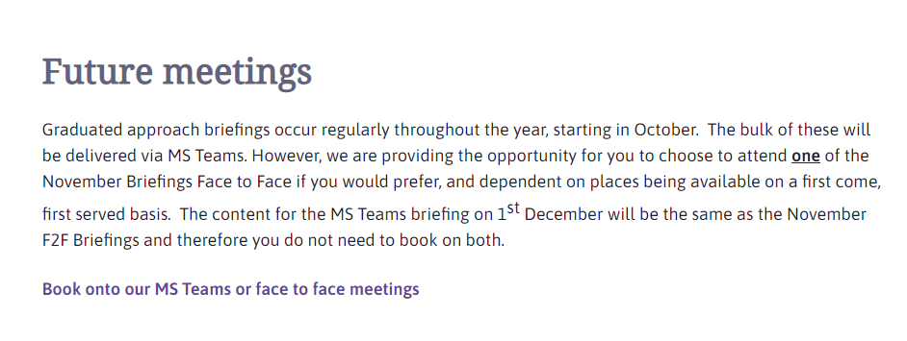
Coming soon for 2023-24 academic year! Remember to book your places for each briefing throughout the year on the Local Offer
Graduated approach briefings – Professional resources (lincolnshire.gov.uk)

Slide 4
Month | Meeting 1 | Meeting 2 | Meeting 3
October 2023 | TEAMS: Thurs 12th October 09.30 – 12.00 | TEAMS: Tues 17th October 13.00 – 15.30 | N/A
November 2023 | TEAMS: Wed 22nd November: 09.30 – 12.00 | TEAMS: Tues 28th November: 13.00 – 15.30 | N/A
February 2024 | TEAMS: Tues 20th February 13.00 – 15.30 | TEAMS: Wed 28th February 09.30 – 12.00 | N/A
April/May 2024 | F2F: Thurs 25th April 09.30 – 14.30 (Including 9.30 – 10.00 networking; 30 mins lunch; and 14.00 – 14.30 networking opportunities) Venue: LEARN Teaching Centre, Warwick House, Long Bennington Business Park. NG23 5JR Maximum 50 attendees Please bring own lunch | F2F: Tuesday 30th April 09.30 – 14.30 (Including 9.30 – 10.00 networking; 30 mins lunch; and 14.00 – 14.30 networking opportunities) Venue: LEAD Teaching School Hub, The Regatta, Henley Way, Lincoln. LN6 3QR Maximum 50 attendees Please bring own lunch | TEAMS: Wednesday 1st May: 09.00 – 12.30
July 2024 | TEAMS: Thursday 4th July 09.30 – 12.00 | TEAMS: Tuesday 9th July 13.00 – 15.30 | N/A

Slide 5
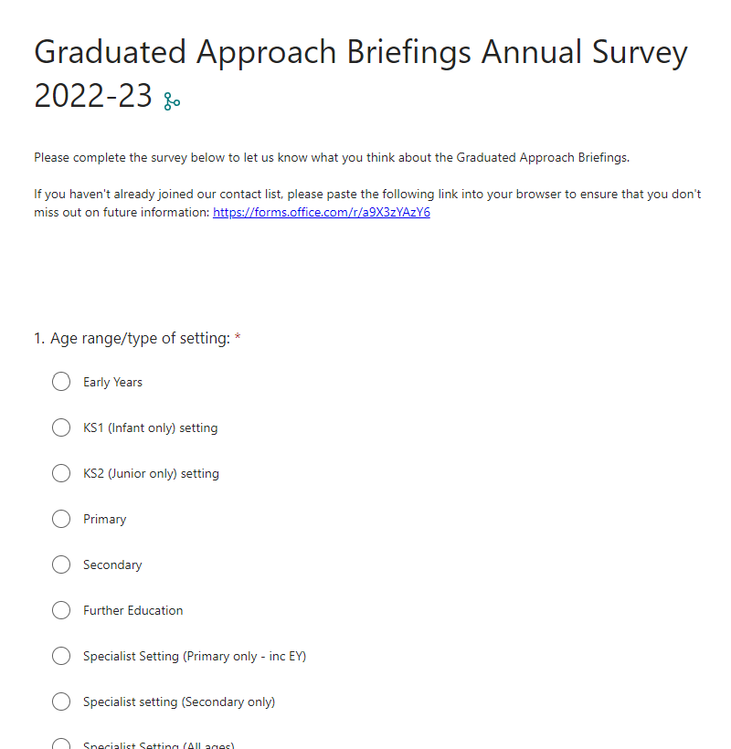
Tell us what you think:
https://forms.office.com/e/D3MuMMnc20

Slide 6
Support with education – Lincolnshire County Council The pages provide information for parent/carers with a link on the final page for professionals to access the Professionals Pages where there is the full protocol and a copy of the parent/carer leaflet.
Transition Protocol

Slide 7
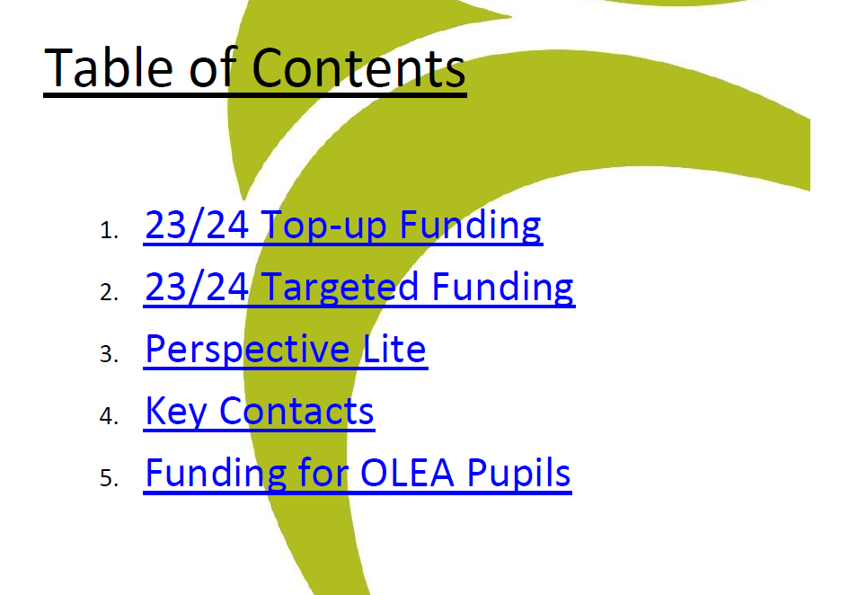
2023-24 Mainstream EHC Funding Guidance
If you haven’t already seen this on Perspective Lite, the guidance document will be available on the Graduated Approach Briefing page on the Local Offer as part of the documents / presentations from this meeting.

Slide 8
Presentations and Videos will be available from 10th July
Remember to visit the Graduated Approach Briefings page on the Local Offer so that you can view the presentations and videos for this round of briefings and any from the previous academic year.
Graduated approach briefings – Professional resources (lincolnshire.gov.uk)

