Slide 1
https://www.youtube.com/watch?v=Biex1XR_mpo&t=4s

Slide 3
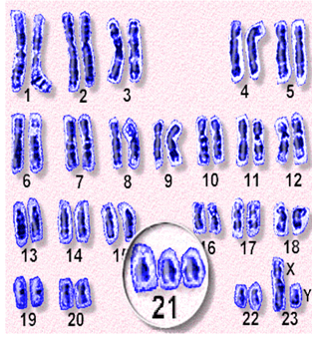
About Down’s Syndrome
Around one in every 1000 babies born in the UK will have Down’s syndrome.
There are approximately 40,000 people in the UK with the condition.
Although the chance of a baby having Down’s syndrome is higher for older mothers, more babies with Down’s syndrome are born to younger women.
Down’s syndrome is not a disease. People with Down’s syndrome are not ill and do not “suffer” from the condition.
People with the syndrome will have a learning disability. The learning disability affects a person’s ability to learn, it does not mean they cannot learn.
Today, the average life expectancy for a person with Down’s syndrome is between 50 and 60 with a small number of people living into their seventies.

Slide 4
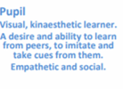
The Learning Profile
How Down’s Syndrome affects learning

Slide 5
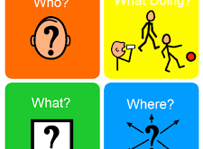
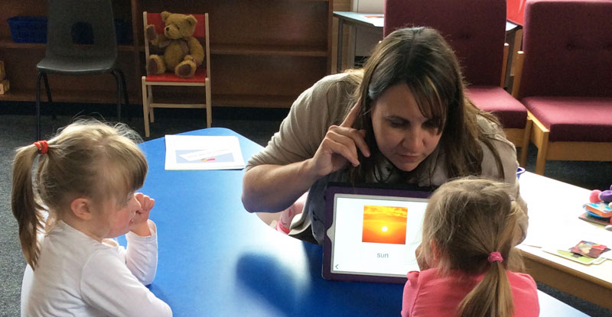
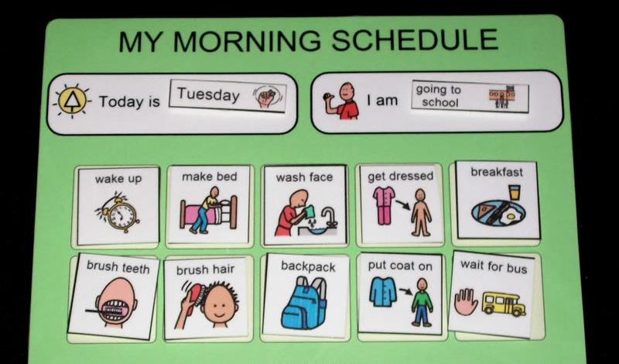
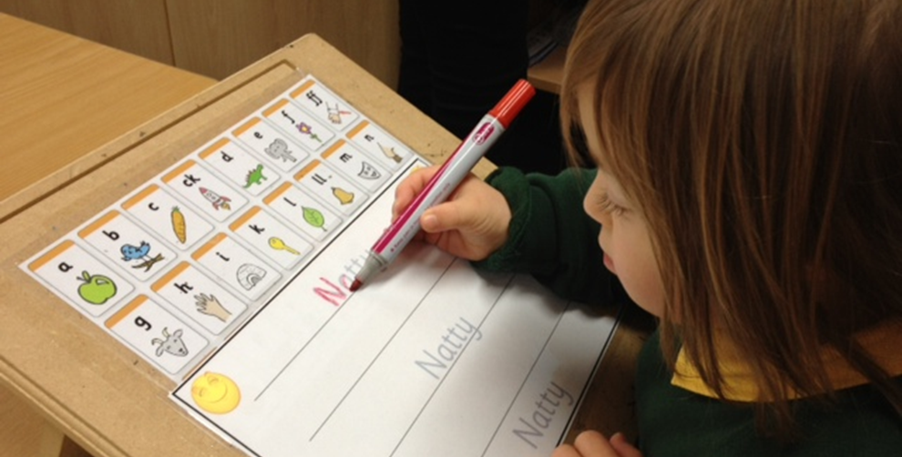
Be Prepared!

Slide 6
Few Key facts
Every learner who has Down's syndrome is unique. Individuals differ across all aspects of social and cognitive development as well as in their family support and educational opportunities. Every individual is helped by teaching staff having high expectations.
Most children with Down’s syndrome need additional support for optimal learning in all types of schools. The quality of support the child or young person receives can have a tremendous impact on his or her learning.
Behaviours are communication - Respond don’t react!

Slide 7
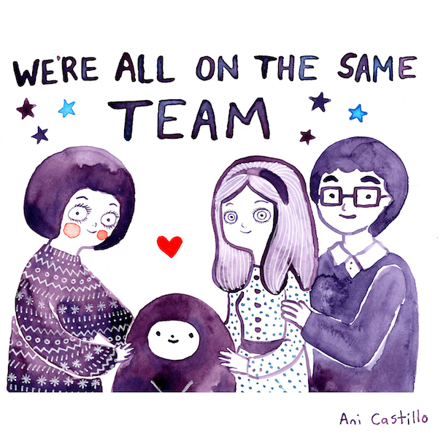
Working with parents…
Maintain a good relationship and regular contact with parents/carers
The school should ensure all staff have basic training about Down’s syndrome
Always use the correct person-first terminology.
Communication book to support health needs that affect learning – for example information about how to use glasses, support hearing, physical or sleep related concerns.
Highlight successes.

Slide 8
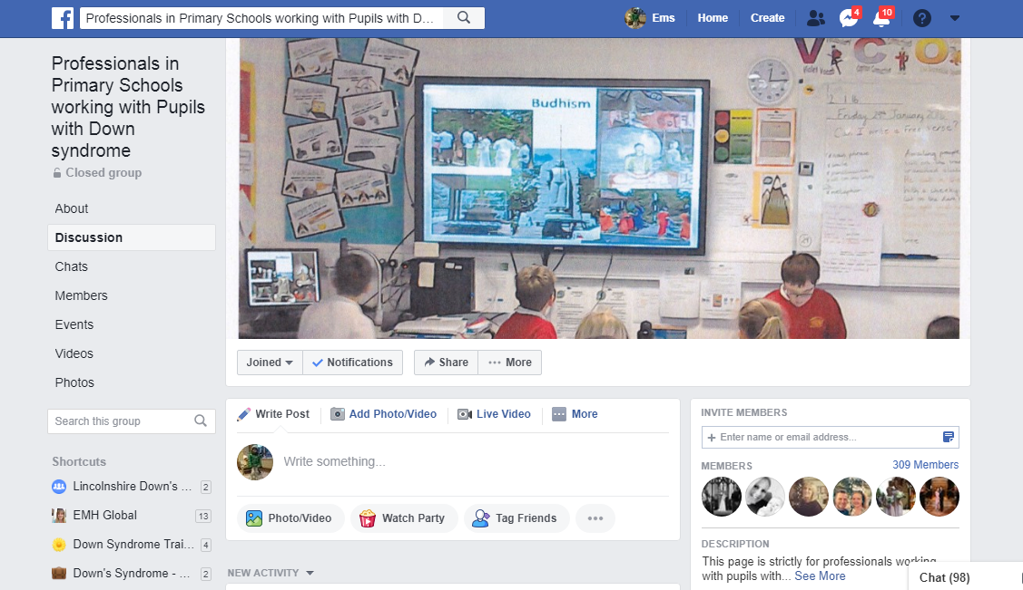
Useful Links:
Emma Hall – emma.ldssg@gmail.com

Slide 9
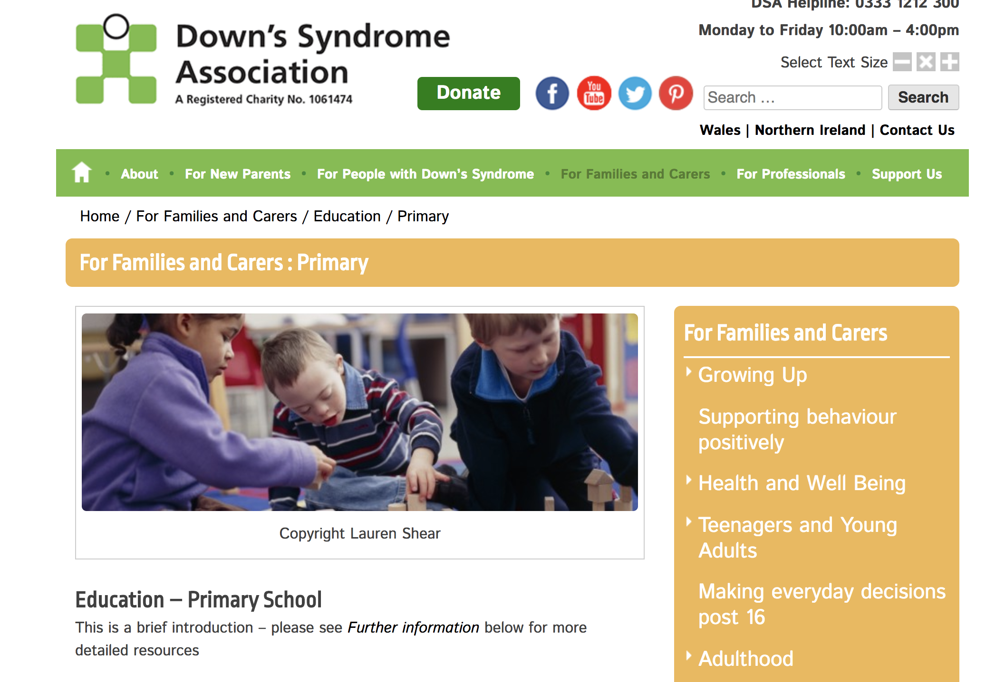
Useful Links:
Emma Hall – emma.ldssg@gmail.com

Slide 10
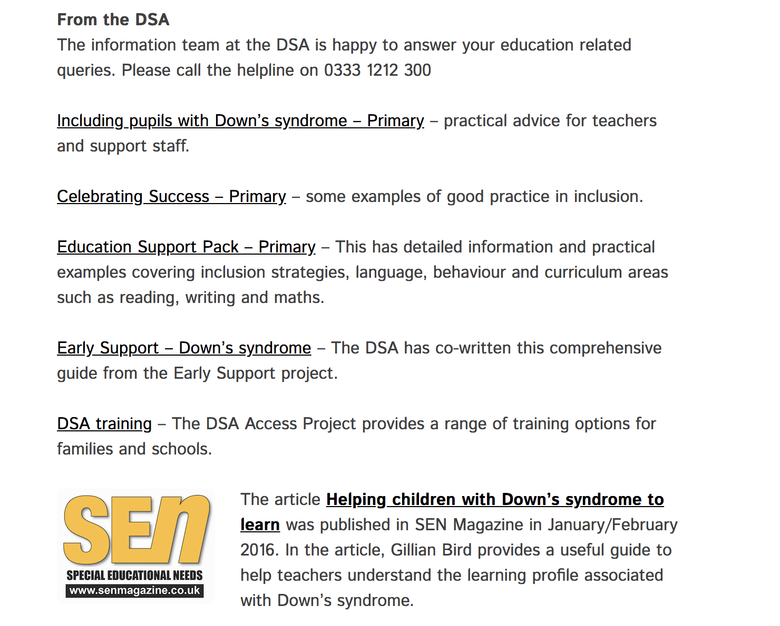
Useful Links:
Emma Hall – emma.ldssg@gmail.com

Slide 11
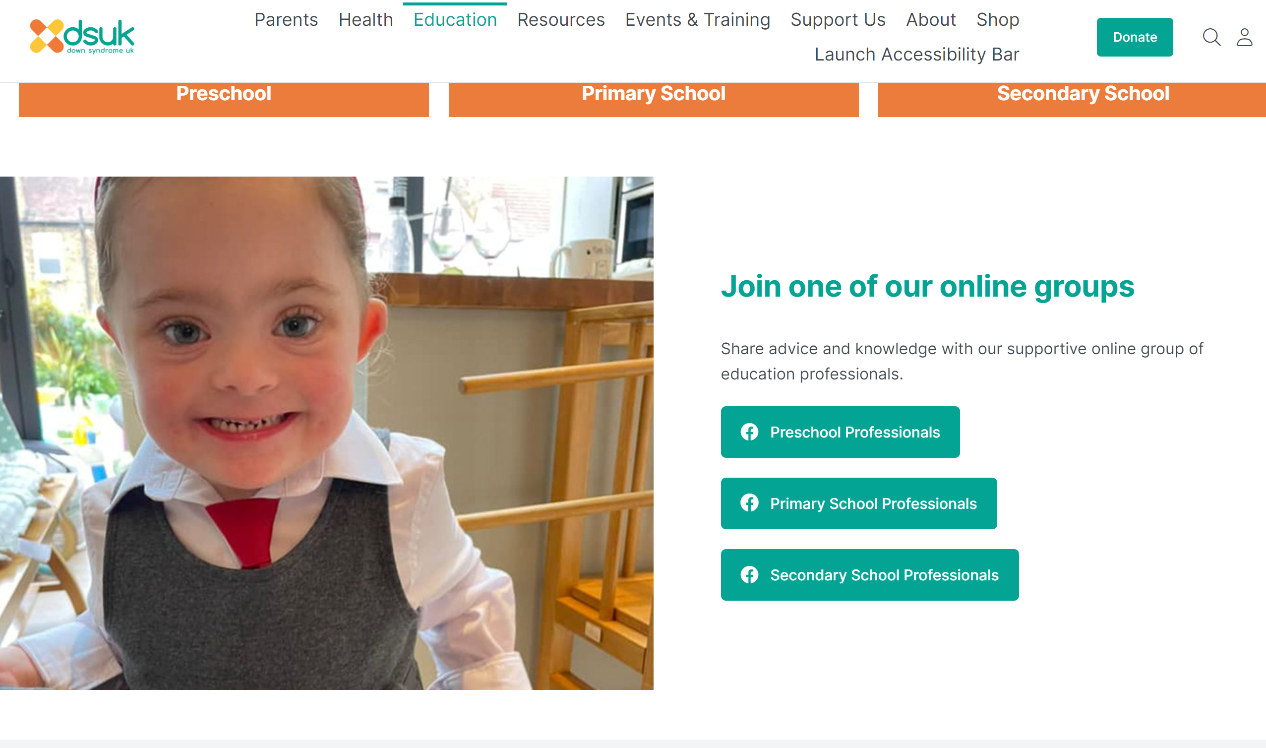
Useful Links:
Emma Hall – emma.ldssg@gmail.com

Slide 12
World Down Syndrome Day is annually observed on March 21 to raise public awareness of Down syndrome, caused by having an extra 21st chromosome.

Slide 13
If you meet one child with Down’s Syndrome, you have met one child with Downs Syndrome…

