Slide 1
ECF Ready
What you need to know (April 2023)
Notes:
This recording is being provided by the ECF & AB Team at L.E.A.D. Teaching School Hub Lincolnshire and is current on it’s release as of 20th April 2023.

Slide 2
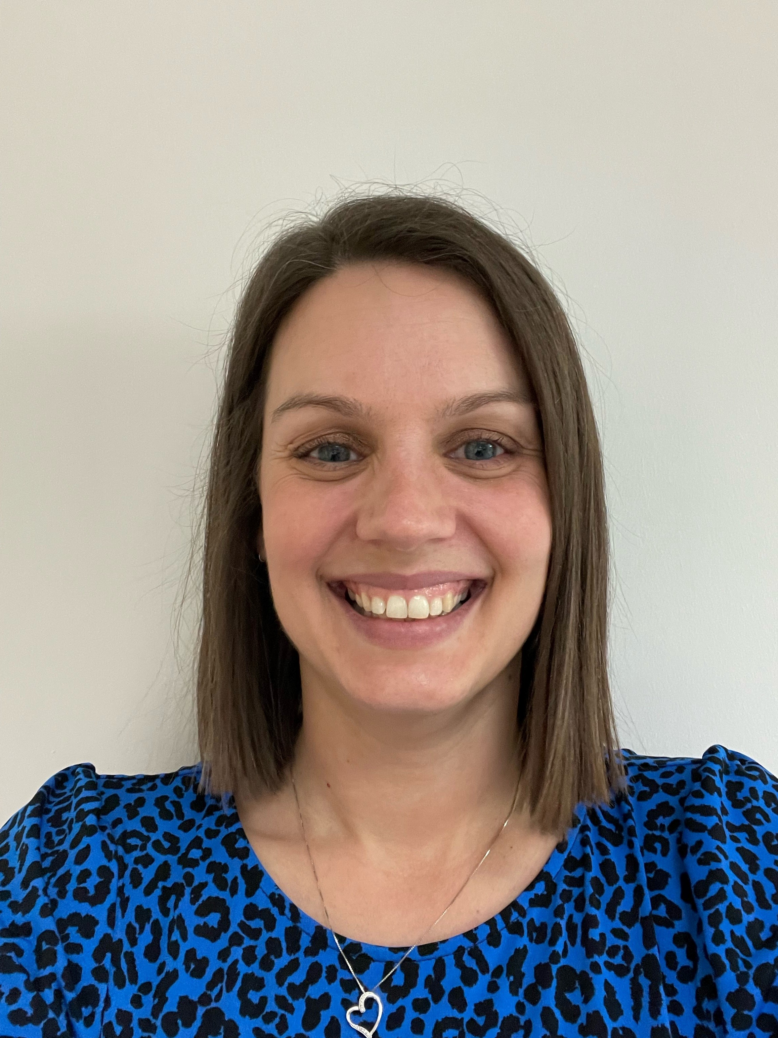
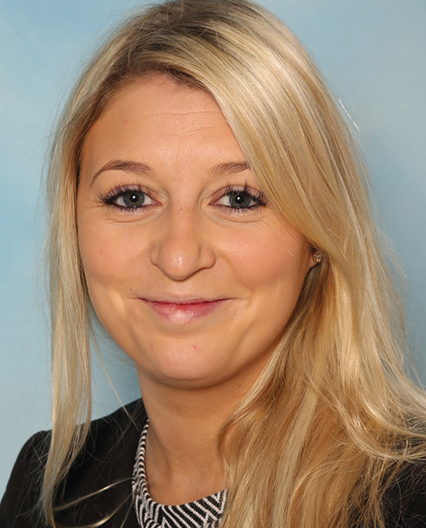
The ECF & AB Team
Stacey Williams
ECF & AB Lead
L.E.A.D. Teaching School Hub
e. stacey@leadtshub.co.uk
t. 01522 214459
Rachael Viscomi
ECF & AB Administrator
L.E.A.D. Teaching School Hub
e. rachael@leadtshub.co.uk
t. 01522 214459
Notes:
Introduce team and what both are responsible for e.g. Stacey background – teaching, C4C, reduced inductions etc. / Rachael – administration – resetting passwords, assisting users with functionality of services etc.

Slide 3
The Early Career Framework and Appropriate Body Services
Notes:
Reca

Slide 4
What is the Early Career Framework?
The Early Career Framework (ECF) is designed to make sure early career teachers focus on learning the things that make the most difference in the classroom and their professional practice.
The full and core induction programmes include high-quality development materials, underpinned by the ECF, which will support early career teachers to develop the essential knowledge and skills to set them up for a successful and fulfilling career in teaching.
They cover the five core areas of the ECF:
behaviour management I pedagogy I curriculum I assessment I professional behaviours
The ECF is not an assessment tool. Teachers will still be assessed against the Teachers’ Standards
Notes:
The Early Career Framework is the evidence base which underpins this new entitlement for early career teachers' professional development. It sets out what all early career teachers should learn about and learn how to do during the first 2 years of their careers.
The full and core induction programmes that we will discuss and find out more about today, are high quality approved materials underpinned by the ECF and high quality research which have been designed to set teachers up for a successful career in teaching.
While the ECF is presented around the Teachers' Standards for clarity, the ECF is not, and should not be used, as an assessment framework. Early career teachers will not be expected to collect evidence against the ECF, and they will continue to be assessed against the Teachers' Standards only.

Slide 5
What is the difference between the Early Career Framework (ECF) and the Appropriate Body (AB)
Notes:
Important to note that from September 2023, will be able to onboard ECTs for AB registration.

Slide 6
Delivery
Infrastructure
Appropriate Body
Induction Programme
Schools
Lead Providers
Delivery Partner
Induction Tutors
ECTs
Mentors
Notes:
The diagram on the screen shows the Delivery Infrastructure –
Schools sit at the very heart of this with ECTs, Mentors and Induction Tutors and a little later in this presentation, we will clarify those roles and their corresponding responsibilities.
We have the DfE reforms which now state that an induction programme for ECTs has to be underpinned by the ECF and overseen by an Appropriate Body to ensure that ECTs receive their statutory entitlements.
Lead Providers are those that have been designated by the DfE to provide an ECF based statutory induction programme. Six were designated and these were: EDT, Ambition Institute, Teach First, Best Practice, Capita and UCL.
Lead Providers work with a Delivery Partner (TSHub)

Slide 7
The options
FIP
Full induction programme
A funded provider-led programme offering high-quality training for early career teachers and their mentors alongside the professional development materials.
Core induction programme
Schools can draw on the content of the high-quality core induction programmes to deliver their own early career teacher and mentor training.
School-based programme
Schools design and deliver their own ECF-based induction programme.
CIP
Schools choosing CIP or SIP will require a significant ECF fidelity check by the AB - additional costs to this
SIP
Notes:
There are three option for schools to choose from: Full Induction Programme (FIP), Core Induction Programme (CIP) and a School-based programme.
Where schools opt for the Full Induction Programme, which includes materials and funded training, the appropriate body does not need to carry out ECF fidelity checks. This is because the providers of Full Induction Programmes will already be subject to separate quality assurance through Ofsted and contract management to ensure their training provides fidelity to the ECF
Both the CIP and the Schools Based route will require significant ECF fidelity checks from the AB, which will result in higher financial costings.

Slide 8
Full Induction Programme (FIP) otherwise known as the Early Careers Professional Development Programme (EC PDP)
A funded lead programme offers high quality training for ECTs and Mentors in a blended approach - face-to-face and online training.
This is the preferred and recommended model both locally and nationally.
IN PARTNERSHIP WITH
Notes:
A funded lead programme offers high quality training for ECTs and mentors in a blended approach - face-to-face, online training and through self-study materials.
There were six DfE approved providers:
Teach First
Ambition Institute
Education Development Trust
UCL Institute of Education
Capita with lead academic partner the University of Birmingham
Best Practice Network
L.E.A.D. Teaching School Hub Lincolnshire has chosen to work as a delivery partner for Education Development Trust (EDT) which means that the Lincolnshire Hub Delivery Partners and colleagues across the Hub deliver a programme designed by EDT.
A funded lead programme is an exceptional professional development programme, designed to meet the needs of early career teachers, learning skills they can use straight away. It is an evidence-led programme of training, designed around what really works, and how pupils learn, for effective improvement in teacher practice.
It is also a focused development programme for mentors, giving them opportunity to develop skills through instructional coaching techniques.
Through a blended approach - face-to-face, online training and through self-study materials.
95% of schools nationally are participating in FIP.
Not for this slide but useful info:
500 schools using the DfE accredited materials to deliver their own ECF based training (CIP)
100 schools designing and delivering their own training based on the ECF)

Slide 9
Partnering with expert organisations
Partnering with schools and expert organisations means the programme benefits from the best of real practice, supported by the latest thinking.
A consortium of expert organisations will work with schools to develop new content, offering challenge and advice.
These partners include:
Notes:
SHU – one of the top institutions for teacher training have worked in partnership with EDT along with the Bell Foundation.
One of the main reasons we chose to partner with EDT was due to the fact that they were the only LP offering Iris Connect as part of their ECF offer – an excellent tool to support with capturing lessons/snippets of lessons for the basis of some mentoring/coaching conversations.

Slide 10
Programme
components
Notes:
We will look at an overview but just so you are aware some of our ECTs have said the following:
That the programme is indepth, has good structure, is comprehensive, progressive and has inter-related modules.
They have enjoyed the self-study materials, revisiting concepts that they met in initial teacher training and contextualising these with their Mentor to make the programme more meaningful to their development.
They have commented that there are plenty of opportunities for reflection, discussion and deeper learning both in the group sessions and individual mentor sessions and like that the programme ensures protected and quality weekly time with their designated mentor.
The local group sessions useful as it’s been an opportunity for a face to face meeting with who are in the same position and stage of development.

Slide 11
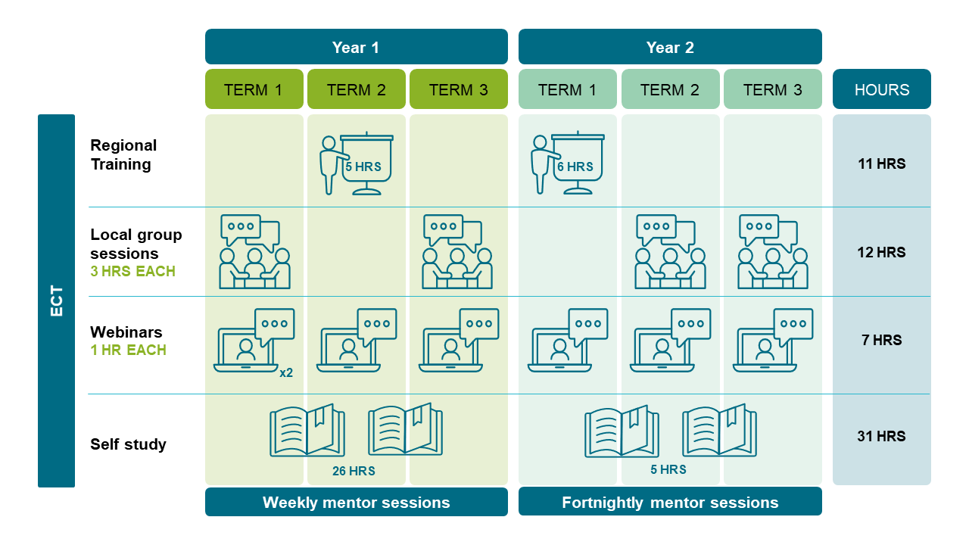
Programme overview
ECTs
Notes:
There is a variety of materials and delivery techniques at local group sessions, each with a minimum of two facilitators. There is different expertise/input from facilitators; through the use of slides, video clips, reading and most importantly - opportunities for individual/ and group reflection and discussion .
Structure of the programme is good; outline of weekly focus points for mentor meeting; content chunked therefore easier to retain and not overwhelming
The structured programme informs mentor sessions back at school which facilitates further discussion, reflection, deeper learning and progress in practice

Slide 12
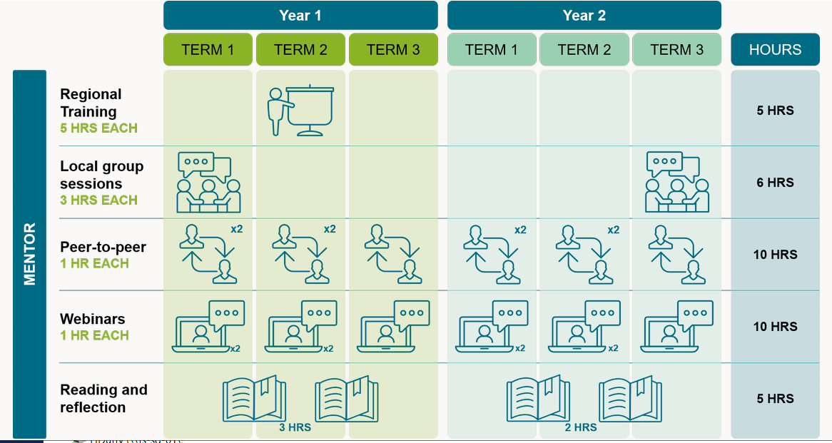
Programme overview
Mentors
Notes:
Programme of support for Mentors
1 hour per week in year 1 and 1 hour per fortnight

Slide 13
The programme in action – ECT Local Group Session

Slide 14
The programme in action – Mentor Regional Event

Slide 15
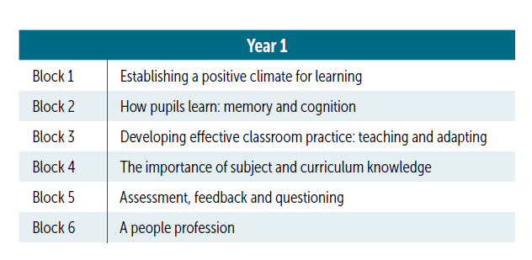
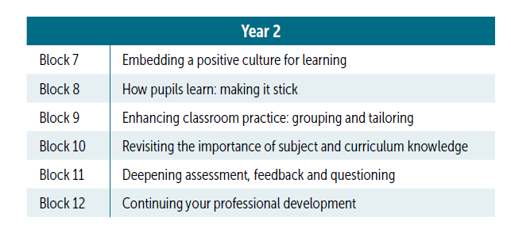
The programme
Notes:
There is rich and relevant examples from expert practitioners, accessible insights from research and frequent opportunities to put knowledge into practice.
Blocks in year 2 build on the foundations encountered in year 1 to develop mastery in these crucial areas of practice and as such ECTs encounter a spiral curriculum.
ECTs say :
‘They like the half-termly focus - the modules build upon and reinforce prior training’
‘Blocks are well chosen and fit in with stage of development. Block 1 was pertinent to what was needed in the first term, building on ITT training and it’s useful that each session has a specific focus which builds on previous sessions’

Slide 16
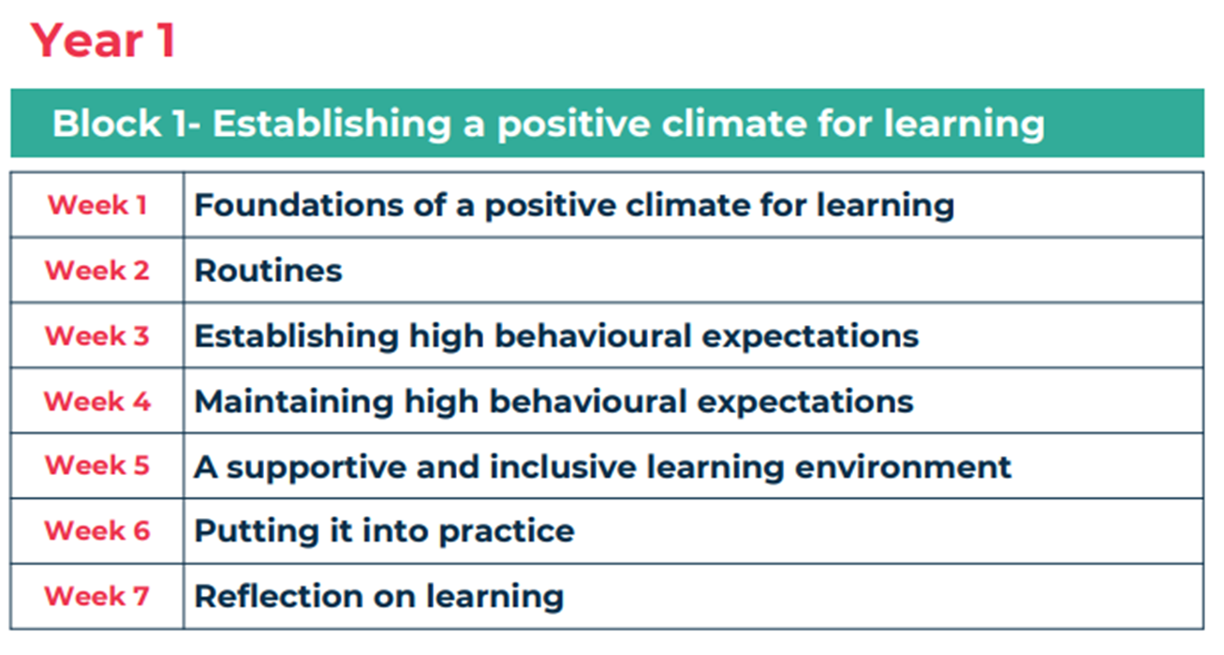
Block sequence
Notes:
The learning approach and delivery schedule ensures every topic is covered by the three dimensions of development, just like a “Block”.
This supports early career teachers to learn the theory, put theory into practice, and reflect on personal and professional development.
ECTs say:
‘Start of blocks is very clear. Expectations are clear and this helps you to shape your thinking
Good to learn the theory and then be given ideas as to how to put it into practice - practical, tried and tested, research-based strategies
The programme and components are manageable and can therefore keep up to date with the blocks.
Reflection activities at end of each module help you to shape your personal reflection.’

Slide 17
To find out more …
Attend an ECF Ready Event
Look at our website
https://www.leadtshublincs.co.uk/

Slide 18
DfE links
Induction, training and support for early career teachers (new) https://www.gov.uk/government/collections/induction-training-and-support-for-early-career-teachers-ects
Changes to statutory induction for early career teachers (updated) https://www.gov.uk/guidance/changes-to-statutory-induction-for-early-career-teachers-ects
How the Early Career Framework supports induction (new) https://www.gov.uk/guidance/how-the-early-career-framework-ecf-supports-induction
Funding and Eligibility for ECF based training (new)
https://www.gov.uk/guidance/funding-and-eligibility-for-ecf-based-training

Slide 19
DfE links
Guidance for Schools/School induction tutors: ECF based training (new) https://www.gov.uk/guidance/guidance-for-schools-how-to-manage-ecf-based-training
Guidance for Early Career Teachers: ECF based training (new) https://www.gov.uk/guidance/guidance-for-early-career-teachers-ects-ecf-based-training
Guidance for mentors: how to support ECF-based training (new) https://www.gov.uk/guidance/guidance-for-mentors-how-to-support-ecf-based-training
The Manage training for early career teachers service step-by-step guide / checklist for setting up the training programme: https://manage-training-for-early-career-teachers.education.gov.uk/how-to-set-up-your-programme

Slide 20
Please send any questions to:
Stacey Williams
ECF & AB Lead
L.E.A.D. Teaching School Hub
e. stacey@leadtshub.co.uk
t. 01522 214459
Rachael Viscomi
ECF & AB Administrator
L.E.A.D. Teaching School Hub
e. rachael@leadtshub.co.uk
t. 01522 214459

