Slide 1
Graduated Approach Briefings
April / May 2023
Notices

Slide 2
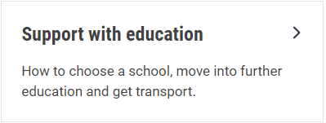
Welcome
To locate information about the Graduated Approach Briefings on the Local Offer, go to: https://professionals.lincolnshire.gov.uk/homepage/54/graduated-approach-briefings
Or on the Home Page, click on: Support with Education
Then scroll down to: Graduated Approach Briefings
Welcome and thank you for joining us for this virtual training session.
Please sign in through the Chat to register your attendance.
As usual, to support everyone to maintain connectivity with so many attendees being here:
Please Mute your microphone and turn off your video when not speaking – we have a large number of participants present today and this may mean that we experience feedback or slowing of the network connection if everybody has their microphone and video on. However, we would like to see you if you ask a question, please, so feel free to switch on both your microphone and video in these instances.
Please note that this meeting, or sections of it, will be being recorded for use on the council’s professionals’ website. If you do not wish to be recorded, you should leave the meeting and watch it back later.
If you would like to ask questions, please use the raise your hand facility or use the chat function in Teams
Please keep discussion in the ‘chat’ relevant – the person presenting may not be able to see your comments but we will have someone monitoring it in order to make sure all questions are answered.

Slide 3
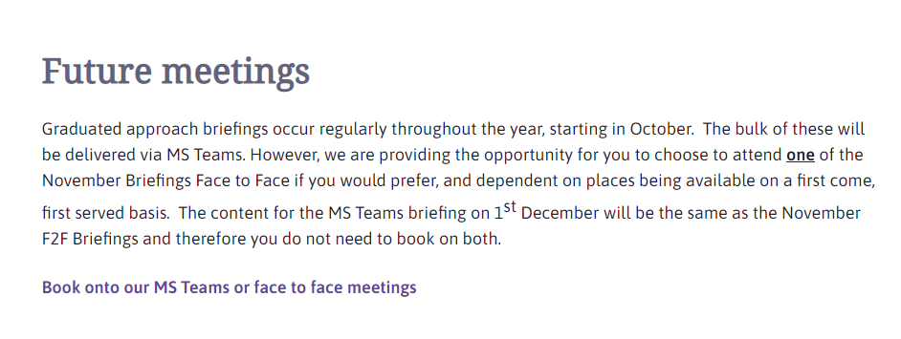
Remember to book your places for each briefing throughout the year on the Local Offer
Graduated approach briefings – Professional resources (lincolnshire.gov.uk)

Slide 4
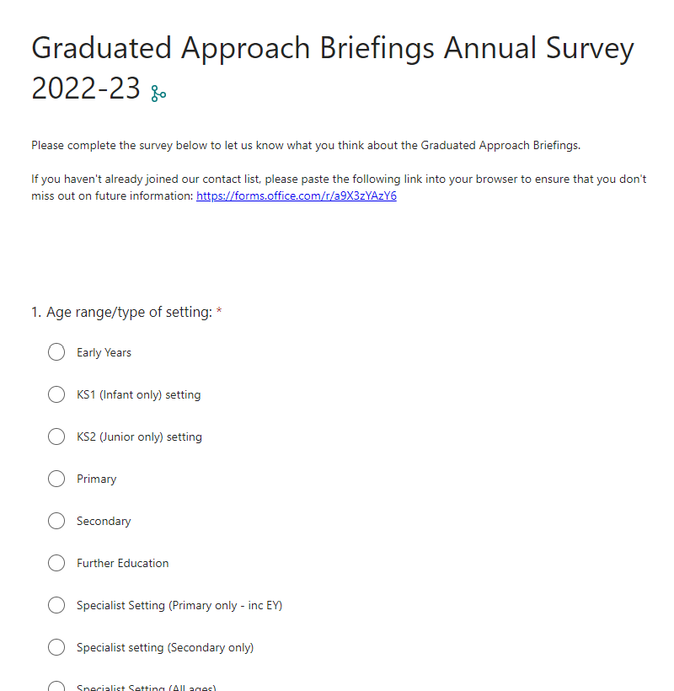
Tell us what you think:
https://forms.office.com/e/D3MuMMnc20

Slide 5
Senior Mental Health Lead Training The Department for Education (DfE) is offering a grant of £1,200 for eligible state-funded schools and colleges in England to train a senior mental health lead to develop and implement a whole school or college approach to mental health and wellbeing. This training is not compulsory, but it is part of the government’s commitment to offer this training to all eligible schools and colleges by 2025. Eligible schools and colleges are able to apply for a senior mental health lead training grant to commence training by 31 March 2024. Grants will be provided to cover (or contribute to) the cost of attending a quality assured course, and may also be used to hire supply staff while leads are engaged in learning. This grant is only available for another 11 months. Find out if you are eligible and how to apply for the grant and access DfE quality assured training to help develop a whole school or college approach to mental health and wellbeing at https://www.gov.uk/guidance/senior-mental-health-lead-training?utm_medium=email&utm_campaign=govuk-notifications-topic&utm_source=f07e532e-a695-47d8-902b-930af7b59ba7&utm_content=immediately
Don’t be one of the 55% of Lincolnshire Schools who have not taken up this offer!

Slide 6
Transition Workshop For the parents and carers of Year 5 and Year 6 children with SEND Tuesday 6th June 2023 7.00p.m. Wednesday 14th June 2023 7.00p.m. A 45-minute session open to all parents and carers, regardless of which setting a child attends or is transferring to. The event will be presented via video link, with the link to each workshop sent out prior to the session. The two evening sessions have the same content so parents can sign up to the most convenient event, by emailing details to: Helen.Lane@lincolnshire.gov.uk
Dyslexia Outreach

Slide 7
Presentations and Videos will be available from 10th May
Remember to visit the Graduated Approach Briefings page on the Local Offer so that you can view the presentations and videos for this round of briefings and any from the previous academic year.
Graduated approach briefings – Professional resources (lincolnshire.gov.uk)

