Slide 1
Outreach support for Pupils with Profound and Multiple Physical Disabilities, including those resulting in Cognitive Disabilities and Life Limiting Conditions.

Slide 2
Access to Service Criteria
Support for pupils:
In school aged between 4-18
Transition from nursery to Reception
Transition from school to college
Pupil must have 1 or more of the following:
A profound and multiple physical disability
A profound cognitive disability (e.g. Down Syndrome, brain injury)
A life limiting condition (e.g. Muscular Dystrophy)

Slide 3
What we Offer
Curriculum Support
Target and goal setting
Advice on and/ or loan of Assistive technology (AT) for practical inclusion in classroom activities and access to IT.
Equipment to support inclusion available to loan
Support in assessment of progress
Attending meetings (where possible) to contribute towards EHC’s, ESCO meetings etc
Moving and handling support
Moving and handling/postural awareness and training (small charge for this)
Attending meetings (where possible) to contribute towards EHC’s, ESCO meetings etc
Equipment available to loan

Slide 4
Open DAY (save the date) Tuesday 4th July 2023
Focus on communication
Free to attend
9.30 – 2.30 at St Francis school
This will be open to all schools in Lincolnshire – up to two delegates per setting
Please email clair.swinton@st-francis.lincs.sch.uk

Slide 5
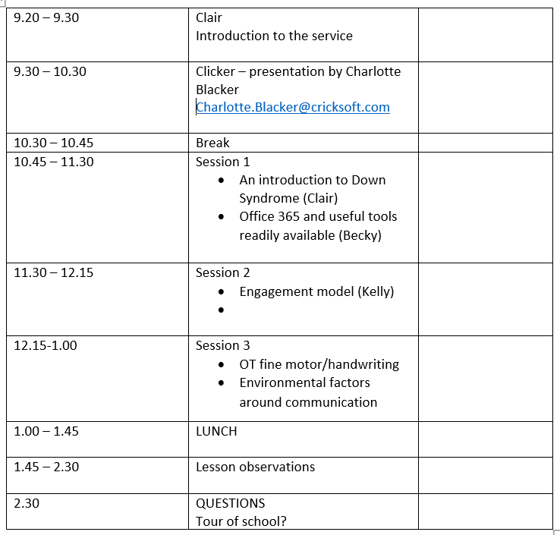

Slide 6
Where to find us
Look on the St Francis School (Lincoln) Website
https://www.st-francis.lincs.sch.uk
Head to the outreach Section. There you will find Referral forms, our promotional leaflet and parent/carer consent form.
Follow us on twitter @outreach_pd
Please contact me by email
Clair.Swinton@st-francis.lincs.sch.uk for any further information

