Slide 1
Whole School SEND: Feb 23 Update

Slide 2
Online Units
Professional Development Groups.
University of Derby- Lesson Study.
Innovation for SEND - What’s the BIG Idea?

Slide 3
Online SEND CPD Units & Live Sessions https://www.wholeschoolsend.org.uk/page/online-cpd-units

Slide 4
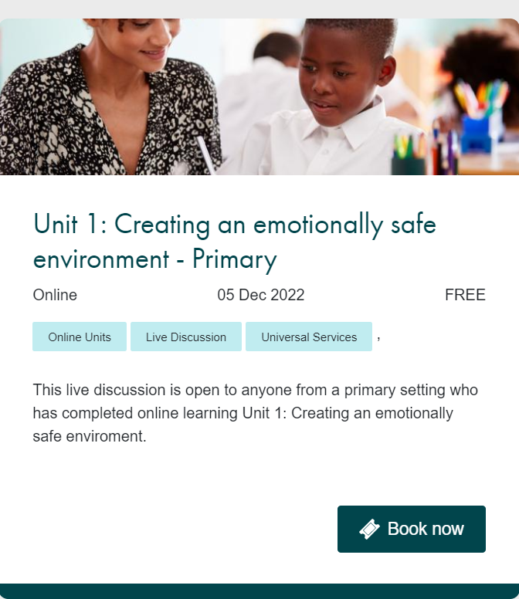

Slide 6
New session just launched.
Exploring focussed support for language and communication​
Identifying specific communication needs​
Creating opportunities for effective interactions​
Creating a communication supportive environment​
Understanding behaviour as communication​
Experiences affect development, intersectionality*​
Anxiety –supporting a calm, alert state – emotional regulation*​

Slide 7
Professional Development Groups.
Expression Of Interest via the Whole School SEND website
Recruiting for groups from Easter 23.
Regional & National depending on focus.

Slide 8
University of Derby- Action Research and Lesson Study for ISEND
Dr Geraldene Codina: g.codina@derby.ac.uk

Slide 9
Innovation for SEND What’s the BIG Idea? Aim & Intention What’s the BIG (Bold, Inspirational & Ground-breaking) Idea for SEND? The project plan is to enable participants to package and share their BIG ideas for SEND, enabling promising, small-scale, valuable, local initiatives within schools and FE College to be widely disseminated and (where possible) scaled to meet the needs of more children and young people.

Slide 10
Aim & Intention (continued)
What’s the BIG (Bold, Inspirational & Ground-breaking) Idea for SEND?
Project participants will receive high-quality, free CPD to share their ideas and support their engagement in simple, effective, class-based research.
The Project will last for three years , with 3 cohorts and a minimum of 25 participants across the 3 years:
To recruit 5 schools for Cohort 1 (Spring 2023- Autumn 2023). There will be 10 schools in Cohort 2 (Autumn 2023 to Summer 2024) and a further 10 schools in Cohort 3 (Spring 2024 to Autumn 2024).
Notes:
Notes of SENCOs

Slide 11
Our Approach
Expressions of Interest have been completed via Microsoft form, hyperlinked in the flyer, and participants were asked to cover the following points in their 250 words.
What is your intended target market (age of learners/ type of needs)?
What is your BIG idea and how do you know it will work?
Have you tried your idea on small scale?
Does your idea have the potential to have high impact for learners with SEND?
Does your idea have the potential to have wide impact for learners with SEND?
Is the idea research informed?
Will the impact of your BIG idea be academic, social, personal or holistic (ie covering all areas)?
Have you got any impact data?
Is this a new innovation or are you looking to scale up promising practice?

Slide 12
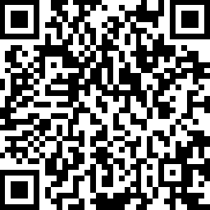
Find out more and join our member community
Stay in touch
info@wholeschoolsend.com
@WholeSchoolSEND
Whole School SEND
www.wholeschoolsend.org.uk
Whole School SEND

