Slide 1

Graduated Approach Briefings
February / March 2023
Notices

Slide 2
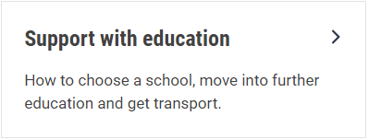


Welcome
To locate information about the Graduated Approach Briefings on the Local Offer, go to: https://professionals.lincolnshire.gov.uk/homepage/54/graduated-approach-briefings
Or on the Home Page, click on: Support with Education
Then scroll down to: Graduated Approach Briefings
Welcome and thank you for joining us for this virtual training session.
Please sign in through the Chat to register your attendance.
As usual, to support everyone to maintain connectivity with so many attendees being here:
  Please Mute your microphone and turn off your video when not speaking – we have a large number of participants present today and this may mean that we experience feedback or slowing of the network connection if everybody has their microphone and video on. However, we would like to see you if you ask a question, please, so feel free to switch on both your microphone and video in these instances.
  Please note that this meeting, or sections of it, will be being recorded for use on the council’s professionals’ website. If you do not wish to be recorded, you should leave the meeting and watch it back later.
  If you would like to ask questions, please use the raise your hand facility or use the chat function in Teams
  Please keep discussion in the ‘chat’ relevant – the person presenting may not be able to see your comments but we will have someone monitoring it in order to make sure all questions are answered.

Slide 3
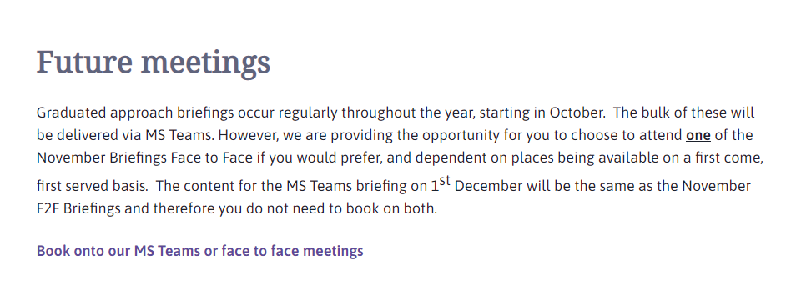
Remember to book your places for each briefing throughout the year on the Local Offer
Graduated approach briefings – Professional resources (lincolnshire.gov.uk)

Slide 4
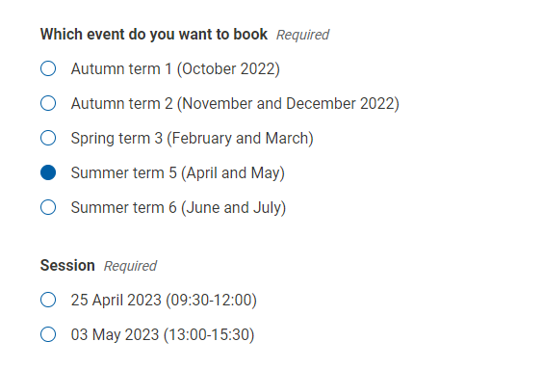
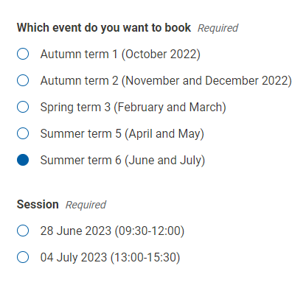
Book one briefing for each term
When you select a term, the options for each for the two available sessions for that term become visible. The content is the same at each – just choose the most convenient. The screenshots show the remaining dates.

Slide 5

Presentations and Videos will be available from 6th March
Remember to visit the Graduated Approach Briefings page on the Local Offer so that you can view the presentations and videos for this round of briefings and any from the previous academic year.
Graduated approach briefings – Professional resources (lincolnshire.gov.uk)

Slide 6
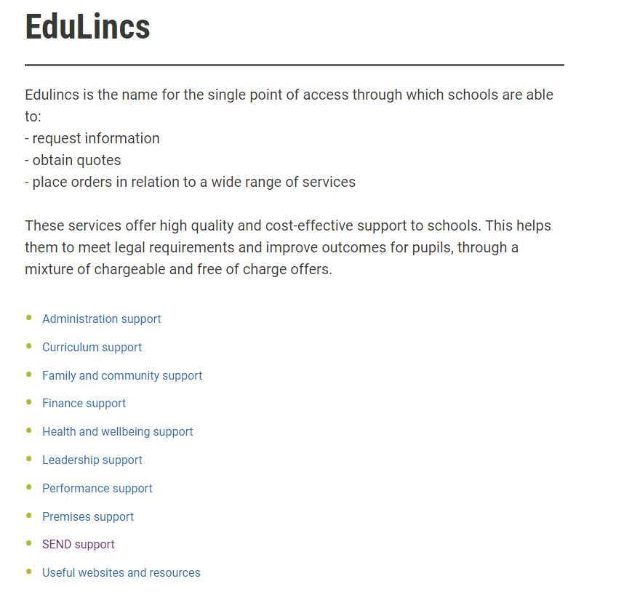
Edulincs Offers
EduLincs Homepage

Slide 7
