Slide 1
L.E.A.D. Teaching School Hub
Notes:
2.00 Welcome- Look at this room- how fortunate to be working together

Slide 2
SEND specific CPD
Notes:
Adapted the programme in response to feedback – cost and number of sessions / later start in year.

Slide 3
SEND specific CPD

Slide 4
Pre-Key Stage Standards
Keystone Academy Trust will be running training to ensure schools are familiar with the Pre-Key Stage Standards.
Participants will also receive a copy of the Lincolnshire Pre-Key Stage Exemplification Materials for Reading, Writing and Maths written by leaders of the Moderation Team with input from the Special School sector.
Additional training is being booked for January in Boston and Lincoln. https://events.bookitbee.com/keystone-academy-trust/
For further information (including purchasing the materials and bespoke training), please contact Paul.Singleton@keystonemat.org
@LincsModeration
Notes:
Details to follow – dates / cost etc
The session follows on from a book that has been written by Keystone supporting schools with pre – keystage standards

Slide 5
Session 2:
Practical strategies and resources schools can take away and use
FREE!!!!!

Slide 6
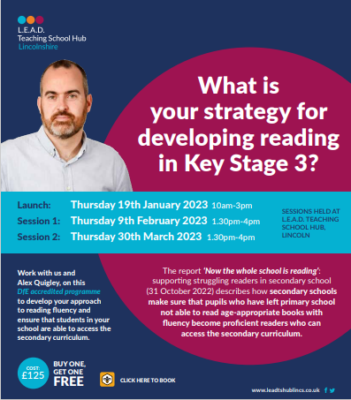
Without identification of their reading needs and targeted additional teaching, pupils who arrive in secondary school as poor readers are likely to continue to struggle. As the secondary curriculum places increasing demands on reading comprehension, older pupils who struggle with reading comprehension do not catch up. Each year, only 10% of disadvantaged children who leave primary school with their reading below the expected standard get passes in English and mathematics at GCSE.
Notes:
Writing is a need that is being flagged across the county – still the opportunity to book on……to attend session 2 with a link for Alex Quigley
There will be supplementary sessions for writing linked to handwriting / spelling / transcription and composition
Reading fluency – supporting children post phonics through to KS2 and 3

Slide 7
Notes:
Writing is a need that is being flagged across the county – still the opportunity to book on……to attend session 2 with a link for Alex Quigley
There will be supplementary sessions for writing linked to handwriting / spelling / transcription and composition
Reading fluency – supporting children post phonics through to KS2 and 3

Slide 8
Notes:
Schools have embraced the science of learning and recognised the need to interject retrieval practice into their curriculum planning to support children and students with retaining learning.
Finding ways creative ways to do this to motivate pupils including revision strategies, common mistakes with retrieval practice and how to avoid them.

Slide 9
Notes:
Schools have embraced the science of learning and recognised the need to interject retrieval practice into their curriculum planning to support children and students with retaining learning.
Finding ways creative ways to do this to motivate pupils including revision strategies, common mistakes with retrieval practice and how to avoid them.

Slide 10
Notes:
Schools have embraced the science of learning and recognised the need to interject retrieval practice into their curriculum planning to support children and students with retaining learning.
Finding ways creative ways to do this to motivate pupils including revision strategies, common mistakes with retrieval practice and how to avoid them.

Slide 11
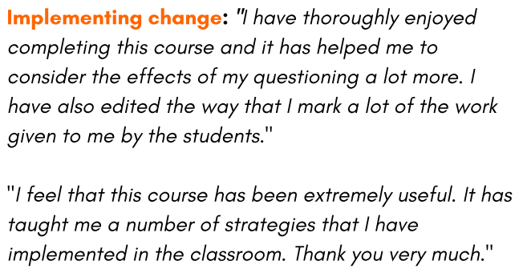
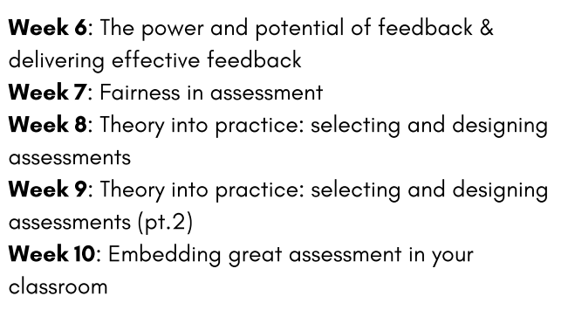
Notes:
Is there anyone in your school who you are aware that would benefit from developing their approach to assessment? Work with the Evidence Based Education team

Slide 12
Whole School SEND Update: Lincolnshire Graduated Approach Briefing Nov’ 22

Slide 13
WSS Consortium
50+ partner organisations
Range of organisations: - condition-specific organisations, research universities, local authorities, individual school trusts and alliances

Slide 14
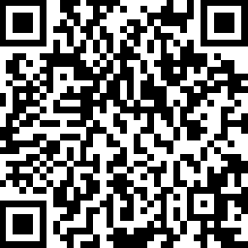
Joining the WSS Member Community
Go to www.wholeschoolsend.org.uk

Slide 15
Joining the WSS Member Community

Slide 16
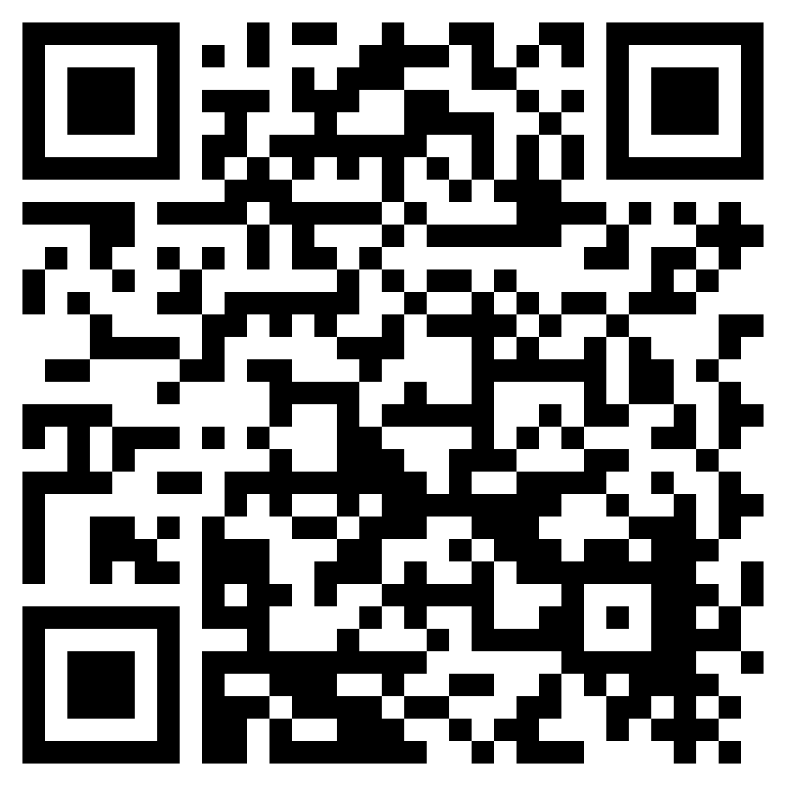
Leadership-specific resources
One of our suite of Review Guides
Use to support your self-evaluation around inclusion
Find all our Review Guides in the ‘Resources and publications’ area
https://www.wholeschoolsend.org.uk/resources/demonstrating-inclusion-tool

Slide 17
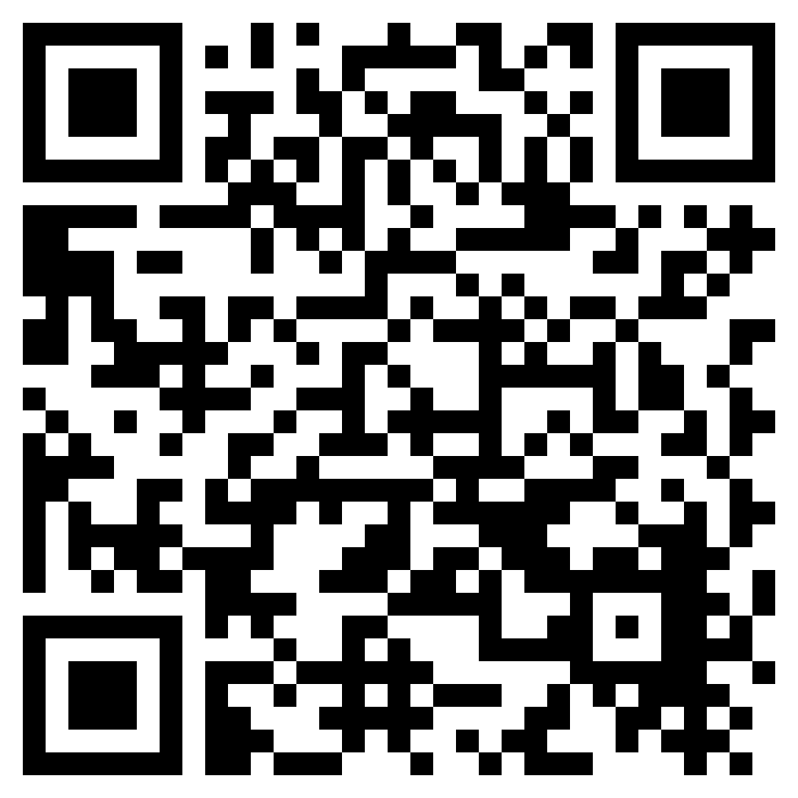
Leadership-specific resources
One of our suite of Review Guides
Use to self-evaluate governance for SEND at individual school or MAT level
Find all our Review Guides in the ‘Resources and publications’ area
https://www.wholeschoolsend.org.uk/resources/send-governance-review-guide

Slide 18
Leadership-specific resources
One of our suite of Review Guides
Use to help you evaluate the role of your SENCO/inclusion leader
Can help you ensure that the SENCO role is strategic
Search ‘SENCO’ in ‘Resources and publications’
https://www.wholeschoolsend.org.uk/resources/effective-senco-deployment

Slide 19
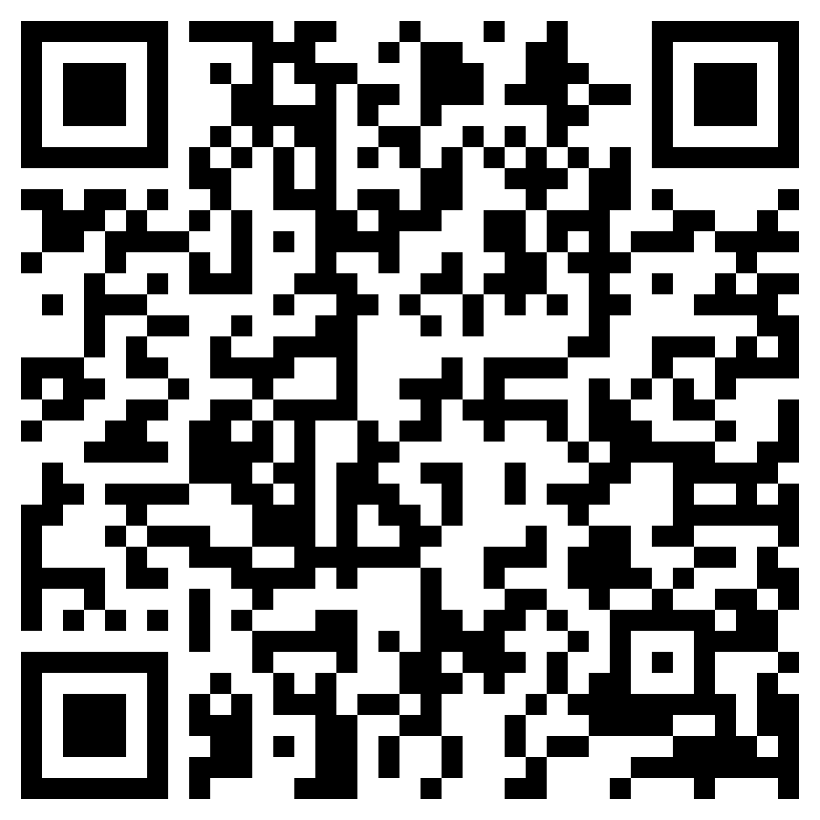
Leadership-specific resources
One of our suite of Review Guides
Use to evaluate how effectively support staff are being deployed
Find all our Review Guides in the ‘Resources and publications’ area
https://www.wholeschoolsend.org.uk/resources/teaching-assistant-deployment-review-guide

Slide 20
Specialist provision area
Special schools and other specialist providers share their effective resources
Find in ‘Resources and publications’
https://www.wholeschoolsend.org.uk/specialist-provision-area

Slide 21
Autism Resource Suite
Search ‘Autism’ in ‘Resources and publications’
https://www.wholeschoolsend.org.uk/resources/autism-resource-suite

Slide 22
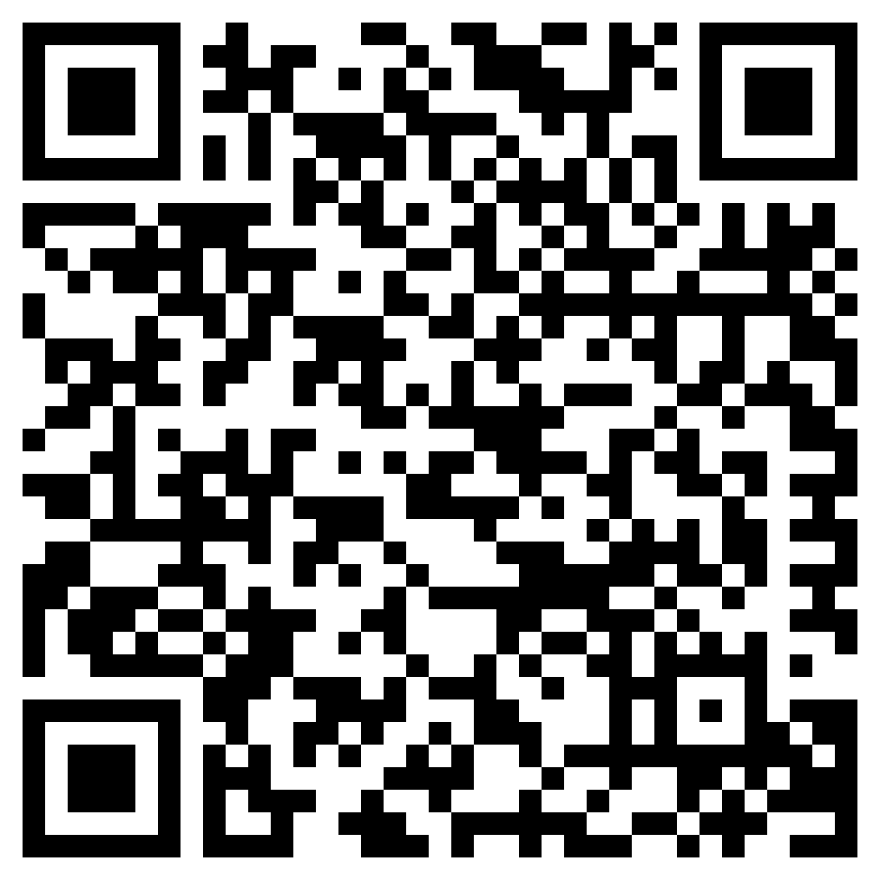
SENCO-specific resources
Perfect for new SENCOs to give an overview of the role
Lots of links to essential and useful information
Can support you to help ensure that other school leaders understand the role of SENCO
Search ‘SENCO’ in ‘Resources and publications’
https://www.wholeschoolsend.org.uk/resources/senco-induction-pack-revised-edition

Slide 23
Resources to support the wider staff team
Your essential interactive companion to support staff with understanding their role in effective practice for SEND
Sections include:
Knowledge of the learner,
planning inclusive lessons,
creating an inclusive environment,
subject-specific guidance,
graduated approach
strategies to scaffold learning
Find in ‘Resources and publications’
https://www.wholeschoolsend.org.uk/teacher-handbook

Slide 24
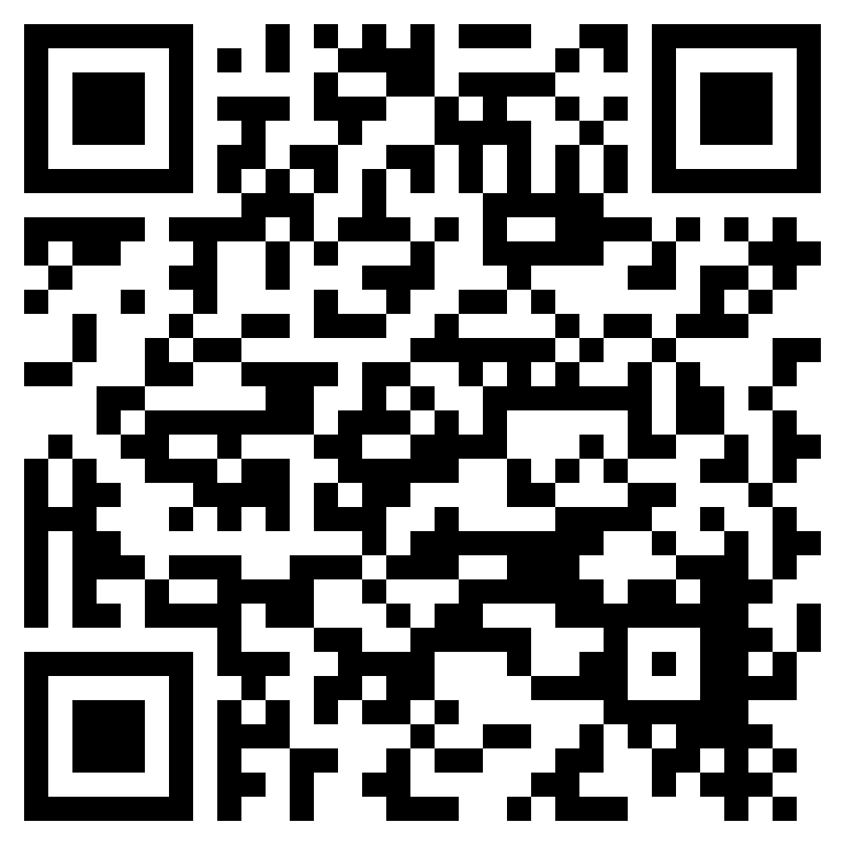
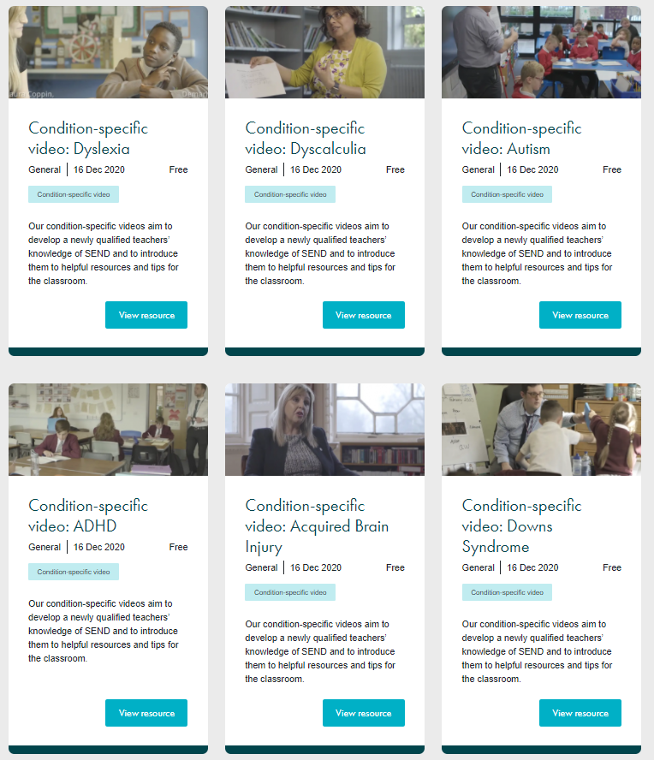
Resources to support the wider staff team
Condition-specific videos
Find in ‘Resources and publications’
https://www.wholeschoolsend.org.uk/page/condition-specific-videos

Slide 25
Resources to support the wider staff team
‘What works’
Organised under the four Broad Areas of Need
Find information and links at universal, targets and specialist levels
Use to help develop a continuum of provision
Find on the home page and in ‘Resources and publications’
https://www.wholeschoolsend.org.uk/page/what-works

Slide 26
ENTER HERE

Slide 27
Teaching
Assistant
Initial
Teacher
Training
Early
Career
Teacher
Teacher
Middle Leader
Senior
Leader
Head Teacher
SENCo
Exec Leader
TARGETED
Teaching
Assistant
Initial
Teacher
Training
Early
Career
Teacher
Teacher
Middle Leader
Senior
Leader
Head
Teacher

Slide 29
Ambitious About Inclusion Ambitious About Inclusion - Online Learning | Whole School SEND

Slide 30
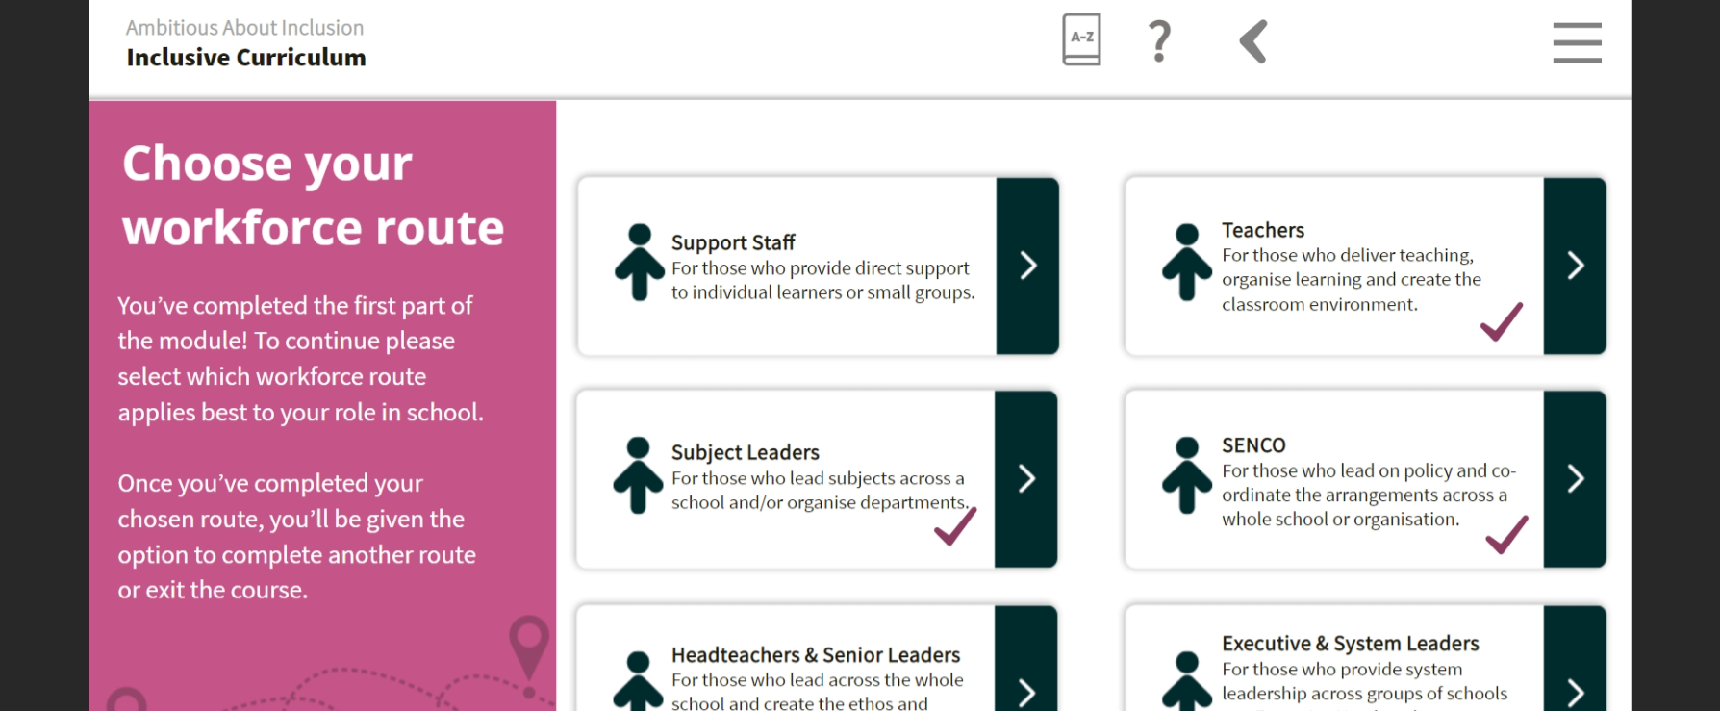
Ambitious About Inclusion Ambitious About Inclusion - Online Learning | Whole School SEND

Slide 31
Online SEND CPD Units & Live Sessions https://www.wholeschoolsend.org.uk/page/online-cpd-units

Slide 34
Find out more and join our member community
Stay in touch
rsl.emsyh@wholeschoolsend.co.uk
drsl.emsyh@wholeschoolsend.co.uk
drsl3.emsyh@wholeschoolsend.co.uk
@WholeSchoolSEND
@WSSemsyhumber
Whole School SEND
www.wholeschoolsend.org.uk
Whole School SEND

