Slide 1
Introduction to the EHC hub
Working smarter for better outcomes
Notes:
Template instructions This is the opening slide to your Powerpoint presentation. The main image should be changed to something that is relevant to your presentation. To do this, click on the image and press ‘Delete’ on your keyboard. Then click on ‘Insert’ in the menu at the top of the screen, then select ‘Picture’. In the new window that appears, choose your image and click the ‘Insert’ button. Your picture will appear on the slide – make sure it is enlarged to fit the whole slide by moving the picture to the top left and then click and drag the bottom right dot on the corner of the picture to the right hand side of the slide. You should ensure that the picture is of good quality and is not distorted by re-sizing it. Now, select the image by right-clicking on it. In the menu that appears, select ‘Send to back’ to position your picture behind the council’s logo. You can now delete these comments.

Slide 2
EHC Hub: an innovative digital platform for families, professionals and education settings to engage, contribute and collaborate on EHC assessments, plans
and reviews.

Slide 3
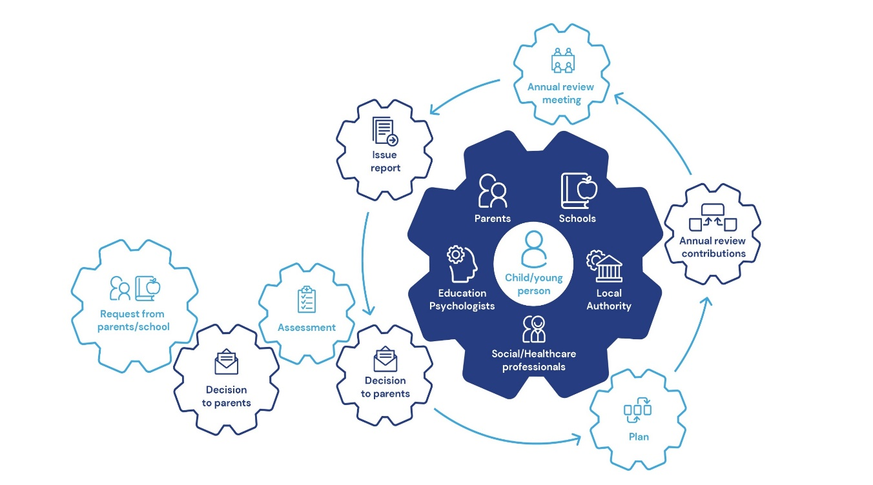
Driving digitisation into EHC plans and processes
Automated workflow to manage EHC plans and processes that create efficiencies, improve productivity and save time.
A digital portal that transforms communication so families, education settings and professionals can collaborate on assessments, plans and reviews.

Slide 4
Designed to address the key challenges A vehicle for cultural change – true digital transformation
Ensuring that the child or young person is at the centre of everything we do
Efficient information recording and supporting The Golden Thread
A truly collaborative approach: secure and easy multi-agency working
Supporting compliance whilst driving practice development
Process and decision transparency:clear, accessible and timely information for all stakeholders
A robust and effective EHCP review process with clear outcome measurement

Slide 5
A Hub for
Young people and families….
Putting children, young people, and families at the heart of the EHC process

Slide 6
A Hub for young people and their families
Online EHC needs assessment request
Document/Information upload areas throughout the process
24/7 access to real-time case tracking
Transparent statutory decisions and timeframes
Clear & accessible guidance and contextual information at each stage
Engaging multimedia spaces for input into assessment, planning & review
Automated email notifications at every stage
Unique case timeline to view all case activity

Slide 7
A Hub for
Efficient and secure multi-agency working that drives better practice

Slide 8
Working smarter
Online EHC needs assessment request pathway
Smart case search and filter dashboard – Easy case tracking & reporting
Automated statutory case timeframes with proactive alerts
Case timeline and chronology & transparent case notes
Panel/meeting module for easy and secure information sharing
Smart professional advice pathway – easy & secure advice requests for assessment and review
EHC Plan builder with family and & education setting consultation
Fully transparent EHCP review pathway and tracker
Supports remote working

Slide 9
A Hub for
Supporting children and young people to achieve their outcomes

Slide 10
Supporting settings and SENCOs
EHC needs assessment request pathway with document/ information upload
Smart case search and filter dashboard – Easy case tracking
Proactive email alerts & notifications
Online EHCP review pathway with clear outcome measurement
Visibility for SENCOs, teachers and headteachers
A support tool for engaging with children, young people and their families
EHCP Consultation pathway

Slide 11
My Cases Dashboard

Slide 12
Multi-media engagement spaces

Slide 13
Smart assessment pathway

Slide 14
Request for EHCNA

Slide 15
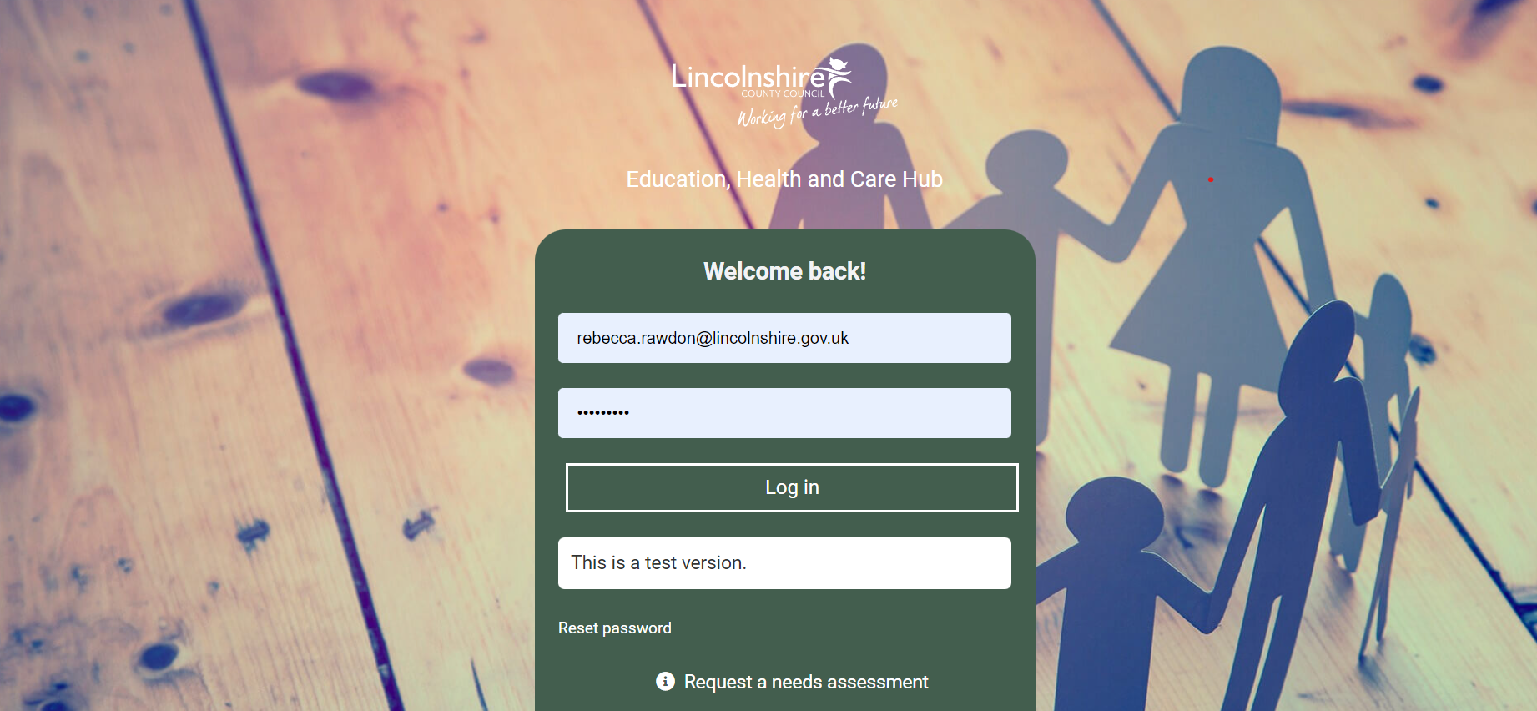
EHC Hub:
Transforms and enhances ways of working
A new way to engage and collaborate with parents.

Slide 16
Workshop
A workshop session to look at the new request format within the EHC Hub and a draft chronology document.
Opportunity to discuss what should be included to help inform the guidance notes that will come out for the request section of the EHC Hub.

