Slide 1
Developing a positive behaviour ethos and how the p.r.t. can support
Karen Richardson

Slide 2
Background and challenges in lincolnshire
In Term 1 - Increased suspensions
- Increased Permanent Exclusions
Rise in pupils with SMEH needs
Rise in more complex needs
Concerns for schools around funding and staffing

Slide 3
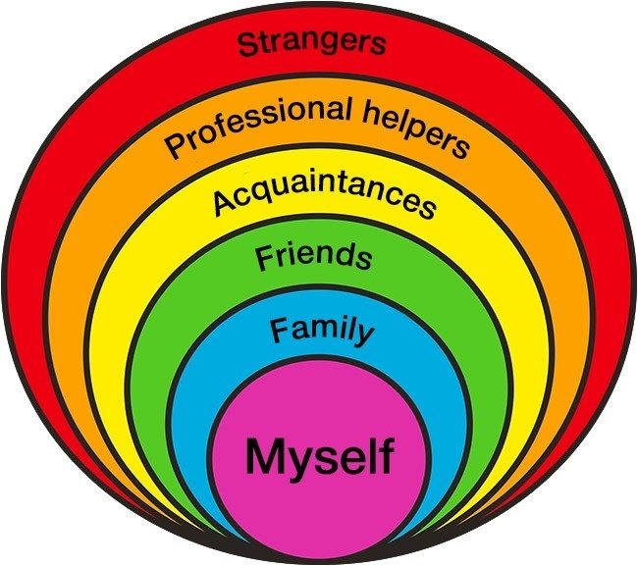
Post covid considerations
Socialisation
Missing school
Chaotic homelives – increase in domestic violence and relationship break ups
Significant input into children’s lives missing i.e. friends, acquaintances, professionals, strangers
Anxiety
Delay in gross and fine motor skills
Effect on young children – facial recognition and understanding of play conventions
Continuity of staff in school/ availability of staff
Increase in poverty

Slide 4
Pupil Voice Youth voice on school exclusions | The Children's Society (childrenssociety.org.uk)

Slide 5
Developing and building Relationships is a key element of addressing issues

Slide 6
Why?
The need for a continued focus on the promotion and development of positive relationships and behaviour in order to improve a school’s ethos and culture.
A positive school ethos and culture (sometimes described in research as ‘climate’) is essential to developing good relationships and positive behaviour in the classroom, playground and wider community.
Research also indicates that schools, where attainment is higher than expected for their catchment area, demonstrate positive relationships throughout the school community and that children and young people are involved meaningfully in decisions which affect them at all levels of the school.
Developing a positive whole-school ethos and culture – Relationships, Learning and Behaviour – Scottish Government 2018

Slide 7
School Safety bubble
Peers
Teachers
Caretaker
CHILD /YP
Senior Leaders
Office Staff
TAs
ELSA
Lunch Time Staff

Slide 8
Relationships and support outside school
Caring2
Learn
Training
Auditing Provision
Awards
BOSS
Training
Support and advice
PRT
Support
Behaviour Ladder
Intervention Placements
EBSA Pathway
Funding for PSP Support
ASK Sall
Signposting
Advice
EP referral
TWTT
Support and advice
Training

Slide 9
Lincolnshire’s SEMH Strategy 2023-26 Co-produced with Lincolnshire Parent Carer Forum (LPCF) and wide range of stakeholders across health, early years’ providers, mainstream and special schools, post-16 providers and local authority staff. Found at Lincolnshire’s Local Offer: www.lincolnshire.gov.uk/support-education/lincolnshire-semh-strategy

Slide 10
Why do we need a SEMH Strategy?
National and Local aim – high quality support in schools to meet cyp’s needs within mainstream education; SEND reforms 2014, SEND/AP review 2022, Lincolnshire’s Transformation & HN Strategy.
Lincolnshire = higher % of pupils requiring SEN Support (12.6%/12.0%) & % of EHC plans (4.2%/3.6%) against national average.
Lincolnshire = less % of pupils with SEMH educated in mainstream schools (England average = 0.2% more pupils with SEMH in mainstream primary schools & 5.5% more in mainstream secondary schools than Lincolnshire)
Lincolnshire = higher percentage of pupils in Lincolnshire with SEMH needs in special schools than the England average (23.5%/12.7%).

Slide 11
How are we going to do this?
Collective understanding and assumption that inclusive education is cyp educated alongside peers in mainstream classroom for majority of school day.
Positive outcomes for cyp as result of inclusion well documented, leading to increased social, academic, employment and life opportunities.
Aim for improved inclusive education, acknowledge that at times a small number of children will require more specialist support and provision.
Access specialist support as/when required. Continuum of provision that builds emotional resilience & well-being. Enabling return to mainstream provision, resulting in improved & increased positive achievements and outcomes.
View inclusive education outside a deficit model that focusses on inadequacies. Instead, focus on existing successful inclusive support & practices, developed to remove barriers.

Slide 12
How are we going to do this?
FIVE ELEMENTS
Development of the Emotional Based School Avoidance (EBSA) pathway.
Embed and develop training / support offer.
Transitions.
Provision used as a continuum of support.
Review of Alternative Provision in Lincolnshire.

Slide 13
What do we want to achieve?
Reduced suspensions and permanent exclusions;
Improved attendance, part-time timetables only used temporarily as short-term solution in very exceptional circumstances;
Reduced reliance & demand on SEMH specialist support/provision, including specialist settings, AP, and specialist mental health.
SEMH needs met at local mainstream setting with support tailored to individual needs, enables positive choices and outcomes and feel they belong in their school & local community.
Flexible, proactive, & coherent planning across transitions provides cyp and families with support & confidence as move between various phases / stages of education &, eventually, into adulthood.

Slide 14
Any Questions

