Slide 1
Lincolnshire Young Voices
Launches: A Rough Guide to
Not Putting Your Foot In It!

Slide 2
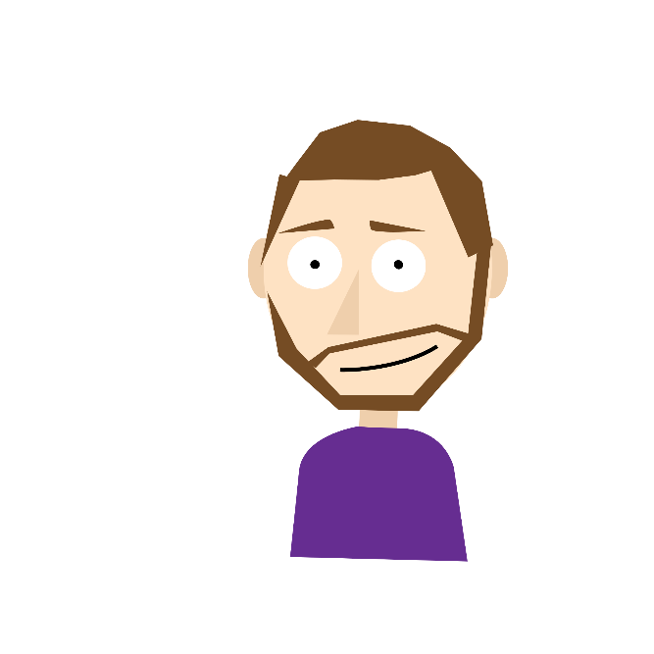
In the next hour
Who are Lincolnshire Young Voices?
Why ‘A Rough Guide to Not Putting Your Foot in It’ exists.
Launch of the resource!
How can this help you – time to sign up!
Your questions for the Committee.

Slide 3
Who we are!
A pan-disability participation committee, funded by Lincolnshire County Council and backed be NHS Lincolnshire CCG
Researching and acting upon issues faced by young people with SEND.
Comprising of 10 devoted, driven young people who collaborate with services in multiple sectors to raise awareness of SEND and inspire change.
Credit: Sian Hutchings [at our
2018 Launch]

Slide 4
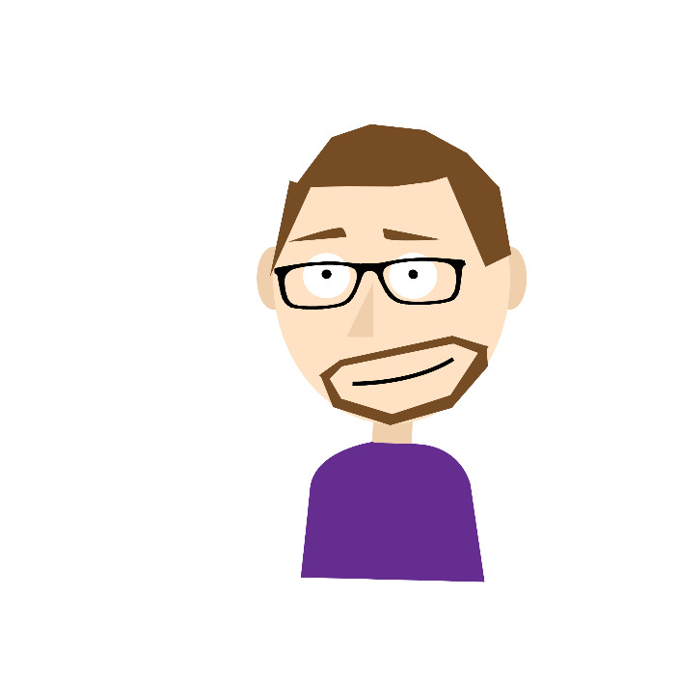
The background
The pandemic changed the way we all communicated.
98.3% of GPs said they wanted further training on working with CYP with SEND.
We combined the shift in how we communicate with the ask for more resources.
‘A Rough Guide to Not Putting Your Foot In It’ was created.
Using our expert knowledge, we developed an interactive e-learning programme for everyone!

Slide 5
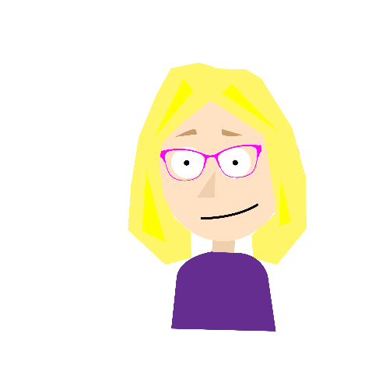
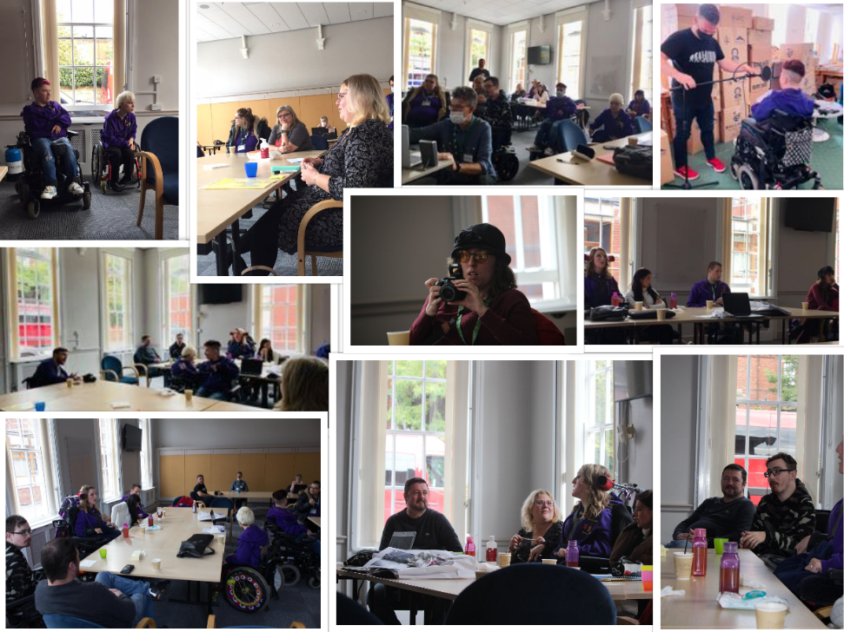
Putting a plan into action
Designed the resource to:
Boost your confidence to communicate with people with SEND by…
Debunking myths and demystifies what it means to have a disability.
Developing ‘This Is Me’ communication tool to give everyone a starting point for conversation.
Demonstrating that we have a voice and that we understand that we all put our foot in it, sometimes!
It’s what you do to avoid it and how you rectify it if you do.

Slide 6
We have lift-off

Slide 7
Any questions?

Slide 8
SEND is everyone’s business
Help us embed ‘A Rough Guide to Not Putting Your Foot In It’ into training everywhere!
Lincolnshire Safeguarding Children Partnership
Lincolnshire Safeguarding Adults Board
Email us to start a conversation within your organization.
Share it across your team and wider networks.

Slide 9
Thank You!
@Lincs_YV
Lincolnshire Young Voices
Website: https://www.lincolnshire.gov.uk/youngvoices
Email: LincolnshireYoungVoices@lincolnshire.gov.uk

