Slide 1


Putting Children First
Notes:
Template instructions
This is the opening slide to your Powerpoint presentation.
The main image should be changed to something that is relevant to your presentation. To do this, click on the image and press ‘Delete’ on your keyboard. Then click on ‘Insert’ in the menu at the top of the screen, then select ‘Picture’. In the new window that appears, choose your image and click the ‘Insert’ button. Your picture will appear on the slide – make sure it is enlarged to fit the whole slide by moving the picture to the top left and then click and drag the bottom right dot on the corner of the picture to the right hand side of the slide. You should ensure that the picture is of good quality and is not distorted by re-sizing it. Now, select the image by right-clicking on it. In the menu that appears, select ‘Send to back’ to position your picture behind the council’s logo. You can now delete these comments.

Slide 2


Lincolnshire
Working Better, Together
November 2022
Michelle White SEND Team Manager
Notes:
An explanation why we have set up the briefings to ‘work together to ensure the needs are met of SEND CYP in county – share knowledge/ understand mutual issues and collectively provide solutions

Slide 3



This Photo by Unknown Author is licensed under CC BY
Notes:
A thank you to Governors for undertaking their voluntary positions as SEND champions in school – discuss how important their role is to ensure children with SEND enjoy and achieve in line with their peers. The 1 hr session focuses on the important role of the SEND Governor and how we can work as a collective team across the county to ensure progress and raise aspirations and achievements. We will share information, ensure a collective understanding of supporting CYP with SEND and hopefully answer any questions and look at future working and support. pLease emphasise the session is not a test it is a safe environment to share any concerns – ideas – successes.

Slide 4
Lincolnshire’s Inclusive Ambition
The strategy has been developed following a review of our high needs provision in Lincolnshire in partnership with a wide range of stakeholders, including young people, parents, early years’ providers, schools and post-16 providers, as well as local authority staff working in collaboration with Impower consultancy. Together, we have defined our inclusive ambition:
1. Children and young people, parent/carers and professionals will have a strong understanding of the graduated approach and support available in Lincolnshire. Children and families will feel supported by their community and have confidence with the SEND system, because the right support is provided at the right time.
2. Mainstream settings have strong knowledge and understanding of supporting children with additional needs and are able to use sophisticated ways to teach social and emotional skills. Settings are able to work together with families to ensure that the home environment reflects the support taking place within the school practice, in order to best meet a child or young person’s needs.
3. We will move away from exclusions to recognise that behaviour is a communication of need. In response to this need professionals are able to wrap services around a child, helping to meet their need in an inclusive way.
4. We will have high aspirations for our children and young people with additional needs, using plans to help meet needs and achieve outcomes, meaning higher academic achievement, increased personal resilience, increased socialisation and more resilient adults after education.

Slide 5
SEND in England
The total number of Education, Health and Care (EHC) plans has continued to increase
The number of children and young people with EHC plans increased to 473,300, as at January 2022. This has increased each year since 2010.
The number of new EHC plans made in the calendar year has also continued to increase
62,200 new EHC plans were made during 2021. The number of new EHC plans has increased each year since their introduction in 2014.
The number of initial requests for an EHC plan increased during the calendar year, continuing the long-term trend of increases
There were 93,300 initial requests for an EHC plan during 2021, up from 76,000 in 2020. Apart from a decrease in 2020, initial requests have increased each year since EHC plans were introduced.

Slide 6
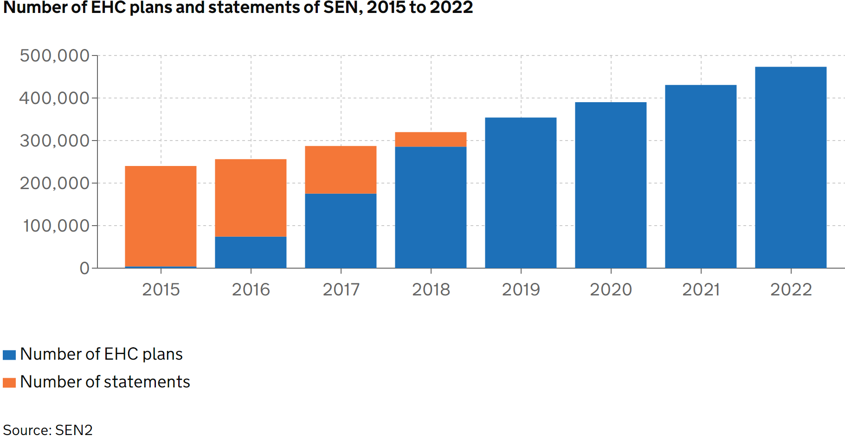

SEND in ENGLAND
The number of Education, Health and Care plans has continued to increase
There were 473,300 children and young people with Education, Health and Care (EHC) plans as at January 2022. This is an increase of 10% from 430,700 as at January 2021. This follows similar increases in recent years.
The combined total of children and young people with statements and EHC plans has increased each year since 2010. EHC plans were introduced from September 2014. The period for local authorities to transfer children and young people with statements of SEN to EHC plans started in September 2014 and ended on 31 March 2018, as such we no longer see statements of SEN in the total.

Slide 7
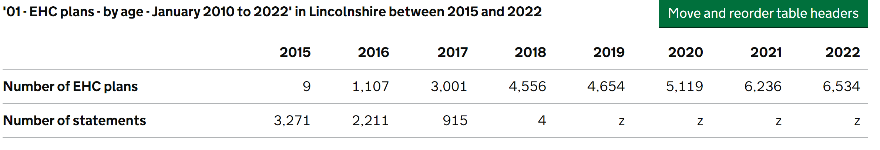
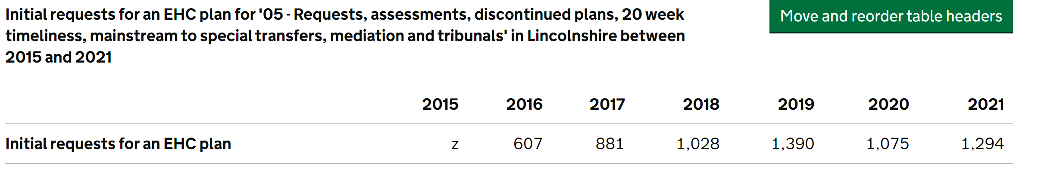
SEND in Lincolnshire
Number of Requests
There were 76,000 initial requests for an EHC plan in England during 2020, down from 82,300 in 2019 and the first decrease since EHC plans were introduced. This is an 8% decrease on the previous year. Lincolnshire saw a 23% reduction in 2020

Slide 8
Lincolnshire, as per the national picture, is seeing an increase in the number of children educated in special rather than mainstream schools. However, concerningly, we are seeing a significant discrepancy in relation to children with SEMH needs. The England average sees 0.2% more pupils with SEMH needs in mainstream primary schools and 5.5% more in mainstream secondary schools than Lincolnshire. There is a significant 10.8% higher percentage of pupils in Lincolnshire with SEMH needs in special schools (more than double) than the England average. This is the first time, since the introduction of the SEND reforms, that the highest primary need in Lincolnshire’s special schools is defined as SEMH; nationally, it ranks third behind Autistic Spectrum Disorder and Specific Learning Difficulty. SEMH as the primary need ranks second in independent sector placements in Lincolnshire behind Autistic Spectrum Disorder (38% v 46%). This is placing unsustainable pressure on our specialist settings.
DfE Local area SEND report England 2020/21

Slide 9
In the academic year 2020/21 16.9% of Lincolnshire pupils had an identified special educational need compared to 15.9% across All English authorities.
Notes:
Governing boards of mainstream schools must ensure that a member of staff is designated as the SENCO.
The SENCO must be a qualified teacher working at the school. A newly appointed SENCO who has not previously been the SENCO at that or any other relevant school for a total period of more than twelve months must achieve the National Award in SEN Co-ordination within three years of appointment.
Governing boards of mainstream schools must ensure that a member of staff is designated as the SENCO
The governing board should ensure that the SENCO’s key responsibilities are outlined and monitor how effectively they are carried out.
This is set out in paragraph 6.84 on page 108 of the SEND Code of Practice, linked to above.

Slide 10
In 2021, 4.2% of Lincolnshire pupils had an EHC Plan compared to 3.8% across All English authorities. This is an increase both locally (up from 3.5%) and nationally (up from 3.4%).
Notes:
Governing boards of mainstream schools must ensure that a member of staff is designated as the SENCO.
The SENCO must be a qualified teacher working at the school. A newly appointed SENCO who has not previously been the SENCO at that or any other relevant school for a total period of more than twelve months must achieve the National Award in SEN Co-ordination within three years of appointment.
Governing boards of mainstream schools must ensure that a member of staff is designated as the SENCO
The governing board should ensure that the SENCO’s key responsibilities are outlined and monitor how effectively they are carried out.
This is set out in paragraph 6.84 on page 108 of the SEND Code of Practice, linked to above.

Slide 11
12.6% of Lincolnshire pupils receive SEN Support compared to 12.2% across all English authorities. For Lincolnshire this is a drop in number as there were 13.3% of pupils in 2019/20 receiving SEN Support. Nationally, the number has remained the same.
Notes:
Governing boards of mainstream schools must ensure that a member of staff is designated as the SENCO.
The SENCO must be a qualified teacher working at the school. A newly appointed SENCO who has not previously been the SENCO at that or any other relevant school for a total period of more than twelve months must achieve the National Award in SEN Co-ordination within three years of appointment.
Governing boards of mainstream schools must ensure that a member of staff is designated as the SENCO
The governing board should ensure that the SENCO’s key responsibilities are outlined and monitor how effectively they are carried out.
This is set out in paragraph 6.84 on page 108 of the SEND Code of Practice, linked to above.

Slide 12
There was a 9.9% increase nationally in the overall number of EHC Plans (from 2020) whilst in Lincolnshire the increase was lower at 4%. In January 2022 (SEN2 reporting date), Lincolnshire held 6534 EHC Plans.
Notes:
Governing boards of mainstream schools must ensure that a member of staff is designated as the SENCO.
The SENCO must be a qualified teacher working at the school. A newly appointed SENCO who has not previously been the SENCO at that or any other relevant school for a total period of more than twelve months must achieve the National Award in SEN Co-ordination within three years of appointment.
Governing boards of mainstream schools must ensure that a member of staff is designated as the SENCO
The governing board should ensure that the SENCO’s key responsibilities are outlined and monitor how effectively they are carried out.
This is set out in paragraph 6.84 on page 108 of the SEND Code of Practice, linked to above.

Slide 13
There were 93,302 initial requests for an EHC plan in England in 2021 which was a 23% increase from 2020. In Lincolnshire, the local authority received 1294 requests for an EHC Plan which was a much lower increase than nationally, at 3%.
Notes:
Governing boards of mainstream schools must ensure that a member of staff is designated as the SENCO.
The SENCO must be a qualified teacher working at the school. A newly appointed SENCO who has not previously been the SENCO at that or any other relevant school for a total period of more than twelve months must achieve the National Award in SEN Co-ordination within three years of appointment.
Governing boards of mainstream schools must ensure that a member of staff is designated as the SENCO
The governing board should ensure that the SENCO’s key responsibilities are outlined and monitor how effectively they are carried out.
This is set out in paragraph 6.84 on page 108 of the SEND Code of Practice, linked to above.

Slide 14
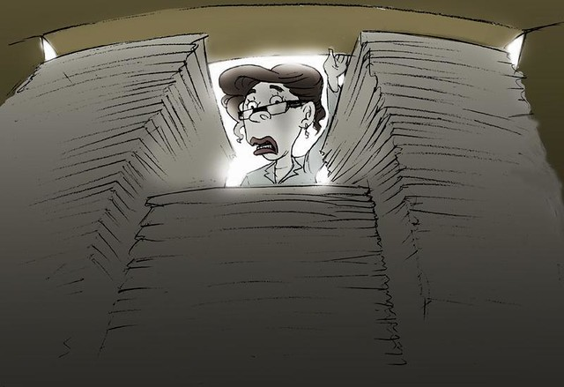
Notes:
Governing boards of mainstream schools must ensure that a member of staff is designated as the SENCO.
The SENCO must be a qualified teacher working at the school. A newly appointed SENCO who has not previously been the SENCO at that or any other relevant school for a total period of more than twelve months must achieve the National Award in SEN Co-ordination within three years of appointment.
Governing boards of mainstream schools must ensure that a member of staff is designated as the SENCO
The governing board should ensure that the SENCO’s key responsibilities are outlined and monitor how effectively they are carried out.
This is set out in paragraph 6.84 on page 108 of the SEND Code of Practice, linked to above.

Slide 15
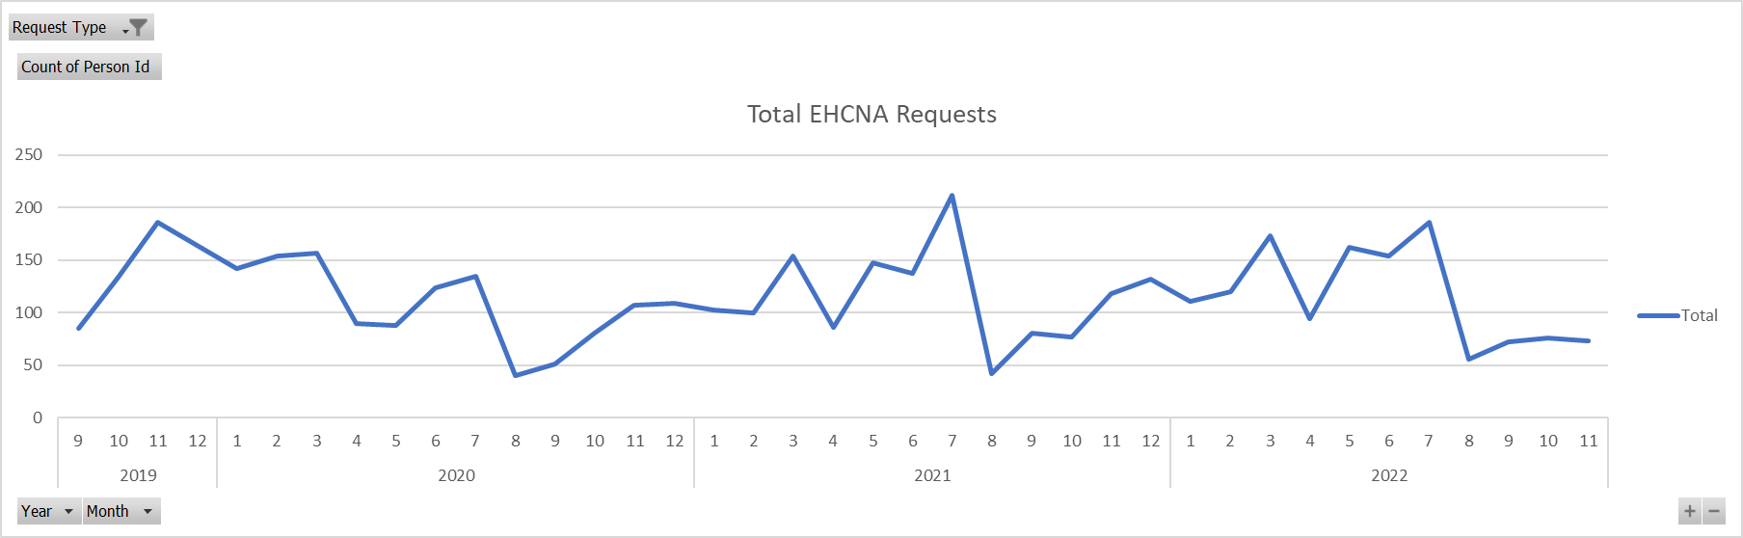
EHCA Requests
Notes:
Governing boards of mainstream schools must ensure that a member of staff is designated as the SENCO.
The SENCO must be a qualified teacher working at the school. A newly appointed SENCO who has not previously been the SENCO at that or any other relevant school for a total period of more than twelve months must achieve the National Award in SEN Co-ordination within three years of appointment.
Governing boards of mainstream schools must ensure that a member of staff is designated as the SENCO
The governing board should ensure that the SENCO’s key responsibilities are outlined and monitor how effectively they are carried out.
This is set out in paragraph 6.84 on page 108 of the SEND Code of Practice, linked to above.

Slide 16
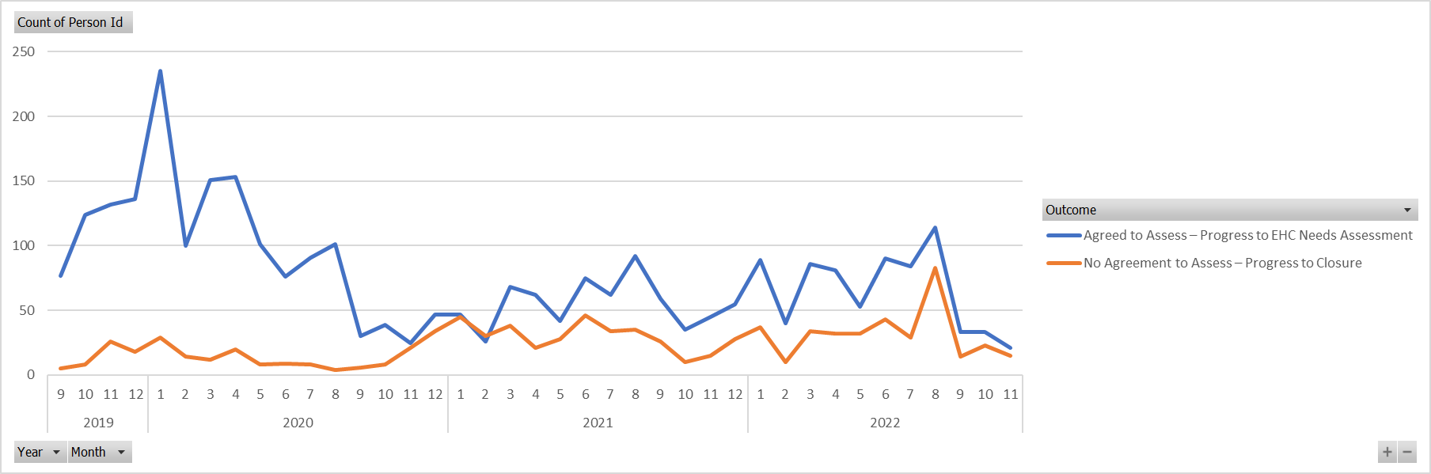
EHCA request decisions
Notes:
Governing boards of mainstream schools must ensure that a member of staff is designated as the SENCO.
The SENCO must be a qualified teacher working at the school. A newly appointed SENCO who has not previously been the SENCO at that or any other relevant school for a total period of more than twelve months must achieve the National Award in SEN Co-ordination within three years of appointment.
Governing boards of mainstream schools must ensure that a member of staff is designated as the SENCO
The governing board should ensure that the SENCO’s key responsibilities are outlined and monitor how effectively they are carried out.
This is set out in paragraph 6.84 on page 108 of the SEND Code of Practice, linked to above.

Slide 17
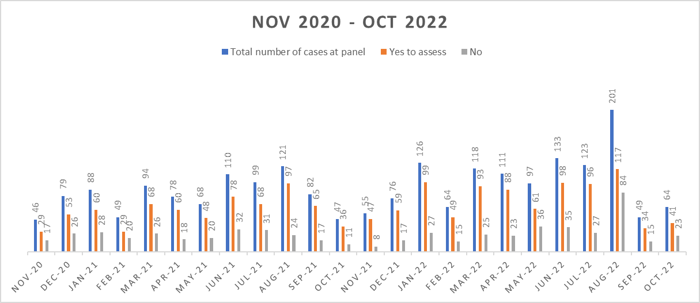
EHCA request decisions
Notes:
Governing boards of mainstream schools must ensure that a member of staff is designated as the SENCO.
The SENCO must be a qualified teacher working at the school. A newly appointed SENCO who has not previously been the SENCO at that or any other relevant school for a total period of more than twelve months must achieve the National Award in SEN Co-ordination within three years of appointment.
Governing boards of mainstream schools must ensure that a member of staff is designated as the SENCO
The governing board should ensure that the SENCO’s key responsibilities are outlined and monitor how effectively they are carried out.
This is set out in paragraph 6.84 on page 108 of the SEND Code of Practice, linked to above.

Slide 18

This Photo by Unknown Author is licensed under CC BY-SA-NC
Notes:
A baseline of knowledge to help us share information – to supporta collective understanding of our joint work. Acknowledge we may be at different levels in our understanding No need to share answers…..

