Slide 1
Graduated Approach Briefings
November 2022
Notices

Slide 2
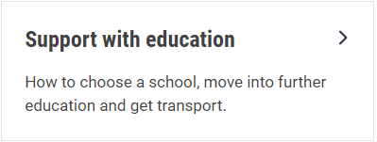
Welcome
To locate information about the Graduated Approach Briefings on the Local Offer, go to: https://professionals.lincolnshire.gov.uk/homepage/54/graduated-approach-briefings
Or on the Home Page, click on: Support with Education
Then scroll down to: Graduated Approach Briefings
Welcome and thank you for joining us for this virtual training session.
Please sign in through the Chat to register your attendance.
As usual, to support everyone to maintain connectivity with so many attendees being here:
Please Mute your microphone and turn off your video when not speaking – we have a large number of participants present today and this may mean that we experience feedback or slowing of the network connection if everybody has their microphone and video on. However, we would like to see you if you ask a question, please, so feel free to switch on both your microphone and video in these instances.
Please note that this meeting, or sections of it, will be being recorded for use on the council’s professionals’ website. If you do not wish to be recorded, you should leave the meeting and watch it back later.
If you would like to ask questions, please use the raise your hand facility or use the chat function in Teams
Please keep discussion in the ‘chat’ relevant – the person presenting may not be able to see your comments but we will have someone monitoring it in order to make sure all questions are answered.

Slide 3
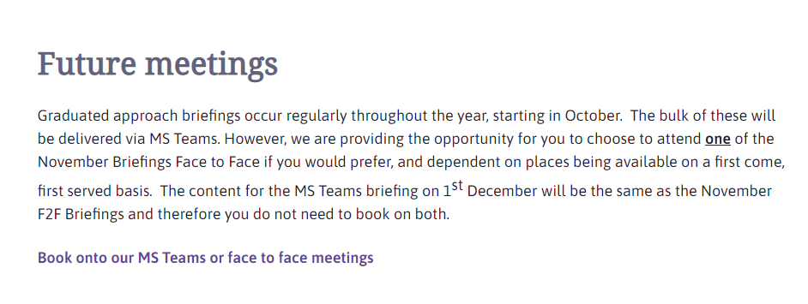
Remember to book your places for each briefing throughout the year on the Local Offer
Graduated approach briefings – Professional resources (lincolnshire.gov.uk)

Slide 4
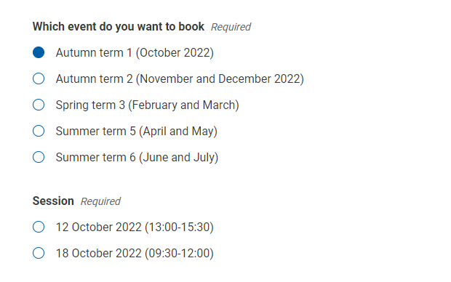
Book one briefing for each term
When you select a term, the options for each for the two available sessions for that term become visible. The content is the same at each – just choose the most convenient.

Slide 5
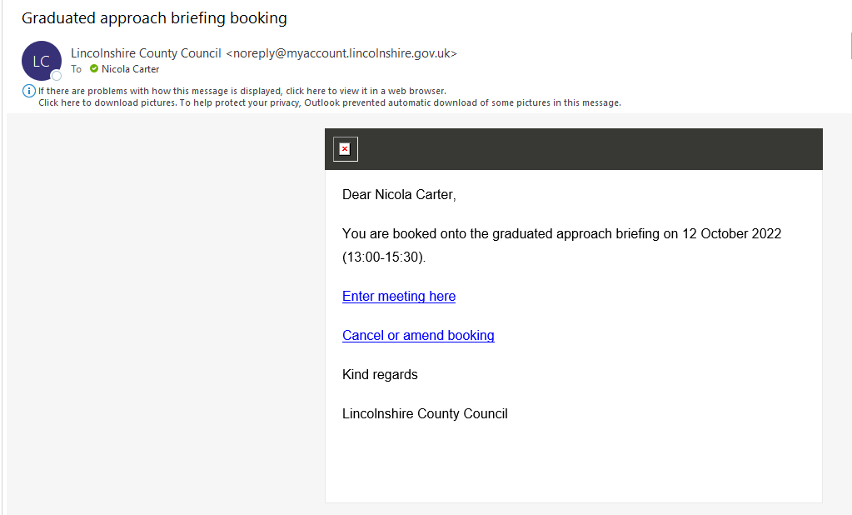
Booking link arrives about an hour after booking
Please save the email straight away in your Graduated Approach Briefings folder! However, if you don’t do this, there should be a reminder email a week before and, failing that, search your in-box for ‘Graduated approach briefing booking’ or ‘Lincolnshire County Council’. If you have any questions or concerns, please contact BS_SEND@lincolnshire.gov.uk and they will be able to help.

Slide 6
Presentations and Videos will be available from 6th December
Remember to visit the Graduated Approach Briefings page on the Local Offer so that you can view the presentations and videos for this round of briefings and any from the previous academic year.
Graduated approach briefings – Professional resources (lincolnshire.gov.uk)

Slide 7
Mental Health review
Lincolnshire County Council and Lincolnshire Partnership NHS Foundation Trust (LPFT) are reviewing the services available locally and have launched a survey inviting children and young people, parents, carers and professionals to share their thoughts.
The feedback will be used to transform and improve services, helping children and young people to live independent, safe, healthy and fulfilling lives.
The survey can be found at www.letstalk.lincolnshire.gov.uk and runs to Sunday 18 December.
There are three versions of the survey, one for each of the following groups:
children and young people
parents and carers
professionals working with children that live in Lincolnshire

Slide 8
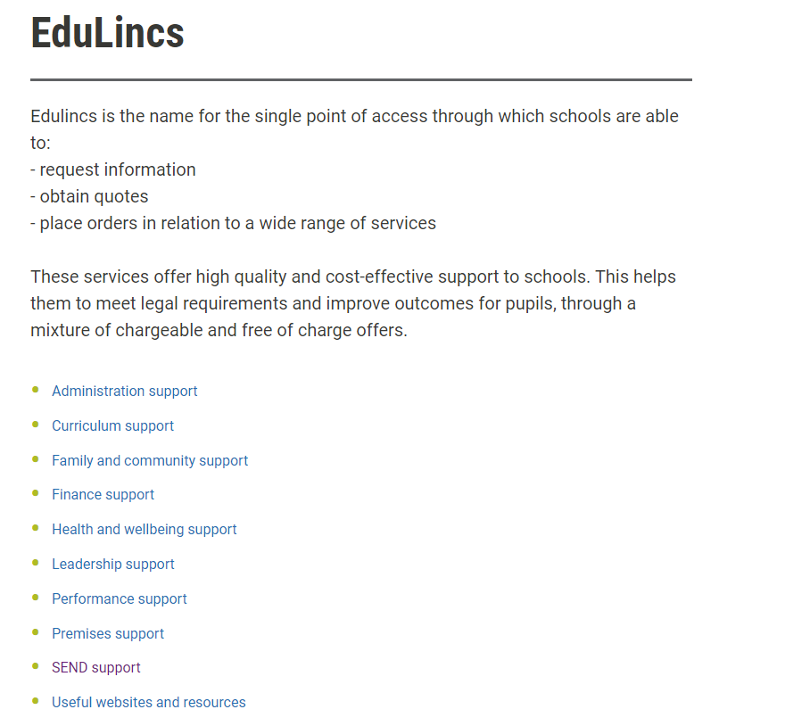
Edulincs Offers
EduLincs Homepage

