Slide 1
L.E.A.D. Teaching School Hub
Notes:
2.00 Welcome- Look at this room- how fortunate to be working together

Slide 2
Strategic Plan

Slide 3
Strategic Plan

Slide 4
Lead Teaching School Hub Website

Slide 5
Please share with:
Childminders
Nursery Settings

Slide 6
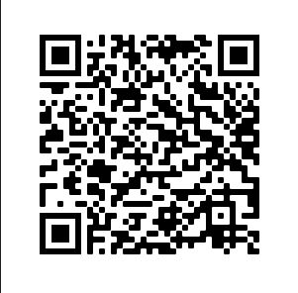

Slide 9
sSENS
Small Schools Special Educational Needs Support Programme
THE PROJECT WILL:
• Enable schools to identify areas for improvement within existing SEND, based on the findings
of a full and thorough audit and review of provision based on the London Challenge Model.
• Equip those supporting school improvements to review and create robust improvement plans
for SEND provision, with clear indicators for improvement.
• Help embed a focus on SEND into every day school improvement practices.
• Evaluate impact, notably with regard to embedding change in classroom practice and pupil outcomes.
Notes:
To refine and enhance the existing offer and develop a broader network

Slide 10
sSENS
Small Schools Special Educational Needs Support Programme
AS PART OF THE PROJECT SCHOOLS WILL RECEIVE:
An initial SEND review,
Support in writing an action plan
A mid-term checkpoint on development
An end of project review
Opportunity to participate in up to 10 core SEND specific webinars which can be viewed live by all school staff
Additional targeted CPD – Elkan & SEND in the Mainstream training
The launch event is on the 11th November. To find out more email enquiries@learnteachingcentre.co.uk or view the programme here https://bit.ly/3rOV9VG
Notes:
To refine and enhance the existing offer and develop a broader network

Slide 12
Notes:
Great teacher toolkit

Slide 14
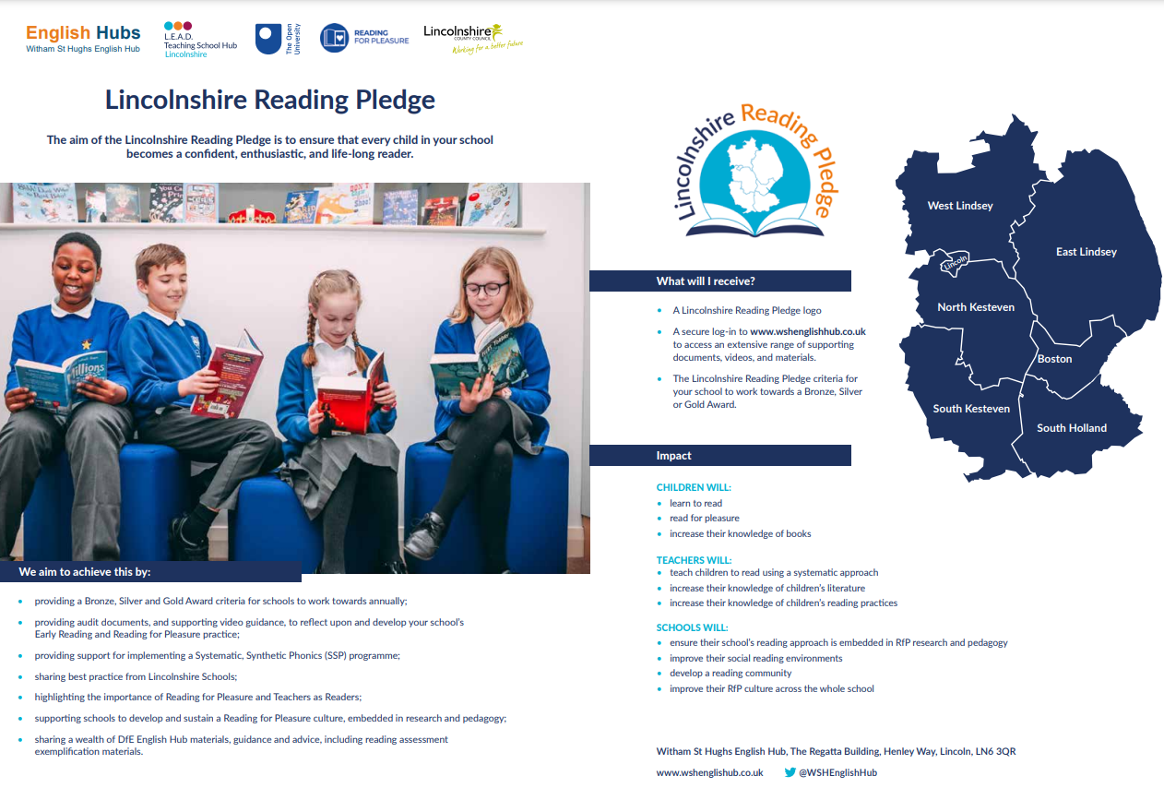
Notes:
½ schools in Lincolnshire- adding to that portal- looking maths pledge.

