Slide 1
The WTT Ladder
Notes:
Welcome and introduction.
This session is to build on the information we have already shared with SENCOs across the county about the new WTT ladder .

Slide 2
www.wtt.org.uk
Forms part of the Graduated Approach.
Evidences engagement with WTT support from Step 1
Provides an ongoing dialogue between setting/family and WTT about an individual’s differences and how the setting should support them.
Opportunity to reflect on and develop existing practice.
Focus on what adults will do to enable success for the child/young person.
Mainstream settings continue to have a WTT outreach teacher linked to their school/academy.
Ladder will capture all pupils-new and existing.
Notes:
Information sessions were held in July and Sept (sent to all mainstream SENCO contacts) and we spoke to over 200 schools this way who are now moving pupils onto the Ladder.
If you were unable to join those sessions, all of the information and a pre-recorded presentation is on our website under Outreach for Education.
A quick recap
Ladder is only for Lincs mainstream settings only.
Specialist settings, Independent and EY can access the central Training offer which can be found on our website

Slide 3
WTT Ladder-documenting engagement and utilisation of the service offer
No need to consult with WTT to start the Ladder (if unsure, talk to AskSALL first)
Planning meeting with WTT
Training workshop offer (Update AET MSA-essential)
Weekly Online helpline for queries about the new process
Support and information for parents/carers on website

Slide 4
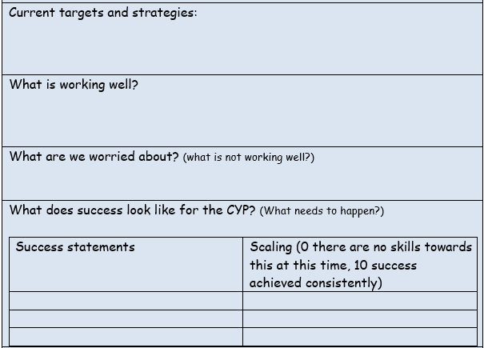
Ladder expectations
Graduated Approach targets should have a social communication focus (not purely academic)
Focus on child's strengths
Importance of pupil voice
WTT are commissioned to develop schools autism inclusive practice through the graduated approach and not a means to an end.

Slide 5
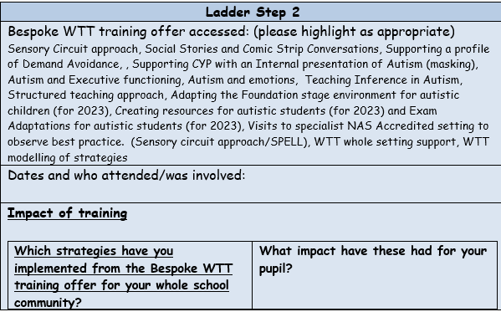
Ladder expectations
Ladder should be a reflective tool and show the journey of how a setting shapes their practice around the pupil.
Needs to be in Word-why? It is evidence of your graduated approach and a dialogue between yourselves and WTT-we all need to be able to add to the document.

Slide 6
Good practice so far ………
Describing what is working well and what the child’s strengths are.
SENCOs looking at the whole school overview.
What do those staff need to upskill/empower them to meet the needs of that pupil? Is it individual pupil support via the Ladder or actually an adult group/whole setting need?

Slide 7
Good practice so far ………
Positive language in success statements.
NOT x will not hit
BUT x will leave a situation that is making him cross (supported by adult prompts, social story, visual reminders, celebrating success etc)
Explaining how adult practice is already being adapted based on understanding of autism and the pupils unique profile.

Slide 8
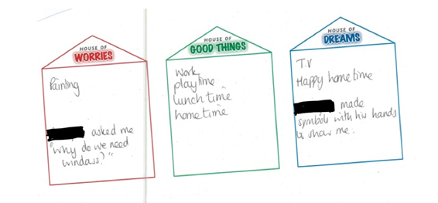
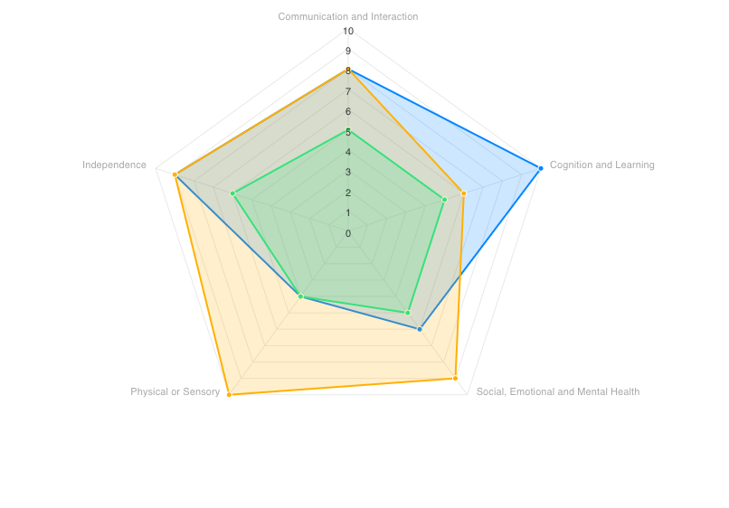
Good practice so far ………
Pupil voice
VSEND readiness radar

Slide 9
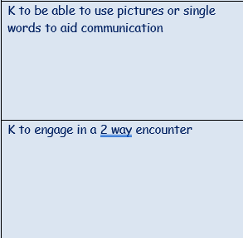
Good practice so far ………
Explained scaling
SC /Autism focused and measurable targets
Success statements | Scaling (0 there are no skills towards this at this time, 10 success achieved consistently)
x will make academic progress | 1 – Extremely limited progress has been made – he can count to 10 but needs support with 1:1 correspondence
X will maintain effective relationships with his peers | 0 – Although his peers are very understanding and want to help him, he is not yet able to take part in an age appropriate conversation
X will be able to comprehend age appropriate social situations | 0 – X paces the playground and is not able to engage with his peers without support

Slide 10
Things to be aware of ………..
Incomplete Ladders
Explore the training offer.
Include everyone’s voice.
Include strengths /the positives no matter how small.
Be prepared to work with WTT advice to adapt your practice.
WTT Ladder Moderation

Slide 11
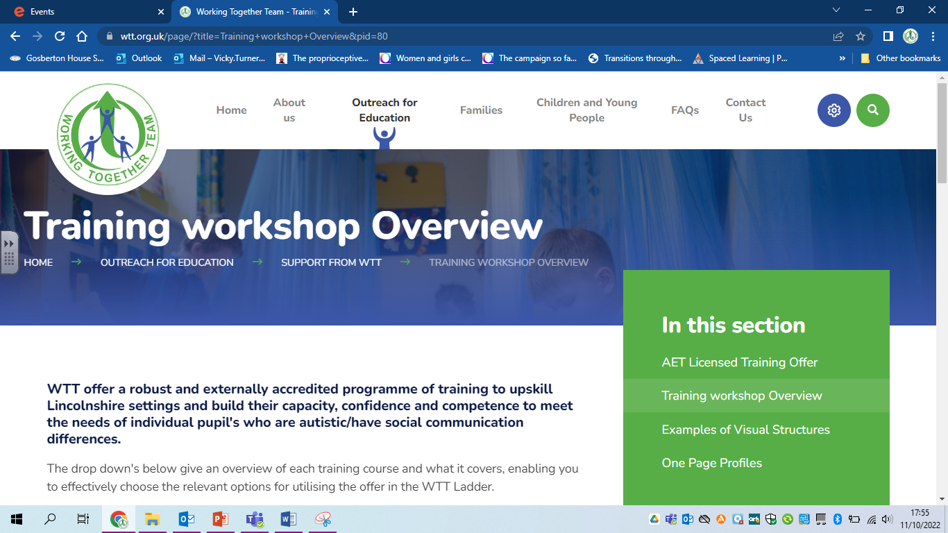
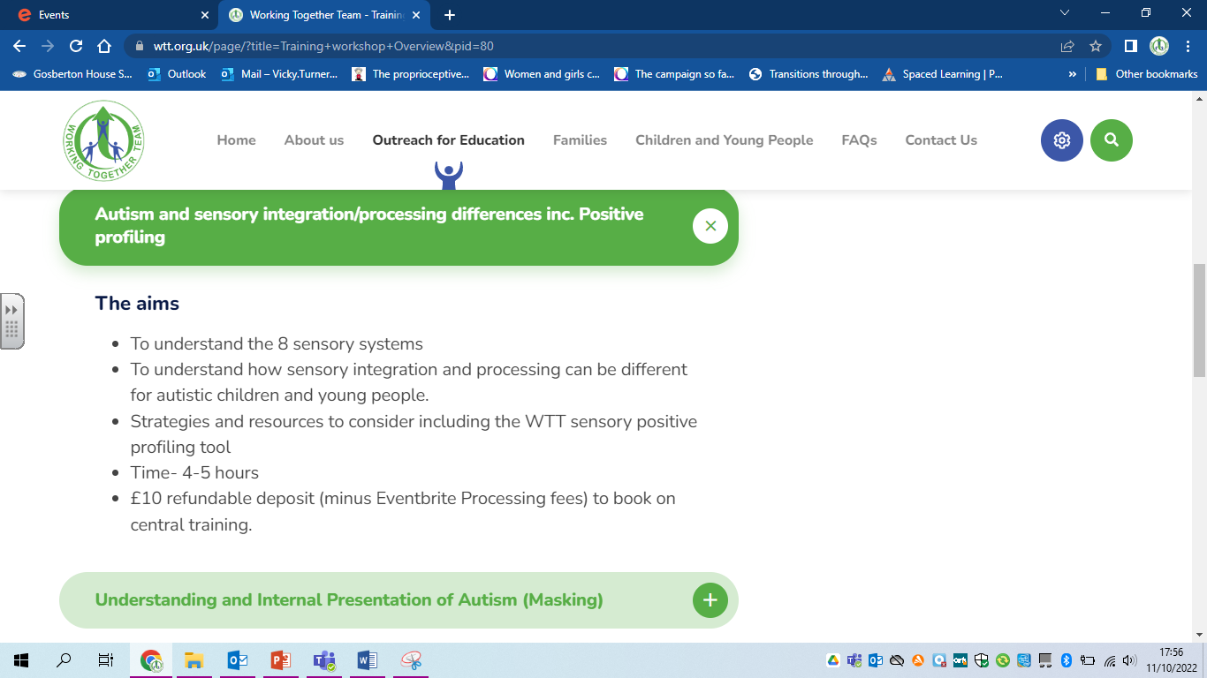
www.wtt.org.uk

Slide 12
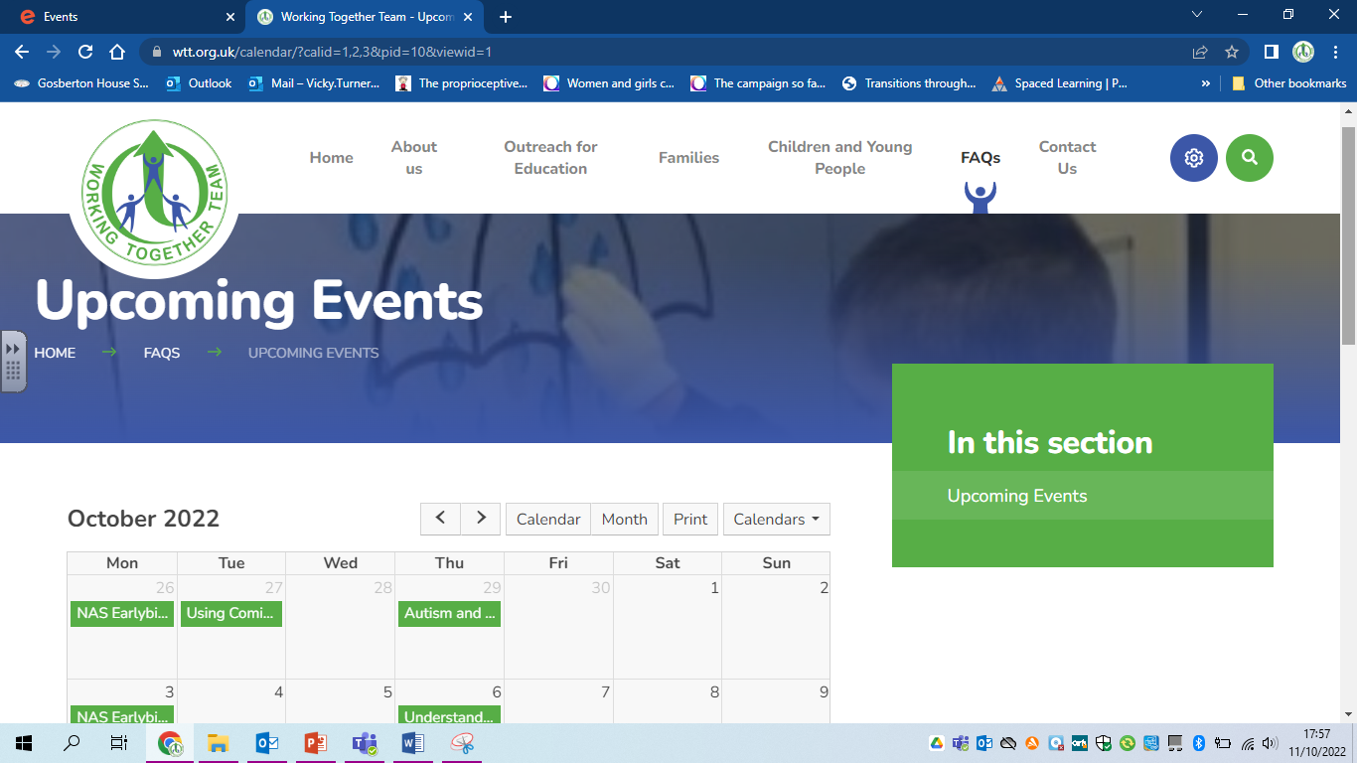
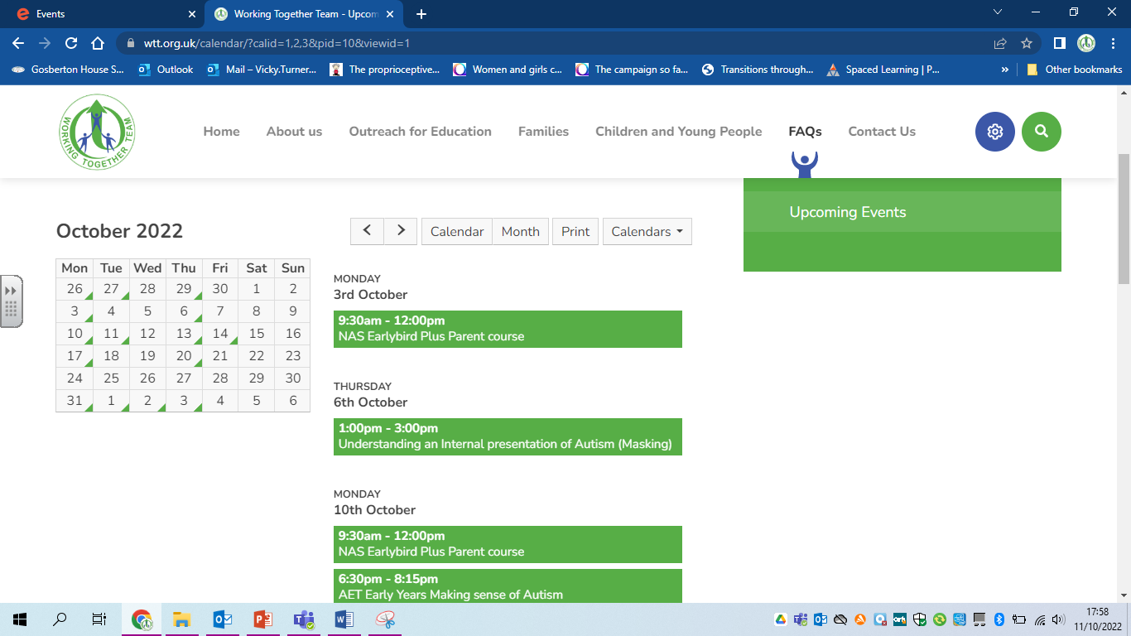
www.wtt.org.uk

