Slide 1
Graduated Approach Briefings
October 2022
Notices

Slide 2
Welcome
To locate information about the Graduated Approach Briefings on the Local Offer, go to: https://professionals.lincolnshire.gov.uk/homepage/54/graduated-approach-briefings
Or on the Home Page, click on: Support with Education
Then scroll down to: Graduated Approach Briefings
Welcome and thank you for joining us for this virtual training session.
Please sign in through the Chat to register your attendance.
As usual, to support everyone to maintain connectivity with so many attendees being here:
Please Mute your microphone and turn off your video when not speaking – we have a large number of participants present today and this may mean that we experience feedback or slowing of the network connection if everybody has their microphone and video on. However, we would like to see you if you ask a question, please, so feel free to switch on both your microphone and video in these instances.
Please note that this meeting, or sections of it, will be being recorded for use on the council’s professionals’ website. If you do not wish to be recorded, you should leave the meeting and watch it back later.
If you would like to ask questions, please use the raise your hand facility or use the chat function in Teams
Please keep discussion in the ‘chat’ relevant – the person presenting may not be able to see your comments but we will have someone monitoring it in order to make sure all questions are answered.

Slide 3
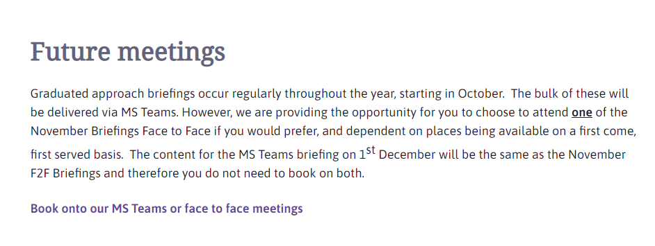
Remember to book your places for each briefing throughout the year on the Local Offer
Graduated approach briefings – Professional resources (lincolnshire.gov.uk)

Slide 4
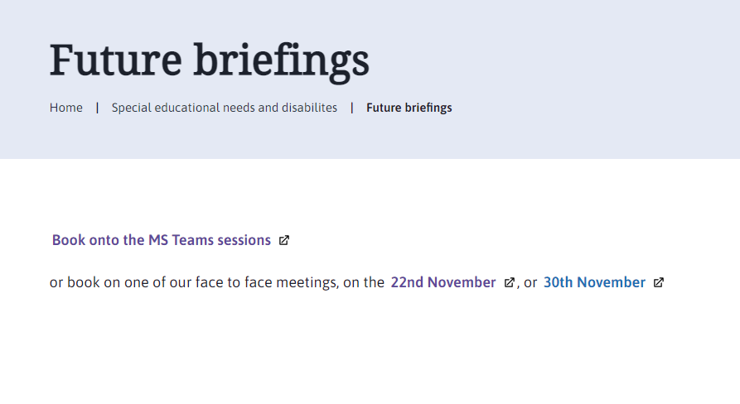
Book one briefing for each term
Places are limited at the F2F briefings in November so please see support document in the uploaded presentations for October 2022 if you need to cancel your F2F session. This will allow someone else to have that place. If you can’t attend the F2F briefing, book the Teams Meeting on 1st December instead. There is no need to attend the F2F briefing and the Teams meeting on 1st December. The content will be the same apart from the networking opportunities.

Slide 5
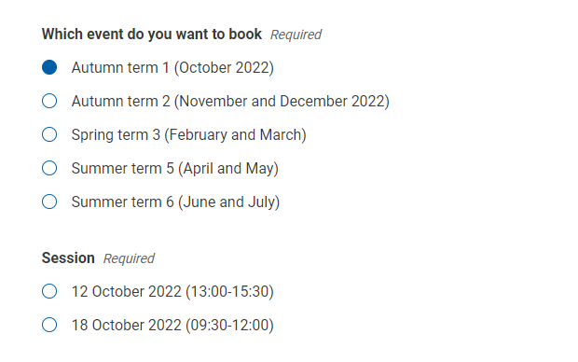
Book one briefing for each term
When you select a term, the options for each for the two available sessions for that term become visible. The content is the same at each – just choose the most convenient.

Slide 6
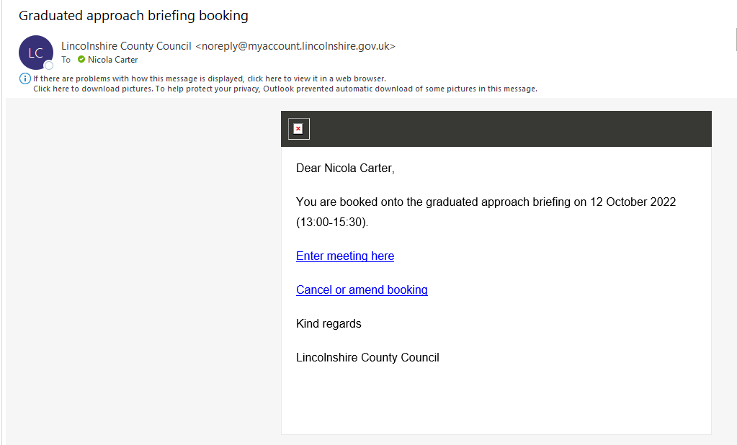
Booking link arrives about an hour after booking
Please save the email straight away in your Graduated Approach Briefings folder! However, if you don’t do this, there should be a reminder email a week before and, failing that, search your in-box for ‘Graduated approach briefing booking’ or ‘Lincolnshire County Council’.

Slide 7
Presentations and Videos will be available from 21st October
Remember to visit the Graduated Approach Briefings page on the Local Offer so that you can view the presentations and videos for this round of briefings and any from the previous academic year.
Graduated approach briefings – Professional resources (lincolnshire.gov.uk)

