Slide 1
SENDCO and Designated Safeguarding Leads briefing in relation to 'Valuing Care'
October and November 2022
Right4U wrapping the Right Care around children, young people and families

Slide 2
Children in Care Transformation Programme
Our Children In Care Transformation Programme is both innovative and ambitious, while embracing our key strategic goals:
To reduce the need for statutory intervention in families lives, by providing the right help to the right children at the right time and for the right duration.
To support families to come to their own solutions by focusing upon building networks which they have in place.
To improve outcomes for our Children and Young People, by providing care locally within Lincolnshire rather than care at a distance to keep children and Young People within their own communities where they can be close to their networks.
Right4U wrapping the Right Care around children, young people and families

Slide 3
Valuing Care
Valuing Care is a new approach to explain, record and track needs and outcomes for children and young people on an individual and cohort level. This approach enables the team around the child to build-up a holistic assessment of both the needs and the strengths of the child / young person at a point in time, and to track how a child / young person’s needs may change over time.
Our Aim:
Every Child in our Care has a Valuing Care Tool
Supporting Evidenced based decision making and placement/permanence planning
Enabling us to ensure the right placement is identified for the child/young person
Enabling us to measure the needs and progress of the child/young person
Right4U wrapping the Right Care around children, young people and families

Slide 4
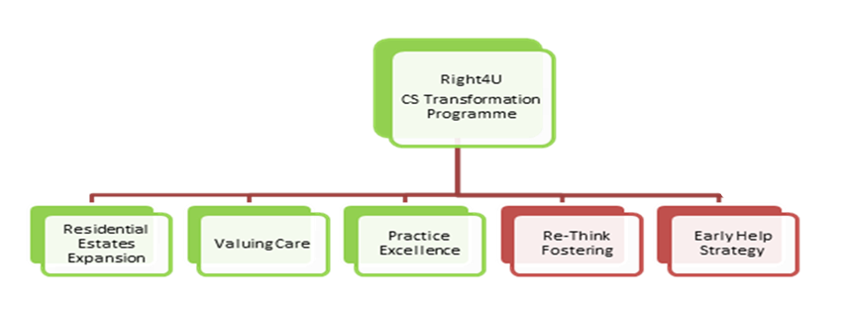
Children in Care Transformation
Right4U wrapping the Right Care around children, young people and families

Slide 5
Programme impacts so far
Launched our new Early Help Strategy that is fully reflective of our strengths and priorities and owned by LCC and our partners
The strategic management of placements and the VC tool is resulting in better planning, outcomes and realising opportunities.
The development of a Placement Tracker keeps the focus on progressing opportunities and tracking potential savings
The development of a ‘one referral’ form through Mosaic, will save social worker time and result in better quality referrals paperwork.
We are changing culture, social workers are thinking of trajectories and using the VC tool to support planning.
Exit planning upon a child's entry into an external placement provision
Right4U wrapping the Right Care around children, young people and families

Slide 6
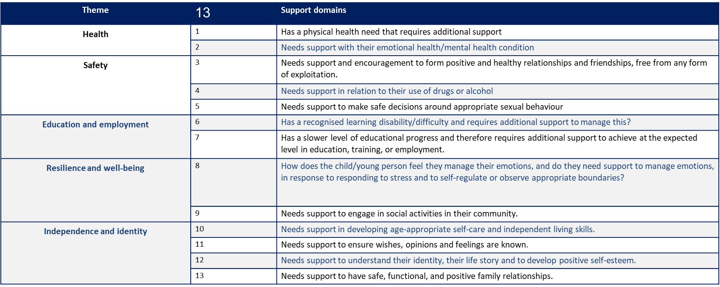
What does the Valuing Care tool look like?
Right4U wrapping the Right Care around children, young people and families

Slide 7
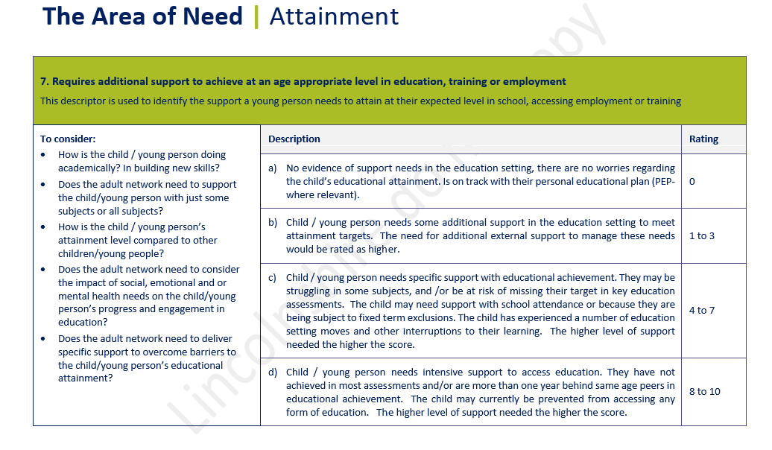
What does the Valuing Care tool look like?
13 domains
Guidance document to support the completion of the tool.
Right4U wrapping the Right Care around children, young people and families

Slide 8
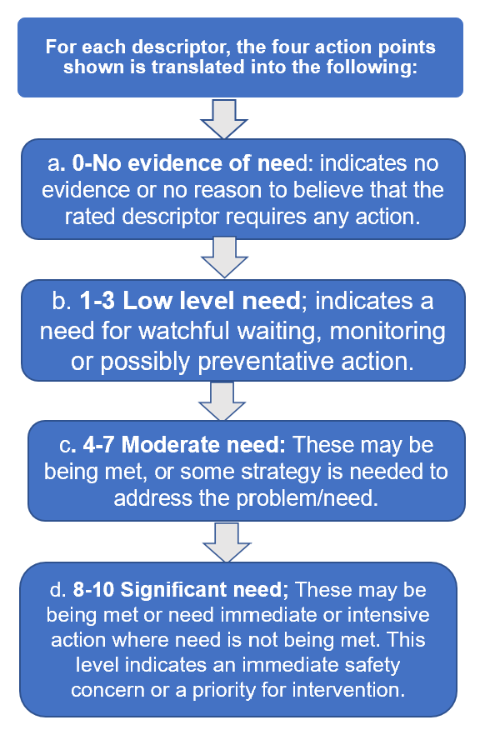
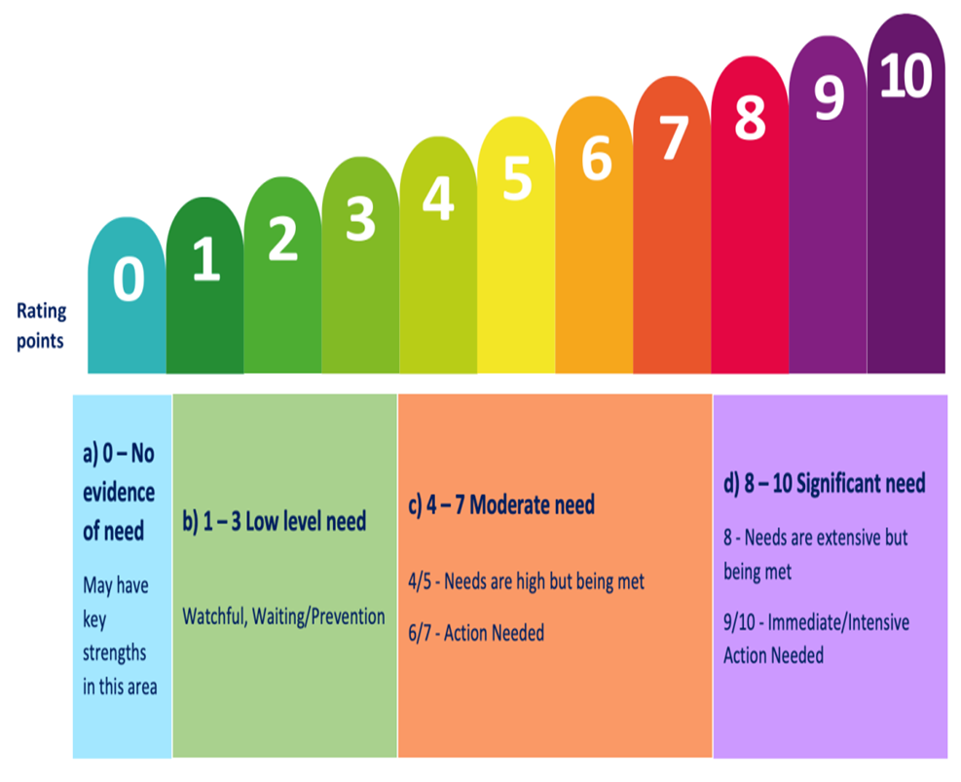
What does the Valuing Care tool look like?
Right4U wrapping the Right Care around children, young people and families

Slide 9
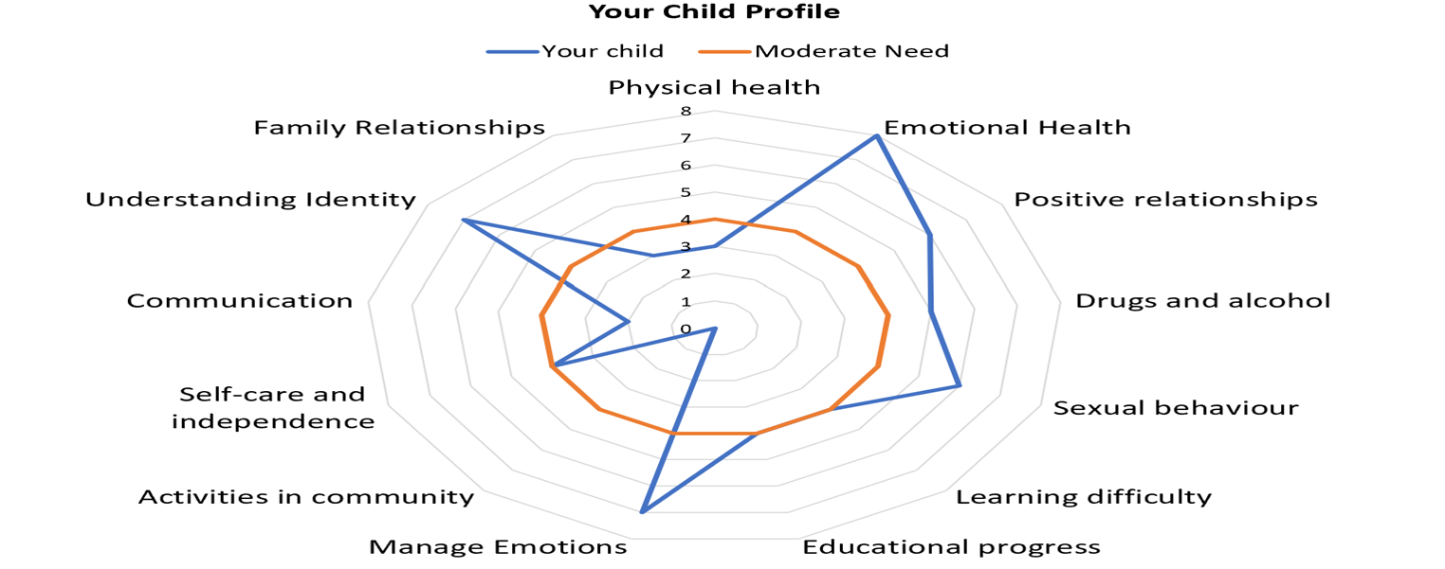
What does the Valuing Care tool look like?
Right4U wrapping the Right Care around children, young people and families

Slide 10
How will I be involved in the completion of the Valuing Care tool?
The tool is completed where possible in a multi-agency setting and in consultation with the young person and their networks.
This means that whenever a Social Worker is undertaking an assessment of any kind, they may ask you to be involved in completing one as part of that holistic approach. This may be undertaken within existing meetings you are already part of.
You may be asked to complete one of the domains before a meeting or a review.
Completion of the V SEND tool will inform the completion of the Valuing Care tool.
Right4U wrapping the Right Care around children, young people and families
Notes:
Where are we currently using the Valuing Care tool?
A child in Care plan and discussed in the Child in Care review
A Pathway Plan
Placement matching
A child returning to their family

Slide 11
What can support your understanding of Valuing Care?
From June 2022 an e-learning package was created within our LSCP website.
https://safeguardinglincolnshire.vc-enable.co.uk/
This is a short development session with a voiceover that guides you through a brief overview of what Valuing Care is; coupled with ' what does this mean for me ?’
You will also find attached documents that the voiceover will take you through and opportunities to pause the session while you take time to reflect about how this can support the Children and Young People you work with.
Right4U wrapping the Right Care around children, young people and families

