Slide 1
L.E.A.D. Teaching School Hub

Slide 2
So what…
‘Local area partnerships are generating energy and commitment because they are making connections across schools and communities to improve outcomes for young people’
Notes:
Quote from another LA- really powerful and a great summary of what we have been trying to achieve not just in the last year but over many years.

Slide 3
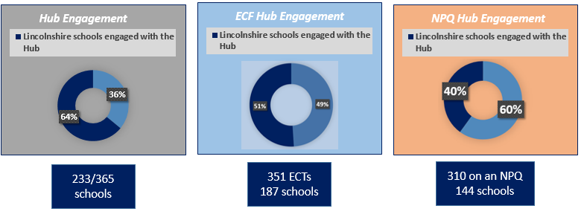
So what…
Notes:
The TS Hub started Sept 2021
So proud- share that 64% are – higher that any other Hub we have been in contact with
.

Slide 4
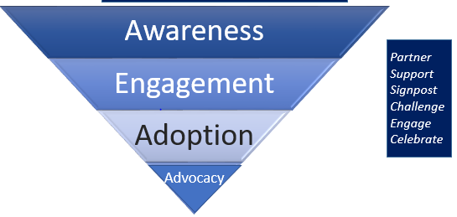
So what…
Notes:
We recognise that schools will go on a journey with us – some are working with us as advocates of the Hub as specialists in a curriculum area others will be engaging with programmes….some might be at the point of just being aware of what we do…

Slide 5
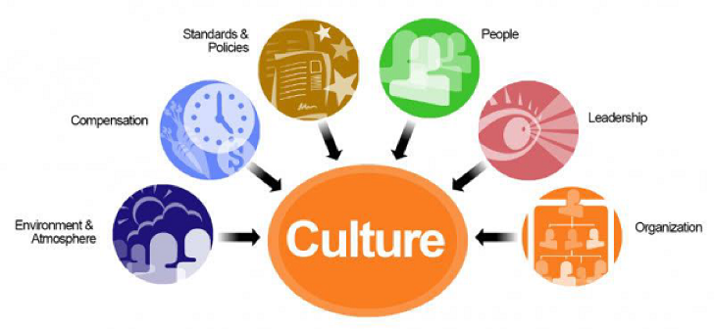
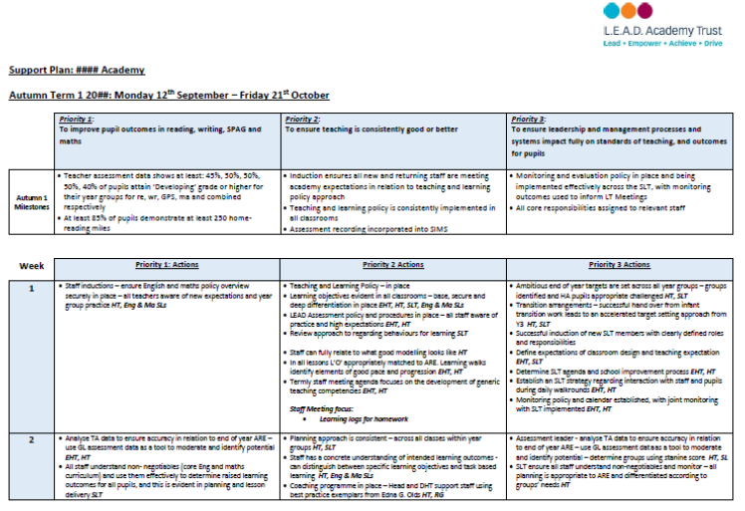
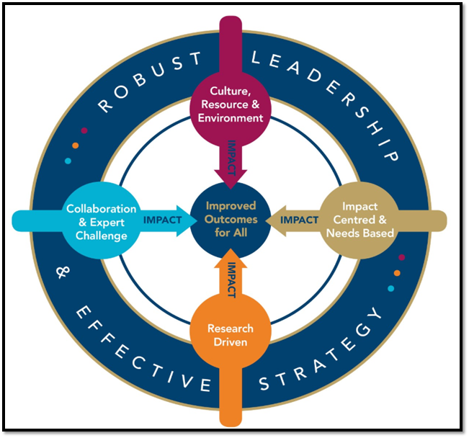
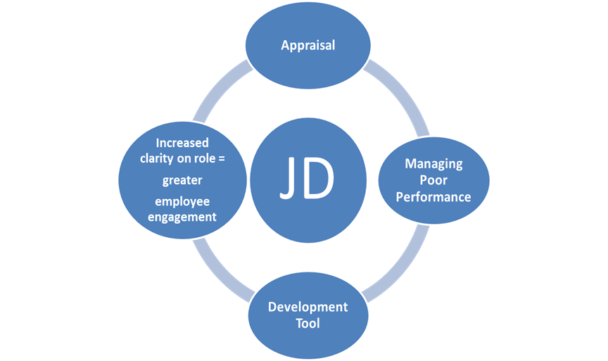
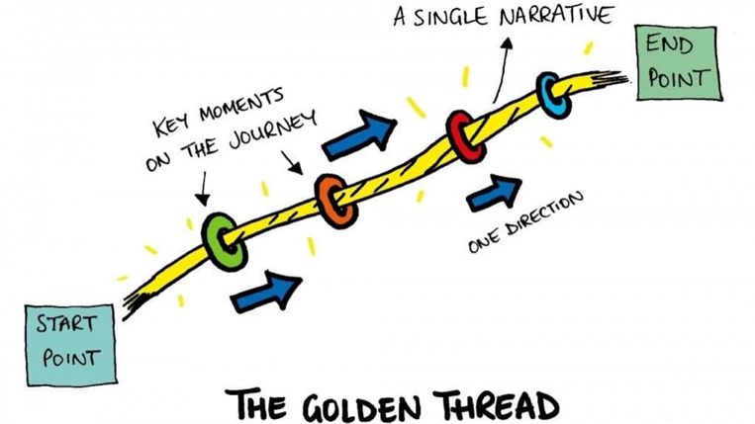
Bigger Picture… Thoughts…
Climate & Culture
What constitutes culture?
High Performing Teams
Improvement Strategy
SEF/ SIP/Vision
Improvement Planning
Co-construction
Workforce Development
Effective CPD
Career Management
Staff retention
JDs and Appraisal
Expectations of Staff
Roles and Responsibilities
Targets Linked to Priorities
Assessment for Leading
Use of Data
Monitoring & Evaluation
Behaviour/Attendance/SEND/PP/LAC
Funding Use
Systems and processes
Structure
Assessment, monitoring, tracking
Notes:
Thoughts on this

Slide 6
HT and DHT Forums
Notes:
.

Slide 7
Needs Analysis Primary
Subject Knowledge in non core subjects
Writing
57%
Maths
43%
Reading
42%
Transition
Teaching and Assessment essentials ECT+
Curriculum/ Subject Leadership
42%
Phonics
25%
Wellbeing of Leaders/Teachers
SEND
15%
EYFS
10%
Forums for HT and DHTs

Slide 8
Offer 2022-23
KS3 Reading: Confident, Vocabulary Rich, Fluent Readers
Writing- Stamina ,Content and Impact
Small School Curriculum Development
Early Years and KS1- Vocabulary and Fluency
Small Schools Maths- Mixed Age Problem Solving
Early Years- Curriculum and Assessment
Refining Subject Leadership
How to Assess for Impact… for Teachers in Y3,4,5 of their career
SEND in the Mainstream/SEND to make an Impact
RSHE Diversity and Protected Characteristics
Moderation: Keystone
Reading 1:1 Audits and Reading Pledge
Notes:
The TS Hub started Sept 2021
So proud- share that 64% are – higher that any other Hub we have been in contact with
.

Slide 9
Sustaining Work Group
Subject Specialist Input
ART
History
Design Technology
RE
Mathematics
Early Years
Literacy
RSHE
Geography
EAL
PE
MFL
Notes:
Optional twilights;
Establishing a Topic model and establishing a progression model
Recording learning
Chris will set gap tasks between the sessions and can do bespoke support where requested

Slide 10
Sustaining Work Group
Reading Pledge
FREE
Portal with resources, audit documents and supporting video guidance, to reflect upon and develop your school’s Early Reading and Reading for Pleasure practice
supporting schools to develop and sustain a Reading for Pleasure culture, embedded by the Reading for Pleasure research and pedagogy;
sharing a wealth of DfE English Hub materials, guidance and advice, including reading assessment exemplification materials
Work towards Bronze, Silver Gold Accreditation.
Notes:
Optional twilights;
Establishing a Topic model and establishing a progression model
Recording learning
Chris will set gap tasks between the sessions and can do bespoke support where requested

Slide 11
Sustaining Work Group
Early Career Framework and
AB Services Pledge
DfE Portal
OPEN
The early career framework (ECF) is a funded entitlement to a structured 2-year package of high-quality professional development.
New to ECF:
23rd June 08.30
Notes:
Optional twilights;
Establishing a Topic model and establishing a progression model
Recording learning
Chris will set gap tasks between the sessions and can do bespoke support where requested

Slide 12
Sustaining Work Group
DfE Portal
OPEN
NPQ
Programme | Name | Duration
NPQEL | Executive Leadership | 18 Months
NPQH | Headship
NPQ SL | Senior Leadership
NPQ BC | Behaviour and Culture | 12 months
NPQ LT | Leading Teaching
NPQLTD | Leading Teacher Development
Programme | Name
NPQLL | Leading Literacy
NPQEYL | Early Years leadership
Notes:
Optional twilights;
Establishing a Topic model and establishing a progression model
Recording learning
Chris will set gap tasks between the sessions and can do bespoke support where requested

Slide 13
Sustaining Work Group
DfE Portal
OPEN
NPQ
The nurture, retention and development of leaders across Lincolnshire
Fully funded for all again for 2022/23
Success of Year 1 98% Good+ and 54% exceptional
Notes:
Optional twilights;
Establishing a Topic model and establishing a progression model
Recording learning
Chris will set gap tasks between the sessions and can do bespoke support where requested

