Slide 1
Lincolnshire Young Voices
Presents at the Graduated Approach Briefings

Slide 2
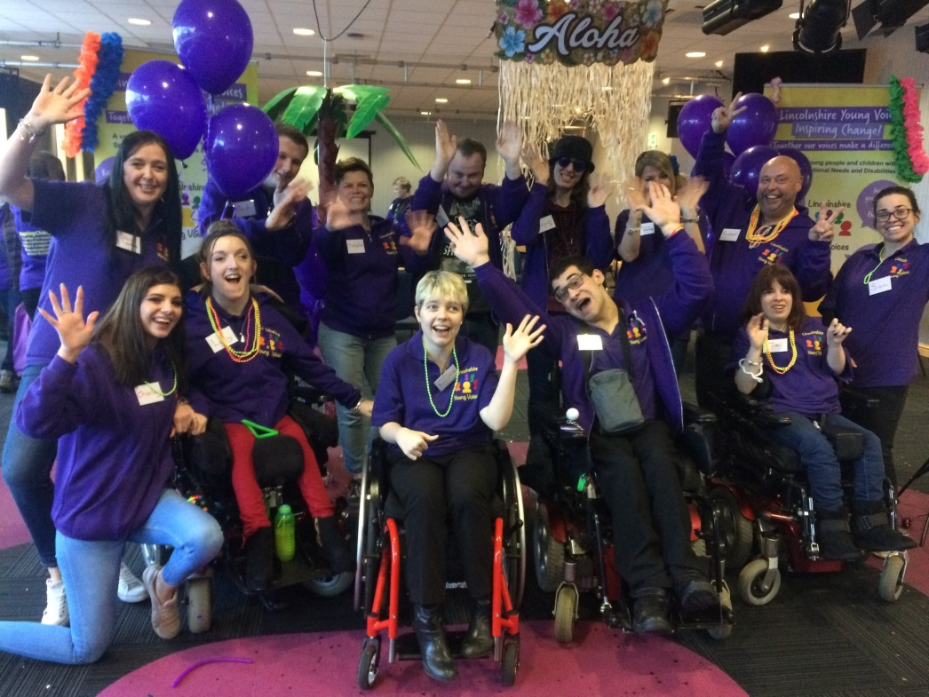
Who we are
A pan-disability participation committee, funded by LCC and backed by NHS
Researching and acting upon issues faced by young people with SEND.
Comprising of 11 devoted, driven young people who collaborate with services in multiple sectors to raise awareness of SEND and inspire change.
Credit: Sian Hutchings [at our
2018 Launch]

Slide 3
Our mission…
Sharing Experiences
Giving Us Purpose
Team Work
Having A Choice
Having A Say
Taking Part
Making Things Better
Inspiring Change
Being Together
Being Valued
Creating Impact
Using Our Voices

Slide 4
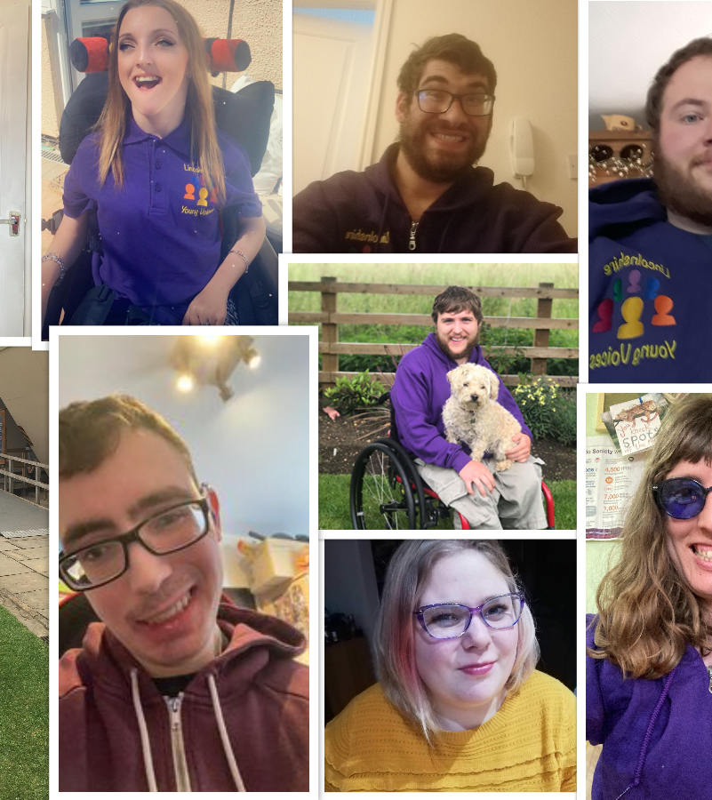
Our Committee

Slide 5
Our Service Delivery Plan
To improve the accessibility of toilets in Lincolnshire.
To improve the accessibility of local transport providers.
To help organisations know how SEND friendly they are.
To help make Lincolnshire's Local Offer the best it can be.
To help the people of Lincolnshire know what LYV do and how they can get involved.

Slide 6
The work we do
An Accessibility Survey to gain the views of children and families on public toilets and transport.
Working with arts and heritage sites across Lincolnshire to make sure they are accessible as well as ensuring they’re on the Local Offer. We aim to make this service the best it can be.
Notes:
EC
Mention SDP
But wanted to create something that had a lasting legacy and influenced change.
Training is everything we stand for

Slide 7
A Rough Guide to Not Putting Your Foot In It!
Working with Bad Shoes Design Company, we, the experts by experience, have:
Designed an online training resource for professionals that boosts confidence to communicate with people with SEND by…
Debunking myths and demystifying what it means to have a disability.
We have developed the ‘This Is Me’ communication model to give everyone a starting point for conversation when they meet.
Crucially, it demonstrates that we have a voice and that we understand that professionals can all put their foot in it, sometimes!
It’s what you do to avoid it and how you rectify it if you do.

Slide 8
‘This Is Me’ is all about CHANGE
Communication is key
How would we like to have the conversation?
Assistance: Reason for us meeting ,
Needs: What does disability mean to us?
Goals: We all need to be on the same page.
Everything Else: Take the time to get to know us.

Slide 9
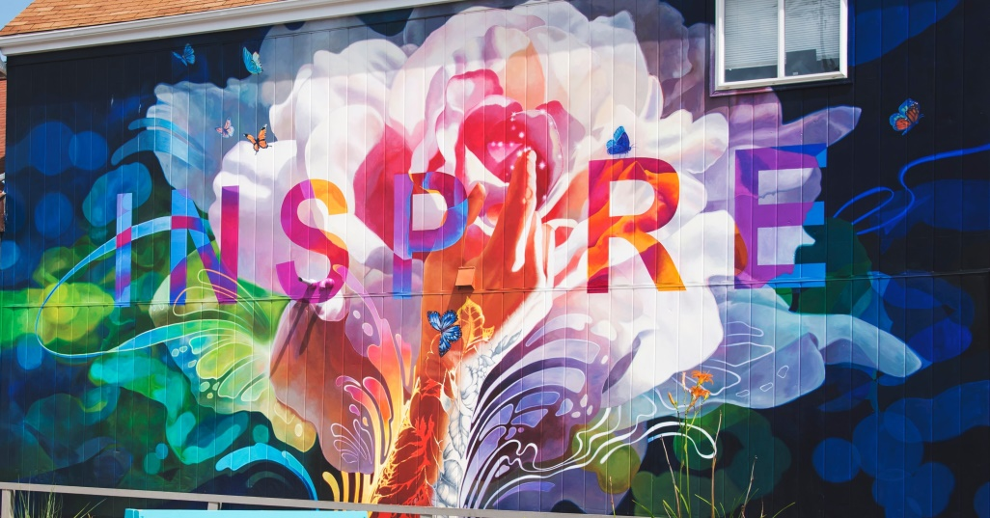
We Want You!
Are you or do you know someone aged 11-25 with lived experience of SEND?
Do you/they want to inspire change for Children and Young People with disabilities across the county?

Slide 10
Get your smart phones out and follow us on…
@Lincs_YV
Lincolnshire Young Voices
Website: https://www.lincolnshire.gov.uk/youngvoices
Email: LincolnshireYoungVoices@lincolnshire.gov.uk

Slide 11
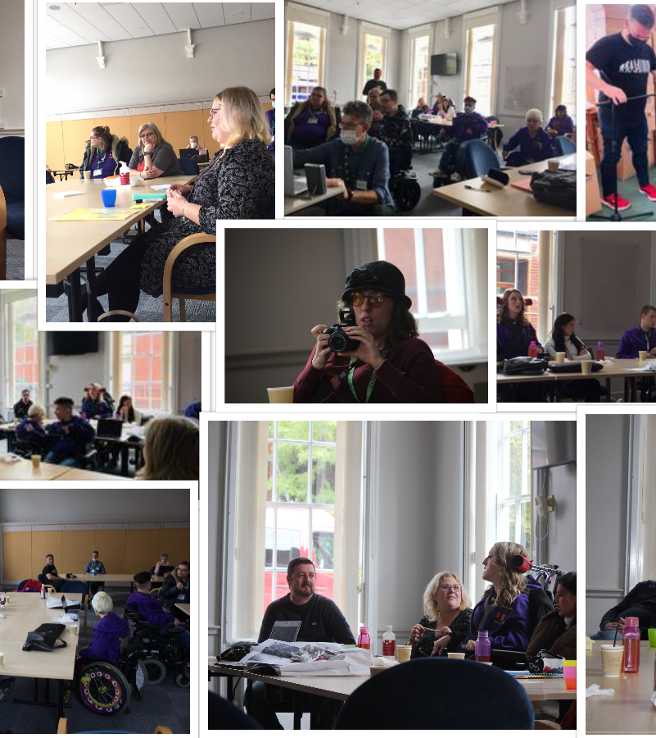
Any questions?

