Slide 1
Graduated Approach Briefing
Specialist Outreach Language Teachers
Trish Hicken
Emma Broddle

Slide 2

Can we spot them...?
Some are well hidden...
Research is highlighting that SLCN is still under identified​
Hardest to spot:​
Very young pupils​
Older pupils with difficulties in:​
  -Vocabulary ​
  -Formulating sentences​
  -Understanding​
Notes:
There is a shift in expectation at secondary school that could mean a young person who was getting on ok at primary school may begin to fail.
Vocabulary, jokes and sarcasm
Sentence order, number of instructions, volume of spoken information

Slide 3
Speech
Refers to saying sounds accurately and in the right places in words.
Relates to speaking fluently, without hesitating, prolonging and repeating words or sounds.
Speaking with expression in a clear voice, using pitch, volume and intonation to add meaning.

Slide 4
Language
Refers to talking and understanding.
Being able to join words together into sentences, stories and conversations.
Knowing the right words to explain what you mean.
Making sense of what people say.

Slide 5
Communication
Refers to how we interact with others.
Using language or gestures in different ways, for example to have a conversation or give directions.
It’s also being able to understand other people’s points of view.
Understanding and using body language and facial expressions.

Slide 6
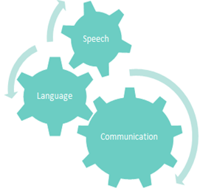
Notes:
All 3 elements need to be efficient for good communication. If there are difficulties in one element, this will have a knock on effect on the other areas.

Slide 7
Prevalence
More than 1.4 million children and young people in the UK have speech, language and communication needs (SLCN)
7.6% - At least 2 students in every classroom have a developmental language disorder that persists throughout school and impacts on learning and on their social and emotional development.
As many as 50% of children in deprived areas of the UK start school without the language they need to learn, learn to read or make friends.
Clear evidence shows the significant impact of SLCN on children across the age range and on learning, socialisation and later life chances. Never has it been more important to ensure the support that is needed is in place.
https://www.bercow10yearson.com/ (March 2018)

Slide 8
So What?
Only 25% of pupils with SLCN achieve the expected level in English at the end of KS2
“..communication skills are the most important employability skills and a lack of them in a candidate is a deal breaker... for many employers”. (Skills for life report).
2/3 of 7-14 year olds with serious behaviour problems have language impairment
40% of 7 to 14 year olds referred to child psychiatric services had a language impairment that had never been suspected
Young people with SLCN are more likey to be bullied and are more susceptible to grooming behaviours
Notes:
Those who struggle to communicate, are at high risk of poor outcomes. This includes education, employability, mental health, vulnerability and criminality.
Criminality
Thousands of people fail to access education, social, economic and career opportunities due to communication difficulties. It has been found that a high proportion of the country’s prison population have got previously undiagnosed speech and language difficulties. Research Report 37 found that offenders gaining oral communication skills qualifications were 50% less likely to re-offend in the year after release than the national average. (37 Moseley et al, The impact of ESB oral communication courses in HM Prisons – an independent evaluation in Developing oral communication and productive thinking skills in HM Prisons (2006), Learning and Skills Research Centre. in the Bercow Report 2008)

Slide 9
Prevalence
No Wrong Door, the service for children in care in North Yorkshire, found 62% of their children in care had communication needs. Only two of the children had previously seen a speech and language therapist (SLT). (Information provided by Youth Communication Team North Yorkshire, 2016).
£17 billion per year is spent in England and Wales by the state on the cost of late intervention – the largest individual cost (£5.3 billion) is spent on children in care. (Early Intervention Foundation, 2016).

Slide 10
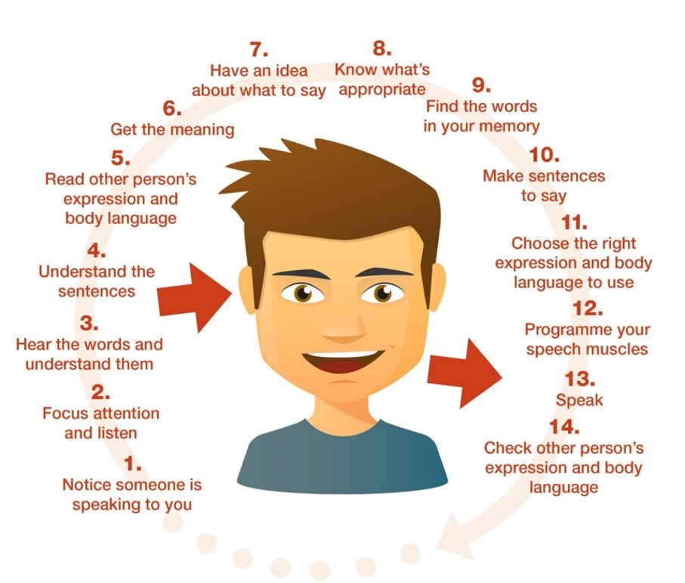

Communication chain
Notes:
The chain is continuous and has to keep going as long as communication continues.
You can see how gaps within the communication chain would have a knock-on effect on other areas.

Slide 11
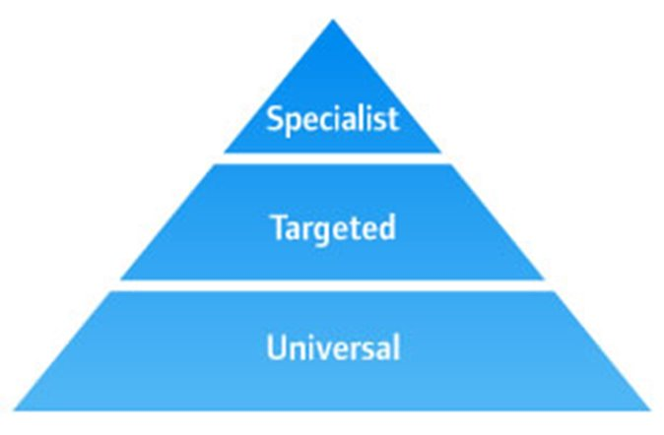
Supporting SLCN
General strategies​
Reasonable adjustments for young people with SLCN​
Targeted support​
Specialist support
Notes:
Targeted
Some pupils (around 50%) in some areas need targeted interventions to help them catch up
Specialist
A few pupils (10%) need specialist support to make progress

Slide 12
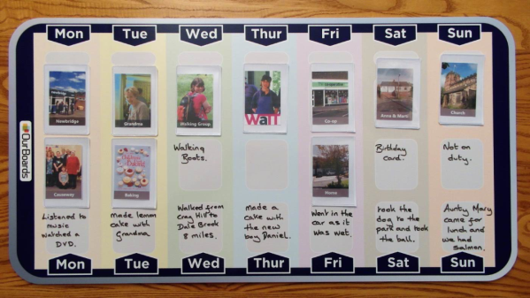
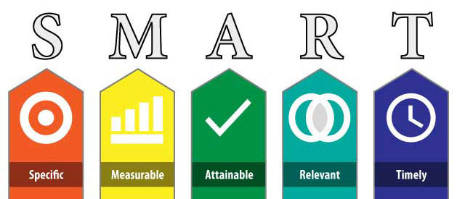
Universal Strategies
Visual support systems:
Visual timetables
Targets
Picture cards
Photographs
Symbols
Videos
Real objects

Slide 13
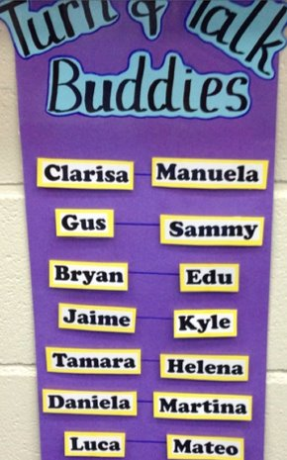

Universal Strategies
Explicit opportunities to build speaking and listening skills for all young people.
Notes:
10 second rule

Slide 14
A limited vocabulary means that;
The young person will not be able to understand the full meaning.
They will be unable to extend knowledge – they missed the foundation.
Learning through reading will be difficult.
Expressing their ideas will be difficult.

Slide 15
Being Word Wise
Vocabulary is an indicator of linguistic health.
Pupils need to know 95% of the words in a text to understand and engage with it. (Schmitt, Jiang & Grabe 2011)
There are stages of knowing vocabulary…

Slide 16
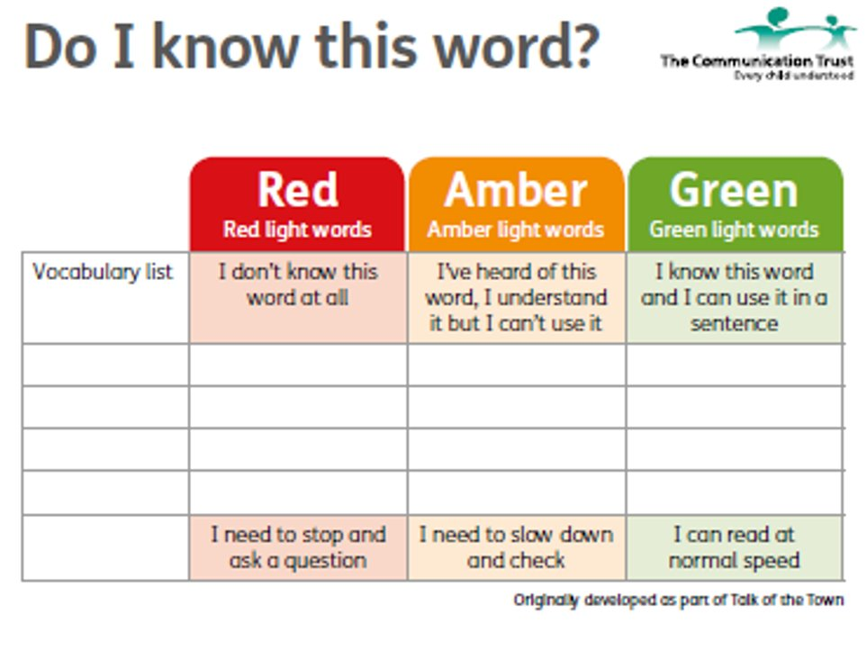

Slide 17
Types of Words:
Tier 3: Specialised
Low frequency
Topic specific
Tier 2: Describing​​
Abstract ​​
Words explaining a concept in greater detail, e.g. agony, impatient, horrendous, exaggerate​​
Vocabulary for learning used across many or all subjects, e.g. estimate, summarise, explain, design​
Tier 1: Core
High frequency
Objects
Rarely taught
Notes:
Tier 2 - these are important – they are found across the curriculum – can be abstract – often have multiple meanings eg ‘rich’ – secpndary aged students need the most support with tier two words.
Tier 3 are Subject specific – often explicitly taught as new vocabulary eg: photosynthesis, trigonometry – but quite often we use tier 2 words to describe / define tier 3 words, so the knock on is clear.
Leading on from tiers of vocabulary. There are also levels of language to consider… This will impact on how much the young person can understand and their ability to answer questions. Language levels can be affected by heightened emotions and stress…

Slide 18


What would you ask now?
Notes:
Example of fizzy coke bottle – shaken up – wouldn’t open until it had settled – wouldn’t ask difficult questions until young person had settled
Warning - Asking why questions when young person isn't ready will result in unwanted answers!

Slide 19

Questioning and behaviour
These levels of questioning can have very important implications for the management of behaviour
If a child does not understand a question, they will not know how to answer appropriately and could get into trouble by either not responding or acting up instead.
Questions need to be at the appropriate level for the child’s ability.
Notes:
Children with low language levels are frequently asked complex questions. Examples – why did you do that? And what should you have done?
Because they don’t understand, they don’t know how to answer them and could get into trouble by either not responding or acting up instead.

Slide 20
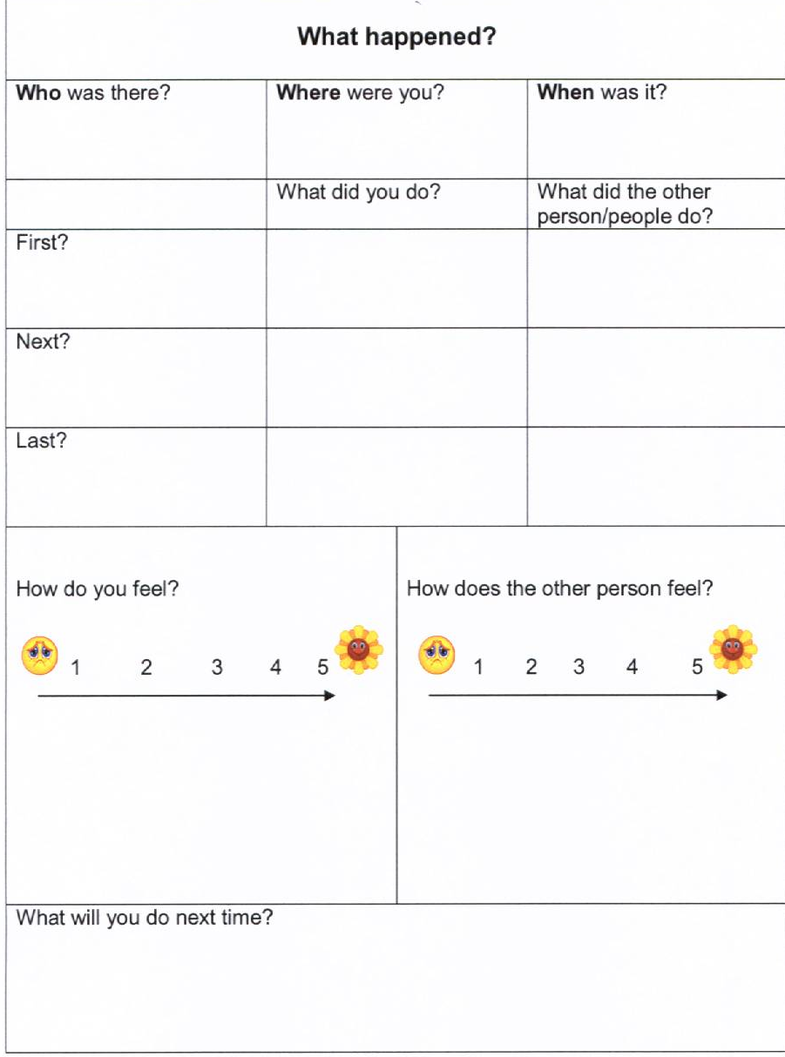
Notes:
Scaffolded questionning

Slide 21
Scale
furious
angry
mad
cross
fed up
irritated
annoyed
bothered
Notes:
Help the young person to identify and rate how they are feeling.

Slide 22
Strategies to develop emotional literacy
Assess
Assess understanding and use of vocab
State
State the feeling as it is experienced
Discuss
Discuss the feelings of others in context
Use
Use comic strip conversations
Evaluate
Evaluate feelings during the day
Explore
Explore emotions of fictional characters
Use
Use games to reinforce learning.

Slide 23




Useful Organisations
www.languageforlearning.co.uk
www.ican.org.uk
www.naplic.org.uk
www.afasic.org.uk

Slide 24
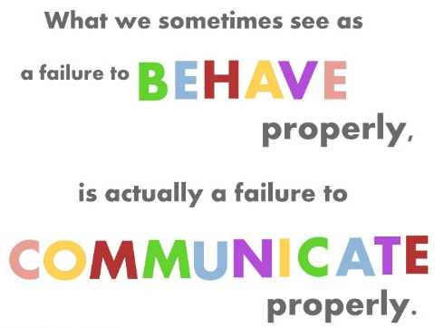

Slide 25

Questions

