Slide 1
Dyslexia Outreach: Training Offer
Helen Lane and Odette Read
Helen.lane@lincolnshire.gov.uk
Odette.read@lincolnshire.gov.uk
Supporting schools with training and advice across a range of areas

Slide 2
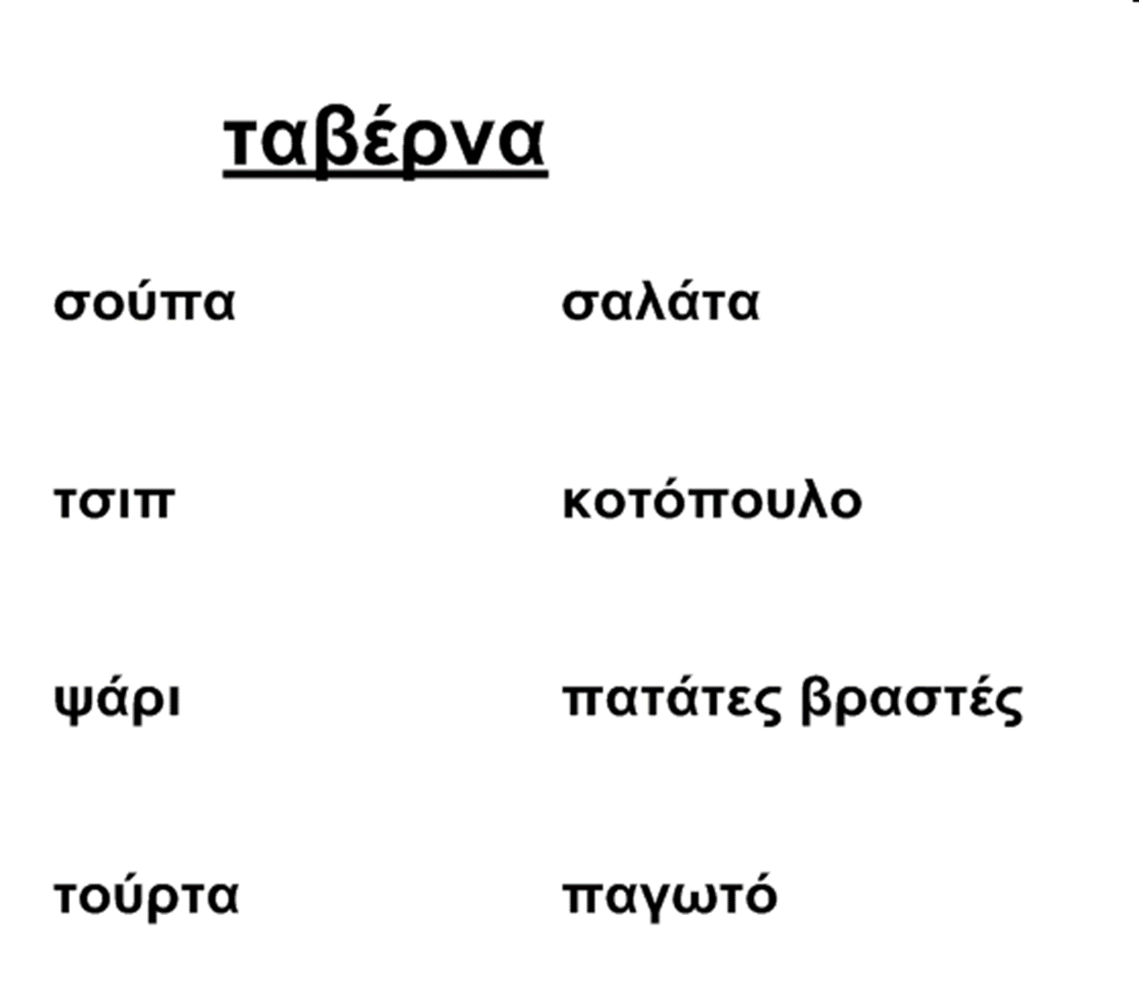
Activity!
Text box
Text box
Notes:
Awareness- Resources- observation and strategies sheets, classroom behaviours, evidence in work and approaches to work
Early intervention- earlier support will prevent later difficulties – what teachers can do to
Working to strengths, considering SEMH needs and looking at common areas of strength
Metacognition – strategies which will help children to understand how they learn and enable them to become life long learners with long term independent strategies
Dyslexia friendly teaching- supporting memory, reading, spelling, writing, using assistive technology
Well founded interventions- what works?

Slide 3
Welcome to Greece!
Text box
Text box
Notes:
Awareness- Resources- observation and strategies sheets, classroom behaviours, evidence in work and approaches to work
Early intervention- earlier support will prevent later difficulties – what teachers can do to
Working to strengths, considering SEMH needs and looking at common areas of strength
Metacognition – strategies which will help children to understand how they learn and enable them to become life long learners with long term independent strategies
Dyslexia friendly teaching- supporting memory, reading, spelling, writing, using assistive technology
Well founded interventions- what works?

Slide 4
Understanding Dyslexia
What is Dyslexia?
Commonly occurring difficulties
Resources and interventions
How we can help
Notes:
Why is understanding so important- not for label but to put in right support early
Literacy difficulties – knowledge will support all pupils
What is dyslexia- over view of the different aspect that create the spikey profile- look for strength as well as weaknesses
What causes dyslexia

Slide 5
How we can help
Awareness- what to look out for
Early intervention
Positive, strength-based approach
Develop metacognition
Dyslexia friendly teaching
Well-founded interventions

Slide 6
Dyslexia friendly teaching
Memory
Spelling
Reading
Writing
Notes:
Also- Maths and using assistive technology

Slide 7
Maths and Dyscalculia
What is Dyscalculia?
How does it compare to other causes of maths difficulties?
Resources and interventions
How we can help
Impact of maths anxiety
Notes:
Why is understanding so important- not for label but to put in right support early
Literacy difficulties – knowledge will support all pupils
What is dyslexia- over view of the different aspect that create the spikey profile- look for strength as well as weaknesses
What causes dyslexia

Slide 8
Further training…
Memory and Metacognition
Precision Teaching
Morphology
Reading Comprehension
Notes:
More in depth in specific areas –
could also focus more on spelling strategies or using multi sensory strategies or using schools own interventions
Or anything the school feel would be useful!

