Slide 1
Graduated Approach Briefings
June 2022
Notices

Slide 2
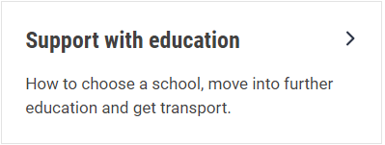
Welcome
To locate information about the Graduated Approach Briefings on the Local Offer, go to: https://professionals.lincolnshire.gov.uk/homepage/54/graduated-approach-briefings
Or on the Home Page, click on: Support with Education
Then scroll down to: Graduated Approach Briefings
Welcome and thank you for joining us for this virtual training session.
Please sign in through the Chat to register your attendance.
As usual, to support everyone to maintain connectivity with so many attendees being here:
Please Mute your microphone and turn off your video when not speaking – we have a large number of participants present today and this may mean that we experience feedback or slowing of the network connection if everybody has their microphone and video on. However, we would like to see you if you ask a question, please, so feel free to switch on both your microphone and video in these instances.
Please note that this meeting, or sections of it, will be being recorded for use on the council’s professionals’ website. If you do not wish to be recorded, you should leave the meeting and watch it back later.
If you would like to ask questions, please use the raise your hand facility or use the chat function in Teams
Please keep discussion in the ‘chat’ relevant – the person presenting may not be able to see your comments but we will have someone monitoring it in order to make sure all questions are answered.

Slide 3
Annual Survey Results:
You said:
You would appreciate the chance to meet up face-to-face, so we have provisionally booked the November briefings as face-to-face meetings. Please access the survey link opposite to have your say and give us an idea of numbers interested.
Over half of you already belong to a SENCo network and most of you who don’t, would like to join one. Details are now available.
Key themes requested for next year: ADHD; ASD; Trauma informed practice; More CPD on embedding the V SEND tool across setting; dyslexia; dyscalculia; EHCNA request process.
https://forms.office.com/r/R3ATGL3NrK

Slide 4
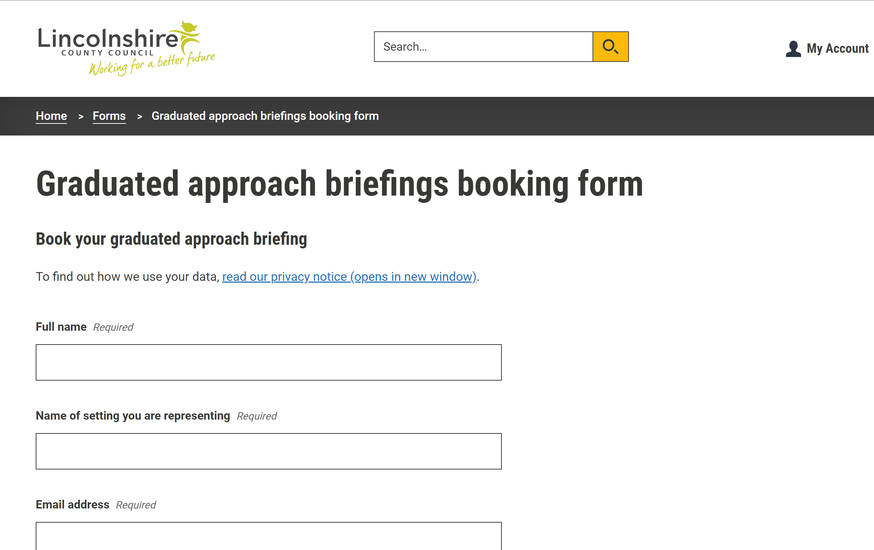
Remember to book your place for next year’s Graduated Approach Briefings on the Local Offer
Graduated approach briefings – Professional resources (lincolnshire.gov.uk)

Slide 5
Presentations and Videos will be available from 1st July
Remember to visit the Graduated Approach Briefings page on the Local Offer so that you can view the presentations and videos for this round of briefings and any from the previous academic year.
Graduated approach briefings – Professional resources (lincolnshire.gov.uk)

