Slide 1
Emotional Based School Avoidance
Pupil Re-integration Team
PRT@lincolnshire.gov.uk

Slide 2
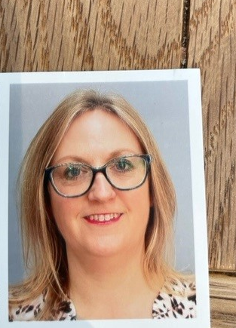
Prior to joining LCC I worked for a large cross-phase Multi Academy Trust in Boston for 9 years as the Senior Education Welfare Officer, responsible for overseeing school attendance across the Trust.
Prior to working in the MAT, I worked as an Education Welfare Officer for LCC for 10 years where I gained a diploma in Education Welfare Studies and a Postgraduate Certificate in Management Studies.
I have thoroughly enjoyed working with children, young people and families from a variety of different backgrounds and settings.
I am excited to take on my new role as Emotional Based School Avoidance (EBSA) Caseworker with LCC and to work with schools to share my knowledge and experience, supporting more students back into the classroom.
Who are
we?
Boston & South Holland
Amanda Smith
AmandaT.Smith@lincolnshire.gov.uk

Slide 3
Who are we?
I previously worked in a large secondary school in Boston for 10 years, having started on an apprenticeship in 2011.
I progressed through various roles dealing with attendance, before completing a diploma to become a qualified Education Welfare Officer, which I have done for the past 5 years. I have really enjoyed working with students experiencing anxiety and trauma.
I am excited to work with schools to share my knowledge and experiences, supporting more students back into the classroom.
North & South Kesteven
Chelsea Ironmonger
Chelsea.Ironmonger@lincolnshire.gov.uk

Slide 4
Who are we?
I have worked in secondary schools for 12 years in pastoral roles incorporating attendance and behaviour. Most recently I have led a pastoral and safeguarding department, where young people and their families were supported holistically, to promote well-being and successful outcomes.
I am a strong believer in early intervention and being solution focused with regard to all barrier's children and young people experience.
I am thrilled to be part of the PRT at Lincolnshire County Council and look forward to working with schools and families across the East Lindsey area.
East Lindsey
Claire Richardson
ClaireM.Richardson@lincolnshire.gov.uk

Slide 5
Who are we?
Lincoln & West Lindsey
Emma Shepherd

Slide 6
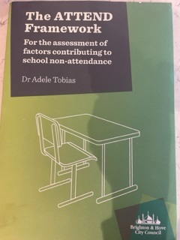
Emotional Based School Avoidance can be used to describe children and young people who do not attend school due to emotional factors. This absence can often lead to long periods of time away from school. Most young people experiencing EBSA can be highly anxious and show significant signs of distress about attending school. In many instances, they remain engaged with education and want to return to school even though they are unable to do so.
EBSA is a complex issue, and it is likely that several factors, rather than one single cause, contribute to a young person finding attending school difficult. Each child and situation is unique. Some factors are complex and interlinked. We also understand that the onset of school avoidance appears at or around the time of transition between key stages, for example moving from primary to secondary school.
What is EBSA?

Slide 7
What is our role?
This is a new role introduced by the PRT to support schools with students experiencing Emotional Based School Avoidance. There has been a significant rise in the number of students out of school due to anxiety & mental health. With the use of the EBSA caseworkers, the ATTEND framework and a robust pastoral support plan, we aim to support schools to get these students back into the classroom.
We can:
Support & advise through EBSA consultations, reviewing the current support and interventions. Providing recommendations & suggestions.
Identify, share and promote good & innovative examples across schools.
Attend PSP meetings, providing strategies and advice.
Signpost to alternative agencies that may be able to support.
Discuss cases prior to completion of a request for Education Support. We can also discuss outcomes & feedback.
Provide support with ATTEND assessments and PSP’s.

Slide 8
Step one
School identify student as displaying Emotional Based School Avoidance using day-to-day attendance tracking procedures.
Signs could include the following:
Lesson avoidance or truancy
Student failing to return after a school holiday
Refusal to get out of bed or the car in the morning
Reluctance to use the school bus or public transport
Arriving late for school to avoid a lesson, registration or busy times
Regular patterns of absence

Slide 9
Use the Early Help Assessment as a tool to identify needs and refer to external agencies if appropriate
Step two
School to case work and establish a positive relationship and trust with the family and child. Keep in regular contact, whether that’s through meetings in school, home visits or over the telephone.
Find the means of contact the child and family are most comfortable with.
Start to use the ATTEND form to explore the reasons for absence and establish what further support and adjustments need to be made to eliminate the anxieties
Identify a key worker for that child. This could be an attendance officer, head of year, form tutor, learning assistant
Early intervention is essential, support needs to be implemented quickly and robustly to prevent further non-attendance.

Slide 10
Step three
Initial PSP and EBSA questionnaires
Complete EBSA questionnaires and initiate your PSP meeting. By doing these in person, you will be able to question some of the responses & explore the reasons behind these.
Draw up a robust Pastoral Support Plan alongside the child and family, identifying strategies to eliminate some of the key anxieties surrounding school and support any requests the child and family may make.
Small, student led steps are more likely to be successful. Use the ATTEND framework to provide some ideas and strategies to ease the anxieties.
Submit your PSP to PRT@lincolnshire.gov.uk
Call your EBSA caseworker for guidance and advice if necessary. Invite them to your next review if appropriate.

Slide 11
Ideas & Strategies
Use the ATTEND framework to gain ideas around using support strategies. Here are just a few of the strategies you can use:
Social factors
Peer mentoring & buddy
Support & self-esteem groups
Nurture groups
Classroom seating arrangements
Give the student a role/responsibility within school
Academic factors
Child profile to introduce to staff
Small group work or 1:1 mentor sessions
Alternative change station for PE
Online learning & TEAMS access from home
Anxiety
Learning walk
Meet & greet
Key mentor
Body maps
Nurture groups
Time out card
Pastoral base & alternative classroom settings
Reduced timetable
Alternative break/lunch arrangements
You can also speak to your EBSA caseworker and book a consultation to discuss your case. They can recommend next steps and new strategies.

Slide 12
PSP funding
As part of your Pastoral Support Plan, you may identify some additional resources that may be useful in supporting the student's anxieties or education. The PRT have funding of up to £1000 per child to provide additional resources to support.
This cannot be used for tuition, transport, or those already in receipt of EHCP funding. Ideas include:
Sensory aids
lava lamps, ear defenders, fidget aids
Social skill, anxiety & emotional resilience
Board games, art therapy, counselling, equine assisted learning, toys, books, school clubs, horse riding or extra-curricular activities
Remote learning
Laptop, internet connection, tablet, AV1 robot, camera
Please submit your request to PRT@lincolnshire.gov.uk with a detailed breakdown of costs for each resource.

Slide 13
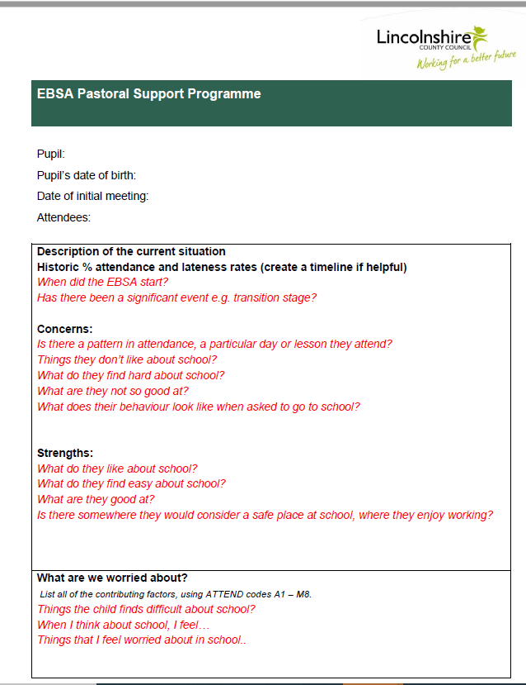
Pastoral Support Plan

Slide 14
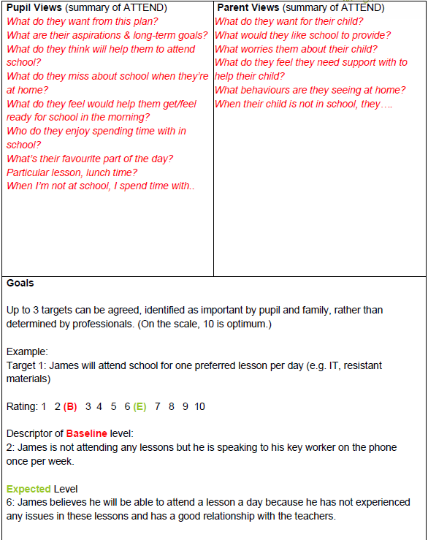
Pastoral Support Plan
Scale the baseline, what is the least we can accept.
The expected is the aim of what everyone would like to see.

Slide 15
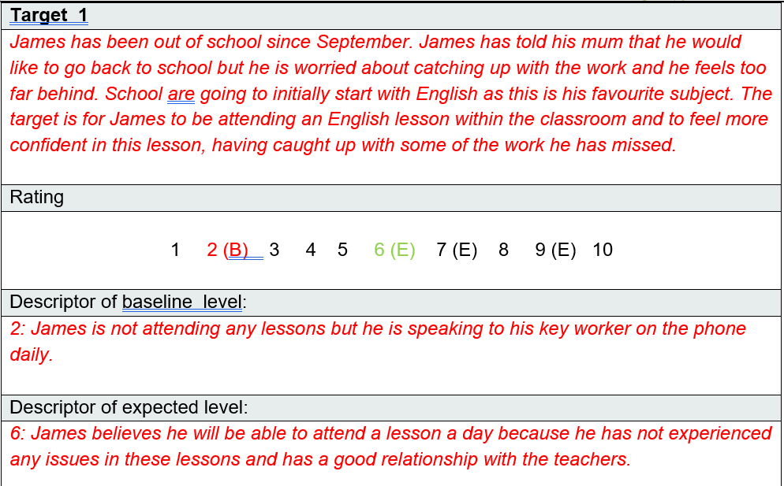
Pastoral Support Plan

Slide 16
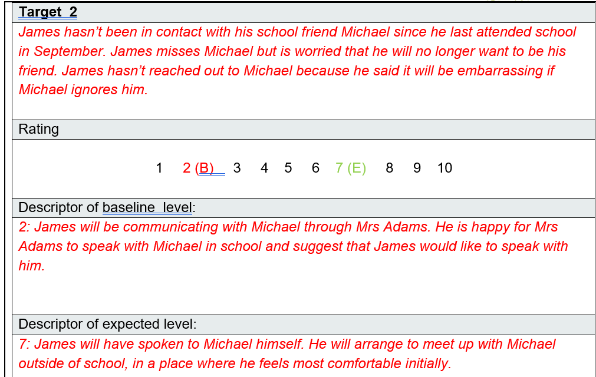
Pastoral Support Plan

Slide 17
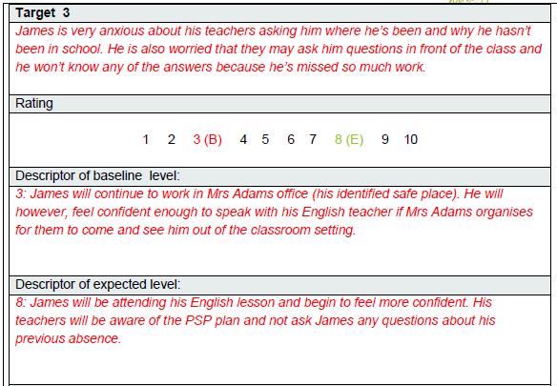
Pastoral Support Plan

Slide 18
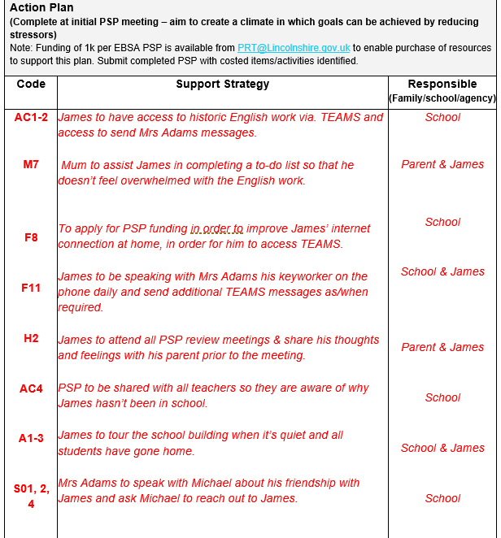
Pastoral Support Plan

Slide 19
PSP: 6 week review

Slide 20
PSP: 6 week review

Slide 21
PSP: 6 week review

Slide 22
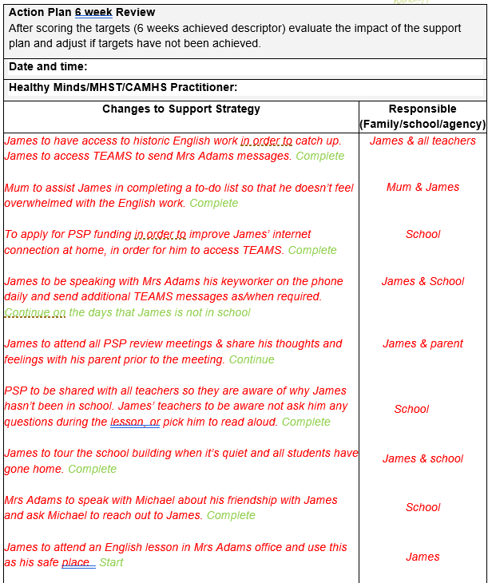
PSP:
6 week review

Slide 23
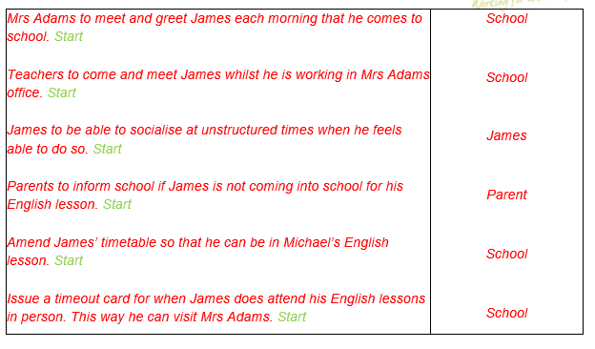
PSP: 6 week review

Slide 24
PSP: 6 week review

Slide 25
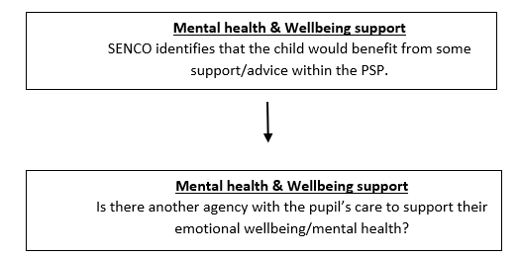
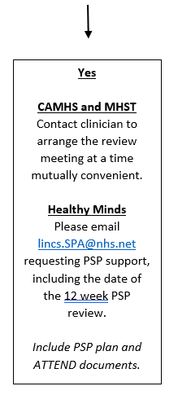
PSP:
6 week review

Slide 26
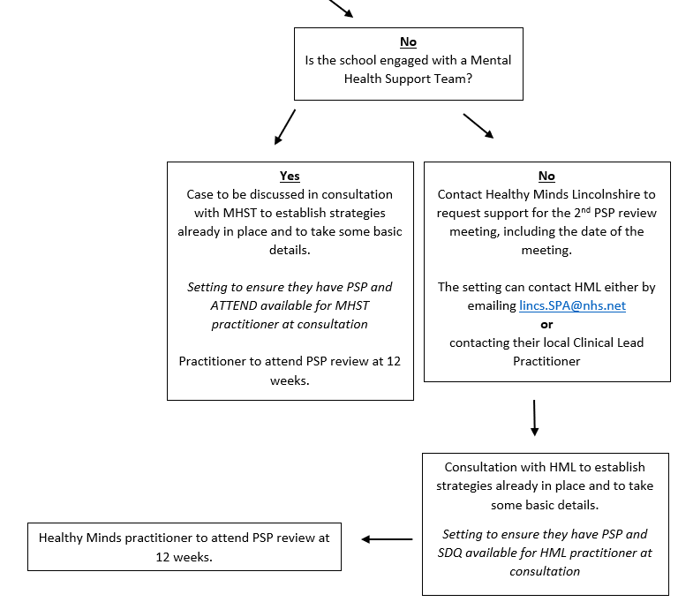
PSP: 6 week review

Slide 27
PSP: 12 week review

Slide 28
PSP: 12 week review

Slide 29
PSP: 12 week review

Slide 30
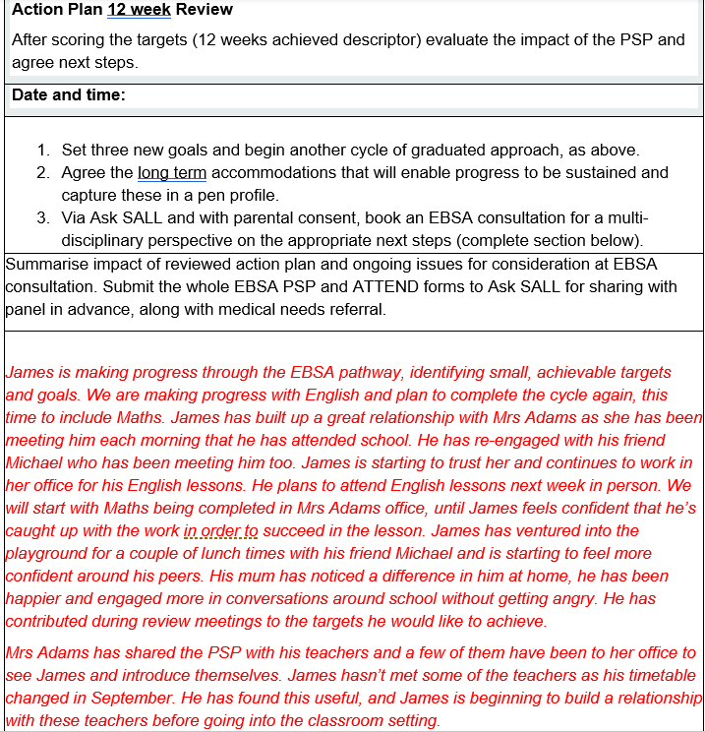
PSP:
12 week review

Slide 31
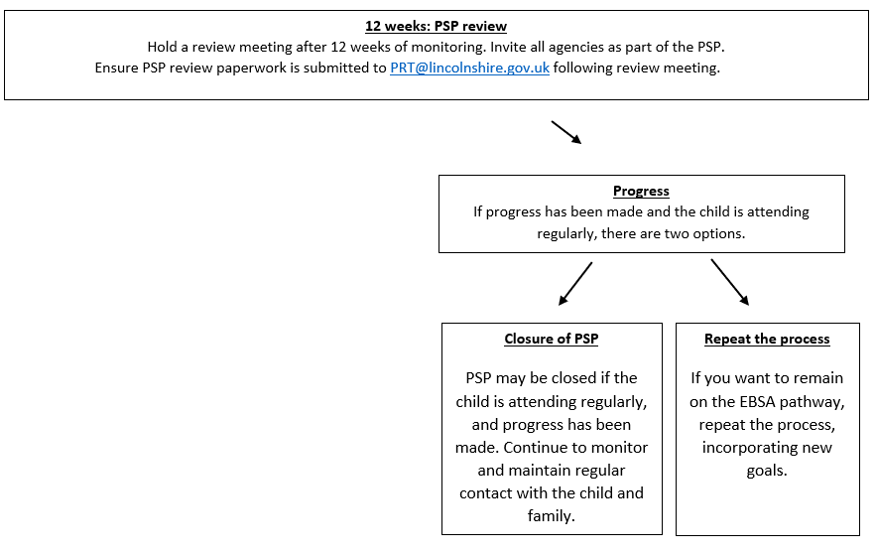
PSP: 12 week review

Slide 32
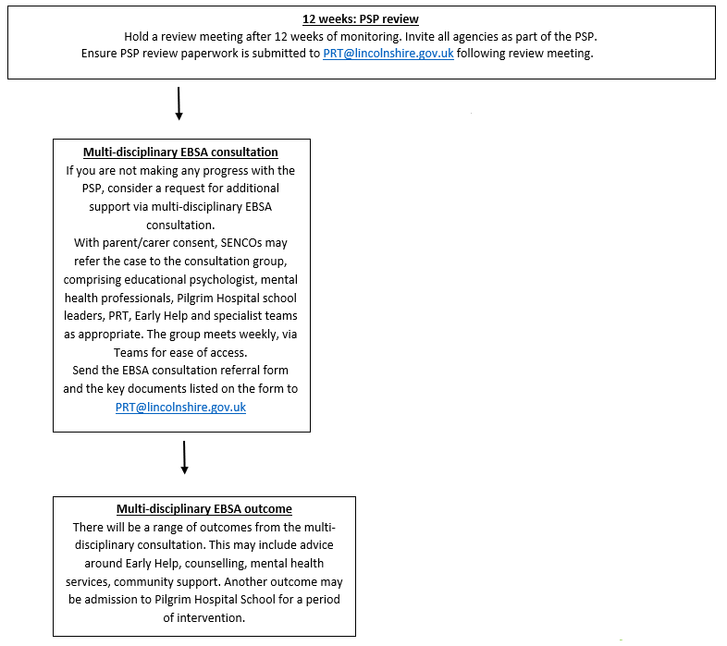
PSP: 12 week review

Slide 33
Medical Support Panel
Complete a Request for Education Support referral form and submit to PRT@lincolnshire.gov.uk
Your request will be discussed by the specialist EBSA panel, and a decision will be made regarding the next steps.
You will receive an outcome from the PRT and detailed feedback.

Slide 34
Leaflets & guidance document
The EBSA caseworkers have put together a professional's guidance document to share with schools. This includes information around Emotional Based School Avoidance and lots of resources to assist you when working with these students. This will be shared with schools once finalised.
There are also parent and student leaflets with information around Emotional Based School Avoidance and signposting to agencies that can help.

Slide 35
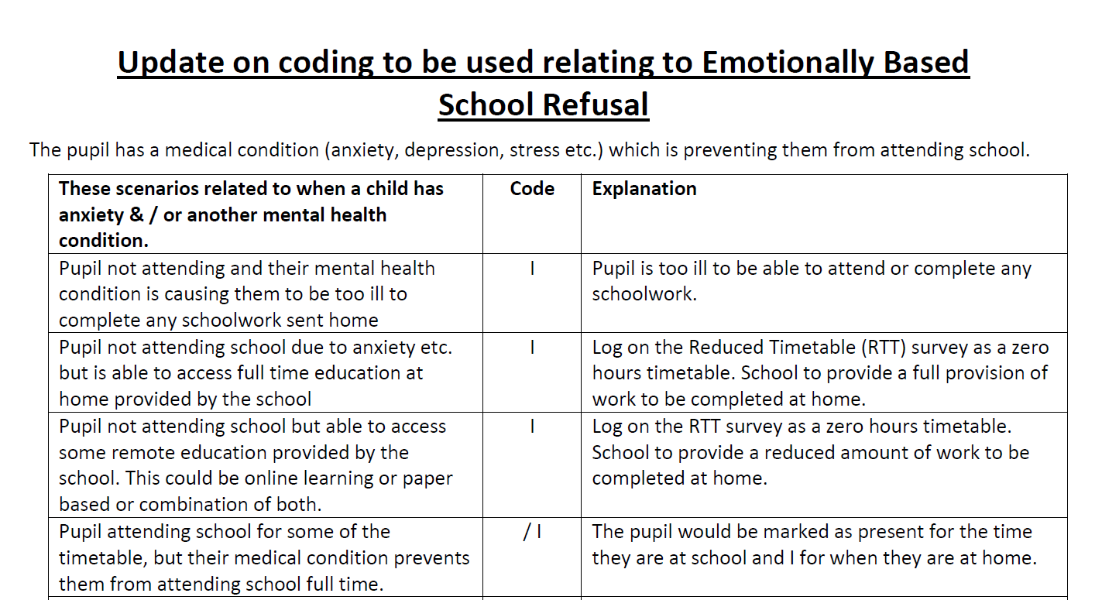

Slide 36
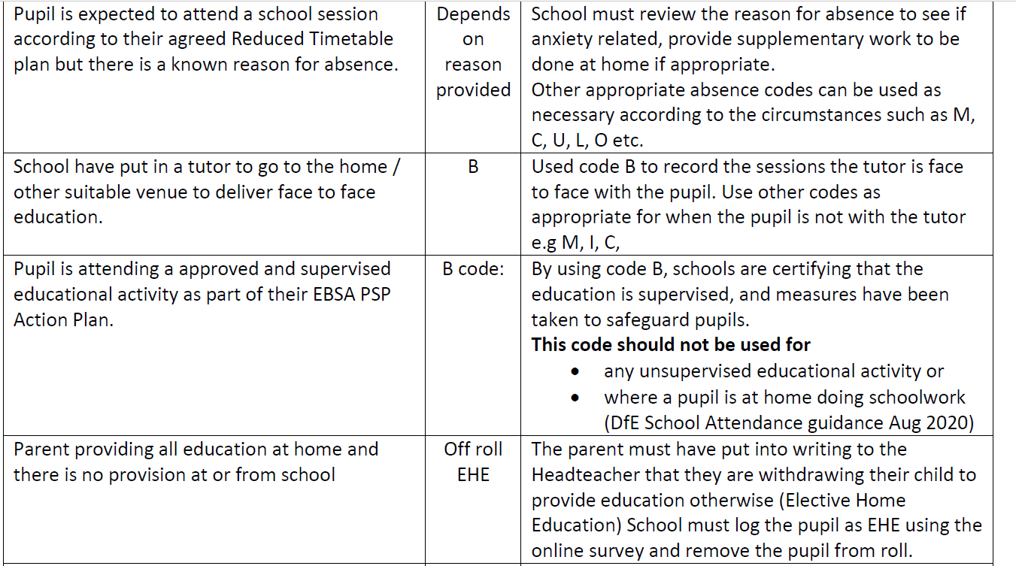

Slide 37
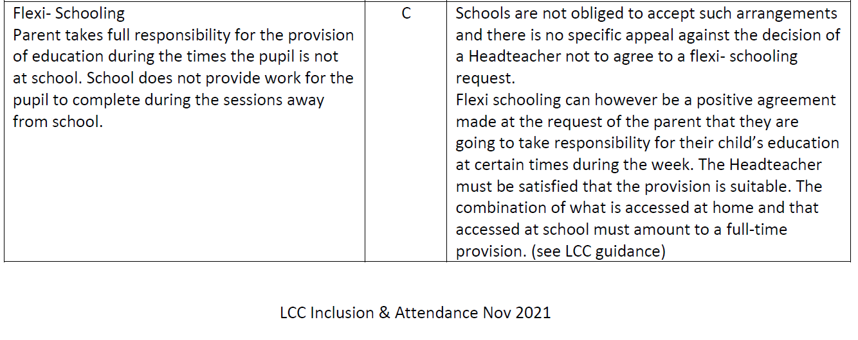
Attendance@lincolnshire.gov.uk
Enquiries related to attendance coding, reduced timetables any other general attendance enquiries

Slide 38
EBSA Questions and Answers
At what point is a student considered officially on EBSA? Once school based anxiety has been identified as main reason for not attending and this has been authorised by the school
Does EBSA replace medical evidence? Medical evidence is always preferable and even once EBSA has been identified, school should continue to try to get medical evidence to confirm their thoughts. A lack of effort by the parent to get this, may contribute to a ‘lack of engagement’ further down the line, but not necessarily
Can school still ask for medical evidence or write to GPs in the same way as before? Depends on the GP (you may be charged), but parents can show evidence of appointments via text
Is an EBSA student coded as an I? Yes if they are too ill to go to school. If they are attending some of the time, but then have an unplanned absence, then this will need to be considered under normal attendance codes.

Slide 39
EBSA Questions and Answers
How to deal with avoidance or delay tactics from parents to start the EBSA process? If there is strong evidence that parents are not cooperating, then it may result in taking more legal approach to non attendance. But school would have to look at full picture as to why they may be avoiding – i.e. do they understand the process?
If it becomes clear that the issue is not an emotional one, can we remove that student from the EBSA? Would be a joint decision within the school. School would need to explain to parent and child if appropriate why they are removing them from the pathway and what is going to be in its place, if anything.
If a student on EBSA is refusing to attend can school un-authorise those absences? Not if the reason for absence has been identified as EBSA. Case by case may identify circumstances where the real reason for being off overrides the fact that the child is EBSA.
Can student with long term illness that is not emotionally based be referred to pilgrim without EBSA? Yes, the medical form clearly distinguishes between medical need and EBSA. However it would be question if a pupil was put through as having a medical need who turned out to have EBSA and the pathway had not been followed

Slide 40
EBSA Questions and Answers
If a student is reported as PNAR is there a point when they can be removed from roll? No, not unless they no longer live in the area, or are attending another school or gone EHE etc
In the case of medical professionals failing to provide evidence for illness, at what point do we change coding as illness to coding as unauthorised? School would have to consider whether, despite having no medical evidence, they think the child is ill. If they do not, and parents have not proven otherwise or there is no other evidence that would support the illness, then the school could consider changing the code
If a student reaches the FPN or becomes a legal case can this continue to the next academic year or do we start the process again? The case can continue but they should really summarise the previous academic year, (a para or couple of paras only to state main concerns, list only main interventions) and then focus on capturing, within the chronology section, what has happened in the new academic year.
If a child is on EBSA how often does a home visit need to be carried out? Case by case, depends on the plan, need of the child, safeguarding etc

Slide 42
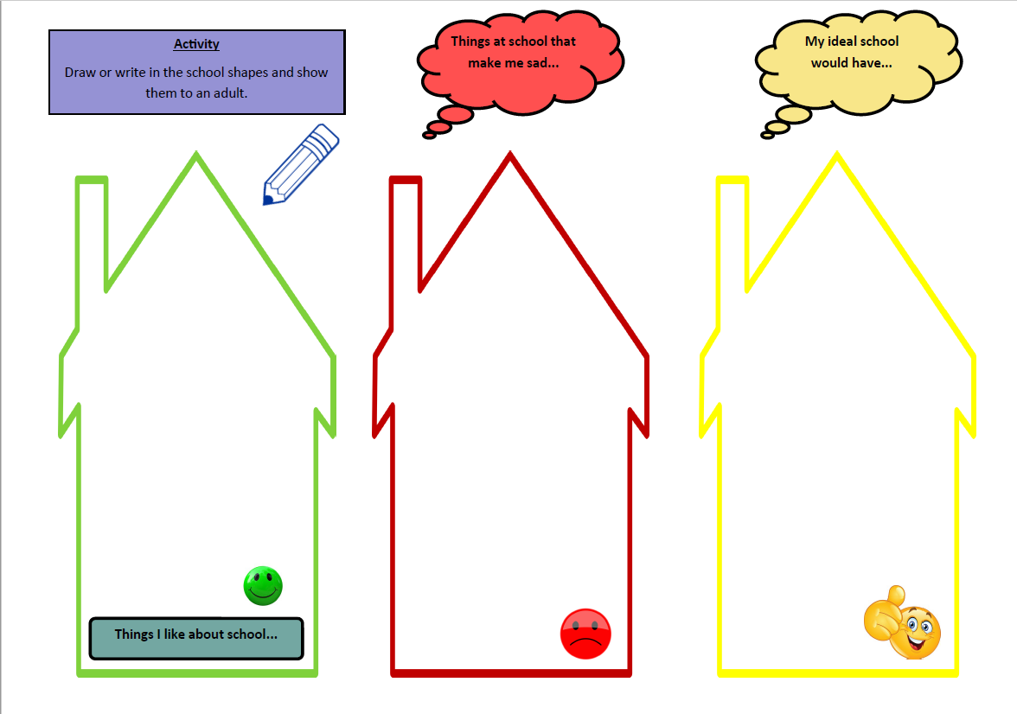

Slide 45
Contact details
PRT@lincolnshire.gov.uk
Funding requests, Medical Support Panel referrals & submitting PSP paperwork
AmandaT.Smith@lincolnshire.gov.uk
EBSA enquiries for Boston & South Holland
Chelsea.Ironmonger@lincolnshire.gov.uk
EBSA enquiries for North & South Kesteven
ClaireM.Richardson@lincolnshire.gov.uk
EBSA enquiries for East Lindsey
PRT@lincolnshire.gov.uk
EBSA enquiries for Lincoln & West Lindsey
Attendance@lincolnshire.gov.uk
Enquiries related to attendance coding, reduced timetables any other general attendance enquiries

Slide 46
Questions?

