Slide 1
An Update from Whole School SEND
Graduated Approach Briefing Summer 1

Slide 2
https://www.sendgateway.org.uk
https://www.wholeschoolsend.org.uk/page/wss-past-events
https://nasen-prod-asset.s3.eu-west-2.amazonaws.com/s3fs-public/Wider%20Reading_0_0.pdf

Slide 3
https://www.sendgateway.org.uk
Wider Reading The below lists some resources utilised by participants on the 2021-2022 Professional Development Groups project. These resources have not been produced or quality-assured by Whole School SEND.
• Elly Chapple - #flipthenarrative
• Rachel Cosgrove – Inclusive Teaching in a Nutshell
• Nic Crossley and Des Hewitt – Inclusion: A Principled Guide for School Leaders
• Barry Prizant – Uniquely Human
• Carol Stock Kranowitz – The Out-of-Sync Child
• Jane Alison Sherwin – My Daughter is Not Naughty
• Daniel Sobel and Sara Alston – The Inclusive Classroom: A New Approach to Differentiation
• The Knoster Model for Managing Complex Change
• The Kotter 8-Step Process for Leading Chang
https://nasen-prod-asset.s3.eu-west-2.amazonaws.com/s3fs-public/Wider%20Reading_0_0.pdf

Slide 4
SEND Review

Slide 5
The review has identified 3 key challenges facing the SEND and alternative provision system.
Navigating the SEND system and alternative provision is not a positive experience for too many children, young people and their families.
Outcomes for children and young people with SEND or in alternative provision are consistently worse than their peers across every measure.
Despite the continuing and unprecedented investment, the system is not financially sustainable.
A single national SEND and alternative provision system
The review concludes that there is a need for much greater consistency in how needs are identified and supported, so decisions are made based on a child or young person’s needs in co-production with families, not where they live or the setting they attend.
Excellent provision from early years to adulthood
The review has heard that we need a more inclusive education system to ensure that children and young people with SEND are set up to thrive.
A reformed and integrated role for alternative provision
At their best, alternative provision schools are experts in supporting children and young people whose behaviour or other needs can present a barrier to learning. But, too often the role of alternative provision is unclear, and it is used too late or in a way that is not best focused on children’s needs.
System roles, accountabilities and funding reform
The review has heard the need to align system incentives and accountabilities to reduce perverse behaviours that drive poor outcomes and high costs in the current system.

Slide 6
https://sendreview.campaign.gov.uk/
How you can get involved
We want to hear from a wide range of people, including:
parents and carers
children and young people
people working in the SEND and alternative provision system
You can share your views on our proposals by responding to our public consultation before Friday 1 July 2022.
https://consult.education.gov.uk/send-review-division/send-review-2022/
Notes:
Workshops with Council for Disabled Children and DfE
Working together we’re running some face-to-face and virtual workshops. They will give you the opportunity to hear more about the proposals and ask questions.
You can register for any of the sessions using Eventbrite.
Thursday 12 May, 10am to 3.30pm in London
Tuesday 17 May, 10am to 3.30pm in Manchester
Thursday 19 May, 10am to 3.30pm in Leicester
Monday 23 May, 10am to 3.30pm via Zoom

Slide 7
https://nasen.org.uk/news/sendgreenpaper?utm_campaign=3116425_Wednesday%2030%20March%202022&utm_medium=email&utm_source=Nasen&dm_i=2F68,1USND,9B0601,6G6G2,1
https://nasen.org.uk/news/schoolswhitepaper?utm_campaign=3116425_Wednesday%2030%20March%202022&utm_medium=email&utm_source=Nasen&dm_i=2F68,1USND,9B0601,6G6G2,1
www.sendgateway.org.uk/resources

Slide 8
New Resources

Slide 9
SEND Development Pathway
https://www.wholeschoolsend.org.uk/resources/send-development-pathways-school-workforce-guidance-document-including-self-study
https://www.wholeschoolsend.org.uk/resources/send-development-pathways-interactive-powerpoint
Notes:
This is a ‘How to Guide’ to support both Pathway participants (school workforce), and their line managers, in using the SEND Development Pathways resources to support ongoing continuing professional development.
An essential part of the SEND Development Pathways will be the discipline of self-study and so, there are a range of self-study support materials provided alongside the pathways. These materials are intended to support participants and their line managers.
Please note: This resource will not be finalised until after the SEND Development Pathways for School Workforce webinar event.
It is strongly advised that you engage with the Guidance Document before accessing the PowerPoint.
The SEND Development Pathway is characterised as a train map. Participants can use the interactive map to plan their career ‘journey’ by selecting the line between their current role (‘current station’) and their intended role (‘destination station’).
This will generate a ‘ticket’ (see ‘How to Use the Ticket’ in this guidance), detailing the CPD resources which are available to support them on their journey. In many cases, career development will involve a number of short journeys, resulting in multiple ‘tickets’.
Participants wishing to develop their skills and expertise in their current role can click on the station itself. Their ticket will then detail the resources that they can access to deepen knowledge, improve skills and increase confidence in their current role.

Slide 12
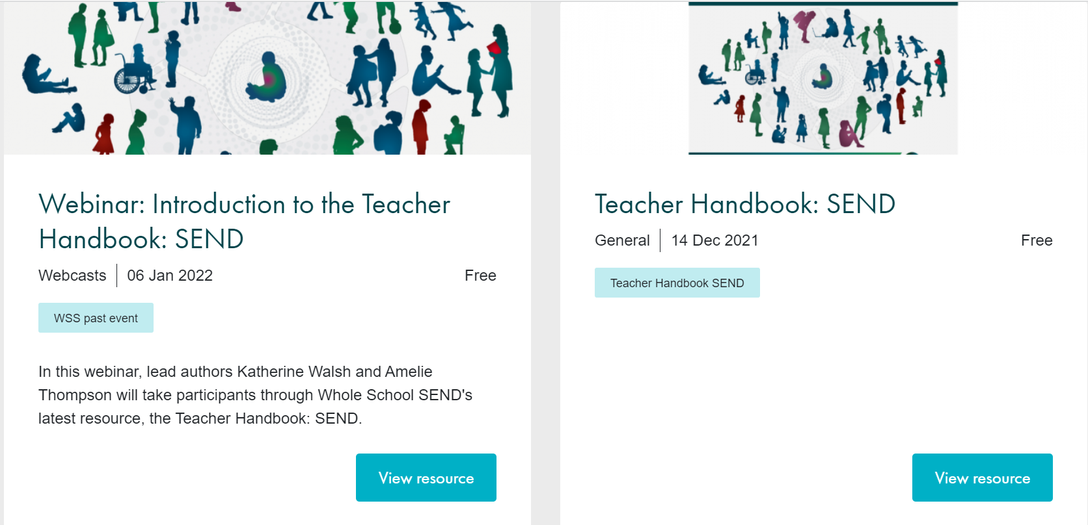
Teachers Handbook: SEND
www.sendgateway.org.uk/resources

Slide 13
https://event.bookitbee.com/38513/strategic-implementation-of-the-teachers-handbook-
https://event.bookitbee.com/38515/teachers-handbook-send-next-steps
Delivered by the WSS Regional Team. Bookable via the LEARN Teaching Centre Bookitbee.

Slide 14
Notes:
Please get in touch should you like to know any more about WSS and the work we do.

