Slide 1
L.E.A.D. Teaching School Hub
Managing the changes together…

Slide 2
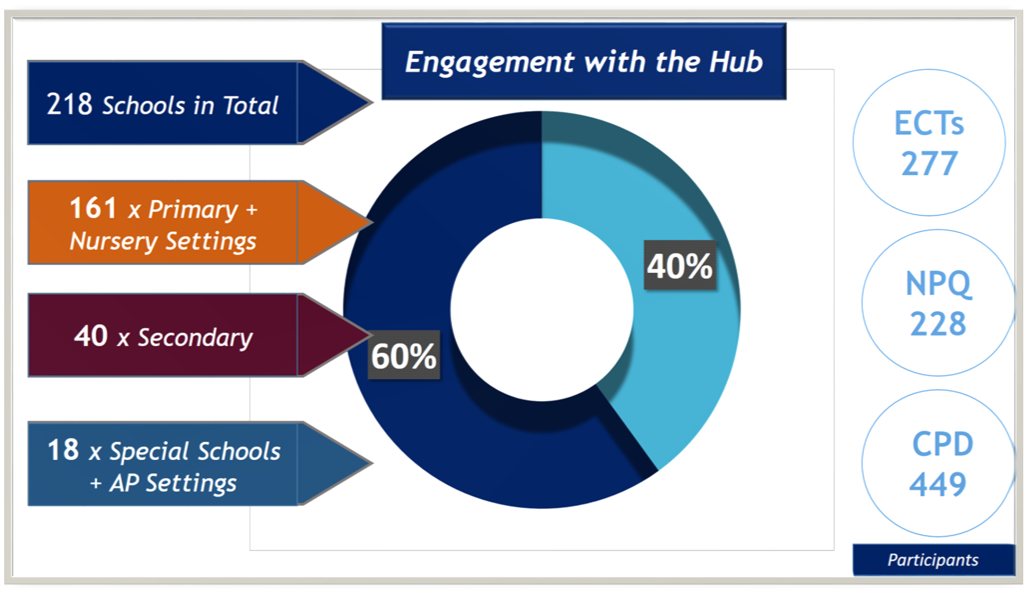
Schools Engaged
‘Working in partnership, achieving the highest outcomes for all’

Slide 3
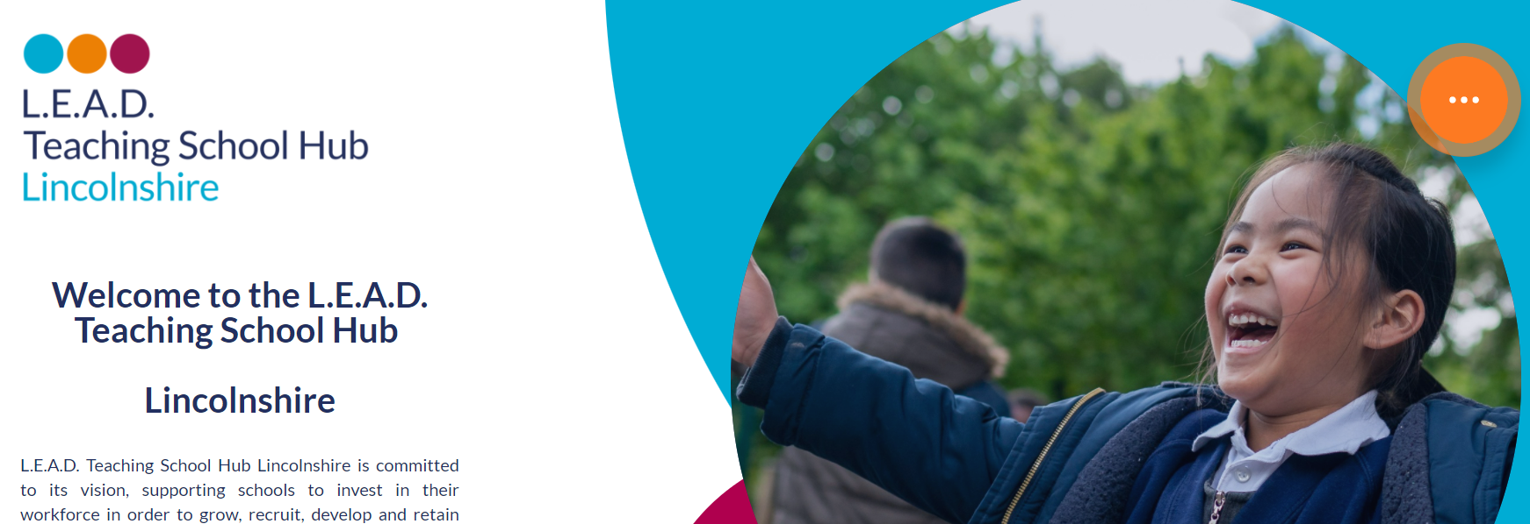
https://www.leadtshublincs.co.uk
Hubs
Hubs
Notes:
Start with the bigger picture in relation to why you are here today.
The Teaching School Hub which was launched in September is responsible for nurturing you to develop professionally. That is its DNA. At each stage on this diagram, there are opportunities for professional development though a range of CPD on offer with the Hub.
The DfE recognised that this needs to be seamless and of high quality which is why Hubs have been designated to provide that all under one umberella – working with EDT a lead provider who wrote the curriculum content which you are currently experiencing.
You are currently on that big red band - as in monopoly, you have already passed go and you are onto the next phase! A two year pathway with a lot of opportunities ahead.
Provided the website, this is one that you need to keep and log for being part of this future development.

Slide 4
The Journey to this Point
‘Working in partnership, achieving the highest outcomes for all’
Notes:
Working so hard to raise the profile and share this for future generations of teachers who hope to come into the profession.
Feel free to tweet to support this and share the good bits.
If not on twitter- consider the benefits as there are a lot of education based communities.

Slide 5
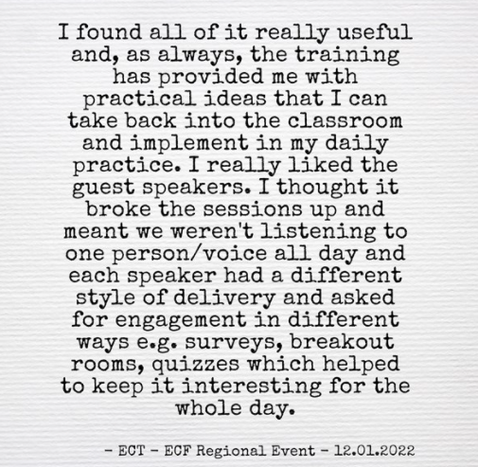
ECF Regionals
Notes:
Focus Groups
ECTs
94% good or above
27% exceptional
Mentors
93% good or above
30% exceptional

Slide 6
ECF Regionals Mentors
Notes:
Focus Groups
ECTs
94% good or above
27% exceptional
Mentors
93% good or above
30% exceptional

Slide 7
Facts so far…
Programme | Participant Target | Actual
NPQH | 20 | 38
NPQSL | 40 | 70
NPQLTD | 50 | 56
NPQBC | 30 | 36
NPQLT | 30 | 86
TOTAL | 173 | 286
286 Participants
‘Working in partnership, achieving the highest outcomes for all’
Notes:
NPQs – engagement is strong.
Two cohorts now
Recruiting again in the summer term
Two blocks of learning released so far – Implementation of change – practical support of how to go about this closely linked to what the research says – we are bringing in contexts of where this has worked

Slide 8
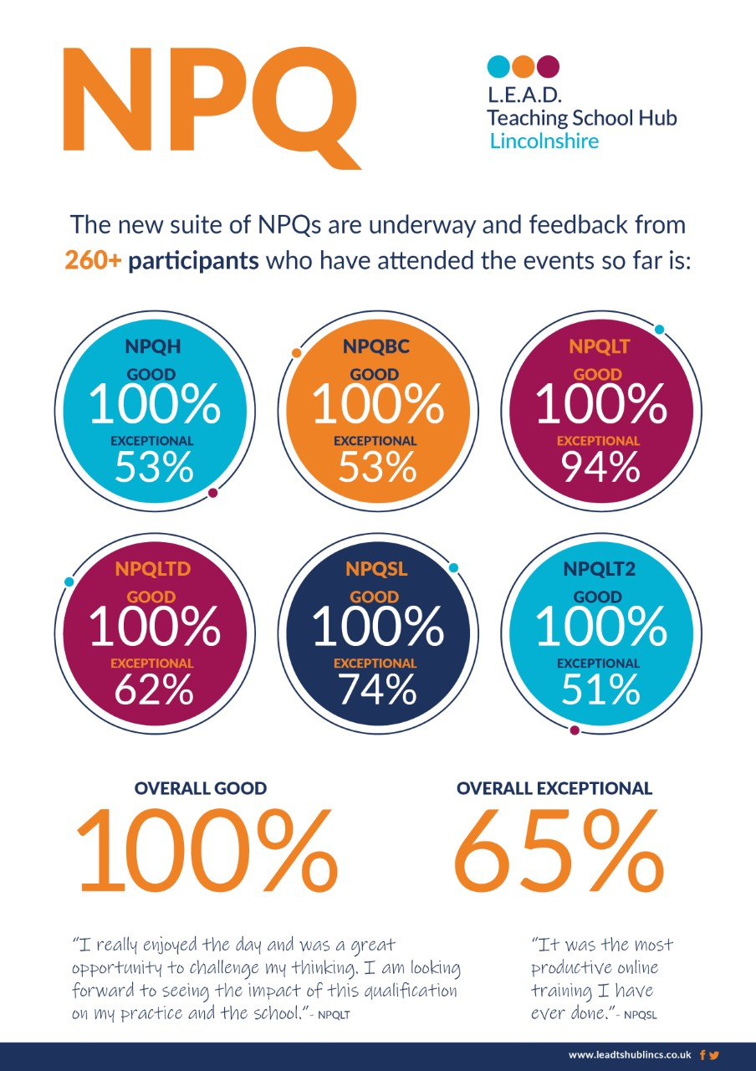
Notes:
Feedback so far
Range of audience is vast – aspiring to leadership as well as experienced leaders – taking steps now we are becoming more familiar with the approach to adapt to ensoure we meet the needs of all engaged

Slide 9
English Hub
30 Partner Schools
42 new schools engaged through Medium Level Support.
203 delegates attended ‘Medium Level Support’ events to date.
44 schools accessed EH funding.
19 Audits in total completed (or booked).
Working closely with Local Authority.
Created SSP Guidance document for schools.
100% Good or better feedback on all training attended.
Notes:
Following a number of enquiries in relation to the most appropriate phonics programme, in line with the latest DfE guidance, the English Hub has produced a document which outlines the most up to date messages in this area. The introduction to this can be found below
https://drive.google.com/file/d/1Pi5w4FJ6awOE-FgMDrZe-GOvWXoVgx6F/view
Medium Level Support is underway as are the English Hub Showcases and follow up Open mornings in school – at the point of graduating current Partner schools and identifying those we will work with next year.

Slide 10
Sarah Robertson
Natalie Packer
James Ellis
Notes:
SEND in the Mainstream

Slide 11
Notes:
LENS 22 is coming
SEND reviews

Slide 12
Bespoke professional development
Back on Track
Support for transition FS to Y1
Notes:
Bespoke CPD – staff meetings / twilights
Individual support / work with groups of teachers in house to support with accessing PD

Slide 13
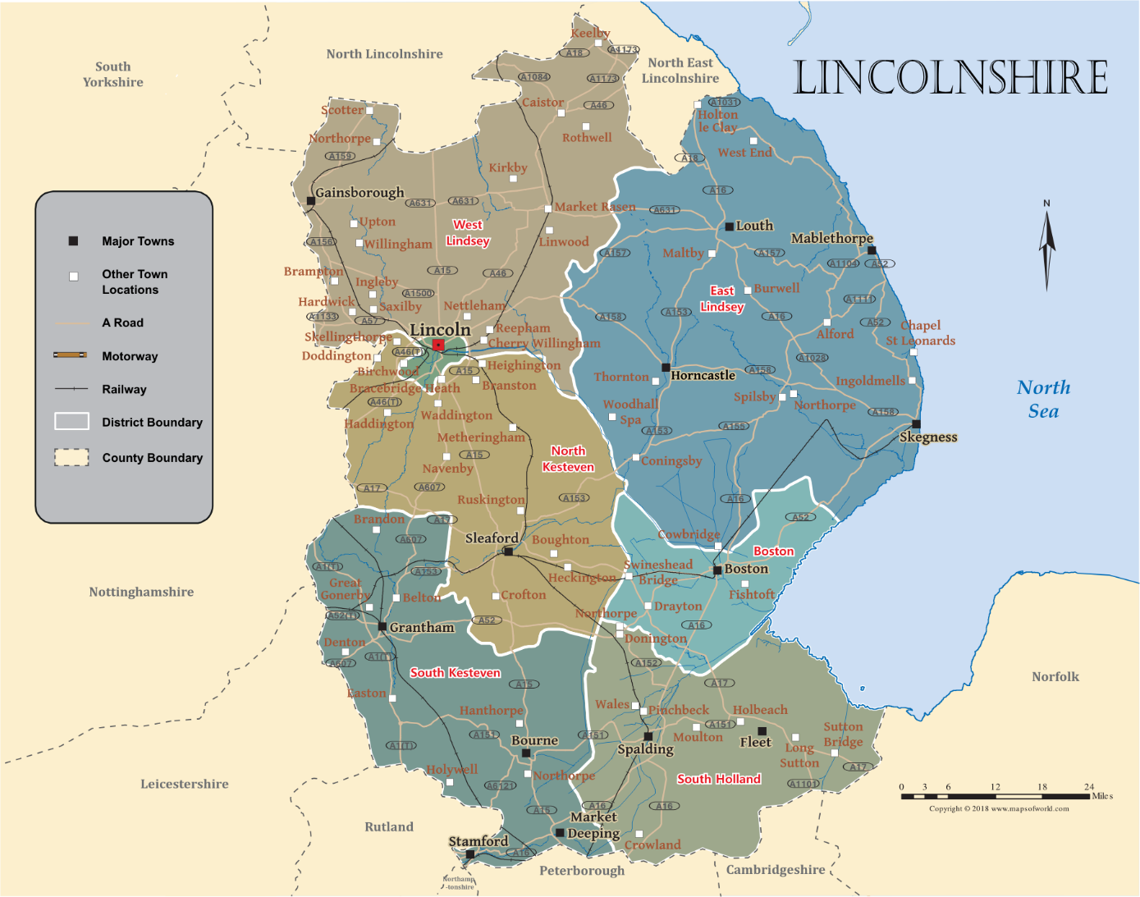
‘Sector Led Specialists’
Notes:
Early Years / Reading / Maths in each region

Slide 14
We want to hear from you…….
What is missing in the sector?
How can we help you?
What CPD do you need moving forwards?
What does your school need?
Notes:
Early Years / Reading / Maths in each region

