Slide 1
Introducing the new digital Valuing SEND Tool and Inclusion Toolkit
February 2022

Slide 2
Accessing the V SEND Tool and support material on the Local Offer.
Valuing SEND – Professional resources (lincolnshire.gov.uk)

Slide 3
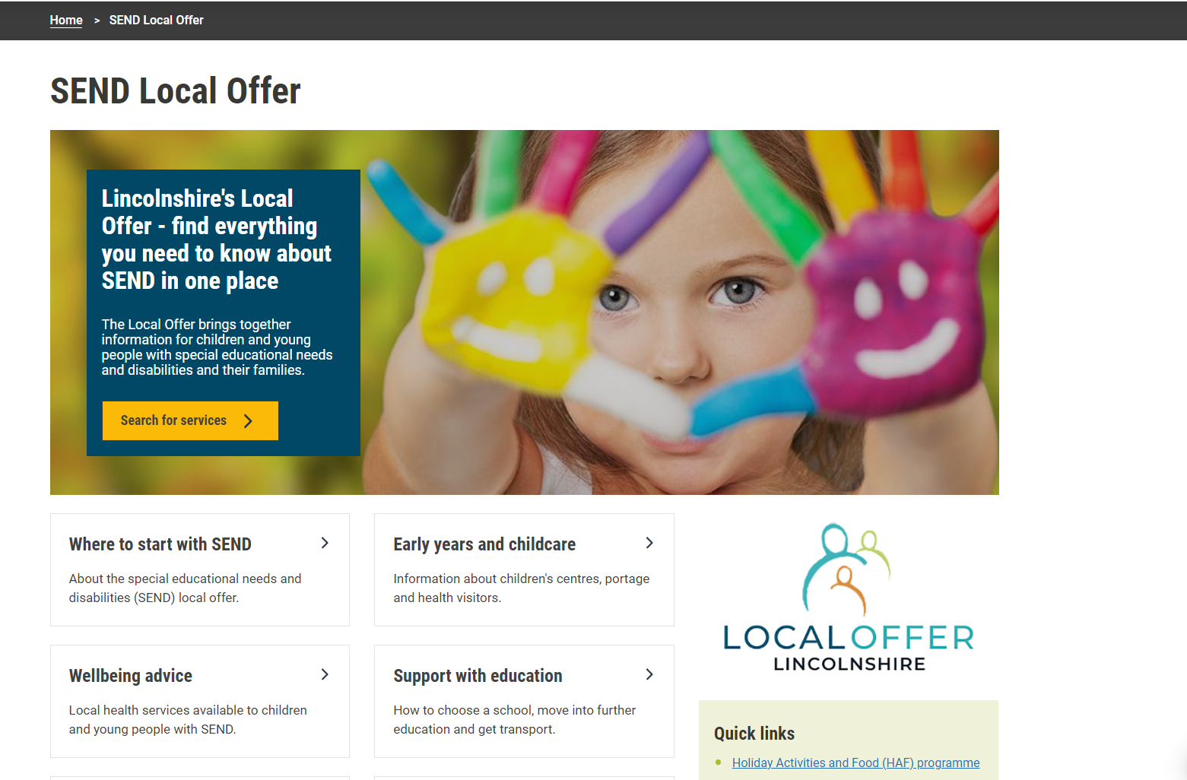
To find everything to do with the Graduated Approach on the Local Offer, go to the Home Page and select Support with Education:

Slide 4
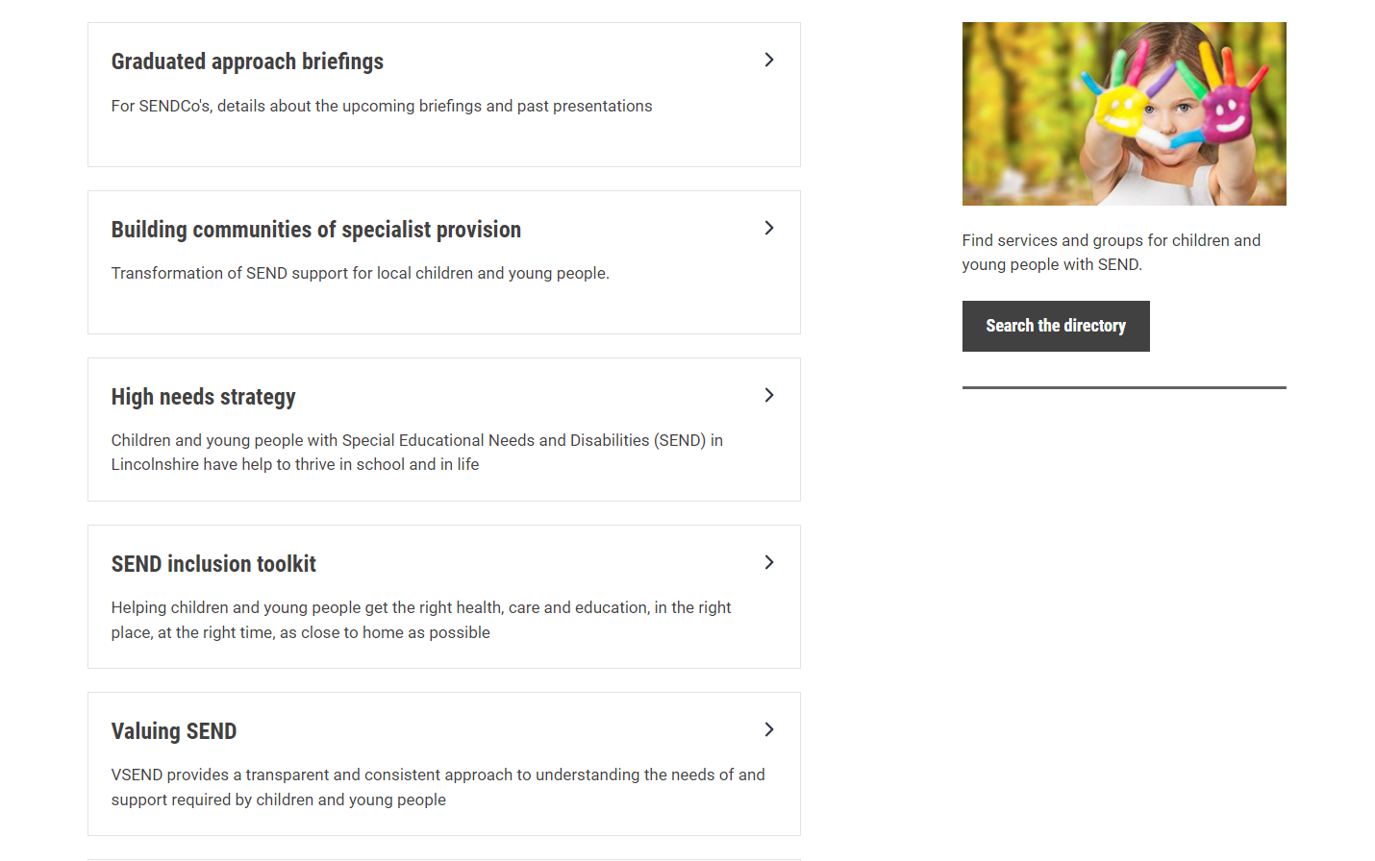
Notes:
The sub-headings move around but will always be found under Support with Education

Slide 5
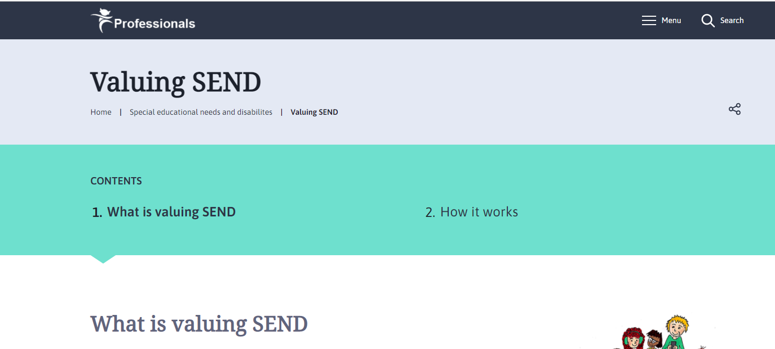

Slide 6
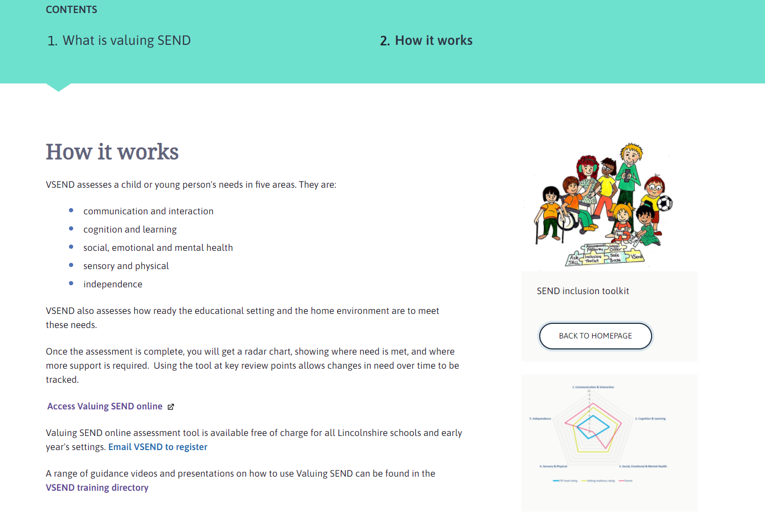
Notes:
Any issues with accessing the tool or registering via link, please email Carrie.Forrester@lincolnshire.gov.uk

Slide 7
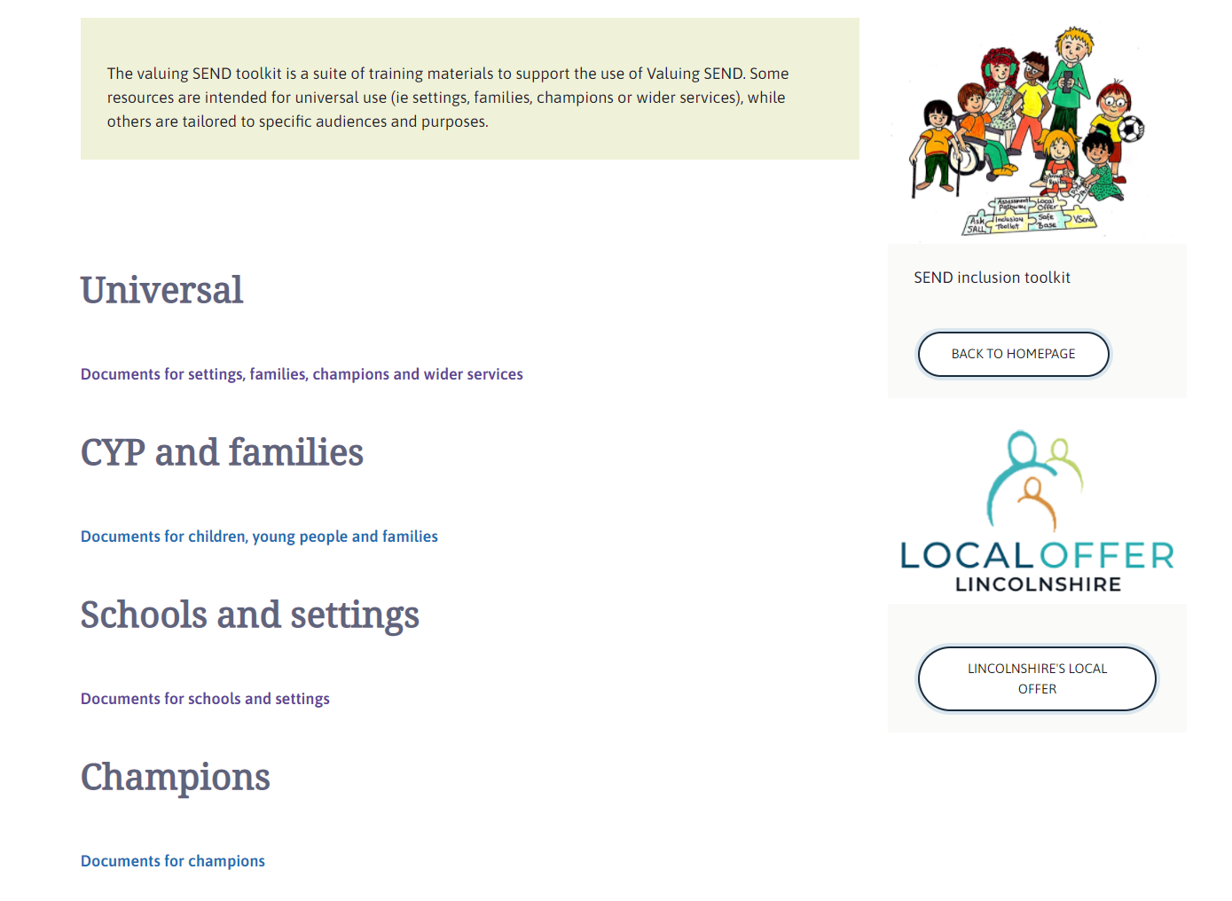
The videos that are coming next are available in the Universal section
Notes:
Watch videos 2-5 here: Universal – Professional resources (lincolnshire.gov.uk)

Slide 8
Note that on all pages in the Valuing SEND section there are links back to the SEND Inclusion Toolkit on the right.

Slide 9
Please encourage your staff team to take the time to read all sections when they first start using the Inclusion Toolkit.

Slide 10
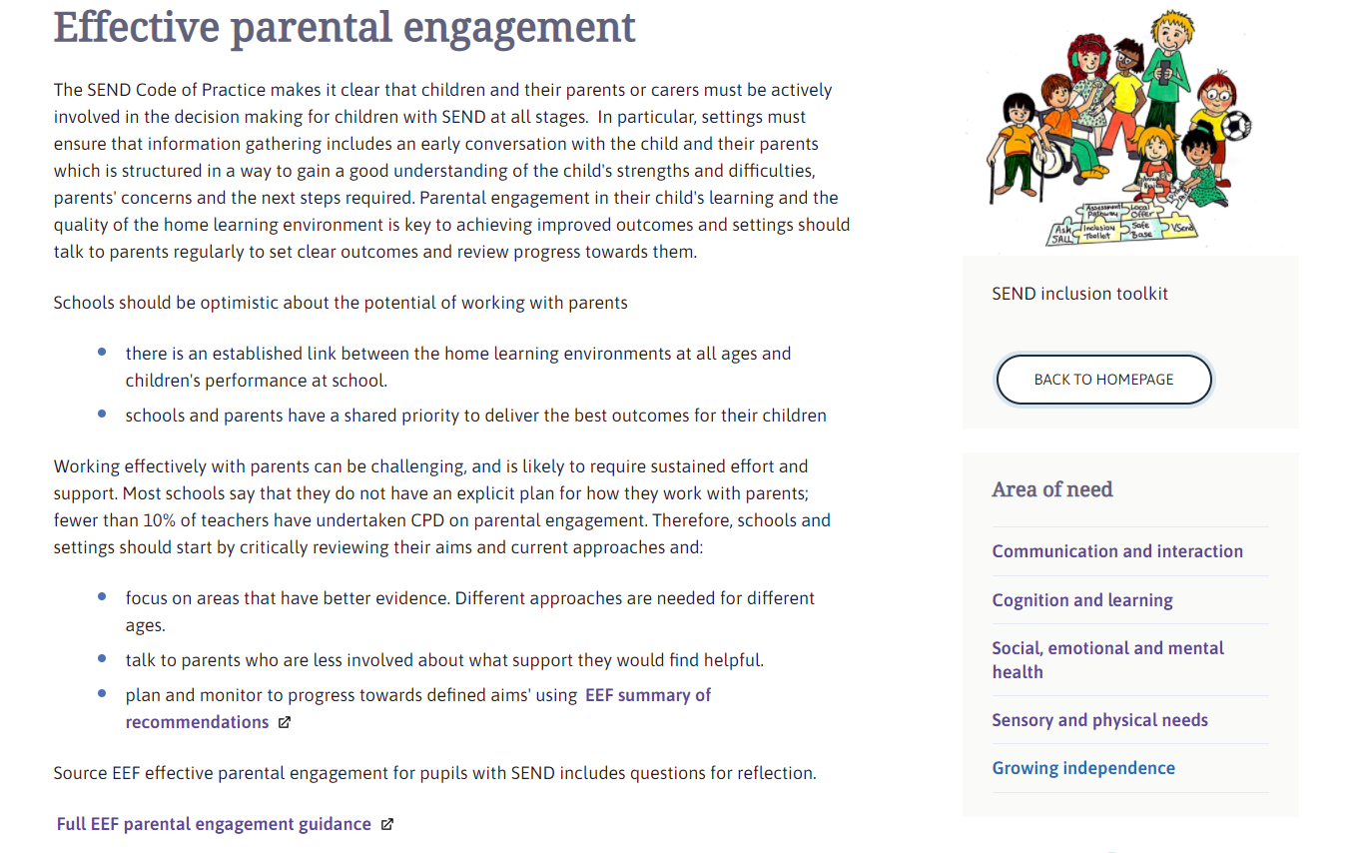
In the Working in partnership with parents and carers’ section there is some useful information on effective parental engagement from EEF:

Slide 11
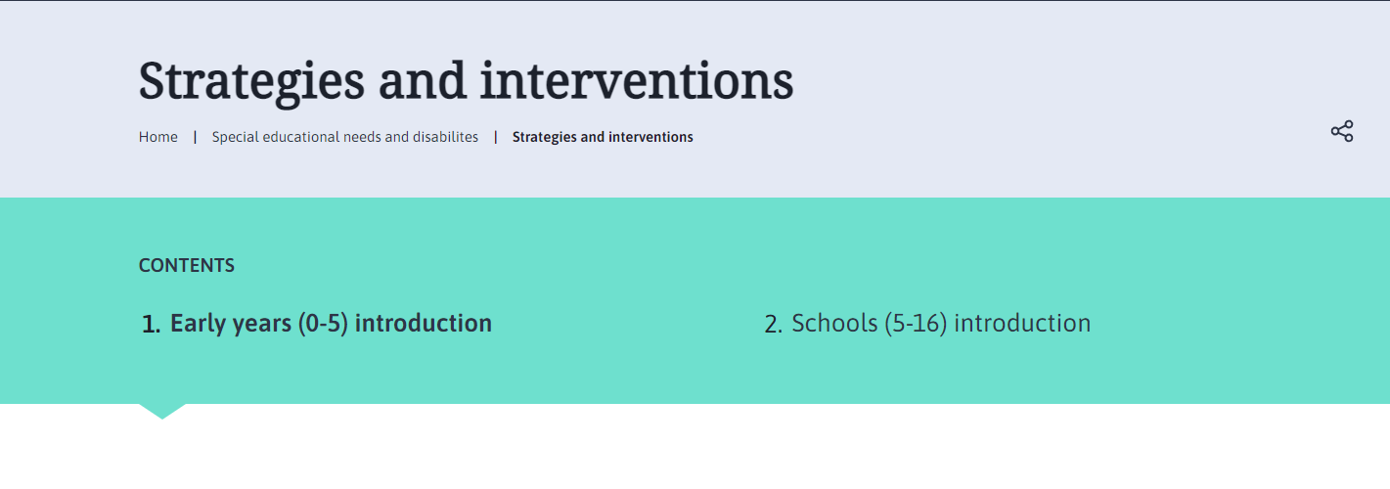
Once they have read all the sections, the Strategies and interventions section will be the one that is used most:
Notes:
Following on from the introduction, you can navigate to the strategies and interventions either by the link at the bottom of the page or by the areas of need quick links in the side bar.

Slide 12
