Slide 1
Graduated Approach Briefings
February 2022
Notices

Slide 2
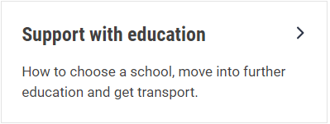
Welcome
To locate information about the Graduated Approach Briefings on the Local Offer, go to: https://professionals.lincolnshire.gov.uk/homepage/54/graduated-approach-briefings
Or on the Home Page, click on: Support with Education
Then scroll down to: Graduated Approach Briefings
Welcome and thank you for joining us for this virtual training session.
Please sign in through the Chat to register your attendance.
As usual, to support everyone to maintain connectivity with so many attendees being here:
Please Mute your microphone and turn off your video when not speaking – we have a large number of participants present today and this may mean that we experience feedback or slowing of the network connection if everybody has their microphone and video on. However, we would like to see you if you ask a question, please, so feel free to switch on both your microphone and video in these instances.
Please note that this meeting, or sections of it, will be being recorded for use on the council’s professionals’ website. If you do not wish to be recorded, you should leave the meeting and watch it back later.
If you would like to ask questions, please use the raise your hand facility or use the chat function in Teams
Please keep discussion in the ‘chat’ relevant – the person presenting may not be able to see your comments but we will have someone monitoring it in order to make sure all questions are answered.

Slide 3
Booking places for future Graduated Approach Briefings will now be available on the Local Offer

Slide 4
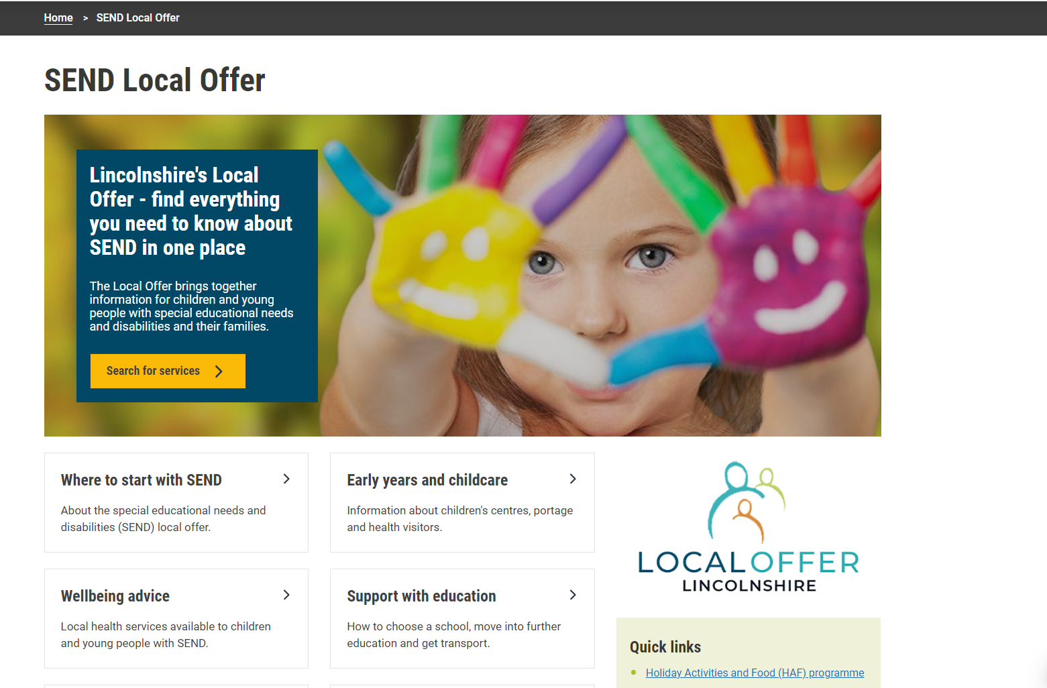
To find everything to do with the Graduated Approach Briefings on the Local Offer, go to the Home Page and select Support with Education:

Slide 5
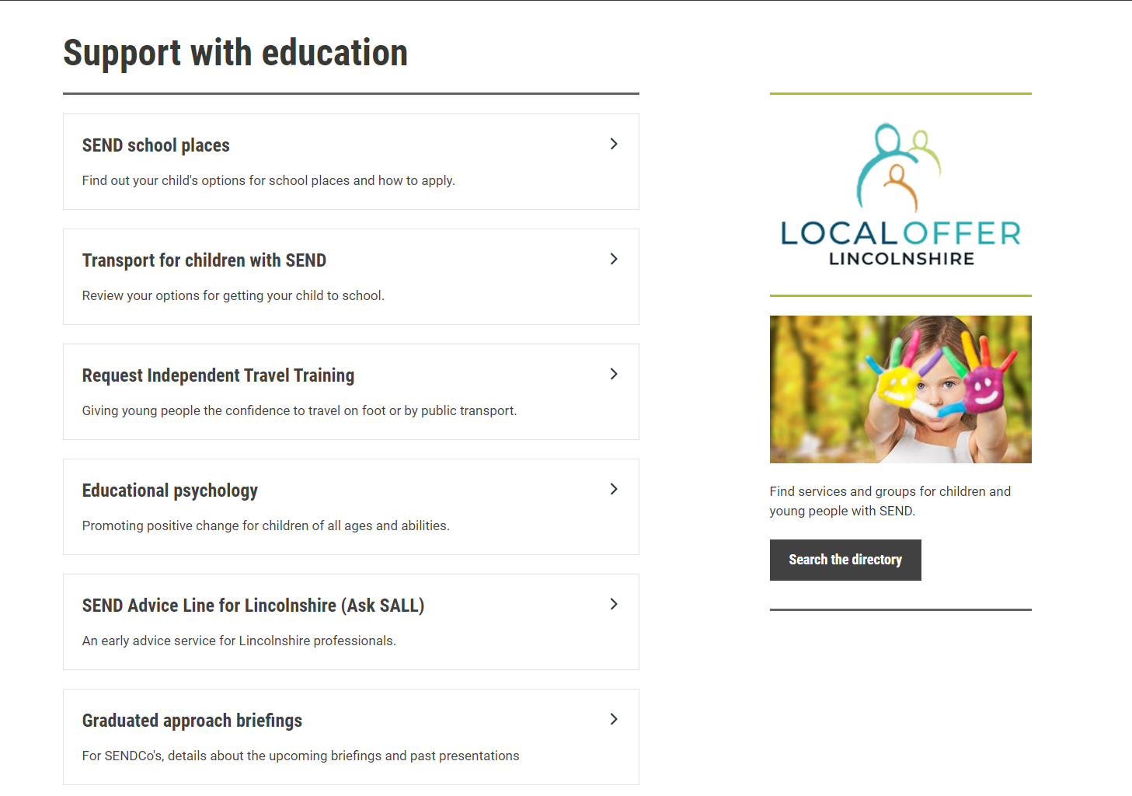

Slide 6
All future meetings need to be booked via this link for the April briefings onwards. This will allow you to book, amend and cancel your place and you will receive automated emails and reminders about your booking and containing the link to enter the meetings. You can book for the April and June Briefings any time now. In July we will get the whole of next year’s briefings on the same page so you can book your sessions for the academic year 2022/23

Slide 7
Revised EHC Needs Assessment Request paperwork
Revised in December 2021
If you have not received a copy of the relevant forms for your setting, please email BS_SEND@lincolnshire.gov.uk if you need a copy urgently. After 15th February, the forms will be available on the Local Offer here: EHC request forms – Lincolnshire County Council
Changes include:
Addition of more information/descriptions to support the completion of
forms
Changes to data sharing information

Slide 8
Specialist Teaching Team (STT) Annual Buy Back
If you wish to purchase annual hours for the financial year 2022/23, please ensure that you have placed your order through Edulincs before the closing date on 24th February 2022.
All details can be found on our Edulincs home page here:
Specialist teaching team – Lincolnshire County Council
A guide to purchasing Annual hours can be found on the Local Offer pages (Graduated Approach Briefings for November 2021) here:
STT_Guide_to_purchasing_annual_hours.docx (live.com)

Slide 9
Dyslexia Outreach Team & ECLIPS
A whole range of training opportunities are available via the Dyslexia Outreach Team and the ECLIPS team. If you have not looked at what they can offer recently, check out their pages in Edulincs.
Dyslexia outreach support – Lincolnshire County Council
Specialist speech and language training – Lincolnshire County Council

Slide 10
Presentations and Videos will be available from 15th February
Remember to visit the Graduated Approach Briefings page on the Local Offer so that you can view the presentations and videos for this round of briefings and any from the previous academic year.
Graduated approach briefings – Professional resources (lincolnshire.gov.uk)

