Slide 1
An Update from Whole School SEND

Slide 2
Notes:
There is still time to book onto the Autumn Term webinar series. If you have missed the first sessions don’t worry they are all available as recordings and you can then register for the remining live events. To do this go to sendgateway.org.uk and register for your free membership to WSS. All staff can do this. Don’t forget to tick for the national newsletter which will inform you of new webinars, blogs etc.
There are more events available for the Spring term which can be accessed by the events link on the sendgateway.

Slide 3
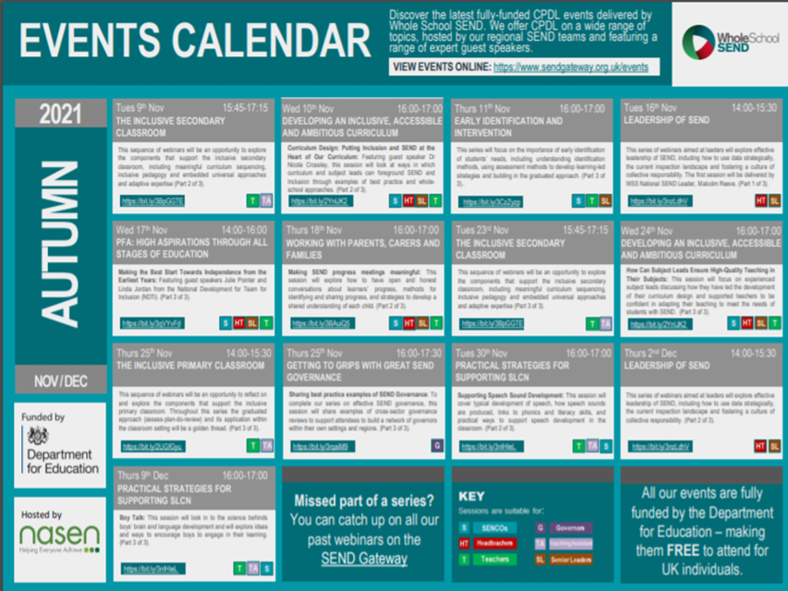

Slide 4
https://www.sendgateway.org.uk/specialist-provision-area
Notes:
A new section has been added to the sendgateway, a Specialist Provision Area.
This area is dedicated to sharing examples of effective resources from specialist settings, and examples of how Whole School SEND resources have been used effectively in a specialist setting. These are resources that special schools themselves have found useful to their practice.
If you would like to feedback on any of the resources on this page, have a resource you would like to share, or know about specific resources you would like to see hosted on this page, please email info@wholeschoolsend.com.

Slide 5
Lead- Inclusion-School locator map.
Notes:
Inclusion 2024 is a funded initiative
Scan the QR Code to see a map where you can locate you nearest Lead-Inclusion-School

Slide 6
Notes:
Talk through slide content

Slide 7
Notes:
Talk through slide

Slide 8
Notes:
Talk through slide

Slide 9
Notes:
There is a suite of film clips made with learner with a range of SEND to show how people with additional needs can and should be active. Championing inclusion.

Slide 10
Notes:
Talk through slide

Slide 11
Notes:
Some useful resources links

Slide 12
Notes:
Please get in touch should you like to know any more about WSS and the work we do.

