Slide 1
Teaching School Hub
Professional Development
Managing the changes together…

Slide 2
Schools Engaged
181/365 schools on a programme NPQ/ECF/CPD
‘Working in partnership, achieving the highest outcomes for all’

Slide 3
Catch Up Funding
Notes:
Following two months of operation, L.E.A.D. Teaching School Hub and Partners are encouraged by the positive feedback- 98% good or better across all areas.
Catch Up / Recovery / Pupil Premium / Tutoring - Clarifying the Funding Streams Following feedback from a number of schools, many have been asking for clarity around the complex landscape of catch up/tutoring/recovery funding streams. To support this, the Teaching School Hub has produced a simple document. We hope that you find this useful. CLICK HERE to access your copy.
file:///C:/Users/LisaCassidy/Downloads/school%20newsletter_6a%20(2).pdf
Reading Framework

Slide 4
Facts so far…
Programme | Participant Target | Actual
NPQEL | 3 | 3
NPQH | 20 | 24
NPQSL | 40 | 44
NPQLTD | 50 | 42
NPQBC | 30 | 21
NPQLT | 30 | 67
TOTAL | 173 | 201
178 Participants
‘Working in partnership, achieving the highest outcomes for all’

Slide 5
NPQ update
Notes:
201+ applicants for NPQs – started the introductory 1:1 phonecalls this week getting to know the people we will be working with,
Thank you to those of you who have applied, we look forward to working closely with you as you embark upon your specified programme. If you did not apply but you would like to be part of the February Cohort, it is not too late! ALL PROGRAMMES ARE STILL FULLY FUNDED- APPLY HERE

Slide 6
English Hub
Notes:
Following a number of enquiries in relation to the most appropriate phonics programme, in line with the latest DfE guidance, the English Hub has produced a document which outlines the most up to date messages in this area. The introduction to this can be found below
https://drive.google.com/file/d/1Pi5w4FJ6awOE-FgMDrZe-GOvWXoVgx6F/view

Slide 7
CPD offers
Notes:
Responded to schools and how tricky it is currently to release staff for CPD.
We have blended the two programmes – self regulation / supporting disadvantaged in the Early Years to enable schools t access both programmes in one
Subject leadership – we have made it possible for schools to access individual sessions with national speakers outside of the subject leadership programme – with a an offer of a morning with Mary Myatt and or C Counsell to look in depth at subject leadership – with a particular focus on foundation subjects – to support schools with ensuring their curriculum is progressive in each curricular area

Slide 8
Bespoke professional development
Whole staff
Coaching
Groups
Individuals
Training
Mentoring
Notes:
Bespoke CPD – staff meetings / twilights
Individual support / work with groups of teachers in house to support with accessing PD

Slide 9
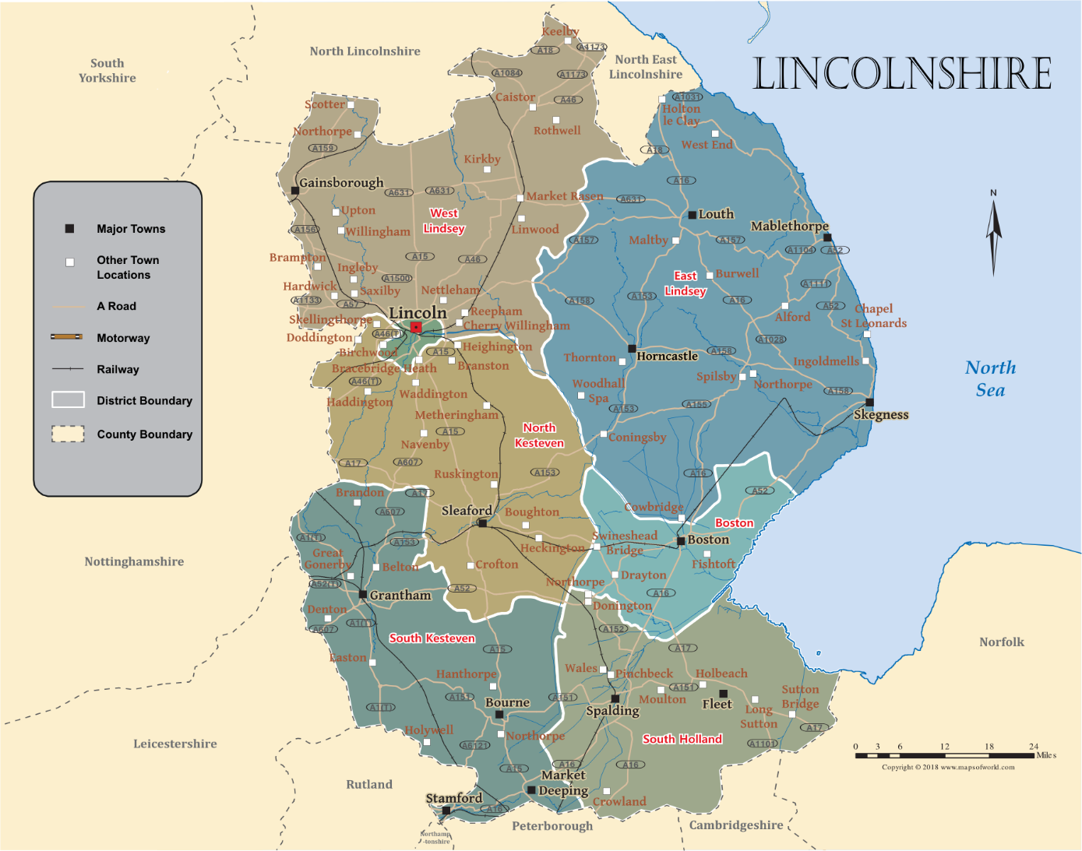
‘Sector Led Specialists’

