Slide 1
Outreach support for Pupils with Profound and Multiple Physical Disabilities, including those resulting in Cognitive Disabilities and Life Limiting Conditions.

Slide 2
Access to Service Criteria
Support for pupils:
In school aged between 4-19
Transition from nursery to Reception
Transition from school to college
Pupil must have 1 or more of the following:
A profound and multiple physical disability
A profound cognitive disability (e.g. Down Syndrome, brain injury)
A life limiting condition (e.g. Muscular Dystrophy)

Slide 3
What we Offer
Curriculum Support
Target and goal setting
Advice on and/ or loan of Assistive technology (AT) for practical inclusion in classroom activities and access to IT.
Equipment to support inclusion available to loan
Support in assessment of progress
Attending meetings (where possible) to contribute towards EHC’s, ESCO meetings etc
Moving and handling support
Moving and handling/postural awareness and training (small charge for this)
Attending meetings (where possible) to contribute towards EHC’s, ESCO meetings etc
Equipment available to loan

Slide 4
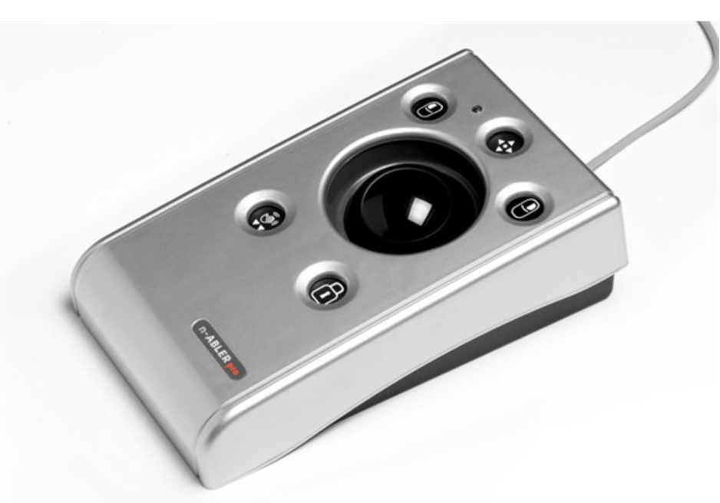
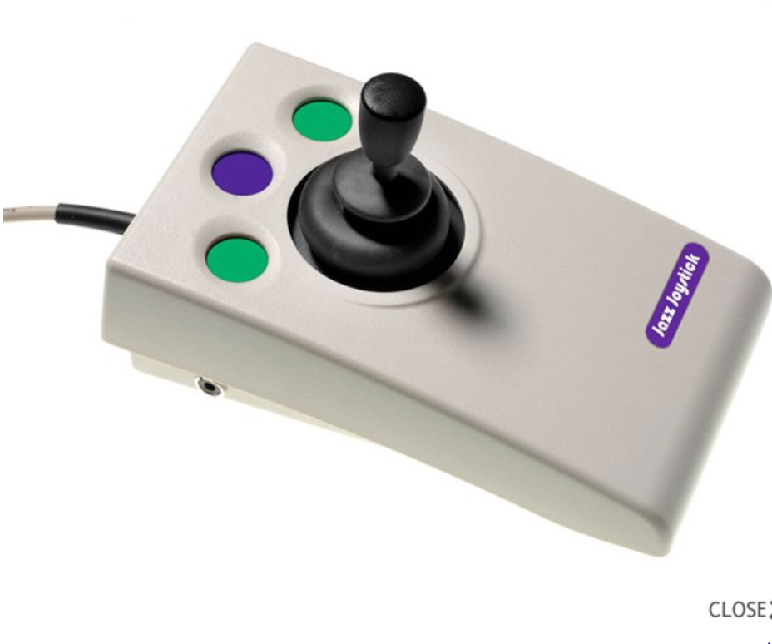
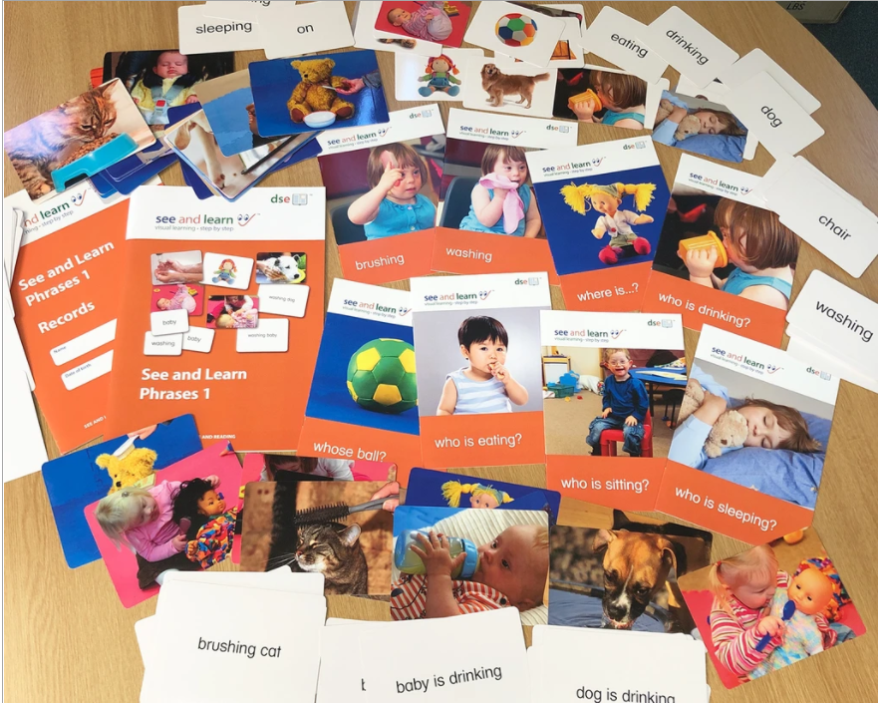
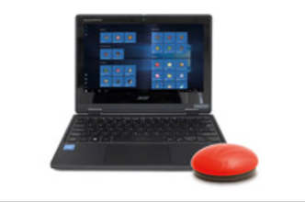
Equipment available for short term loan

Slide 5
How to Access the Service
Step 1 Contact
Give us a ring, drop us an email or speak to any member of the team.
Step 2 Complete referrals
Try to be specific with the support required.
Step 3 Make Arrangements
A Member of the team will make contact
Step 4 Visits
Observe/work with the pupil, 1:1, class teacher and/or SENCO to create an action plan.
Step 5 Follow up
Follow up the action plans and set new targets where required.

Slide 6
Online Training This is open to all Lincolnshire schools and it is not a requirement that you have a pupil with physical disabilities or a pupil receiving our support at present. Sessions will run from 3.45 on Microsoft teams. Places will be limited so please book in advance. Follow the link to book; https://www.eventbrite.co.uk/o/lincolnshire-pd-outreach-32172182801
Thursday 14th October 3.45-4.15
An Introduction to Down Syndrome and intervention strategies with Clair (repeat session)
Thursday 4th November 3.45-4.30
Assistive Technology in the classroom with Becky (repeat session)
Thursday 18th November 3.45-4.45
The Engagement Scales in a mainstream classroom with George
Thursday 2nd December 3.45-4.15
The teaching of sight word strategies for reading alongside phonics with Laura

Slide 7
Where to find us
Look on the St Francis School (Lincoln) Website
https://www.st-francis.lincs.sch.uk
Head to the outreach Section. There you will find Referral forms, our promotional leaflet and parental consent form.
Follow us on twitter @outreach_pd
Please contact me by email
Clair.Swinton@st-francis.lincs.sch.uk for any further information

