Slide 1
Children’s Therapy Services

Slide 2
Overview
We provide specialist therapy services for children between the ages of 0 -19, to support them to achieve their potential.
County wide service
If your child is referred to us, you will have contact with a qualified Occupational Therapist, Physiotherapist, or Speech and Language Therapist. All our therapists are registered with the Health Care Professions Council (www.hcpc-uk.org) as well as their relevant professional bodies.
Our therapists are supported by Therapy Assistants and Assistant Practitioners who often work alongside the Therapists to provide support to Children and their families.

Slide 3
Locations of the service
Mainstream Schools
Special Schools
Preschool, Nurseries
Children's Centres
Clinics at different locations in the county
Home
Virtual support

Slide 4
Referring to SLT
There is an open referral system in place.
This means that we accept referrals from any source including parents, health visitors, pre-schools, nurseries, mainstream and special schools, paediatricians and GPs.
Parental permission is required.
We operate a client initiated review system- re-referrals are NOT required if we have seen the child within 12 months. Just call and book a review.

Slide 5
How we work
If you have any questions or queries about a child you support, call us at any time!
Telephone consultations can be booked with parents and educational staff.
Mainstream assessments are carried out virtually or in the clinic. Some specialist assessments are carried out in school.

Slide 6
Who SLTs can support
Children and young people who have:
Difficulty paying attention or listening to what has been said
Difficulties with understanding what is being said
Difficulties with vocabulary
Difficulties putting words together and using grammatical markers
Unclear speech
Difficulty communicating with others
Difficulties with chewing and swallowing
A hearing impairment
A cleft lip and/or palate
A stammer/stutter (these words mean the same thing)

Slide 7
What do we provide?
We provide specialist assessment where indicated
We refer to evidence based pathways to decide on next steps for children
We can provide SLT programmes to be delivered in school
We provide advice and strategies
Where appropriate we provide blocks of 1:1 therapy, usually with one of our therapy assistants or assistant practitioners

Slide 8
Current picture within schools
50% of children in areas of social disadvantage start school with delayed language skills.
10% of children have long term speech, language and communication needs.
(Communication Trust, 2014)
Not all of these children will need speech and language therapy, however their language difficulties impact on their learning and their overall development.
We identified a need to offer a range of traded services in addition to our core offer.

Slide 9
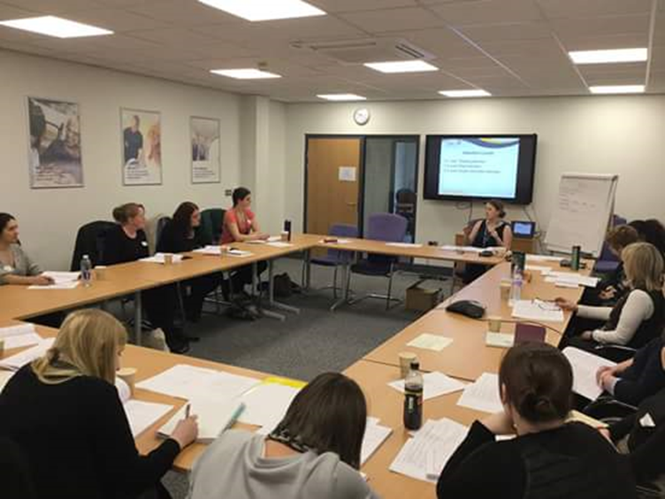
Meeting the need: Training
We offer a range of Elklan courses which support teachers and teaching assistants to develop their knowledge and to become more confident to support the speech, language and communication needs of the children they work with.
Learner feedback: “Really enjoyable course and I now feel a lot more confident with supporting the children at my school with their SLT programmes.”
Please find more information here: http://lincolnshirehealthyfamilies.nhs.uk/childrenstherapyservices/professionals-area

Slide 10
Meeting the Need: Training
We offer Makaton training delivered by licenced Makaton tutors.
As well as offering parent workshops, we also offer ‘Makaton for professionals’ which allows teachers and teaching assistants to access Makaton training. This enables them to use signs and symbols to support the language development of the children they work with.

Slide 11
Meeting the Need: Training
Get in contact for training packages, including:
Colourful semantics (a versatile colour-coded system, which helps understanding of words and sentences; develops an awareness of how sentences work and supports more effective use of sentences in reading, writing and speaking)
Vocabulary support
Autism ELKLAN (provides learners with theoretical knowledge and a range of practical skills and ideas to support children and young people with autism and/or social communication needs)
This list is not exhaustive and we can provide bespoke packages of training/input to schools as part of the traded services.
Please contact us for more information.

Slide 12
Website
https://www.lincolnshirecommunityhealthservices.nhs.uk/our-services/childrens-services/childrens-therapy-services
First Call resource- further information about SLT difficulties and advice/strategies/activities to support these

Slide 13
Occupational Therapy
Who can refer to the Children’s Occupational Therapy Team?
The Children’s Occupational Therapy Team requires a referral to be completed by a healthcare professional in order to be accepted; this includes health visitors, school nurses, GPs, paediatricians.
However to make the service more accessible to all we have started to take referrals from parents who are worried about their children’s development or physical difficulties. Parents can contact the service on 01522 309025 to refer their child.

Slide 14
Does a child require OT?
Our Occupational Therapists work with children with a variety of difficulties. This includes children with:
Rheumatology conditions
Orthopaedic problems (problems with joints or bones) that are causing functional problems
Neurological conditions (for example Cerebral Palsy or Traumatic Brain Injury)
Muscular conditions (for example Charcot Marie Tooth)
Children with profound and multiple learning disabilities where physical ability impacts on function or care.

Slide 15
We are unable to see…
At this current time, the Occupational Therapy Service is not commissioned to see children who have a diagnosis of Developmental Co-Ordination Disorder (DCD, also known as Dyspraxia) or to assess for this condition.
The Occupational Therapy Team is also currently unable to see or assess children with sensory processing disorders or difficulties.
Please refer to First Move

Slide 16
Physiotherapy
Who can refer to the Children’s Physiotherapy Team?
Ideally referrals to the children’s physiotherapy team should come from a health professional (Health Visitors, School Nurses, GPs and Paediatricians)
However to make the service more accessible to all we have started to take referrals from parents who are worried about their children’s development or physical difficulties. Parents can contact the service on 01522 309025 to refer their child.
We will also accept referrals from SENCos in the same way (provided that parental consent is gained). It is always preferred that a parent refers as they will know more about their child’s holistic needs.

Slide 17
Does a child require Physio?
Delays reaching their developmental milestones (sitting, crawling, walking etc)
Movement difficulties
Co-ordination difficulties
Balance difficulties
Orthopaedic problems (problems with joints or bones)
Rheumatology conditions
Cystic fibrosis
Neurological conditions (conditions affecting the brain)

Slide 18
Before you Refer…
Have you seen our all new online version of 1st Move?
The 1st Move Resource has now moved online – making it accessible to parents, schools and professionals alike.
Please refer to 1st Move for gross motor and fine motor activities to practise prior to making a referral to our PT and OT services
https://www.lincolnshirecommunityhealthservices.nhs.uk/our-services/childrens-services

Slide 19
Hypermobility….
Is absolutely normal and is not often a concern…
If a parent is worried about hypermobility please refer them to our website for information.
Children are often over-diagnosed with this condition that is present in 71% of under 8’s and 55% of under 15 year olds.
https://www.lincolnshirecommunityhealthservices.nhs.uk/our-services/childrens-services

Slide 20
Contacting us
Children’s Therapy Services
Beech House
Waterside South
Lincoln
LN5 7JH
Call us on 01522 309025
Email us: LHNT.lincschildrenstherapyservice@nhs.net

