Slide 1
Healthy Minds Lincolnshire (HML)

Slide 2
Who are HML:
Countywide emotional wellbeing support service for Lincolnshire children and young people up to the age of 19 (25 SEND or care leaver) set up in Oct 2017
Clinical staff are made up of a range of professionals (inc. nurses, qualified teachers, counsellors, psychological well-being practitioners, social workers etc.)
We have links with every school in Lincolnshire and work as closely as possible with a young person’s school when offering support. (NB some schools are now alternatively supported by Mental Health Support Teams MHSTs)

Slide 3
Eligibility:
Child or Young Person (CYP) aged 0-19 (25 if SEND/ on an EHCP or LAC) experiencing emotional wellbeing difficulties
Ordinarily resident of Lincolnshire or attends a state maintained school in Lincolnshire.
If they are ordinary resident in Lincolnshire but attend a school out of Lincolnshire then they are eligible but we would not be able to see them at school and would need to make alternative arrangements within Lincolnshire.
If they are registered with a Lincolnshire GP they also need to either live in Lincolnshire or attend a school in Lincolnshire. A GP in Lincolnshire alone is not enough to make them eligible
How to refer:
A child or parent can speak to their teacher, GP or call us on our Lincolnshire Here4You Line on 0800 234 6342
Monday to Friday 09:30-16:30.
If a child is under 16 we will usually need to speak to a parent/carer.
Professionals can refer via completion of an Early Help Assessment sent to LPFT at lincs.spa@nhs.net

Slide 4
What HML do:
Support for children/young people and their families via our website lpft.nhs.uk/young-people;
- Pre recorded workshops
- Self help guidance and advice
Provide brief interventions (between1 and 6 sessions) for emotional wellbeing to children and young people age 0-19 in the form of;
- Groups and workshops
- 1:1 support
- Parent workshops
Parent- child workshops
Common emotional well-being concerns include:
Exam stress
Worries
Bullying
Relationship difficulties
Self-harm
Low mood
Low self-confidence
Low body image

Slide 5
Healthy Minds Education Offer
- Professionals hub via hidden link on our website
- School link practitioner
- Clinical supervision for school staff
- Pre recorded training sessions
- Centralised training offered virtually ‘Nurturing the wellbeing of children and young people’
- Support at stage 3 of the EBSA process
Schools have the opportunity to request more specific and individualised training support via request to lpft.trainingrequest.hml@nhs.net
Full details of the Healthy Minds offer will be provided with links of how to access everything outlined.

Slide 6
What HML don’t do:
We do not provide a mental health assessment or work with high risk cases
We are not a counselling service
We do not diagnose, prescribe or review medication.
We are not a behaviour service and will only be able to see the young person if they have a clear emotional wellbeing issue
Duplicate work – if similar work is being completed with another service e.g. Counselling at school

Slide 7
Signposting

Slide 8
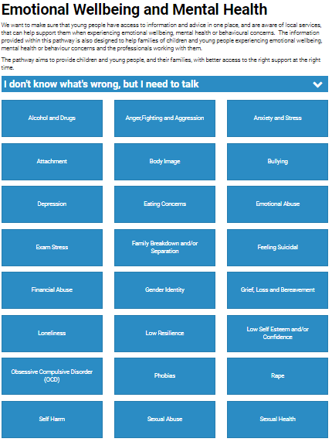
Emotional Wellbeing Pathway
For self-help and information on which services in Lincolnshire can be of support visit:
www.lincolnshire.gov.uk/emotionalwellbeing

Slide 9
The Mix:
UK based charity that provides free, confidential support for young people under 25 via online, social and mobile.
0808 808 4994 www.themix.org.uk
Kooth:
free online counselling service for age 11-25 www.kooth.com
Young minds:
support young peoples mental health www.youngminds.org.uk
Steps 2 Change:
free service for 16+ experiencing common mental health problems www.lpft.nhs.uk/steps2change/home
Young Minds Crisis Messenger (Shout); text SHOUT to 85258

Slide 10
Linkage:
Free advice and support to young people, their families and carers who have an additional need or disability
01472 372311
Childline:
0800 1111 www.childline.org.uk
LPFT young people (HML and CAMHS):
gain information and self-help
https://www.lpft.nhs.uk/young-people
Papyrus:
national charity dedicated to the prevention of young suicide www.papyrus-uk.org
Hopeline: 0800 068 4141
Self-help
Get self-help
www. getselfhelp.co.uk ·Mood Juice
http://www.moodjuice.scot.nhs.uk/
See ‘mental health/ emotional wellbeing apps’ booklet

