Slide 1
SEND Advice Line for Lincolnshire (SALL)
Joanne Makings

Slide 2
The SEND Advice Line Lincolnshire
Intended impact
The SALL service is key to efforts to: Ensure children’s needs are understood and met at the earliest point to support better outcomes and inclusion.
Purpose
To support settings for Children and Young People from 0-25 Years to understand and meet the needs of Children and Young People with SEND, delivering better outcomes and maximising inclusion.
Helping settings to follow the graduated approach to Child and Young People’s needs by providing information, advice and guidance and signposting to services and support.
Support offer
The service offers settings:
Easy and quick access to an experienced advisor to discuss the individual child/young person, or broader school/setting issue and provide information, advice and guidance (IAG).
Signposting to the Local Offer, SEND Inclusion Toolkit, the Valuing SEND tool and other services to better understand and meet need.
Where appropriate, a follow up appointment with a relevant Ask SALL team member, or other professional (Educational Psychologist, Early Years Specialist Teacher) can be arranged.

Slide 3
How settings can access this support
Settings (usually SEND Manager or SENCo) will be able to get in touch with the team by:
Submitting a short form via the Local Offer
https://www.lincolnshire.gov.uk/support-education/ask-sall
Calling the dedicated number for the team
01522 553199 Mon- Fri 9:30 – 16:30
Support can be at individual child or whole school level.
*

Slide 4
What does support look like?
Phone call or online form
Arrange a time convenient for a call back – or email response.
Go through the case – What are the needs? Who is involved and supporting now? What are the concerns? What are you worried about? What is working well?
Email Response
Ask SALL advisor will provide a detailed email response providing information, advice and guidance that was discussed in the contact.
Follow-up
Call back from SALL advisor – to discuss things further or share further information.
The Ask SALL advisor will discuss information, advice and guidance they are providing.
The email will include links to recommendations, attached documents or forms, further recommendations for research or information, agreements of next steps.
Educational Psychologist – call back – one off video meeting (approx. 1 hour). This is for a focused conversation to problem solve the difficulty/issue the child young/person is currently experiencing. Provide a follow-up summary of the recommendations from the EP.
EYST call back – to offer support.

Slide 5
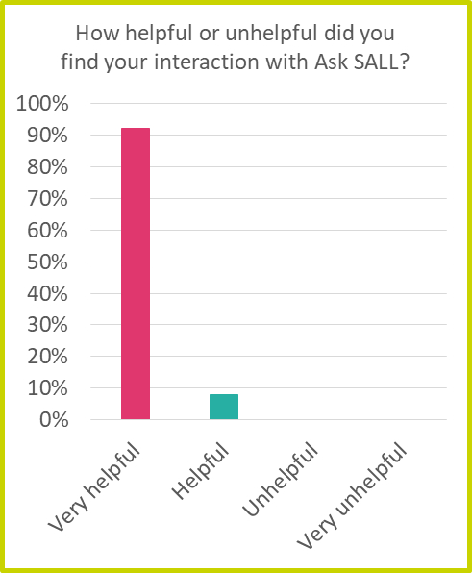
Some information from the data
- Since launch Sep 20
Since service launched 25% cases have needed EP appointment.
75% calls have been met with just SALL contact.
“Being able to have the option to speak to an EP is incredibly helpful, that other layer or expertise can sometimes be the missing piece in helping to develop the best outcomes for our SEND pupils.”

Slide 6
Would you use Ask SALL again?
100% of those asked would “Definitely” use the service again
43% of total settings who have called SALL have contacted on more than one occasion
“I think this is a most valuable resource. Most SENCO's work alone in a school, therefore, having a dedicated advice line to support is crucial for being able to refer to with questions/queries.”
“This is my third time calling the service and each time I have got the support I need. I think this is a very important service for SENCOs”
“Time to problem solve together. Time to talk to a person with great knowledge of local area and support services available.”
“I filled in the online form and then straight away was contacted asking to have a follow-up phone call, they were very helpful with all my enquiries and emailed me to follow up our discussion.”

Slide 7
New expanded offer...
Advisor on 6 week allocation panel
Advisor on the 6 week Education Health and Care Needs Assessment (EHCNA) panel each week.
Support Huddles for settings
Offering group support for SENCo’s. Providing opportunities to share good practice and ideas.
Promoting good practice in Lincolnshire.
Buddying/ Mentor Scheme
Last year this was set up for new SENCo’s in settings and those needing further support.
SALL worked on identifying and matching SENCo’s to a named experienced SENCO in another school.
Support settings with next steps when the decision has been not to proceed with EHCNA.
V SEND Champions
Support settings with introducing and using the Valuing SEND tool.
Share advice and information about the V SEND tool and Inclusion toolkit.
Next steps looking to discuss with settings about how we can expand this.

Slide 8
Any questions

