Slide 1

Teaching School Hub
Professional Development
Managing the changes together…

Slide 2


National Professional Qualifications
NPQEL: Executive Headship
NPQH: Headship
NPQSL: Senior Leadership
Leadership
NPQLTD: Leading Teacher Development
NPQLBC: Behaviour and Culture
NPQLT: Leading Teaching
Specialist
If your school is in the top 30% of schools for your Pupil Premium Data ( We have a list of these schools) | All other schools
All NPQs are Free | LTD- Free
NPQH- You can be in a leadership role aspiring to be a Headteacher to access it | NPQH- You have to be in a HT role for 2 years to get this free otherwise you have to pay for it
 | Pay for all other NPQs
Notes:
Booking link: events.bookitbee.com/?q=NPQ+ready
If your school is in the top 30% of schools for your Pupil Premium Data
( We have a list of these schools)

Slide 3

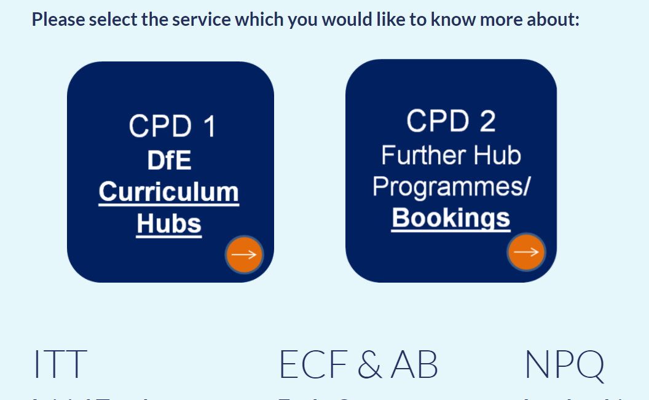
Notes:
https://www.leadtshublincs.co.uk/page/?title=Booking+Programmes&pid=11

Slide 4

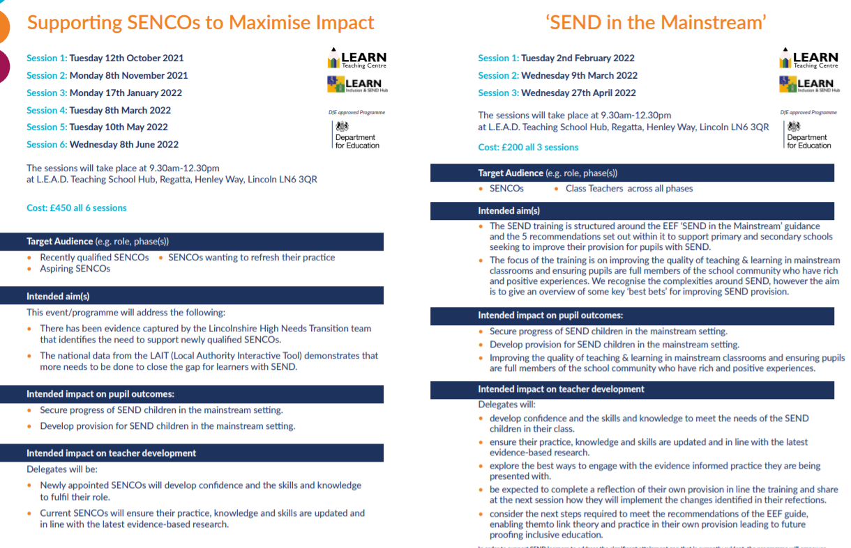
SEND
Notes:
LEARN working closely with us on the following programmes:
Booking links
SEND in the mainstream
https://event.bookitbee.com/34036/send-in-mainstream-schools
Supporting SENCOs
https://event.bookitbee.com/33717/supporting-sencos-in-impact

Slide 5

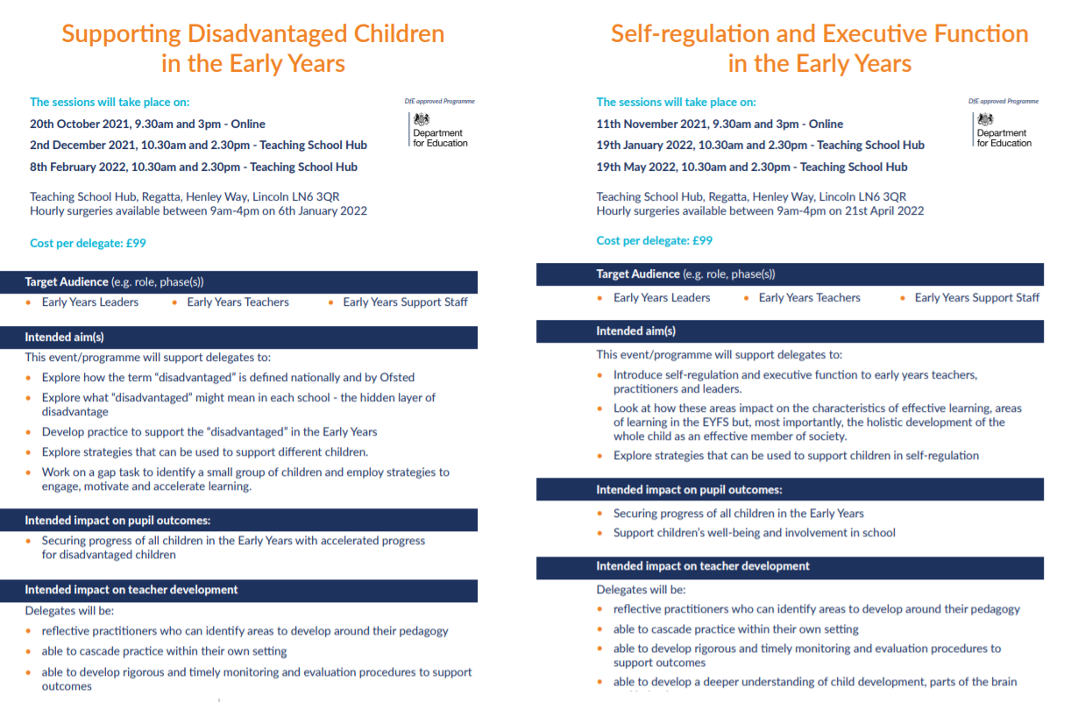
Early Years
Notes:
Early Years is a challenge currently with the new EYFS framework and with children starting school having spent much of their time at home. The DfE have recognized this and accredited the following 3 programmes – each run by Sarah Quinn – ex Ofsted / Also worked for Focus Education for many years

Slide 6
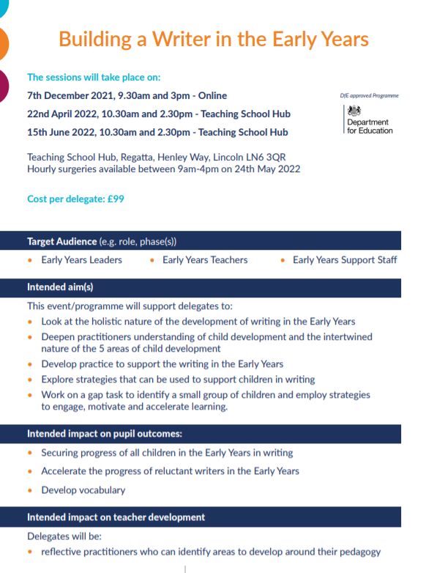
Early Years

Slide 7
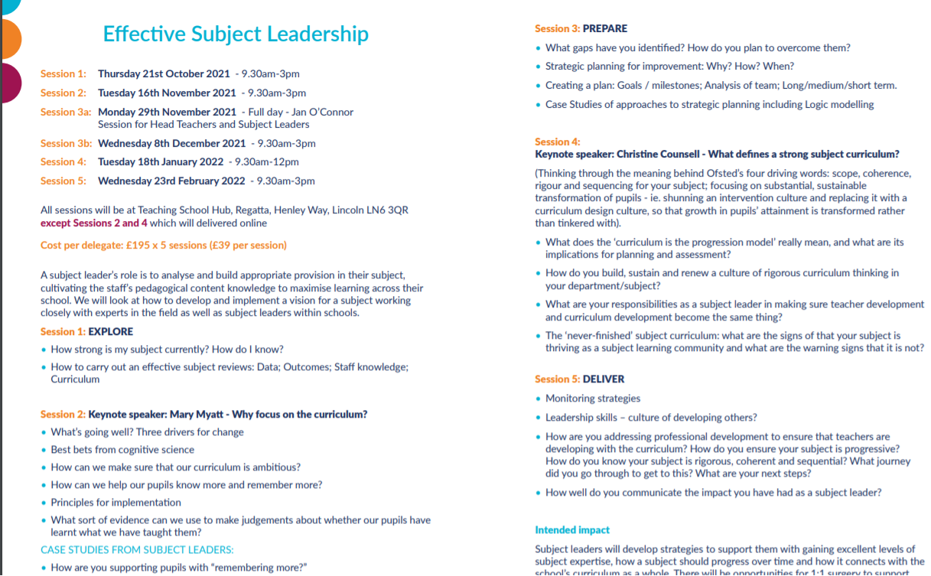
Effective Subject Leadership
Notes:
Subject Leadership was requested by HTs
We are running this as a full programme but also as separate sessions – can buy into morning with Mary Myatt or with Christine Counsell or with both for some inspiration – both respected and recognized national speakers on the curriculum

Slide 8

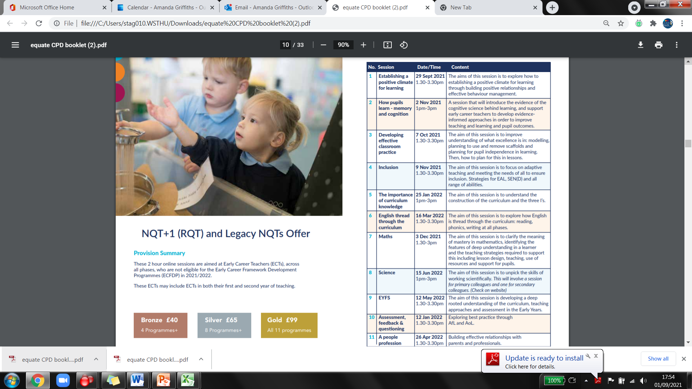
Legacy NQT/ RQTs
Notes:
If you know of any NQT+1s / RQTs back in school that had a disrupted year please point them to this programme.
Book : https://www.leadtshublincs.co.uk/page/?title=Booking+Programmes&pid=11&courseType=11

Slide 9
Quality Assurance
Is the programme appropriate?
Has it led to change?
-practice/attitude/culture/
knowledge and skills
Has it improved pupil outcomes? Is it sustainable?
Notes:
There are rigorous processes around the CPD that we have on offer – these have been accredited by the DfE and will undergo further QA to ensure that the PD is the best it can be and worthwhile not being in school for.

Slide 10
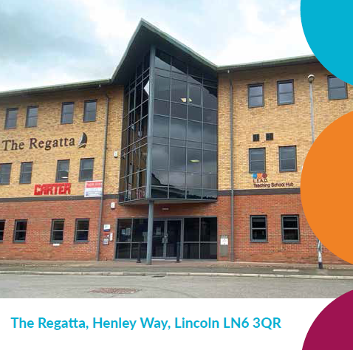
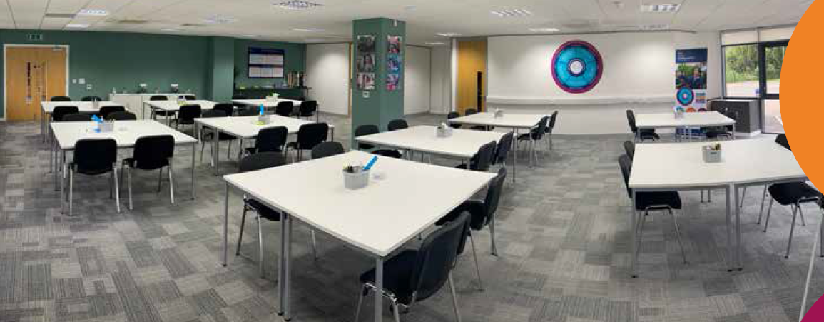
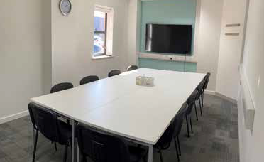
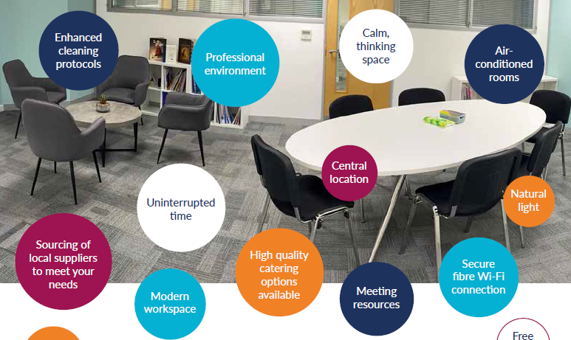
Professional Learning Space
Notes:
A space available for meetings / headspace – this is your hub.

Slide 11


An Update from Whole School SEND

Slide 12
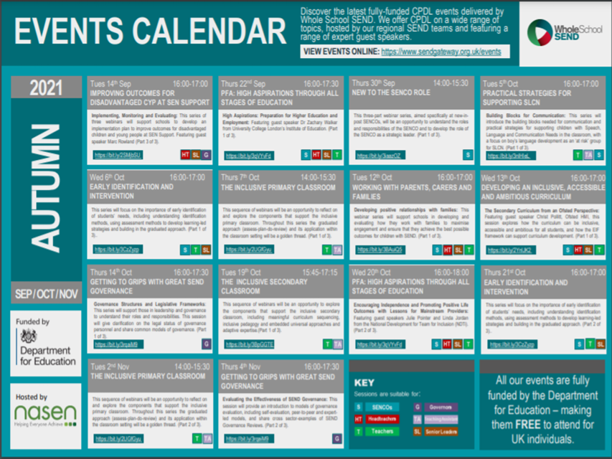
Notes:
All Whole School SEND webinars can be accessed for free. All delegates need to do is sign up to the sendgateway https://www.sendgateway.org.uk.
and register. Then go to the Event link where you can book your place. Don’t foregt to tick the box for the newsletter so you recieve updates and access to a wide range of opportunities.
If you have missed the start of a series or are interested in a historic webinar dont worry. All sessions are record and avaible through the sendgateway.
Lisa this is a list of the opportnities in case you are asked any quesions.
ENELON webinar series - Preparation for Adulthood: High Aspirations Through All Stages of Education
Featuring expert guest speakers from University College London (UCL) and the National Development Team for Inclusion (NDTi), this three-part webinar series will explore Preparation for Adulthood and how to maintain high aspirations for learners with SEND across all stages of education.
Part 1, Wednesday 22 September 2021,16:00-17:30, Part 2, Wednesday 20 Oct 2021,16:00-18:00, Part 3, Monday 15 November 2021,14:00-16:00:
SESLON webinar series - New to the SENCO Role: Understanding the role of the SENCO within a context of distributed leadership
This three-part webinar series will be an opportunity to understand the roles and responsibilities of the SENCO. There will be a particular focus on the strategic leadership role of the SENCO, including how we can work to ensure the leadership for SEND is distributed and how we work with all stakeholders to achieve this. We will also explore practical aspects of the role, including the annual review process and the SEND information report, as well as reflecting on how we match policy to practice.
Part 1: Thursday 30 September 2021, 14:00-15:30, Part 2: Thursday 20 January 2022, 14:00-15:30, Part 3: Thursday 10 February 2022, 14:00-15:30
WM webinar series - Practical Strategies for Supporting Speech, Language and Communication Needs
This series of three webinars will introduce the building blocks needed for communication and practical strategies for supporting children with Speech, Language and Communication Needs in the classroom, with a focus on boy’s language development as an ‘at risk’ group for SLCN.
Sessions will feature input from Speech and Language Therapists and case studies from school practitioners who have successfully implemented strategies.
This series is suitable for classroom practitioners and Teaching Assistants, SENCOs and leaders of SEND from Primary, Secondary and specialist settings.
Part 1: Tues 5th October 2021, 16:00-17:00 - Building Blocks for Communication, Part 2: Tues 30th November 2021, 16:00-17:00 - Supporting Speech Sound Development, Part 3: Thurs 9th December 2021, 16:00-17:00 - Boy Talk
North webinar series - Early Identification and Intervention: Acting upon the Earliest Indicators of Need at Every Stage
This series of three webinars will be an opportunity to reflect on and explore the importance of early identification of students’ needs. We will develop an understanding of identification methods and consider how you can use assessment methods to develop learning led strategies. Throughout this series we will reflect on the graduated approach and how to embed this into all levels of responsiveness in your school.
Each session will share best practice and reflect on case studies and differing approaches schools use. Participants will be encouraged to consider their school’s practices and how early identification and intervention can support all students at every level.
Sessions are suitable for practitioners across all phases of education from both mainstream and specialist settings.
Part 1: Wednesday 6th October 2021, 16:00-17:00, Part 2: Thursday 21st October 2021, 16:00-17:00, Part 3: Friday 11th November 2021, 16:00-17:00
SESLON webinar series - The Inclusive Primary Classroom
This sequence of webinars will be an opportunity to reflect on and explore the components that support the inclusive primary classroom - meaningful curriculum sequencing and delivery; inclusive pedagogy; an enabling learning environment; embedded universal approaches; adaptive expertise; etc.
Throughout this series the graduated approach (assess-plan-do-review) and its application within the classroom setting will be a golden thread. There will also be opportunities to reflect on how leaders can facilitate a 'built in not bolt on' approach to effective practice for pupils with SEND across the whole school.
Part 1: Thursday 7th October 2021, 14:00-15:30, Part 2: Tuesday 2nd November 2021, 14:00-15:30, Part 3: Thursday 25th November 2021, 14:00-15:30
SW webinar series - Working with Parents, Carers and Families
This series of three webinars will support schools in developing and evaluating how they work with families to maximise engagement and outcomes. The series will focus on using evidence to inform the graduated approach to SEND support, in order to help schools and settings achieve the best possible outcomes for children young people and with SEND.
This series will feature speakers from Special Needs Jungle, the Autism Education Trust and the National Network of Parent Carer Forums. The series is suitable for practitioners across all phases of education, from both mainstream and specialist settings.
Part 1: Tuesday 12th Oct 2021, 16:00-17:00 - Developing positive relationships with families, Part 2: Thursday 18th Nov 2021, 16:00-17:00 - Making SEND progress meetings meaningful for all, Part 3: Wednesday 12th Jan 2022, 16:00-17:00 - Preparing young people for transition: a co-ordinated approach
EMSYH webinar series - Developing an Inclusive, Accessible and Ambitious Curriculum
This three-part series aimed at secondary practitioners will explore how to make the curriculum inclusive, accessible and ambitious for all pupils. The series will explore the curriculum from the perspective of curriculum and subject leads, Ofsted and most importantly learners.
Each session will share ideas, approaches and case studies of best practice in how schools have created and developed ambitious curriculum pathways for students with SEND.
Part 1 - Wednesday 13th October 2021, 16:00-17:00: The Secondary Curriculum from an Ofsted Perspective
This session explores how the curriculum can be inclusive, accessible and ambitious for all students. Chris Pollitt HMI will look at curriculum through the lens of the EIF sharing expectations and implications for colleagues responsible for curriculum and subject areas.
Part 2 - Wednesday 10th November 2021, 16:00-17:00: Curriculum Design: Putting Inclusion and SEND at the Heart of our Curriculum
This session looks at ways in which curriculum and subject leads can place SEND and Inclusion at the heart of all they do. Speakers will share examples of best practice and explore whole-school approaches to creating an accessible, inclusive and aspirational curriculum. This session will feature guest speaker Dr Nic Crossley.
Part 3 - Wednesday 24th November 2021, 16:00-17:00: How Can Subject Leads Ensure High-Quality Teaching in their Subjects
This session will focus on a range of subjects with experienced subject leads discussing how they have led the development of their curriculum design. Speakers will identify practical ways they have supported teachers to be confident in adapting their teaching to meet the needs of students with SEND.
LWY webinar series - Getting to Grips with Great SEND Governance
This webinar series will be an accessible course for all those in leadership and governance to understand their roles and responsibilities, audit and evaluation mechanisms, and best practice examples in relation to SEND governance.
This course has been specifically designed to support all governance personnel in fulfilling their statutory duties and to prepare for external scrutiny. The series will support those responsible for governance in both maintained and academy sectors.
Part 1 - Thursday 14th Oct 2021, 16:00-17:30: Governance Structures and Legislative Frameworks, Part 2 - Thursday 4th Nov 2021, 16:00-17:30: Evaluating the effectiveness of SEND Governance, Part 3 – Thursday 25th Nov 2021, 16:00-17:30: Sharing best practice examples of SEND Governance
SCNWLON webinar - The Inclusive Secondary Classroom
This sequence of webinars will be an opportunity to reflect on and explore the components that support the inclusive secondary classroom – meaningful curriculum sequencing and delivery; inclusive pedagogy; an enabling learning environment; embedded universal approaches and adaptive expertise.
Throughout this series the graduated approach (assess-plan-do-review) and its application within the classroom setting will be a golden thread. There will also be opportunities to reflect on how leaders can facilitate a 'built in not bolt on' approach to effective practice for pupils with SEND across the whole school.
Part 1 - Tuesday 19th Oct 2021, 15:45-17:15, Part 2 - Tuesday 9th Nov 2021, 15:45-17:15, Part 3 - Tuesday 23rd Nov 2021, 15:45-17:15
North webinar series - Leadership of SEND: Building a Culture of Collective Responsibility
This series of three linked webinars will start with an understanding of how to use data strategically to lead SEND provision and foster a collective responsibility for SEND within your setting. The first session will be presented by WSS National SEND Leader, Malcolm Reeve.
We will explore effective leadership strategies for curriculum and middle leaders. There will also be opportunities to reflect on the recent inspection landscape; reviewing case studies of settings who have experienced an Ofsted visit within the Autumn term.
Our sessions are split across Autumn and Spring term and to allow participants to reflect on and develop their practice and reflect on data gathered in the first term.
Sessions are suitable for all practitioners in leadership roles, across all phases of mainstream and specialist settings.
Part 1: Tuesday 16th November 2021, 14:00-15:30, Part 2: Thursday 2nd December 2021, 14:00-15:30, Part 3: Tuesday 11th January 2022, 14:00-15:30
EMSYH webinar series - Beyond the School Gates: Exploring Opportunity and Aspiration into FE and Beyond
The webinar series will focus on aspiration, provision and opportunities from KS4 through to FE and beyond. Professionals, families and learners themselves will illuminate our sessions with their authentic experience and journey through education. The series will feature guest speakers from ETF and DFN Project Search, and will explore curriculum, PfA and long term outcomes, transitions and connectivity across the system to best support students and families.
Part 1, Wednesday 19 January 2022, 15:45-17:00: Part 2, Wednesday 2 February 2022, 15:45-17:00: Part 3, Wednesday 23 February 2022, 15:45-17:00:

Slide 13
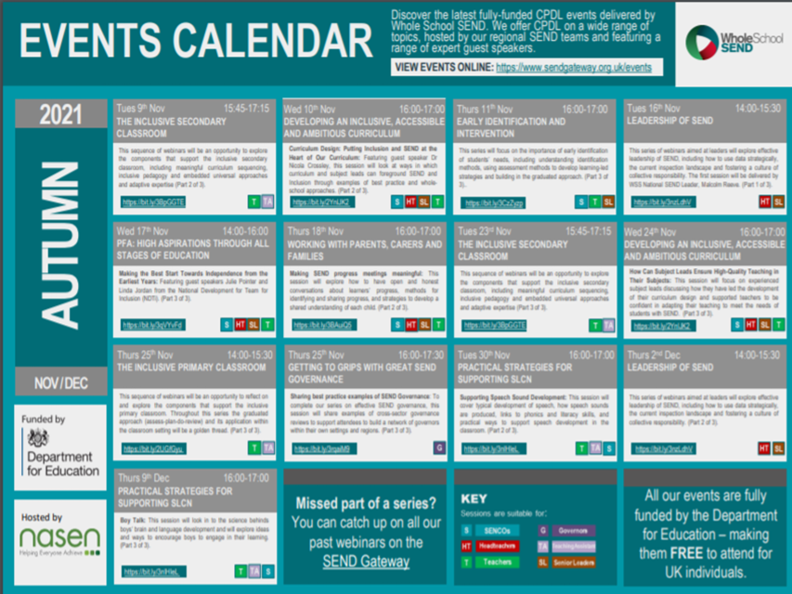

Slide 14

Notes:
Please share this information with your staff team and the content of the SEND gateway is suitable for all practioners.
If you haven’t come across the what works section please check it out. What works?
On this page you will find information to help you develop your practice with children and young people in the four broad areas of need.
Online links are provided to all sources relating to England and the UK, organised within the Graduated Response to Need Framework within each of the four categories of need. Within this broad framework, categories of source will include diagnosis-specific organisations and materials as appropriate. Where a diagnosis might fit under two or more of these categories, such as autism, guidance will be given to interpreting the research.
The resources include ‘what works’ in respect of interventions and strategies to support children and young people with special educational needs, but they also include processes and resources to support identification, monitoring and planning for children and young people.

Slide 15


Approved
https://www.gov.uk/guidance/senior-mental-health-lead-training
Notes:
Currently the Advanced Mental health course has been approved by the DFE. The Root of IT have assured me any schools who are booked on to this before the 25-10-21 will be entitled to the grant funding. The root of it have been missed off the providers list , This has been addresses with the DfE and as soon this becomes active schools will be informed.
The National Educational Leaders course we are hoping will be approved by the end of this month. I have been assured by The Root of It that any schools who have booked on this course will not be charged until grant funding has been released. If this is not the case the schools will be able to withdraw.
These courses will run in Lincoln, Grantham and Boston. Starting during the late autumn term. The exact dates are available on the root of booking page. Should you require more information please got to https://mentalhealthlead.com/ Here you can also sign up to the National Network of Mental Health Leads. Please use the DfE link to find out more https://www.gov.uk/guidance/senior-mental-health-lead-training. Should you have any further questions please contact enquiries@learnteachingcentre.co.uk

Slide 16
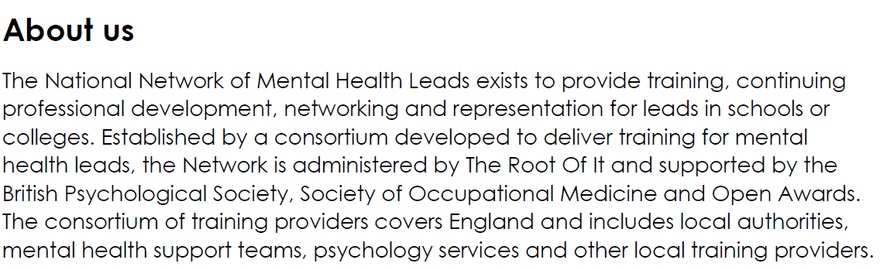
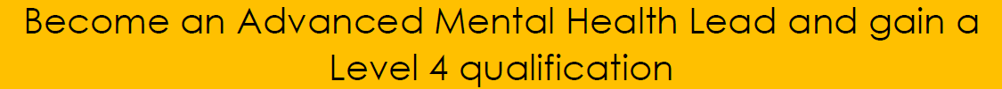
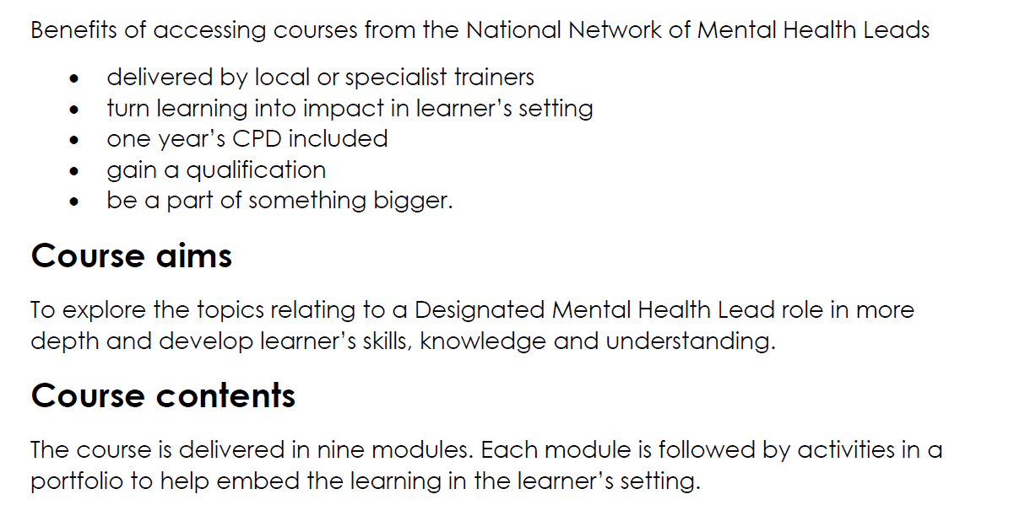
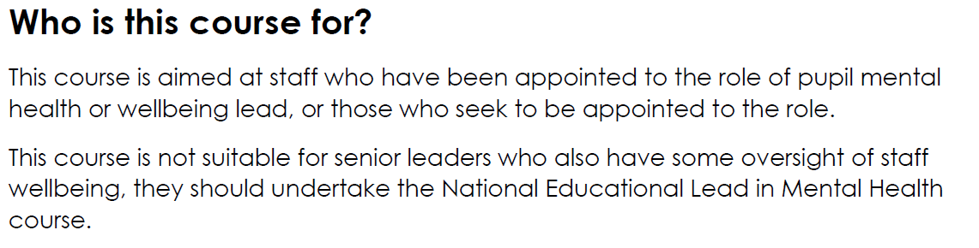
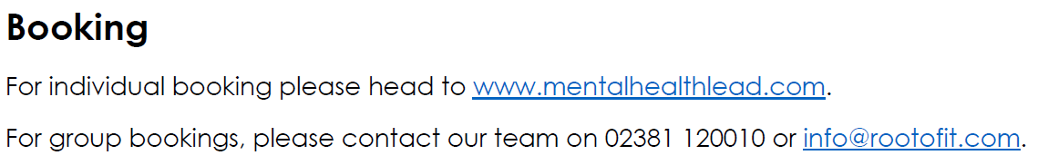


Slide 17

