Slide 1

An Introduction to Stop Smoking support
Rebecca Anderson
Smoking Cessation Lead

Slide 2
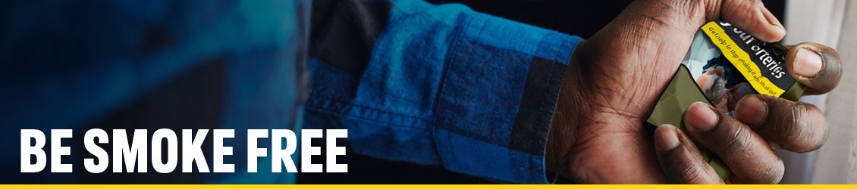



One You Lincolnshire helps residents:
LOSE WEIGHT
Notes:
So who are we?? One You Lincolnshire is an integrated healthy lifestyle service that enables Lincolnshire residents to live healthier lives by – becoming smoke free, moving more, drinking less and losing weight.

Slide 3
Smoke Free
SELF REFERRAL or referral from a Healthcare Professional
Who is it for? – Current Tobacco Smokers, age 12+.
Confidential support.
Tailored one to one support with a specialist Smoking cessation practitioner.
12 week course with 6 / 12 month follow up
Can support small groups – i.e. members of the same household together.
Virtual / telephone appointments
Weekly appointments. Flexible appointments, including evenings and weekends.
FREE Nicotine Replacement Therapy

Slide 4
Supporting Young PEOPLE to Stop Smoking
Young people including young carers are more likely to smoke if:
Their parents or household smoke.
Friends and social circles smoke.
Positive attitudes to smoking and believe smoking is the norm.
Unaware of the dangers of smoking.
2/3 of all smokers begin smoking before the age of 18.

Slide 5
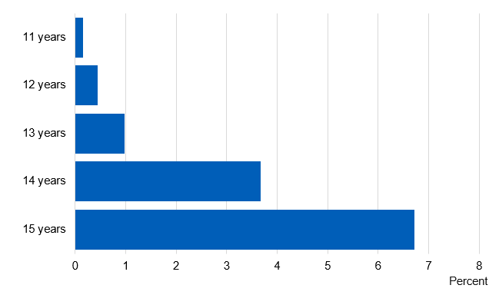
SMOKING PREVELANCE IN YOUNG PEOPLE
The proportion of regular smokers increases with age; from less than 1% of 11 and 12 year olds, to 7% of 15 year olds.
Notes:
NHS Digital Date, 2019.
Little research attention has been focussed on determining smoking prevalence among people with an intellectual disability. Smoking rates reported in the small number of published studies vary because of heterogeneity in participants’ severity of intellectual disability and living circumstances.
In 2016, 19% of pupils reported they had tried smoking at least once, similar to 2014. There has previously been a steady decline since 1996.
6% of pupils were current smokers, and 3% were regular² smokers.

Slide 6
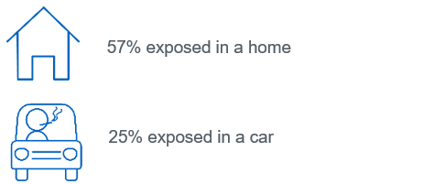
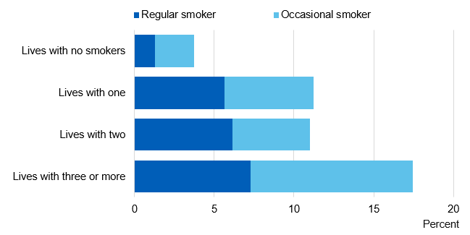
EXPOSURE TO SECONDHAND SMOKE
In the last year, 62% of pupils reported being exposed to secondhand smoke in the home or in a car.
Pupils more likely to smoke if they lived in a household with other smokers.
Regular smoking increased from 1% of pupils living with no other smokers, to between 6% and 7% of pupils who did live with other smokers.
Notes:
NHS Digital Data, 2019.
This is a survey of secondary school pupils in years 7 to 11 (mostly aged 11 to 15) in England, conducted every 2 years and published by NHS Digital.
Pupils were categorised in three ways based on the responses given:
Regular smokers (defined as usually smoking at least one cigarette per week);
Occasional smokers (defined as usually smoking less than one cigarette per week); or
Non-smokers.

Slide 7
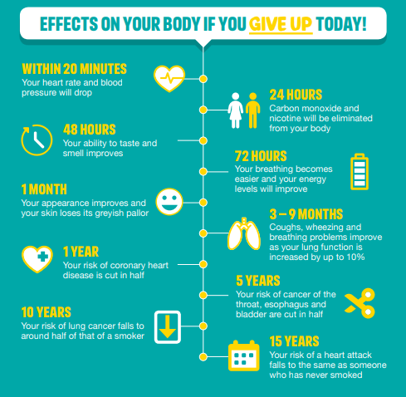
BENEFITS OF QUITTING smoking
Average cost of a pack of cigarettes: £10.76
This is how much you could save:
Cigarettes per day? | 5 | 10 | 20 | 40
Weekly savings | £18.83 | £37.66 | £75.32 | £150.64
Monthly savings | £81.83 | £163.66 | £327.32 | £654.64
Yearly savings | £981.85 | £1, 963.70 | £3,927.40 | £7,854.80

Slide 8
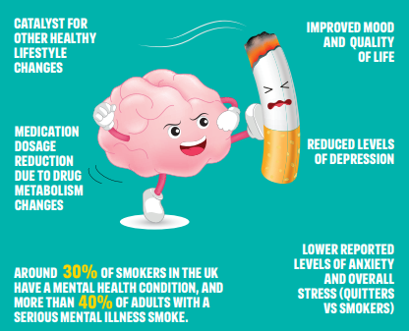
BENEFITS OF QUITTING SMOKING ON
MENTAL HEALTH
Notes:
People with a mental health difficulty die 10-20 years earlier, on average, than people in the general population, and smoking is the single biggest factor contributing to this difference¹².
Despite this, little research attention has been focussed on determining smoking prevalence among people with an intellectual disability. Smoking rates reported in the small number of published studies vary because of heterogeneity in participants’ severity of intellectual disability and living circumstances.
n 2016, 19% of pupils reported they had tried smoking at least once, similar to 2014. There has previously been a steady decline since 1996.
6% of pupils were current smokers, and 3% were regular² smokers.

Slide 9
Referral Process
SystmOne or EMIS
Email: tt1.oneyou.lincolnshire@nhs.net
Telephone: 01522 705 162
One You Lincolnshire Website: www.oneyoulincolnshire.org.uk/referral

Slide 10
SIGNPOSTING
National Centre For Smoking Cessation & Training (NCSCT)
Website: https://www.ncsct.co.uk/
Daniel Lowbridge
Email: Daniel.Lowbridge@lincolnshire.gov.uk
Young Persons Tobacco Control Specialist – Lincolnshire County Council
One You Lincolnshire
Email: hello@oneyoulincolnshire.org.uk
Resources / Training
Notes:
Stats: For 2020, 62 QDS for people U18, 32 4week quits (20 went on to achieve 12W, 2x26W & 1x52). 30 LTFU/Cancelled.
Smokefree champions / Training / S.Smoking Practitioner

