Slide 1

Higher Needs Funding
David Leonard
Finance Team Manager
Children’s Services

Slide 2
Introduction
- Improved understanding of Higher Needs Funding process
- Generic Presentation focusing on mainstream settings
- Slides / Guidance Note
- Questions

Slide 3
Agenda
Background
21/22 Formula Changes
Top-Up Funding
Targeted Funding
Other Funding
Summary

Slide 4

Background
2013/14 – Government introduced notional SEN approach
2015/16 – Authority implemented targeted funding. Schools expected to fund the first £6k for a pre-determined number of EHC’s
2015/16 Targeted budget was £892k. In 2020/21, the budget requirement had increased to £7.8m
Number of plans increased by 55% since start of SEND Reforms
2020/21 High Needs Block overspend - £2.4m
2020/21 SEND overspend - £9.2m
- Top-up (£4.5m o/s)
- Targeted (£3.6m o/s)

Slide 5
21/22 Formula Changes
NFF has brought in increased funding to Lincolnshire since 2018/19, increasing the value of its formula factors that make up the notional SEN.
Targeted thresholds have remained the same throughout, resulting in double funding
- Hourly rate increased from £10.61 to £11.35
- Targeted funding only triggered once the notional EHC requirements exceed the value equivalent to 30% of the notional SEN figure
- Transitional protection has been applied to ensure schools have received MFG protection at +0.5% per pupil.

Slide 6
Top-Up Funding
What is top-up funding?
The total cost of the EHC, less the £6,000 notional funding
How is top-up funding calculated?
Per Pupil - Hourly rate x weeks in a year x number of hours support, less notional funding
e.g. (£11.35 x 52.14wks x 32.5hrs) - £6,000 = £13,233
Per School – Caseworkers issue provision forms to finance, provision is entered onto pupil database, and report is ran on a termly basis to summarise annual entitlements, and calculate funding adjustments to be made.
Where can I find details of top-up funding?
Budget Shares Front Sheet (published 1st March) - http://www.lincolnshire.gov.uk
Pupil breakdowns are uploaded onto Perspective Lite
Contact Schoolperformancedata@lincolnshire.gov.uk for any log-on issues or licence requests.

Slide 7
Top-Up Funding
Perspective Lite Example:
Service Start | Service End | Funded Hours Per Week | Funded Months in 21/22 | Notional Funding | Total Funding | Top-up Funding
01/04/2019 | 31/08/2024 | 20 | 12 | £6,000.00 | £11,835.78 | £5,835.78
01/04/2020 | 31/08/2022 | 25 | 12 | £6,000.00 | £14,794.73 | £8,794.73
 |  |  | Sum: | £12,000.00 | £26,630.51 | £14,630.51

Slide 8
Top-Up Funding
How are the allocations made?
Monthly – Separate allocations for top-up / targeted
When are updates to allocations made?
Termly – Apr 21 / Sep 21 / Jan 22 / Mar 22 / Jun 22
What do I do if the information is incorrect?
Child missing off list
Child has now left school so funding needs to be retracted
Disagreements over EHC start date
  SENFinanceProject@lincolnshire.gov.uk

Slide 9
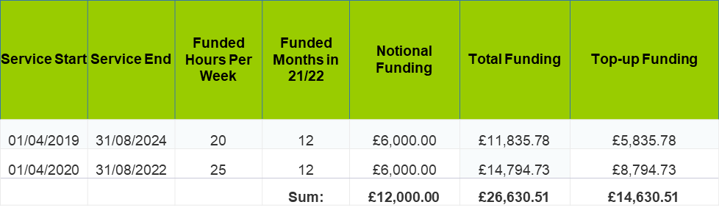
Top-up Funding
How is the funding allocated? ………
    Apr – Aug = £14,630.51 / 12 = £1,219.21 x 5 i.e. £6,096.05
    Sep – Dec = Revised Total less £6,096.05, divided by 7 remaining months
    Jan – Feb = Revised total less funding already allocated for Apr - Dec
    Mar = Revised Total less funding given for Apr – Feb
    Jun = Revised total less Apr – Mar allocations

Slide 10
Targeted Funding – Old Formula
Primary Sector
1 Band 6 to 8 statement for schools with between 0 and 100 pupils.
2 Band 6 to 8 statement for schools with between 101 and 200 pupils.
3 Band 6 to 8 statement for schools with between 201 and 400 pupils.
4 Band 6 to 8 statement for schools with between 401 and 650 pupils.
Secondary Sector
4 Band 6 to 8 statement for schools with between 0 and 350 pupils.
5 Band 6 to 8 statement for schools with between 351 and 450 pupils.
6 Band 6 to 8 statement for schools with between 451 and 550 pupils.
7 Band 6 to 8 statement for schools with between 551 and 650 pupils.
8 Band 6 to 8 statement for schools with between 651 and 750 pupils.
9 Band 6 to 8 statement for schools with between 751 and 850 pupils.
10 Band 6 to 8 statement for schools with between 851 and 950 pupils.
11 Band 6 to 8 statement for schools with between 951 and 1050 pupils.
12 Band 6 to 8 statement for schools with between 1051 and 1150 pupils.
13 Band 6 to 8 statement for schools with between 1151 and 1250 pupils.
14 Band 6 to 8 statement for schools with between 1251 and 1350 pupils.
15 Band 6 to 8 statement for schools with between 1351 and 1450 pupils.
16 Band 6 to 8 statement for schools with between 1451 and 1550 pupils.
17 Band 6 to 8 statement for schools with between 1551 and 1650 pupils.
18 Band 6 to 8 statement for schools with between 1651 and 1750 pupils.
19 Band 6 to 8 statement for schools with between 1751 and 1850 pupils.
20 Band 6 to 8 statement for schools with between 1851 and 1950 pupils.
What is targeted funding?
    Additional ‘notional’ allocations for when schools exceed their expected level of Higher Needs student admissions.
How is targeted funding calculated?
    Ascertain level of HN students we’ve allocated notional funding for
    Ascertain level of HN students actually present within top-up funding breakdown
    If current level is higher, variance is funded at £6,000 less 5% AWPU value for every full year child that exceeds the expected level.
    Primary = £5,857 per FTE
    Secondary = £5,786 per FTE

Slide 11
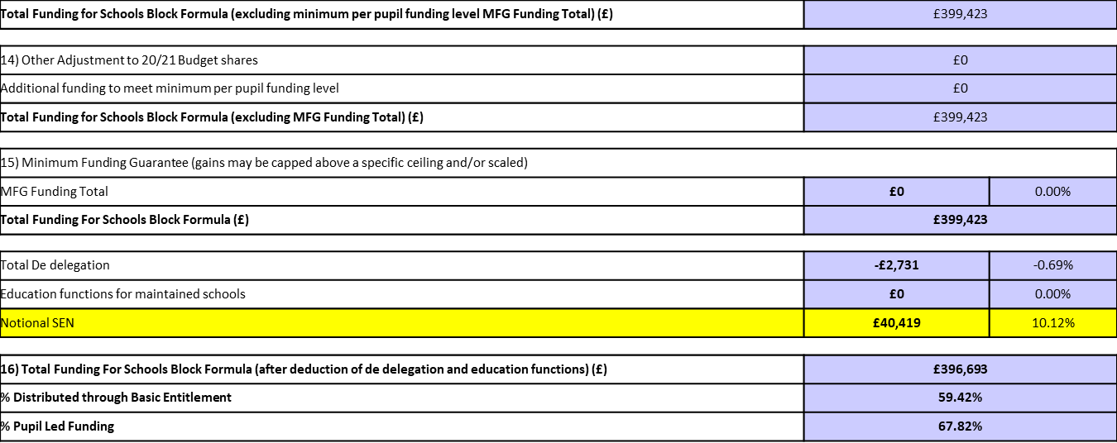
Targeted Funding – New Formula
What is targeted funding?
    Additional ‘notional’ allocations for when schools exceed 30% of the value of their notional SEN (found on ‘Schools Level SB’ tab of Budget Share)

Slide 12
Targeted Funding – New Formula
How is the notional SEN broken down?
Formula Factor | % | Notional SEN
AWPU | 5.34% Primary / 5.20% KS3 / 5.20% KS4 | £12,674
Free School Meals | 14.94% Primary / 18.68% Secondary | £756
Free School Meals Ever 6 | 14.94% Primary / 18.68% Secondary | £945
IDACI (all bands) | 61.14% Primary / 71.06% Secondary | £393
Low Attainment | 70.47% Primary / 59.26% Secondary | £15,167
Lump Sum | 8.90% Primary / 5.33% Secondary | £10,484
Notional SEN Total | £40,419

Slide 13
Targeted Funding – New Formula
How is targeted funding calculated?
Notional SEN Total | £40,419
30% Notional SEN | £12,126
Notional SEN Required | £12,000
Targeted Funding | £0

Slide 14
Other Funding
Early Years Funding
    Separate formula for Independent Nursery Settings – Rates based upon National Living Wage , and categorised into two types; Significant or Profound needs.
    Mainstream School Nursery settings are subject to Higher Needs rates (without any notional deductions) i.e. £11.35 x number of hours attended
    Carol.Moore@lincolnshire.gov.uk
Post 16 Funding
    No £6,000 deductions for pupils continuing into 6th form
    Annual figure is agreed at hub meetings for Post 16 College funding (using a standard framework model)
    Element 3 (top-up) funding is calculated and paid to Colleges via a PO and invoicing route
    We purchase set number of places through ESFA return in advance of academic year. We would then only pay notional funding direct to colleges if we exceed the number of places purchased as part of the return

Slide 15
Other Funding
Out of County Recoupment Funding
Lives in Lincolnshire / attends Out County School – Any funding will be recouped directly from LCC, by the relevant school (using OLEA rates)
Lives Out County / attends Lincolnshire School – School recoup top-up funding direct from OLEA (using LCC rates).
ESFA have introduced an import / export process to account for the transfers of £6,000 notional funding
Special School Funding
Pupils are moderated into bands A-G (based on need) to determine funding levels
Staffing and Non-Staffing Blocks
SEND Strategy Project – Creating over 500 additional (all need) places
Alternative Provision
    Current agreement with Springwell to fund 252 places across 4 different sites
    In 2021/22 each place consists of £10,000 place funding, and £10,693 top-up funding
    Funding has potential to be adjusted upwards or downwards depending on actual numbers on roll

Slide 16
Other Funding
CIC Pupil Premium / Preventing Exclusion / Hard to Place Funding
  Sandra.miller@lincolnshire.gov.uk
Early Years Inclusion Funding
  Carla.snowshall@lincolnshire.gov.uk
Other School budget shares funding issues
    Schools_finance@lincolnshire.gov.uk

Slide 17
Summary
- Improved understanding of Higher Needs Funding process
- Authority Budget Pressures
- Top-up / Targeted Calculation Process
- Value of your role in helping shape finances
- Slides / Guidance Note
- Questions

Slide 18

Questions

