Slide 1
Valuing SEND: Graduated Approach
Getting the most out of the VSEND tool
May 2021

Slide 2
Valuing SEND | agenda
Agenda item | Time
Welcome and introductions | 5 mins
A recap on VSEND & Reflection
How can VSEND help in your school? | 20 mins
How to get the best from VSEND
The importance of settings readiness
Q&A | 10 mins

Slide 3
Valuing SEND| Introduction
The shared ambition for Valuing SEND is to:
Improve children’s long-term outcomes and inclusion
Improve the experience of families and professionals across the system
Valuing SEND aims to achieve this by:
Developing a single, rounded picture of the needs of children and the support they need to succeed and prosper within and outside of their education - from birth to adulthood (across early years, primary, secondary, special and post 16 education).
Using this as the foundation for planning and commissioning of support, monitoring of progress and evaluation of support at a child and cohort level, and to enable earlier and more co-ordinated intervention.
“It is straightforward and captures all the information in a succinct, meaningful way. It’s enabled us to sit down with parents and say ‘look, we’ve tried this, but not this, so we’re not ready to apply for an EHC plan yet.’”
Lincolnshire head teacher
Notes:
Thank you for having us in your meeting today.
We are here to offer you some guidance in how to develop the use of Valuing SEND in your schools, showing you how to get the most out of the tool, including when and how to use it. Valuing SEND was rolled out to SENDcos across Lincolnshire last year, now we are looking to embed that use of the tool in order to maximise what you can get out of it in school.
Valuing SEND was developed by IMPOWER through engagement and partnership with three counties; Hertfordshire, Norfolk and Oxfordshire. These three counties shared an ambition for improving children’s outcomes but also improving the experience of the system for children, families and professionals. The tool was coproduced with parents, carers and practitioners to capture, understand and track holistic needs – to inform planning and provision of the right support at the right time
As a practitioner, there are two things that make the tool unique to me:
It is simple. Jargon free, quick and easy
It brings everything together into one place, the three critical things we need to think about in order to support SEND in one pictoral representation, making this the most effective tool for conversation and discussion around need I’ve ever used.

Slide 4
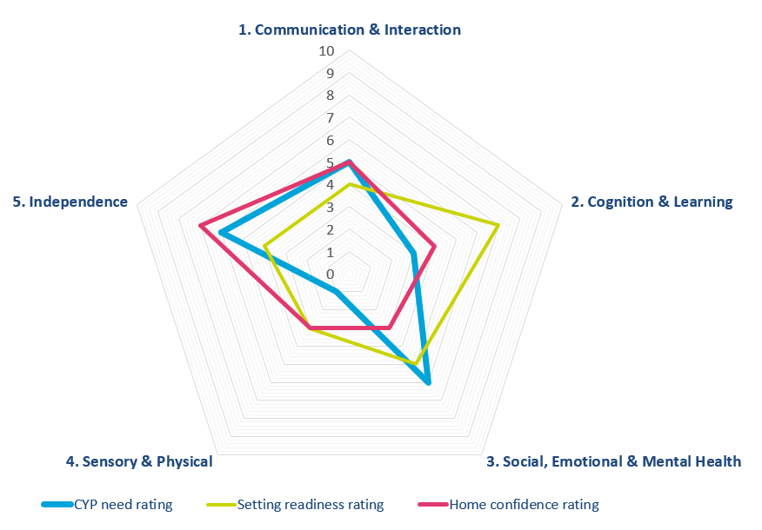
Valuing SEND | Recap and reminder
Summary
Needs descriptors
Setting readiness
Home confidence
Support planning
Notes:
As most of you will know, The Valuing SEND tool produces a radar chart that maps three things simultaneously on a scale of 0-10. As you can see, the radar chart is split into 5 key areas of need:
Communication & Interaction
Cognition and Learning
Social Emotional and Mental Health
Sensory and Physical
Independence
If you look first at the blue line on the chart you can see that the first thing we map across the five key areas of need is the child’s needs. This means that whatever else we do, the child’s needs are always up front and centre, keeping conversations needs focused. In order to map this part of the chart we use a set of iterative needs descriptors which are unique to Lincolnshire. The higher the number the more profound the needs.
Next, looking at the yellow line we map the school’s readiness to meet these needs. This judgement is made by the school themselves by using a set of support prompts. This is a really useful part of the tool and the part I used most as a practitioner, but Phil will talk more about this later. The higher the number the better equipped the school feel they are to meet need.
Finally, when we were coproducing this with the three counties, a parent gave us the challenge of ‘how can you possibly have a whole picture of the child without considering the home environment?’ and so with the help of parents, carers and families we developed the home confidence part of the tool which you can see mapped here in pink. This is completed with the parent or carer through conversation using a set of prompts to determine how confident they feel in meeting the needs of their child at home.
So what can this specific radar chart tell us? In the areas of Cognition and Learning, and Sensory and Physical the school can easily meet the needs of this child. It looks at the moment like even though the school have rated themselves at a 6 for SEMH, the child’s needs are actually at a 7 showing the school is struggling. It is interesting to see that parents and carers also really struggle in this area and don’t feel confident at all. Clearly this is an area to focus on for the school and family, and accessing support through the local offer and Ask SALL could be a good place to start. It also shows that in the areas of Independnce and Communication and Interaction, the school rate themselves quite low, but the parent feels confident in meeting need. Is this an opportunity for school to learn from what the parent does at home or potentially a workforce development issue?
The key is, this is one chart, that everyone can look at, that facilitates a conversation and unpicks what is going right but also what needs to change to meet the needs of children going forward.

Slide 5


Valuing SEND | Your reflections
One aspect that is going well?
One challenge you need to overcome?
Notes:
Poll?
In order for us to better understand the use of VSEND in your schools it’s over to you. We would be really interested to hear what’s currently going well and what challenges are you facing. You can put your hand up if you’d like to contribute these or put them into the chat if you would prefer.

Slide 6

1. For which children/young people can I complete this tool?
2. When should I complete the tool?
3. Should I provide a completed tool as evidence when applying for additional support for a child or young person (e.g. an intervention such as from BOSS or Healthy Minds, or an EHC Needs Assessment)?
4. Will the Valuing SEND tool replace the old EHC Needs Assessment form?
5. How would the Valuing SEND tool be used as part of decision-making on an EHC Needs Assessment Request and Needs Assessment?
6. The tool is suggesting we are meeting the child’s needs comfortably within school, however I believe this is only because my settings is providing support over and above notional funding, which is unsustainable. How do I ensure this is reflected when requesting additional support?
7. Should I use the tool to support annual reviews for children with EHC Plans?
8. Should I use to support transitions between settings?
9. Should the tool replace the support plans we currently use for children with an SEN?
10. Should the tool be used with and shared with parents and families?
11. Does the tool signpost to Lincolnshire services?
12. Can it be used to audit needs and support at cohort, setting or whole area level?
13. Will this replace the Open Objects EHC Hub we have heard about?
14. Can I share the tool with other local authorities (e.g. for children/young people who are not resident in Lincolnshire, or who move to a setting out of county)?
Valuing SEND | Your FAQs
Notes:
I have used your FAQs to inform my session today. We are still collecting and please keep sending in your questions.

Slide 7
Valuing SEND | ‘brings clarity to the graduated approach’ Lincolnshire head teacher
‘Teachers are responsible and accountable for the progress and development of the pupils in their class, including where pupils access support from teaching assistants or specialist staff.
High quality teaching, differentiated for individual pupils, is the first step in responding to pupils who have or may have SEN.
Additional intervention and support cannot compensate for a lack of good quality teaching.
Schools should regularly and carefully review the quality of teaching for all pupils, including those at risk of underachievement.
This includes reviewing and, where necessary, improving, teachers’ understanding of strategies to identify and support vulnerable pupils and their knowledge of the SEN most frequently encountered.’

Slide 8
The Time is Now…Research
•Carried out in Autumn term 2020
•Focused on the impact of lockdown 1 on SEND provision and on the SENDCo’s role
•73% of SENDCos stated their school experienced challenges with providing virtual support for pupils with SEND
•8 in 10 Secondary SENDCOs stated they found it difficult to provide differentiated learning on line
•72% felt schools had experienced challenges in providing support for pupils with EHC plans

Slide 9
National SENDCo Workforce Survey
SENDCos reported a ‘sharp increase’ in workload
•More management tasks and paperwork
•Over half of SENDCos sited managing the risk assessments for pupils with EHC plans as being a key activity that impacted on work load
•Duties relating to senior leadership and safeguarding increased
•Many SENDCOs were required to teach class or SEND bubbles so “SENDCo role was not the primary focus”

Slide 10
Valuing SEND | How and when to use it
“Valuing SEND is simple and strategic. Its scale and statements provide information without jargon and this is crucial for getting parents on board. It really brings clarity to the graduated approach for staff and parents. I’ve only been using it since the pandemic and it’s still been brilliant, when we are able to be face to face with families I imagine the benefits will be even better still.”
Child/ young person level
ASSESS
PLAN
DO
Regular (e.g. termly) review of ratings enable changes in need to be tracked
Needs are identified
Support is planned
Needs are monitored
Use the tool to identify need support early intervention and enable the right support at the right time
Use the tool to inform development of support/ interventions in response to need
The tool facilitates communication of needs and support planning around transitions between settings
REVIEW
Support is reviewed
Support is planned in a new setting
Tracking increases/ decreases in needs levels supports evaluation of impact and informs changes to support
Notes:
The tool has been designed for use for any child/ young person with additional needs, from birth through to age 25, whether in a mainstream or specialist setting and whether the child/ young person is subject of an Education, Health and Care plan or identified as needing SEN support.
Assess: Use the tool to identify needs
Plan: Use the tool to plan support
Do: Use the tool to monitor needs as interventions are delivered
Review: Use the to understand where needs have changed and support should too

Slide 11
Valuing SEND | Using at setting level
Setting
Level
Needs of cohort are analysed and patterns in prevalence identified
Support and specialisms are reviewed
Staff training plans and local provision are tailored to needs
Completion of the Valuing SEND tool for all children/ young people with additional needs will provide a much richer picture of the types of needs present – and therefore of the types of support required.
Settings should regularly (at least annually) review the needs profiles across the whole setting, within year groups and within classes, to understand the complexity of needs mixes as well as the prevalence of different needs types.
This information should be used to inform how the setting is planning staff development for the coming year as well as the types of interventions commissioned and where investment is directed.
Notes:
Further detail on:
Identifying need
Planning support
Monitoring need
Reviewing support
Communicating need and support plans ???

Slide 12
Valuing SEND | Why use it?
Whole school tool - understood and used by all professionals
Establishes common language when describing levels of need across all subject areas
Promotes collaboration between staff when young person’s response varies across subjects
Supports the young person throughout the transition process
Identifies behaviour associated with learning needs
Active tracking and monitoring of young person’s progress during SEN Support and from EHCPs to Annual Reviews
Supports the work of the SENCO when carrying out learning walks and class observations and training
Notes:
Reflects the evidence based programmes, approaches and resources available in the readiness section

Slide 13
Valuing SEND | Why use it?
Becomes familiar to parents and assists discussions with professionals
Identifies gaps and areas for further development and training, informing whole school training needs.
Informs skills required when recruiting staff
Provides active feedback on provision and anopportunity to celebrate school’s best practice
Demonstrates School SEND provision for Governors, SEN Annual Report , website etc.
Clarifies requests to AskSALL and referrals to specialist services
Supports the strategic roll of the SENDCO
Notes:
Reflects the evidence based programmes, approaches and resources available in the readiness section

Slide 14

The tool is suggesting we are meeting the child’s needs comfortably within school, however I believe this is only because my settings is providing support over and above notional funding, which is unsustainable. How do I ensure this is reflected when requesting additional support?
Can I share the tool with other local authorities (e.g. for children/young people who are not resident in Lincolnshire, or who move to a setting out of county)?
Should I use the tool to support annual reviews for children with EHC Plans?
Should the tool replace the support plans we currently use for children with an SEN?

Slide 15
Valuing SEND | Importance of setting readiness
Get to know the VSEND tool first and plan training for staff
Start with setting readiness section and rate your school’s interventions.
Do this with a colleague – either together or separately and compare ratings. Involve middle leaders?
Notes:
Extract from Guidance to SENCOs
The tool is suggesting we are meeting the child’s needs comfortably within school, however I believe this is only because my settings is providing support over and above notional funding, which is unsustainable. How do I ensure this is reflected when requesting additional support?

Slide 16
Valuing SEND | Importance of setting readiness
Share and celebrate your rating with your staff
Review profile of skills in SEND department to deliver interventions
Staff confidence to deliver interventions and training/modelling needs
Notes:
Extract from Guidance to SENCOs
The tool is suggesting we are meeting the child’s needs comfortably within school, however I believe this is only because my settings is providing support over and above notional funding, which is unsustainable. How do I ensure this is reflected when requesting additional support?

Slide 17
Valuing SEND | Importance of setting readiness
Review SEND Development and Training plan
Share with parents and partner agencies – including website, SEN Report etc.
Now think about a child or young person to work with
Now you are ready to complete the full VSEND tool with a colleague who also knows the pupil, subject teacher, Head of Year and also the parent(s)/ carers.
Notes:
Extract from Guidance to SENCOs
The tool is suggesting we are meeting the child’s needs comfortably within school, however I believe this is only because my settings is providing support over and above notional funding, which is unsustainable. How do I ensure this is reflected when requesting additional support?

Slide 18


