Slide 1
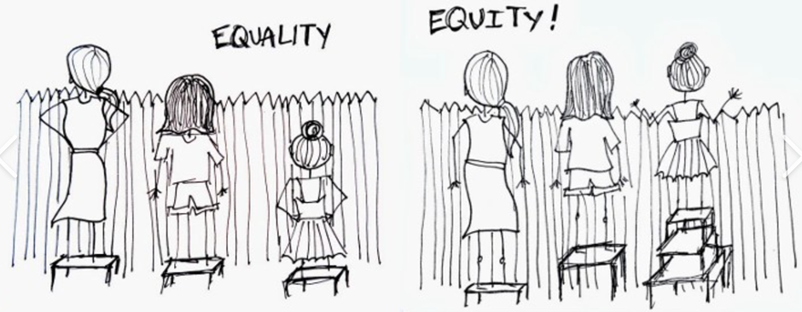
Graduated Approach SENCO Briefings
November 2020

Slide 2
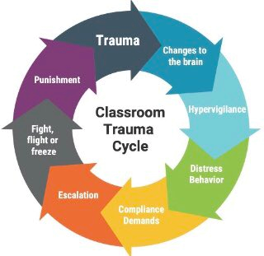
Differentiated discipline: why & how
Notes:
There can be no doubt that trauma will be a bigger issue in your school communities now than it was before the pandemic so I am really grateful to have the opportunity to talk to you about the implications of that, in relation to school policy and practice.
The risk is when we don’t differentiate the way we go about discipline, needs escalate – resulting in either PX (and we are seeing a spike) or the move into SEMH special settings….crudely because of this cycle.
Starting at the top, a child who has experienced trauma will experience changes in the brain – crudely, they will be in survival mode impacting on brain architecture. We know that there is actually inflammation – a larger amygdala in children who grow up in unpredictable, stress-filled households.
This results in hypervigilance – children who can’t settle to learn, who are restless, jumpy and volatile. Teachers will then issue warnings and these often lead to escalation because the pupil is not yet ready to hand over any control to the adult – survival means looking after yourself and we need to remember too that trauma is at root the experience of utter powerlessness. Escalation results in FFF responses – the total shutting down of the cortical brain - which results in punishment which is traumatising. This cycle doesn’t only continue but it spirals as school becomes more and more stress-inducing.
This can be a difficult cycle to break and it’s what I wanted some time thinking about with you this afternoon.

Slide 3
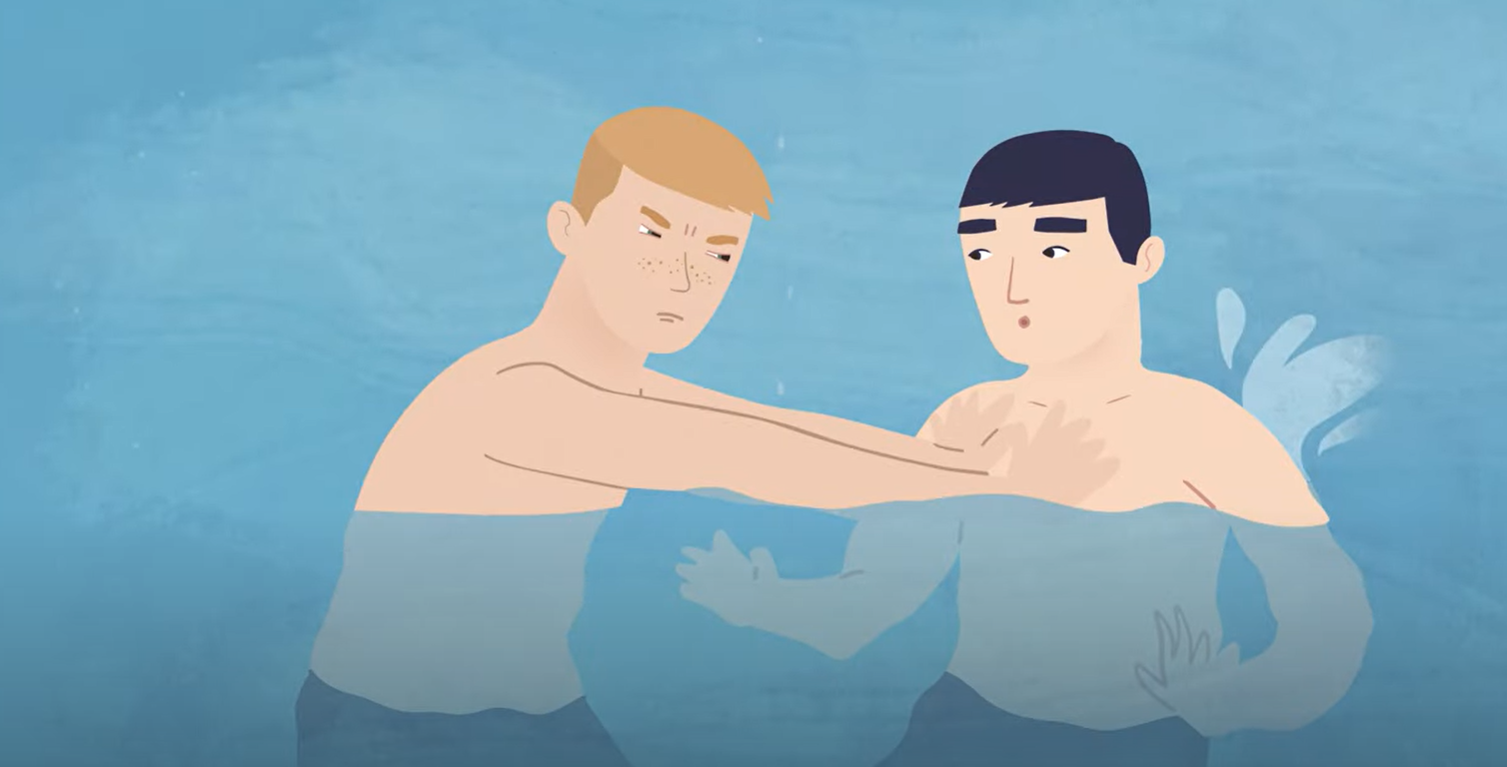
Childhood trauma & the brain Anna Freud Centre
https://youtu.be/xYBUY1kZpf8

Slide 4
Questions for the breakout rooms
How do we identify the cohort? (V.J. Felitti)
How do we expand the window of tolerance? (Dr. Spephen Porges)
How do we enforce boundaries whilst avoiding shame and ostracism? (Dr. Allan Schore)
How do we create relational wealth & a sense of belonging? (Dr. Bruce Perry)

Slide 5
Group 1
Identifying pupils impacted by trauma

Slide 6
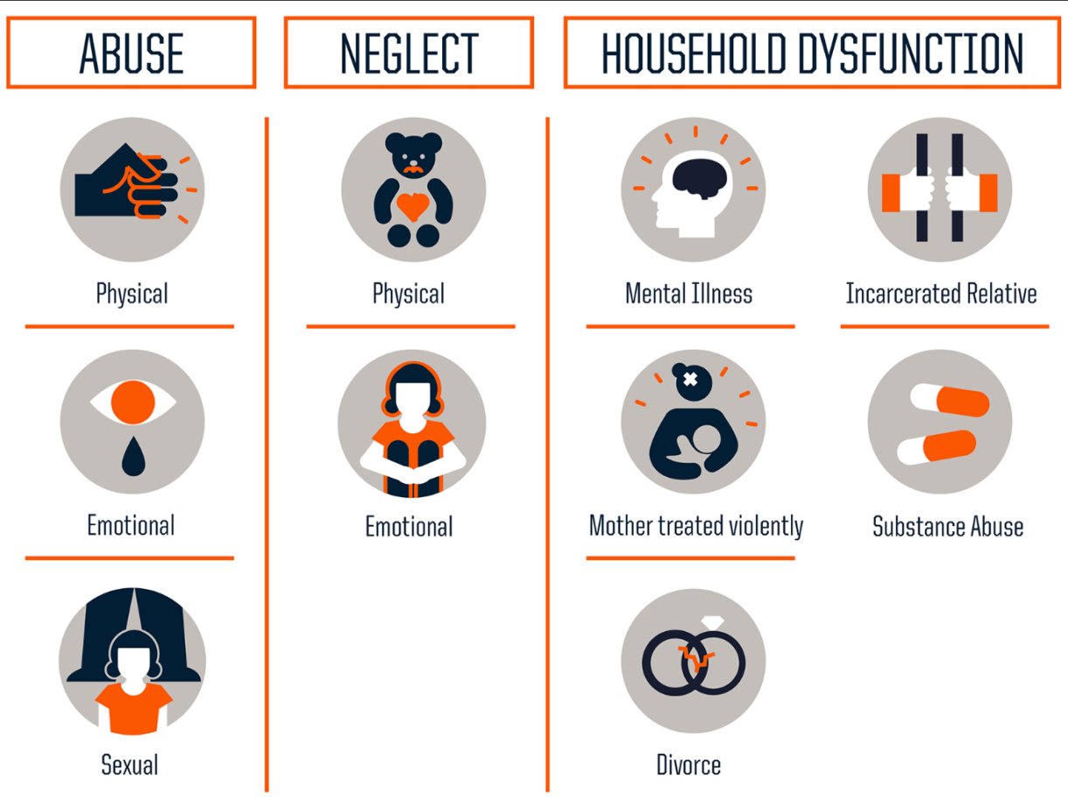
Understanding ACEs - Felitti
Notes:
Group 1 will be thinking more about how we identify the CYP who need relational help – one way is through ACEs. That is, thinking about the number of adverse childhood experiences that a child has had. Certainly, we need to be curious about this if they’re distressed and the behr policy isn’t working.
Original ACE study was undertaken in 90s by……16,ooo citizens 10 questions. 5 environment, 5 personal abuse. Every time an answer was Yes – that’s an ACE score. So lowest 1, highest 10. Feliitti then found a correlation between ACE score and outcomes. Even a link with the life span. Since then, study has been repeated across the globe, with the same pattern. Public health priority must be to reduce ACEs – or mitigate their impact.

Slide 7
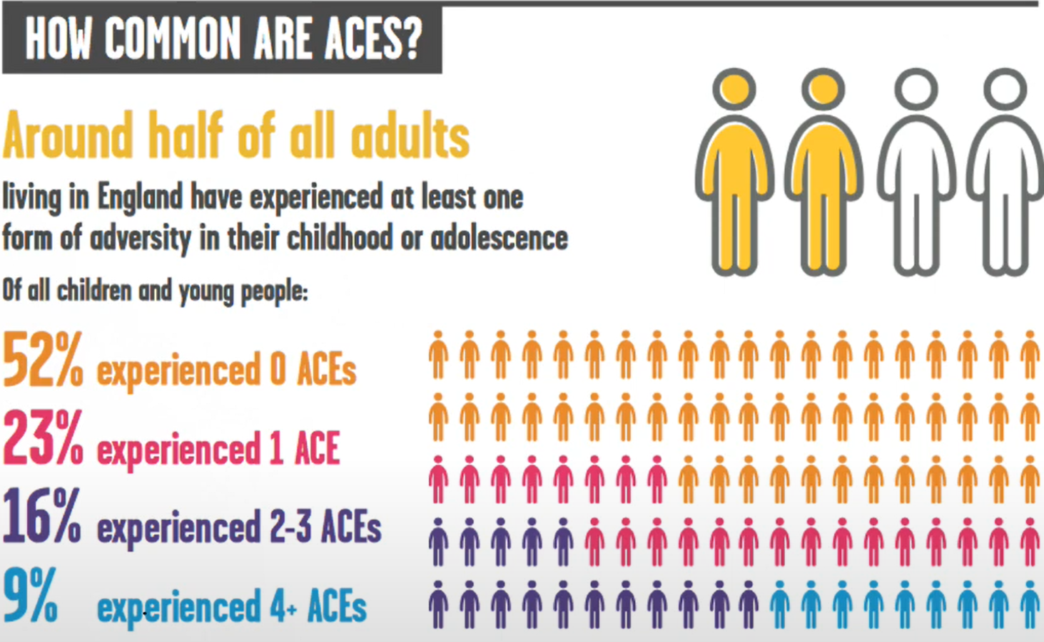
How common are ACES?
https://www.bing.com/videos/search?q=childhood+trauma+video&&view=detail&mid=0D423CC9335D9ED9EB9C0D423CC9335D9ED9EB9C&&FORM=VRDGAR
Notes:
He also found they are very common. This is a population study of England, pre pandemic. Even then - common. 3 pupils in every class will need significant additional support to achieve emotional equalibrium.

Slide 8
Impact of the pandemic
Notes:
If that study were to be repeated now, we would be seeing much higher ACE scores….more parents with mental health issues impacting on their capacity to provide consistent enough care, alarming increase in DV, divorce skyrocketing and drug addiction on the increase.
We’ve seen already that the child’s brain is shaped and sculpted by the environment.

Slide 9
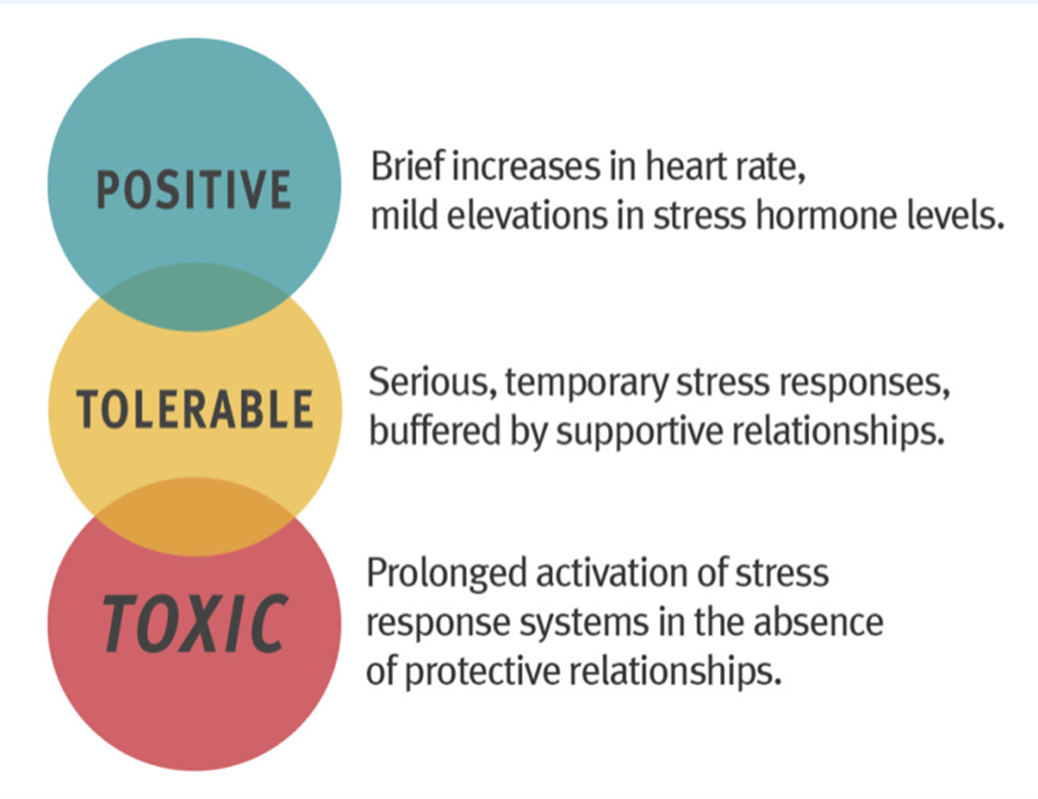
How can we detect toxic stress?
Notes:
So we need to create the conditions in school for growth – broadly by reducing stress. But how do we know who needs this support – how do we identify the pupils impacted by toxic stress?
And worth thinking about stress before saying a bit more about the ACE survey and it’s limitations as an assessment tool.
Positive – essential for growth
Tolerable – unavoidable but mostly we move on. That’s because the brain knows what it needs to do – we seek connection; we tell our story; we talk through; we habituate. Children may not and some of most dysregulated behaviour we see it rooted in blocked grief.
ACE survey is not an assessment. Three health warnings:
It’s too narrowly defined……where is being bullied, being racially abused, where is bereavement? Does divorce have to be a trauma? What about the child devastated by sexual abuse….an ACE score of just one perhaps, but a potentially life-changing traumatic event.
When did it happen? The earlier, the more devastating because of the exponential growth of the baby brain….flood a tiny system with adrenalin and cortisol and new connections are reduced and lost.
Protective factors are not considered….social buffering is a key concept.

Slide 10
Group 2
How to expand the window of tolerance

Slide 11
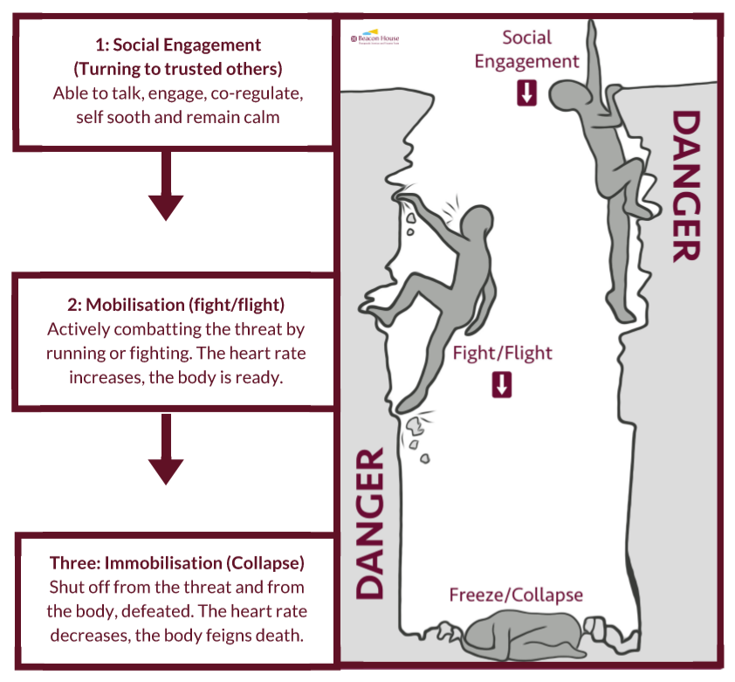
Polyvagal Theory (Stephen Porges)
Hyperactive
Attention deficit
Notes:
Stephen Porges’ innovative research into the autonomic nervous system has shown us how we have evolved to cope with threat. His Polyvagal Theory shows us that when faced with threat or danger, we first turn to our social engagement system to re- establish safety (we turn to trusted others). If that does not bring us into safety or if the danger is severe and immediate, we turn to our fight/flight response. If that does not bring us safety then our mind and body move into collapse and shut down.
People who experience social engagement as repeatedly unsuccessful at keeping them safe become ‘hardwired’ to move straight into fight/flight or collapse.

Slide 13
Triggers
Sensory memories & time holes
Hostile attribution bias
Non-verbal communication

Slide 14
Group 3
How do we maintain boundaries whislt avoiding shame?

Slide 15
The discipline problem
Attunement
Boundary setting
Rupture
Shame
Repair

Slide 16
Socialisation
Attunement
Boundary setting
Rupture
Guilt
Repair
“What happens between rupture and repair builds resilience. Reparation makes relationships stronger.” (Schore, 2014)

Slide 17
The shame-based identity
Poor Attunement
Boundary setting
Rupture
Shame

Slide 18
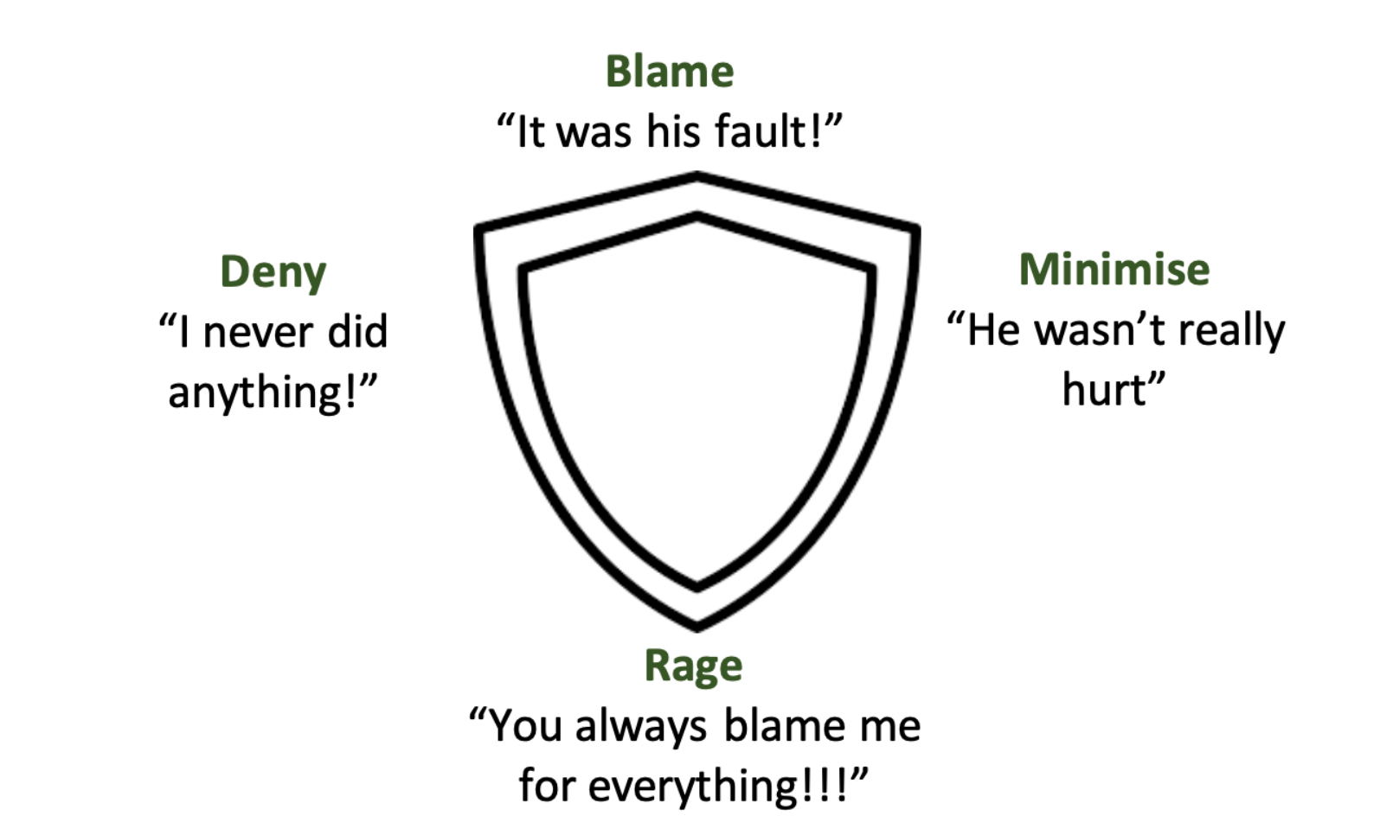
The shield of shame (Golding & Hughes)

Slide 19
Group 4
How do we create relational wealth?

Slide 20
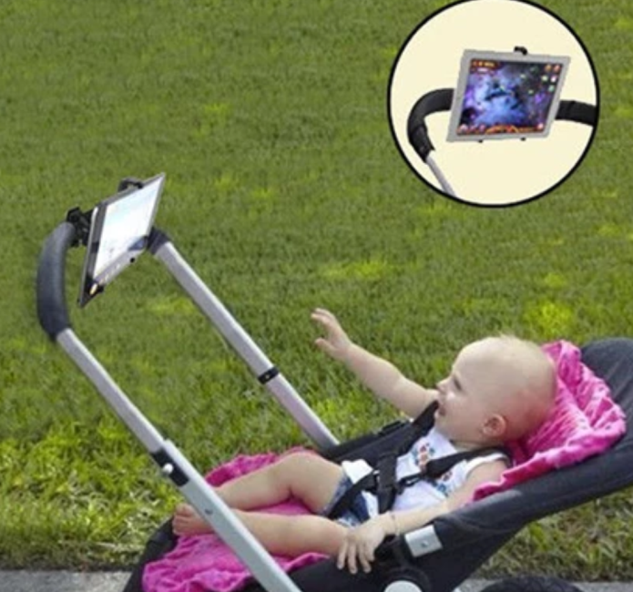
Relational Poverty

Slide 21
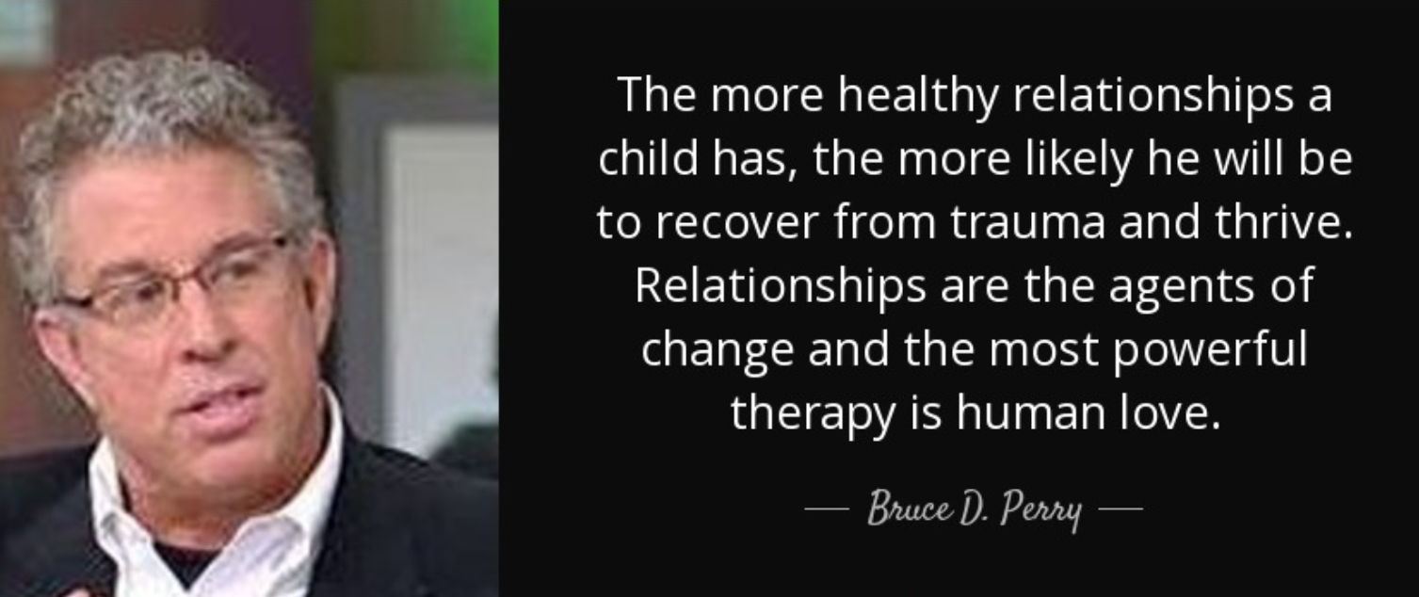
Relational Wealth
Notes:
Number of quality of relationships stronger predictor of positive outcomes than adverse experiences are of negative
Ask survivors – like Ian wright – about impact of just one relationship
But how do we make the time in class of 30?
How do we ensure that our consequences don’t ostricise. The exclusion is highly problematic. Our ancestors survived through the group. To this day, we experience being pushed out as life threatening and leader in the field Kip Williams showed that the same part of brain that is activated when we experince physical pain is activated when we feel pushed out into the cold. It’s who the silent treatment hurts so much…that loss of connection is acutely felt.
Medicine then is killing the patient – even tactical ignoring is a high risk strategy….

Slide 22
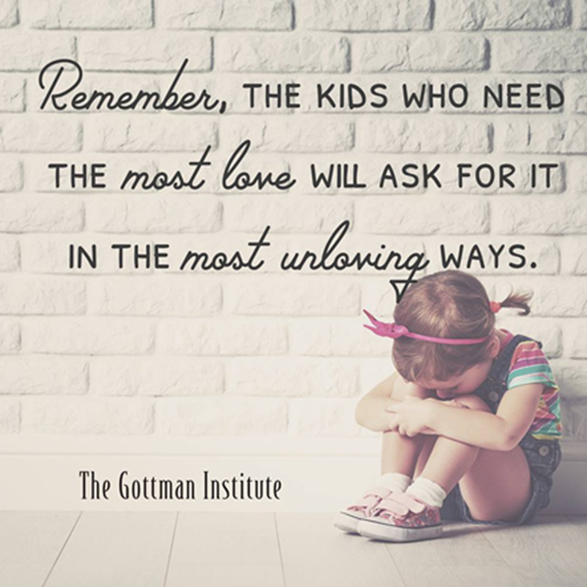
Notes:
And the rich do get richer
We are drawn to the socially engaged. They get to practice more….
So group 4 - how do we create emotional wealth to mitigate that social thinning that was mentioned in the Anna Freud video?

Slide 23
15 minute group discussion
5 mins each to feed back
Strategies,
Adjustments or
Interventions

