Slide 1
Infection Prevention and Control Link Practitioner Programme.
Faye Hunter
Infection Prevention and Control Nurse Advisor.

Slide 2
Aims of the session.
Understand what a Link Practitioner is.
What does the role entail?
Contractual agreements
The coming programme
Back to Basics – IPC refresher

Slide 3
What is a Link Practitioner?
The Infection Prevention & Control Link Practitioner is a nominated individual responsible for imparting the necessary knowledge to colleagues about infection prevention and control in the workplace and how it impacts care delivered.
Notes:
10 minutes to discuss in groups what a link practitioner is and write a definition.

Slide 4
The Link practitioner role.
To develop a robust knowledge base and act as a key person to;
  Develop staff knowledge in the delivery and management of infection prevention & control
  Develop staff knowledge in identifying, assessing and managing potential and/or actual infection risks to service users
  Promote harm free care to demonstrate a reduction in avoidable harm in service users e.g. falls, pressure ulcers and catheter acquired infections,
  Promote the implementation of robust systems and processes to identify and monitor good levels of infection prevention & control e.g.: audit programme
  Report and escalate areas of risk associated with poor standards of infection prevention and control e.g.: pressure ulcers
  Promote effective identification, escalation, management and reporting of infections, with a coordinated response to promote effective management of outbreaks
  Liaise with the Health Protection, Infection Prevention & Control team to seek specialist advice and support, to promote awareness of infection prevention & control and deliver best practice in the clinical area, in line with policy
  To ensure and maintain high standards of hand hygiene by monitoring and auditing practice (recommend monthly)
  Demonstrate, teach and promote hand hygiene procedures to staff, service users and visitors
  Actively disseminate information
  Implement and promote changes in practice
  Support CQC key lines of enquiry
Notes:
10 minutes to discuss what you think the job entails.

Slide 5
Continued…
To be a key participant in the formulation and implementation of Infection Prevention & Control activities and audit within the work environment (Recommend: 8 hours per month)
To play a key role in promoting effective communication and liaison between the work environment and the Health Protection, Infection Prevention & Control team
To act as an initial point of contact and resource for work colleagues, providing advice for Infection Prevention & Control related issues
To identify and support the educational needs of the staff, in the principles of Infection Prevention & Control
To lead by example and apply the principles of Infection Prevention & Control in practice
To attend the Infection Prevention & Control Link Practitioner meetings (Recommend: x4 per year)
To assist colleagues in evaluating associated Infection Prevention & Control risk assessments, to minimise the risk of cross infection and reduce avoidable harm to service users e.g.: Falls and pressure ulcers
To assist the Health Protection, Infection Prevention & Control Team in related surveillance, audit and/or investigations of incidents and outbreaks
To maintain a local, up to date Infection Prevention & Control resource file

Slide 6
Contractual requirements.
  The Provider will ensure a clean, hygienic and tidy home environment
  The Provider shall carry out an annual infection prevention audit and supply the findings of this audit to the Purchaser in the method described in Schedule 3
  Providers are encouraged to use a national infection control self-assessment audit tool which is available at http://www.ips.uk.net/professional-practice/quality-improvement-tools/quality-improvement-tools/
  The Provider shall name an Infection Prevention Link Practitioner to support and promote the Infection Prevention Agenda
  The Infection Prevention Link Practitioner is encouraged to attend quarterly link practitioner meetings to share best practice
  In the event of an outbreak of an infectious disease (e.g. diarrhoea and vomiting) the Provider shall inform the Purchaser and shall provide daily updates until the conclusion of the outbreak - The daily updates will state the number of staff and residents affected by the outbreak and any actions taken to manage to outbreak
Notes:
Each registered provider is required to meet the following adult social care contractual requirements, in response to infection prevention and control;

Slide 7
The coming programme.
It is going to be a rolling programme.
Each home nominates a link practitioner to complete the year long programme.
At the end of the year a certificate will be awarded to the practitioner, provided they have met the criteria for completion of the programme.
A new link practitioner will then be nominated to partake in the programme.
Notes:
To be awarded a certificate the link practitioner must have completed all four workbooks. The contractual agreements states that 3/4 link meetings must be attended, however for the purposes of the educational programme all four work books must be completed to receive the certificate of completion.

Slide 8
Workbook
Over the next year, as the nominated Link Practitioner, you will be given a workbook at each meeting. The aim of this is to support the link programme with additional information and activities to be completed during the programme.
SWOT analysis – complete the SWOT analysis in the workbook and identify the potential strengths, weaknesses, opportunities and threats of being a link practitioner.
Notes:
Each quarter will include a workbook and this will be given at the start of the session.
Q2 – antimicrobial resistance
Q3 – seasonal illnesses
Q4 – practical assessment

Slide 9
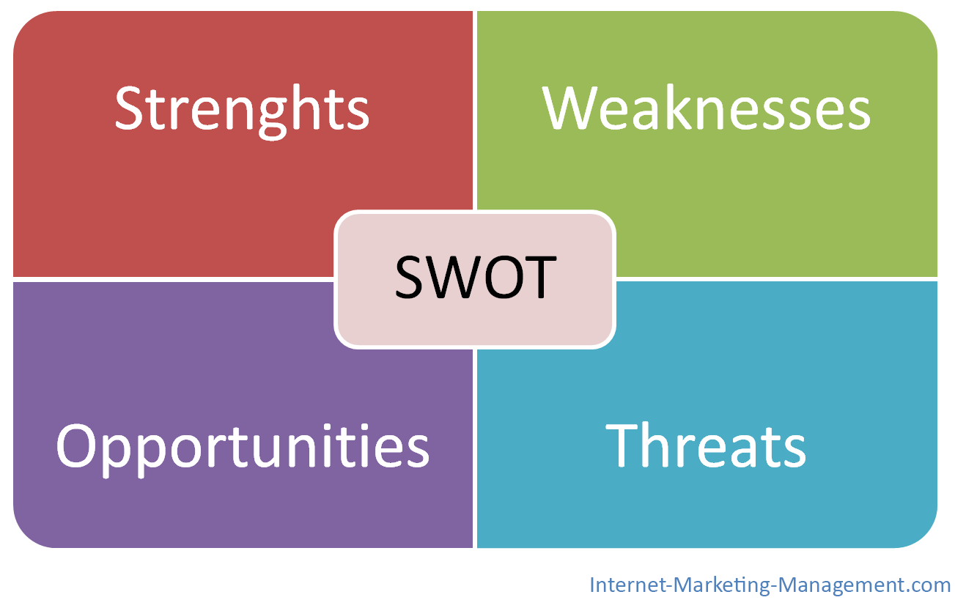

Slide 10
Education day
As part of the link practitioner programme the IPC team will provide an education day. The education day provides;
Continuing professional development of IPC for the Link Practitioners.
Equips Link Practitioners with practical skills and knowledge on how to reduce the spread of infection
Two dates for the education day throughout the programme.
Provides additional learning that will complement the link programme
Is an opportunity for networking with other homes in the county

Slide 11


Slide 12
IPC back to basics.
Infection Prevention & Control measures, aim to ensure the protection of those who might be vulnerable to acquiring an infection both in the general community, while receiving care due to health problems and in a range of settings. The basic principle of infection, prevention and control is hygiene.
World Health Organisation (WHO)

Slide 13
How are infections caused?
Bacteria - Bacteria are the plural of bacterium, which are microscopic one-celled organisms. They are found everywhere and can be harmful.
Virus – DNA or RNA covered in proteins on its surface. The proteins attach to other cells and force the cells to make more of the virus.
Fungi – This includes mould and yeasts. Mould in the environment can produce spores and toxins. These spores can be breathed in and can lead to allergic reactions and lung disease.
Parasites – These can be multi-cellular or single celled.

Slide 14
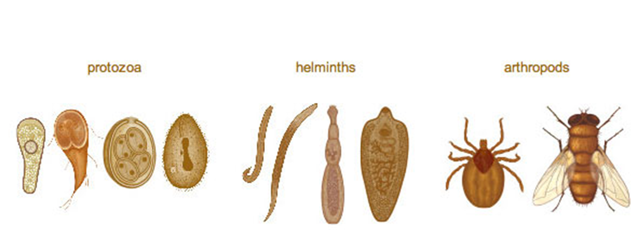
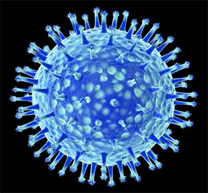
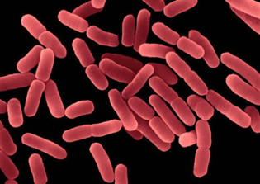
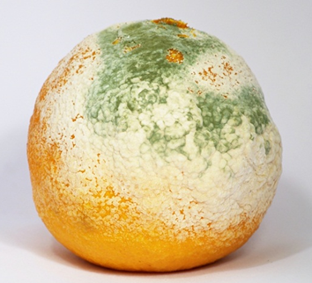

Slide 15
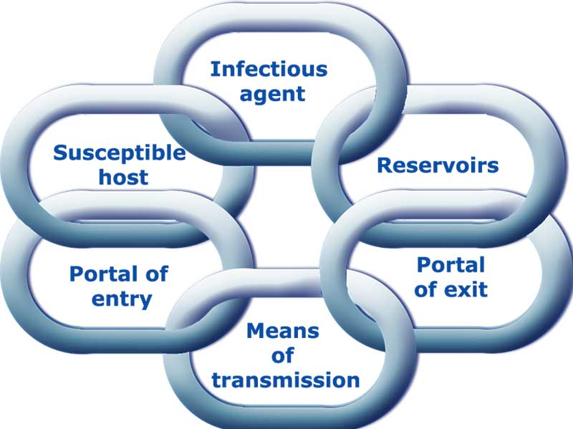
How are infections spread?
Notes:
This is the chain of infection. It demonstrates the links involved in spread of infection.
The infectious agent is the micro-organism, so the bacteria or virus.
The reservoir is the where the infection comes from, so people, animals, food etc.
The portal of exit is the way in which the infectious agent leaves the reservoir (coughs, sneezes, saliva)
Means of transmission is how the infectious agent is transmitted, so airborne, blood borne etc.
The portal of entry if the way in which the infectious agent enter the body, so mouth, nose, wounds etc.
The person at risk is determined by a number of factors including age, medical conditions, suppressed immune system etc.

Slide 16
Direct vs Indirect contact spread.
Direct contact spread:
Skin contact e.g. holding hands can be a way of transmission for scabies and ringworm.
Head to head contact can also facilitate the transmission of head lice
Indirect contact spread:
Aerosol (Small Droplet) Spread - small droplets in the air caused by coughing or sneezing are then inhaled or ingested (swallowed) by another person..
Droplet spread - droplets in the air caused by coughing or sneezing and then inhaled or ingested (swallowed) by another person.
Faecal/Oral Route of Spread - For some diseases e.g. gastroenteritis and Hepatitis A, the infecting organism is excreted in the faeces (motions).
Notes:
Aerosol - Examples of such diseases are norovirus, colds, measles and mumps
Droplet - As these droplets are larger than for aerosol spread they cannot be carried long distances so close contact with the infected person is required. An example of such a disease is influenza.
Faecal Oral - The hands of an infected person may become contaminated after they wipe themselves and, after inadequate hand washing when going to the toilet, the infecting organisms may be transferred to others' hands and subsequently to their mouths

Slide 17
How can you prevent the spread of infection?
There are several things that can be put in place, some of which should be common practice, that can help reduce the spread of infections.
PPE
Hand Hygiene
Waste management
Linen management
Cleaning
Personal care

Slide 18
Personal Protective Equipment
PPE
Personal Protective Equipment should be worn on all care interventions. This is not only to protect yourselves but also to protect those that you are caring for. PPE plays a vital role in preventing the spread of infections.
A risk assessment should be carried out before care interventions so that you ensure you are wearing the most appropriate forms of PPE.

Slide 19
Hand Hygiene
When should hands be washed?
After removing PPE
After touching any bodily fluid (other than tears or sweat)
If hands are visibly dirty or soiled
Before and after handling food
After handling waste
Before and after visiting or caring for sick people
Alcohol gels
Only to be used for quick decontamination of the hands and only if they look visibly clean.

Slide 20
Hand washing process…

Slide 21
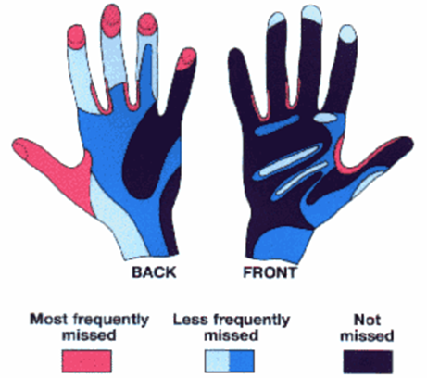
Practical assessment.

Slide 22







Waste Management
Waste management plays an integral part of preventing the spread of infections. It is important that waste management is carried out properly. All staff is responsible for the safe management and disposal of waste. Waste is potentially hazardous and if not disposed of correctly can result in injury and infection.

Slide 23
Cleaning
Cleaning (physically removes dirt, blood, body fluids & many micro organisms)
Disinfection ( removes or kills more micro organisms to a less harmful level)
Sterilisation (complete destruction or removal of all micro organisms)
Cleaning products should be stored in a designated cupboard to comply with COSHH regulations.

Slide 24
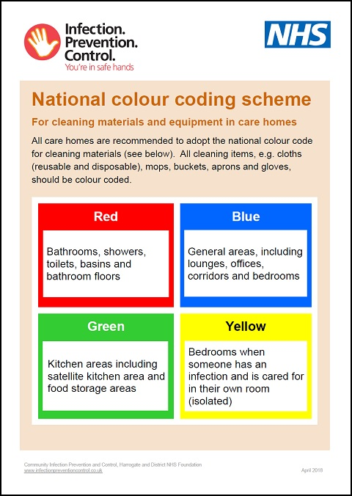
National colours

Slide 25
Linen Management
The way that linen is managed can also impact on Infection Prevention and Control.
Homes must have a designated laundry room which should have a clear dirty-clean flow.
When handling linen PPE should be worn.
Make sure that dirty linen is in the appropriate coloured bag and washed on the correct cycle.

Slide 26
Personal care
Providing effective personal care can prevent an infection beginning. It is also a vital part of preventing the spread of infections.
Maintaining skin integrity – skin is the largest organ of the body. Its function includes protection from microorganisms entering the body. If this is damaged by a skin tear or pressure ulcer then it becomes a portal of entry for bacteria and can lead to infections.
Oral heath - Dental plaque contains many different species of bacteria, some of which can cause pneumonia. Breathing in secretions, including dental plaque, has been found to be associated with pneumonia. Patients lying supine in a hospital bed and older patients with decreasing levels of consciousness are more likely to aspirate oral secretions. Ensure that all residents have an oral health assessment and oral hygiene is carried out daily.
Notes:
Skin – ensure using a wash that compliments pH

Slide 27
Importance of IPC in your environment.
In a care home environment it is important that all staff are working towards preventing the spread of infections.
The people you care are often very vulnerable and will have many medical co-morbidities. Good IPC practices can help prevent the spread of infection.
There is a contractual agreement to adhere to IPC in your homes.

Slide 28
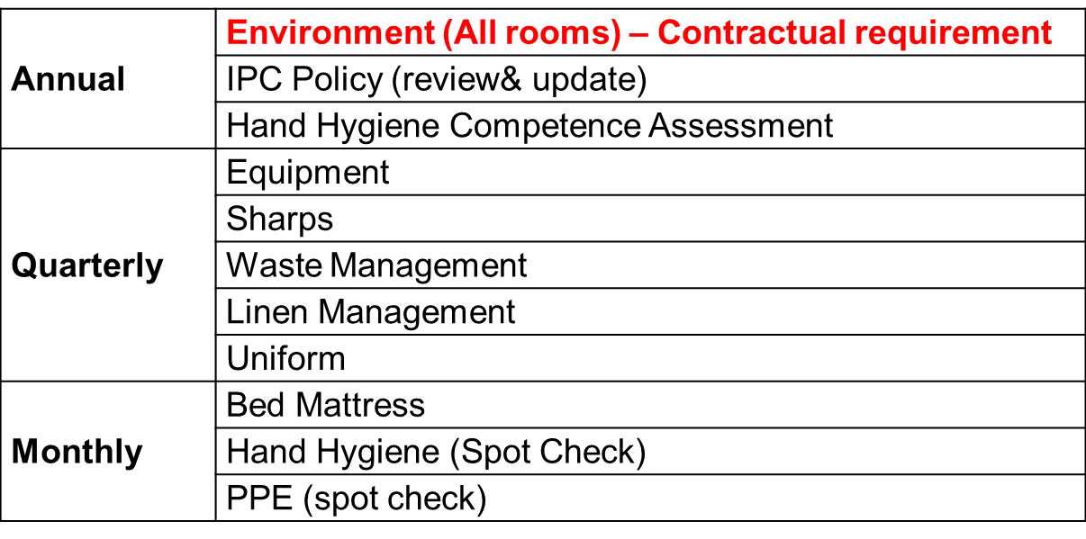
Monitoring of IPC - Audits
Audits provide a way of monitoring the IPC practices in your care home and ensuring that they are meeting required standards

Slide 29
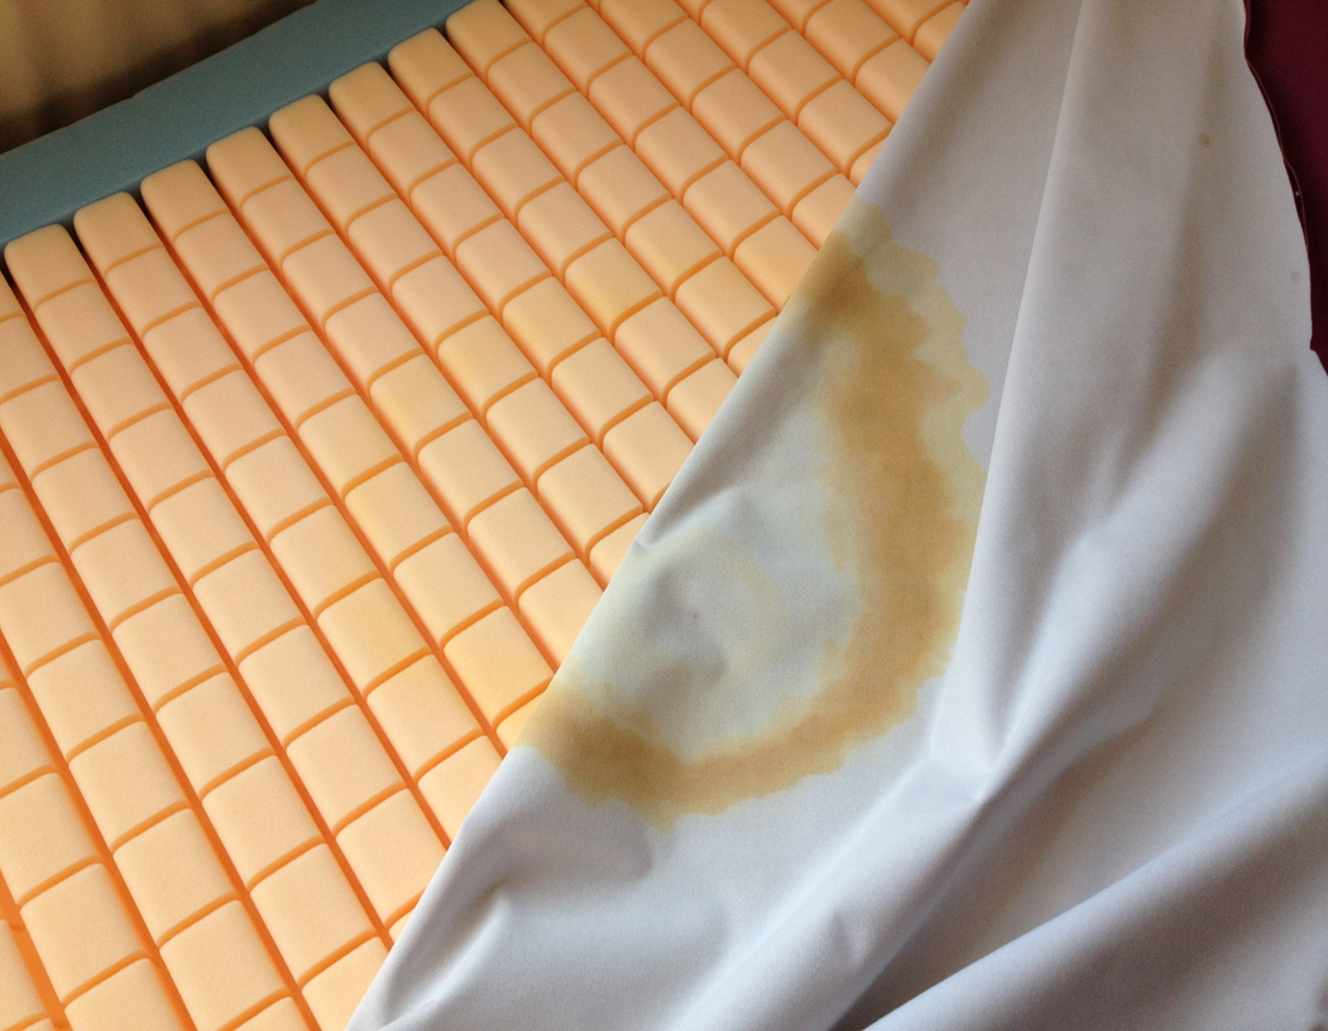
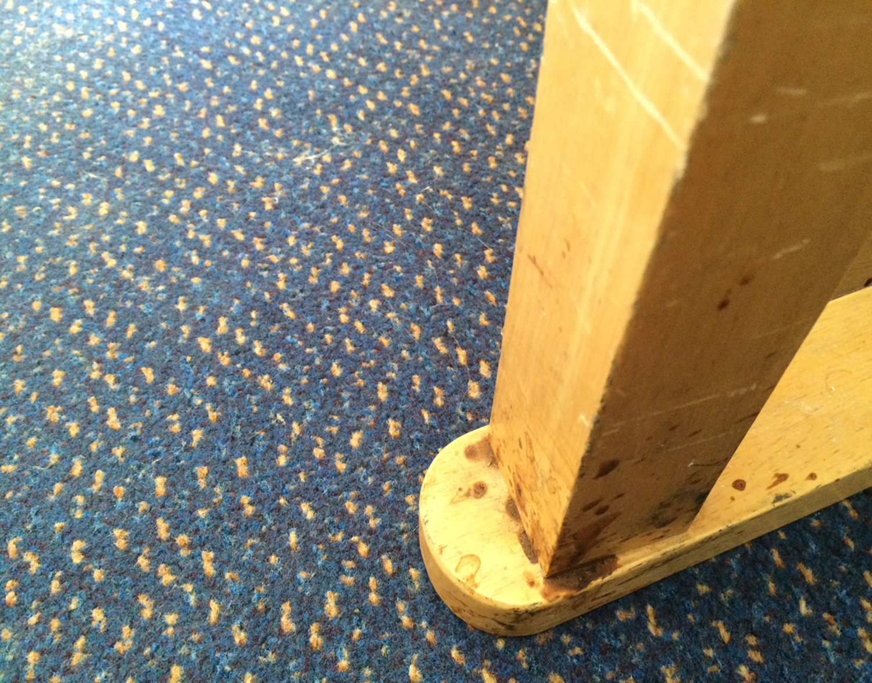
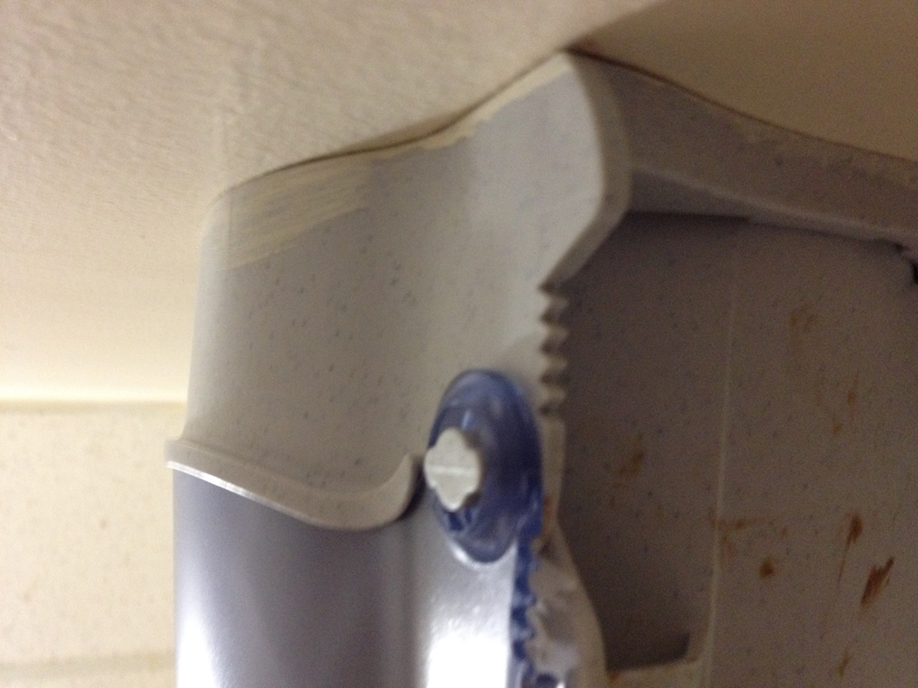
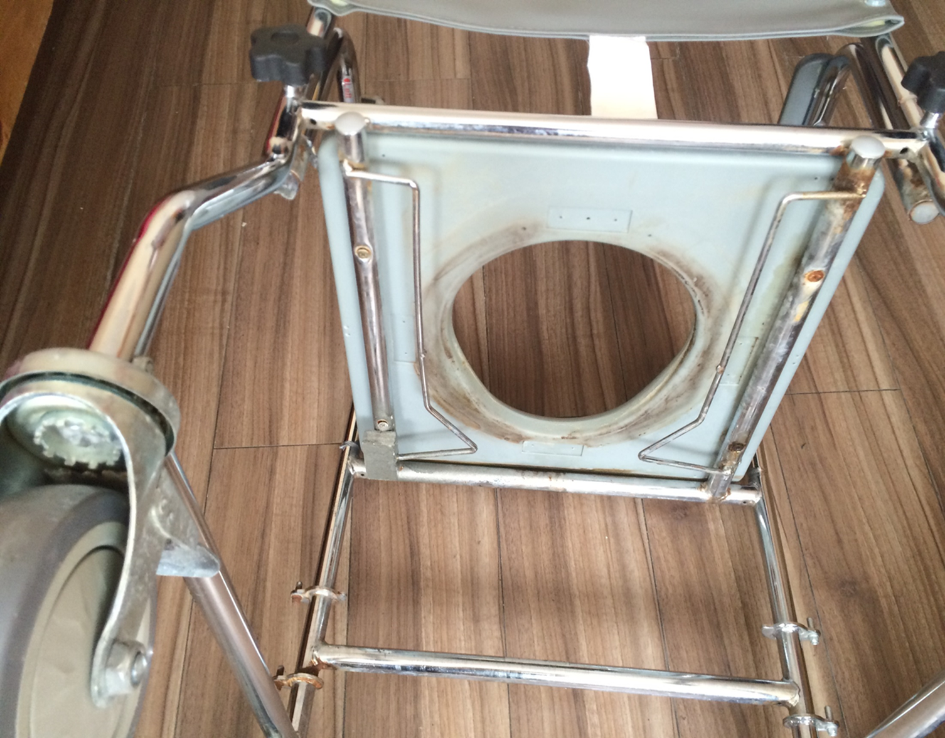
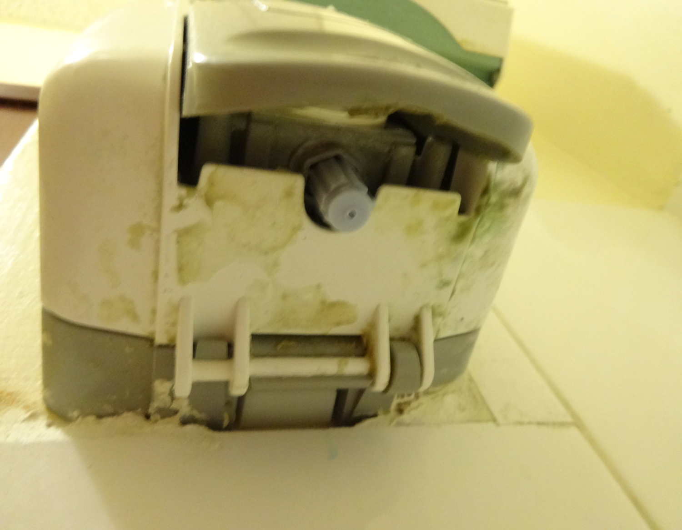

Slide 30
QUIZ…
Give 3 examples of infections caused by bacteria
Give 2 examples of infections caused by viruses.
Name one way to break the chain of infection
Give an example of an infection spread by direct contact
Give an example of an infection spread by indirect contact
Name 2 standard precautions
Where should PPE be stored?
When should hand gel be used?
What area is most missed during hand washing?
Give examples of waste that should go in yellow bags
Give examples of waste that should go in orange bags
What is the difference between cleaning and disinfecting?
What are the national cleaning colours and where are they used?
Where should housekeeping equipment be stored?
How should a laundry room be set out?

Slide 31
Any Questions?

