Slide 1
Mark Q1 Workbooks – 15 minutes

Slide 2
Housekeeping
No Planned fire alarms
Keep phones on silent
Toilets
Tea and coffee

Slide 3
Antimicrobial Resistance
Faye Hunter
Infection Prevention and Control Nurse Advisor

Slide 4
Aims of the session
By the end of the session you should understand;
What AMR is
Why is it occurring?
Bacteria and its role in AMR
What antimicrobial stewardship is
Your role in preventing infection

Slide 5
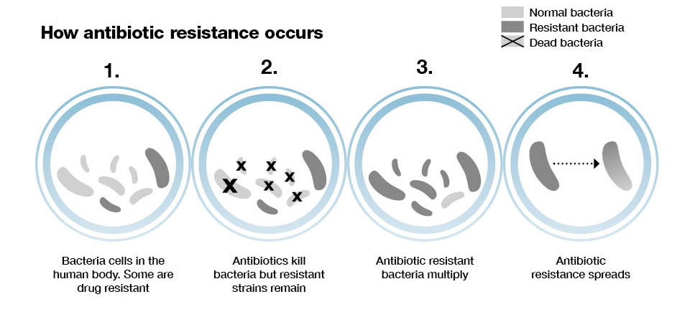
What is AMR?
‘Antimicrobial resistance arises when the organisms that cause infection evolve ways to survive treatments. The term antimicrobial includes antibiotic, antiprotozoal, antiviral and antifungal medicines’ GOV.UK
Notes:
Picture from: Public Health England (2015) Guidance Health matters: antimicrobial resistance. Available from https://www.gov.uk/government/publications/health-matters-antimicrobial-resistance/health-matters-antimicrobial-resistance#the-scale-of-the-problem. [accessed on 28 July 2019]
Antibiotics were discovered in 1928 by Alexander Fleming.
Not all antibiotics work in the same way. Some kill bacteria whilst others inhibit growth of bacteria. There are 3 main ways that antibiotics work:
Damage the cell wall
Interfere with DNA replication
Interfere with protein synthesis
Depending on what the bacteria is will depend on the antibiotic used – not all bacteria respond to the same method of attack by the antibiotic.

Slide 6
Why is AMR a problem?
https://binged.it/2SM2djy
Notes:
Many patients have been inappropriately prescribed an antibiotic, most commonly to treat:
coughs and colds
sore throats
ear infections
Estimates suggest that as many as half of all patients who visit their GP with a cough or cold leave with a prescription for antibiotics. Viruses cause many of these infections, meaning antibiotics are of no use. It is suggested that AMR could lead to an estimated 10 million deaths every year globally by 2050. Across Europe, an estimated 25,000 people die each year as a result of hospital infections caused by the following 5 resistant bacteria:
Escherichia coli (E. coli)
Klebsiella pneumoniae (K.Pneumoniae)
Enterococcus faecium
Pseudomonas aeruginosa
Methicillin-resistant Staphylococcus aureus (MRSA)
Ref: Public Health England (2015) Guidance Health matters: antimicrobial resistance. Available from https://www.gov.uk/government/publications/health-matters-antimicrobial-resistance/health-matters-antimicrobial-resistance#the-scale-of-the-problem. [accessed on 28 July 2019]

Slide 7
The UK’s 20-year vision for antimicrobial resistance
By 2040, our vision is of a world in which antimicrobial resistance is effectively contained, controlled and mitigated. The UK is determined to sustain its efforts to combat resistance, taking local, national and global 'One-Health' approaches across humans, animals, the environment and food, in line with global ambitions and in collaboration with other nations, partners and the international community.
In the UK, we will contribute to the global effort through:
A lower burden of infection
Optimal use of antimicrobials and good stewardship across all sectors.
New diagnostics, therapies, vaccines and interventions in use, and a full antimicrobial resistance research and development pipeline for antimicrobials, alternatives, diagnostics, vaccines and infection prevention across all sectors; with access to new and old technologies for all.
Notes:
better treatment of resistant infections, and minimised transmission in communities, the National Health Service (NHS), farms, the environment and all other settings.
including access to safe and effective medicines that have been manufactured responsibly for all who need them; achieving and maintaining usage levels by sector as good as the best countries in the world where comparable data are available.
Ref: Department of Health (2019) Contained and controlled The UK’s 20-year vision for antimicrobial resistance. Available from https://assets.publishing.service.gov.uk/government/uploads/system/uploads/attachment_data/file/773065/uk-20-year-vision-for-antimicrobial-resistance.pdf [accessed 01 May 2019].

Slide 8
UK 2019-2024 plan
The plan focuses on three key ways of tackling AMR:
reducing need for, and unintentional exposure to, antimicrobials
optimising use of antimicrobials
investing in innovation, supply and access.
The plan also sets out four measures of success to ensure progress towards the 20-year vision. These include, among others, targets to:
Halve healthcare associated Gram-negative blood stream infections
Reduce the number of specific drug-resistant infections in people by 10% by 2025
Reduce UK antimicrobial use in humans by 15% by 2024
Reduce UK antibiotic use in food-producing animals by 25% between 2016 and 2020 and define new objectives by 2021 for 2025
Be able to report on the percentage of prescriptions supported by a diagnostic test or decision support tool by 2024.
Notes:
Ref: Department of Health (2019) Tackling antimicrobial resistance 2019-2024. Available from https://assets.publishing.service.gov.uk/government/uploads/system/uploads/attachment_data/file/784894/UK_AMR_5_year_national_action_plan.pdf [accessed on 01 May 2019]

Slide 9
Gram Negative Bacteria
What are Gram Negative Bacteria?
E. coli, Pseudomonas aeruginosa and Klebsiella spp. Account for 72% of all Gram negative bloodstream infections.
E.Coli is the most common cause of UTI’s. Of the diagnosed UTI’s above 70% are community aquired.
Gram negative bacteria have a greater ability to learn or acquire resistence to antibiotic therapies.
Only a few antibiotics will work for gram negative infections.
Notes:
Lets take an example of how AMR is becoming a problem for GNBSI
The government want to reduce GNBSI by 50% by 2024, with an initial focus on E.Coli.
Ref: Public Health England (2015) Guidance Health matters: antimicrobial resistance. Available from https://www.gov.uk/government/publications/health-matters-antimicrobial-resistance/health-matters-antimicrobial-resistance#the-scale-of-the-problem. [accessed on 28 July 2019]

Slide 10
https://youtu.be/Didrc3wJ3E8

Slide 11
Antimicrobial Stewardship
‘The term 'antimicrobial stewardship' is defined as 'an organisational or healthcare‑system‑wide approach to promoting and monitoring judicious use of antimicrobials to preserve their future effectiveness’. (NICE 2015)
Notes:
National Institute for Health and Care Excellence (2015) Antimicrobial stewardship: systems and processes for effective antimicrobial medicine use Available from https://www.nice.org.uk/guidance/ng15/chapter/1-Recommendations [accessed 01 May 2019]

Slide 12
PHE campaign
https://binged.it/2xAGCAL

Slide 13
Clostridium Difficile
C. diff are bacteria that exist widely in the environment, notably in soil, and may become established in the colon of healthy people.
C. difficile produces spores, which are passed out in the faeces and may survive for months or years in the environment (for example, on clothes or bedding).
Spores that get into the gut then develop into mature bacteria.
C. difficile infection occurs when the other harmless bacteria in the gut are disrupted (for example, by taking antibiotics) or when the immune system is compromised, allowing the numbers of C. difficile bacteria to increase to high levels.
Certain C. difficile strains produce toxins that damage the lining of the colon, causing symptoms ranging from mild, self‑limiting diarrhoea to pseudomembranous colitis, toxic megacolon, perforation of the colon, sepsis and death.
Notes:
Lets look at one infection that can be reduced by antimicrobial stewardship.
National Institute for Health and Care Excellence (2015) Clostridium difficile infection: risk with broad-spectrum antibiotics. Available from https://www.nice.org.uk/advice/esmpb1/chapter/key-points-from-the-evidence [accessed on 06 June 2019].

Slide 14
As well as antibiotics, factors that increase the risk of C. difficile infection include:
advanced age
Frailty
underlying morbidity such as abdominal surgery, cancer, chronic renal disease and tube feeding.
Hospitalisation
exposure to other people with C. difficile infection
long duration of antibiotic treatment
taking multiple antibiotics concurrently or multiple antibiotic courses inflammatory bowel disease.
The mortality associated with C. difficile infection can be up to 25% in frail older people in hospitals.
Notes:
Ref:
National Institute for Health and Care Excellence (2015) Clostridium difficile infection: risk with broad-spectrum antibiotics. Available from https://www.nice.org.uk/advice/esmpb1/chapter/key-points-from-the-evidence [accessed on 06 June 2019].
National Institute for Health and Care Excellence (2019) clinical knowledge summary: diarrhoea - antibiotic associated Available from https://cks.nice.org.uk/diarrhoea-antibiotic-associated [accessed on 06 June 2019]

Slide 15
Preventing infections – Your Role
Brainstorm some ideas in groups – how can you help prevent infections?
Notes:
Environmental cleaning – if done properly then bacteria in the environment can be reduced and lead to less infections.
Are you using the appropriate contact time and kill time? – determined by the manufacturer usually.
Are you using the correct products.
There is starting to be an increase in microorganisms being resistant to disinfectants so it is vital that housekeeping is done correctly.

Slide 17
Activity
Criterion 3: Ensure appropriate antimicrobial use to optimise patient outcomes and to reduce the risk of adverse events and antimicrobial resistance (access to microbiology services and responsibility for stewardship activities rests with the service user's general practitioner)
In groups decide how you would respond to each part of the scenario. What assessments would you need? What care plans would you need to consider? – 30 minutes.
How are you going to capture the data for antibiotic prescribing in your homes and what will you do with it?

